Slide 1
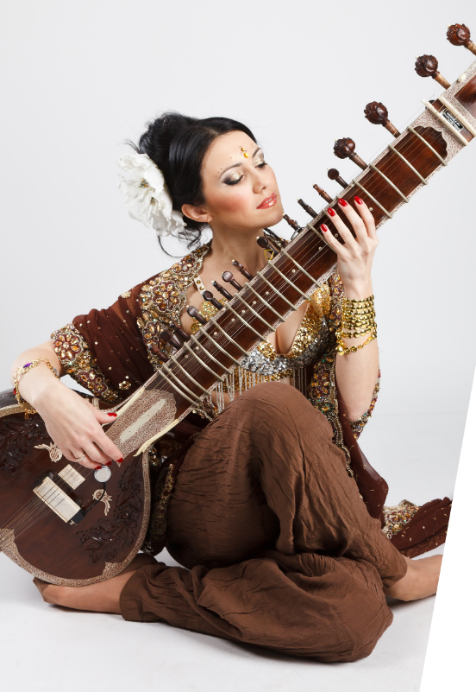
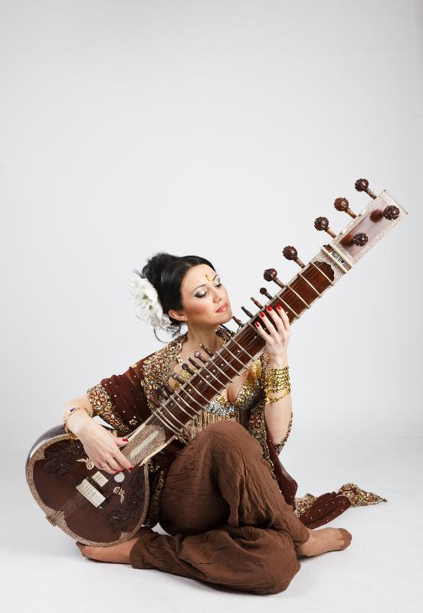
Around the World
Lesson 2
Music from India
Unit 2 Version 3

Slide 2
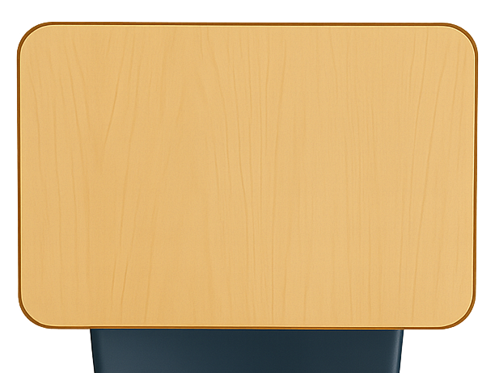

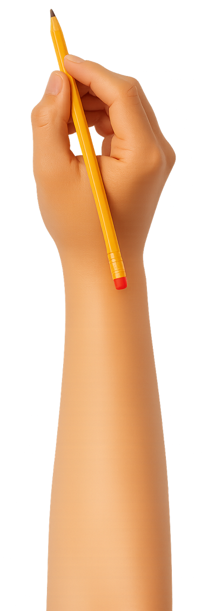


What We Learnt
Exit Ticket
Lesson 1A
Lesson 1
different
Music sounds __________ in places and cultures around the world.
People around the world:
  play instruments like koto and sitar to make music
  gather to sing and play together
  make music about the cherry blossom
  all of the above.
Instruments from around the ______ make different sounds.
the same
happy
different
world

Slide 3
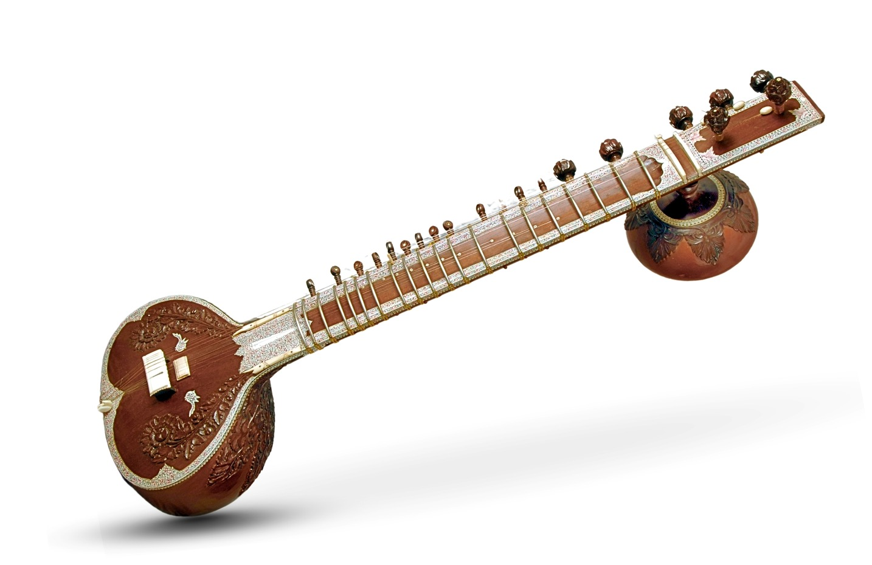
Where do people play the sitar?
Hawaii
India

Slide 4
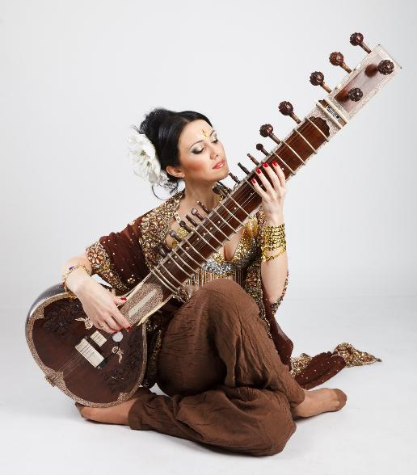
In this lesson, we will explore music from India.

Slide 5
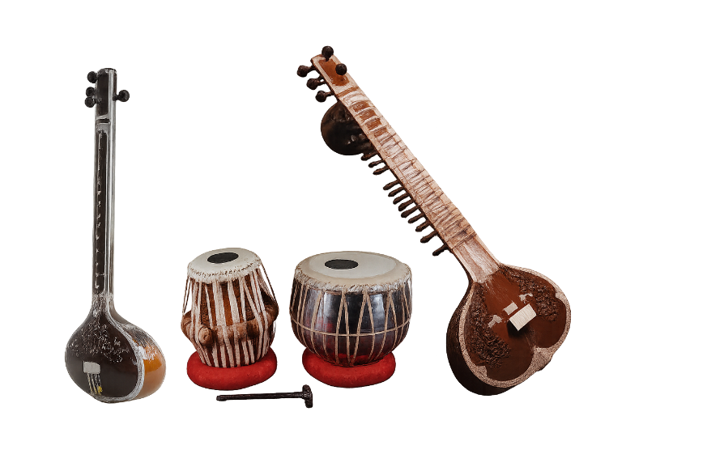
You will be able to: ​
musical instruments from India
a drone
a scale on
the keyboard.
name
Name means to say what something is called.
sing
Sing means to make music with your voice by using words and a tune.
Play means to make a musical sound on your instrument.
play

Slide 6
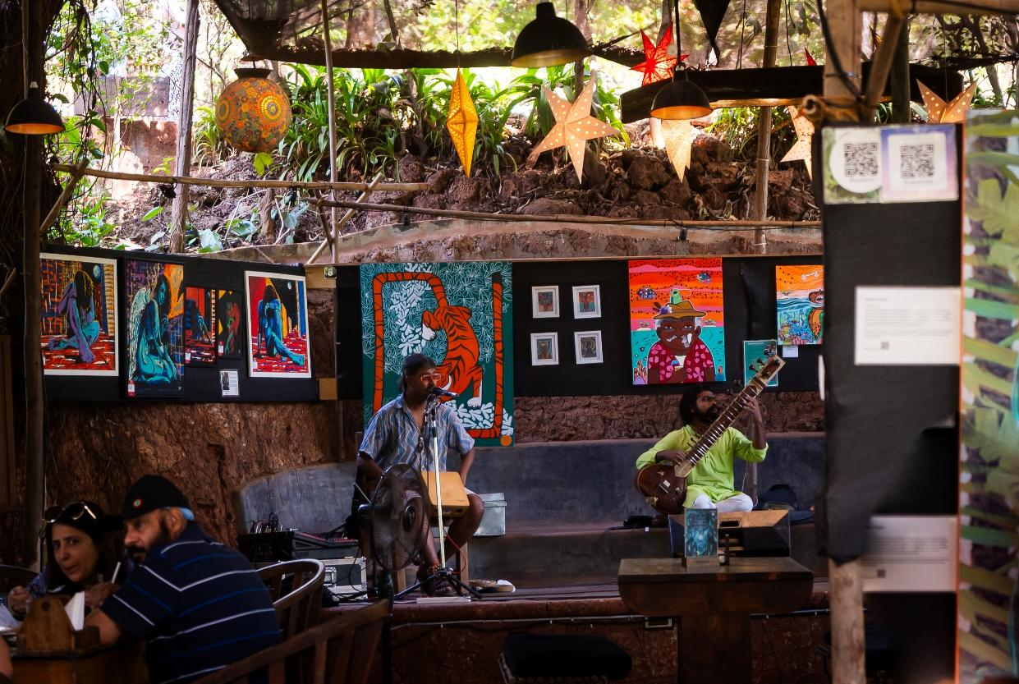
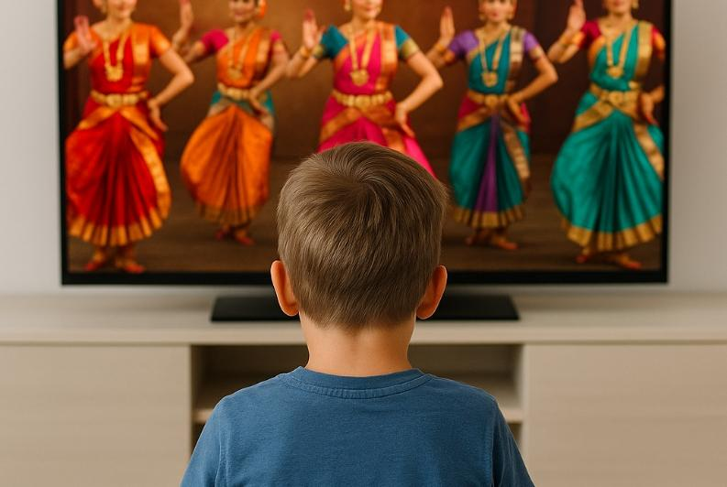
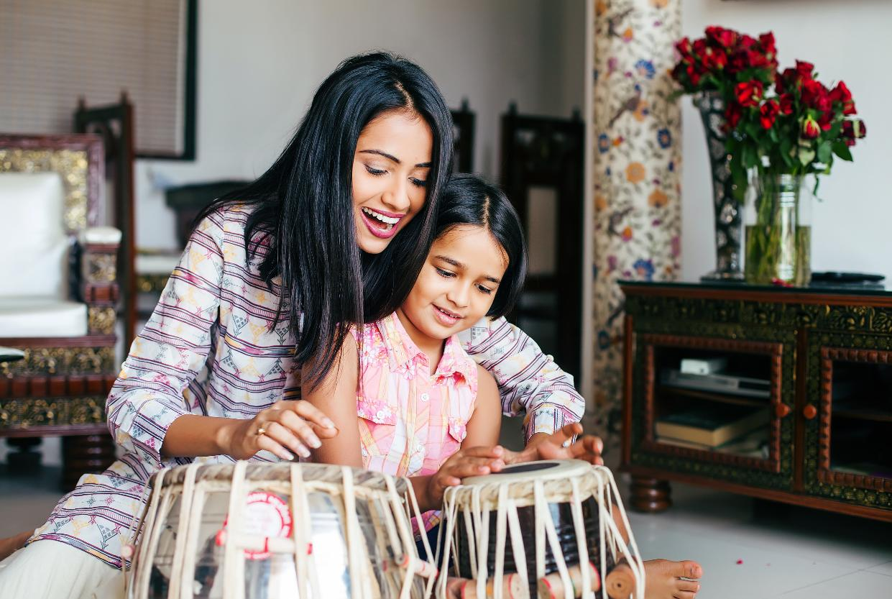

Slide 7
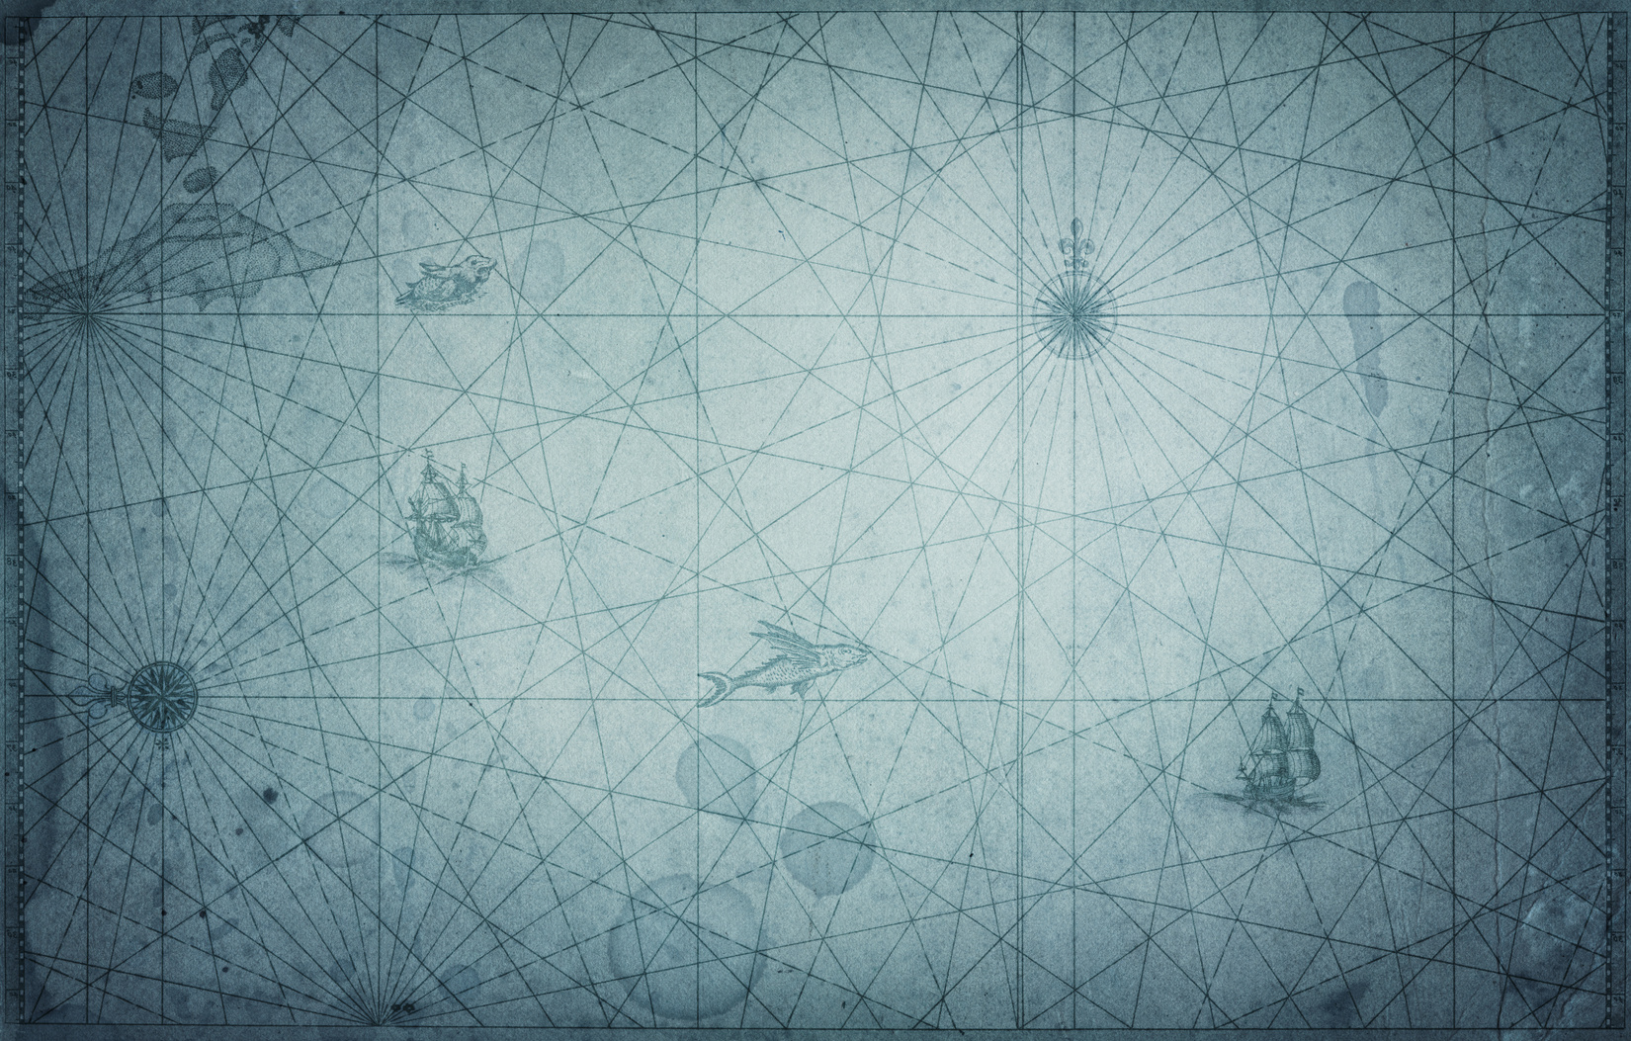
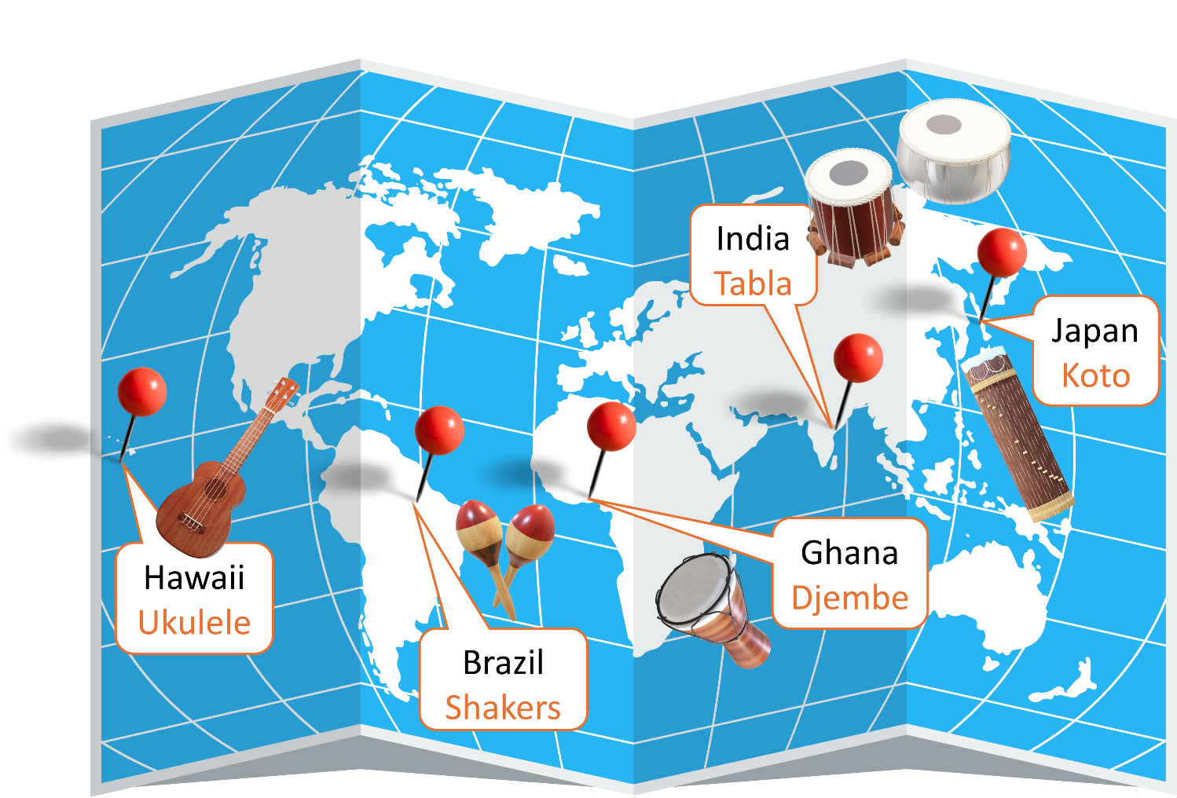
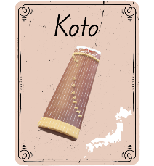
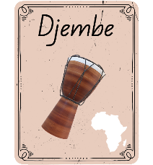
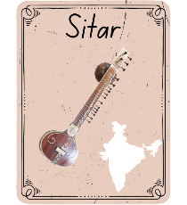
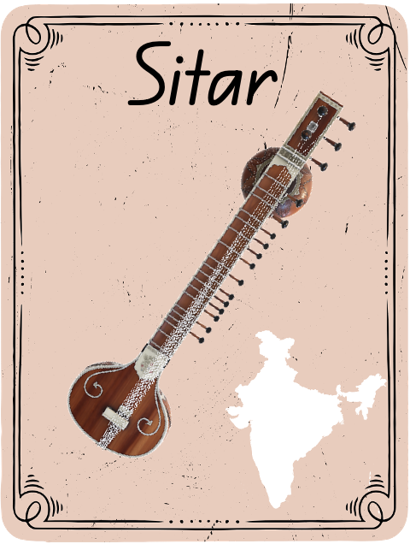
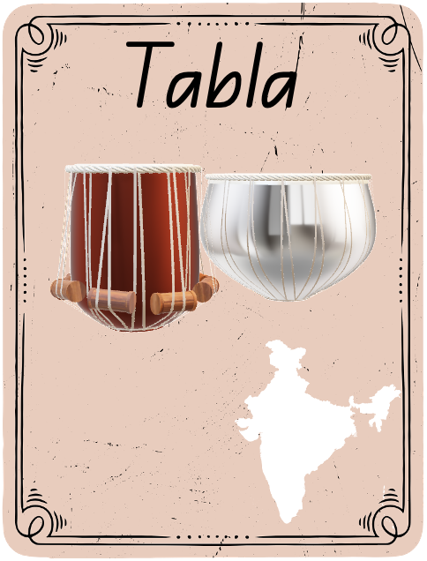
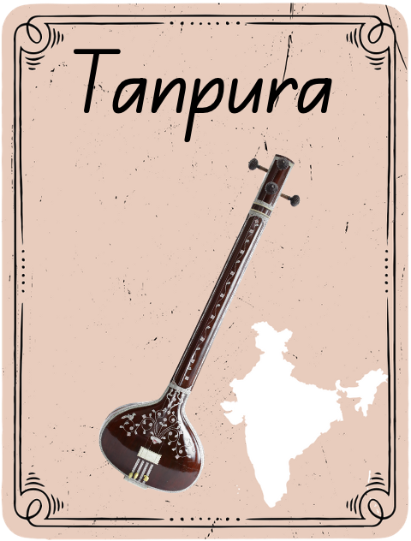
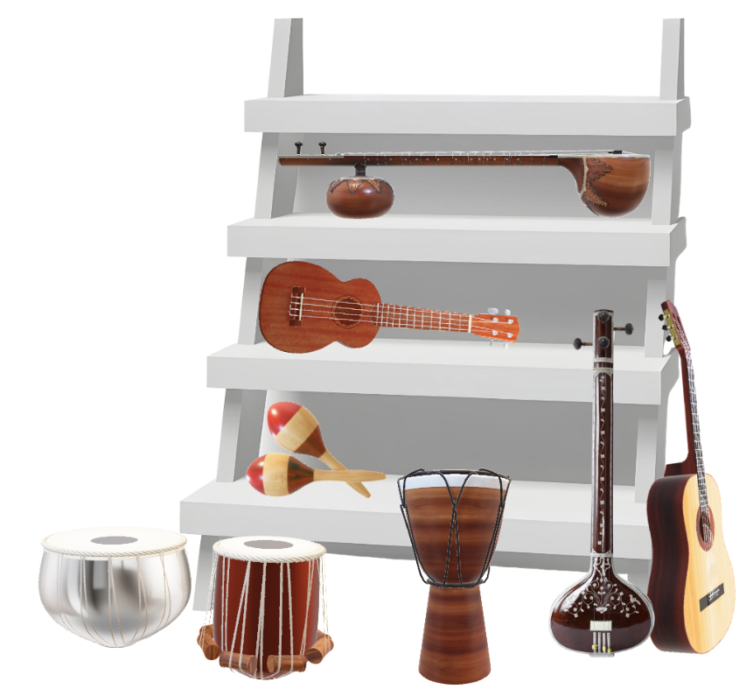
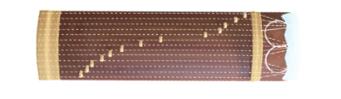

Slide 8

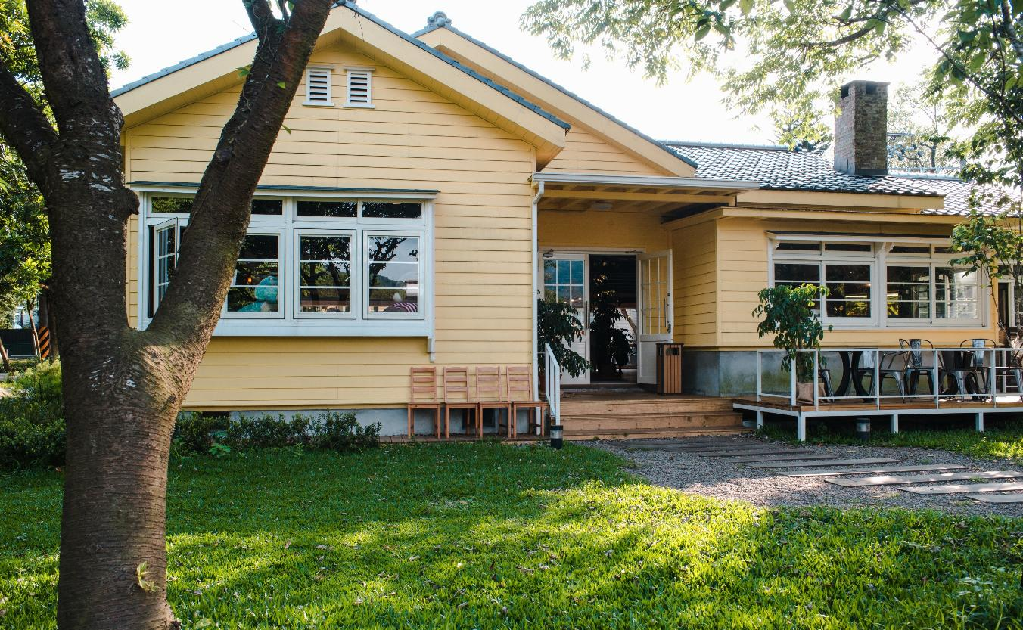
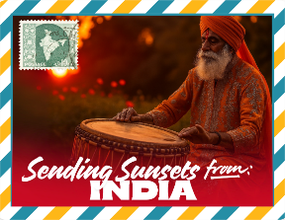
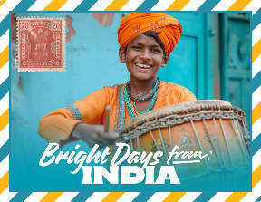
Postcards from India

Slide 9

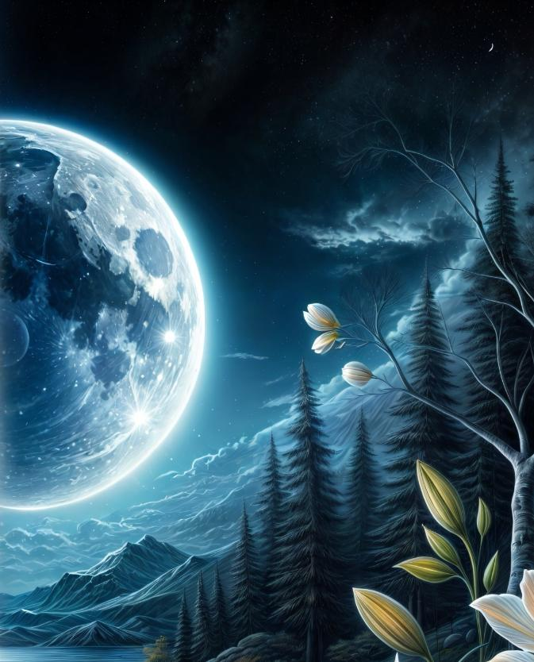



Music in India

Slide 10
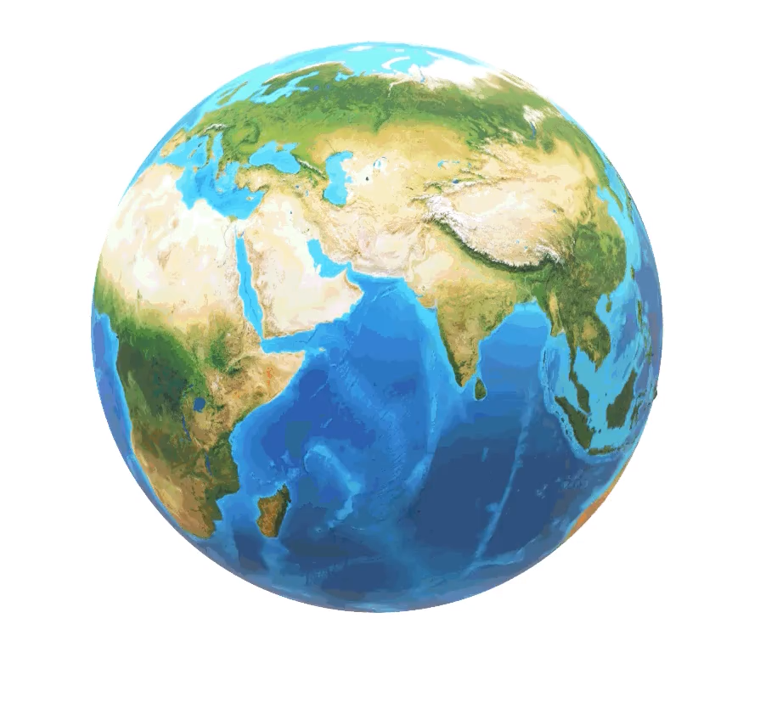
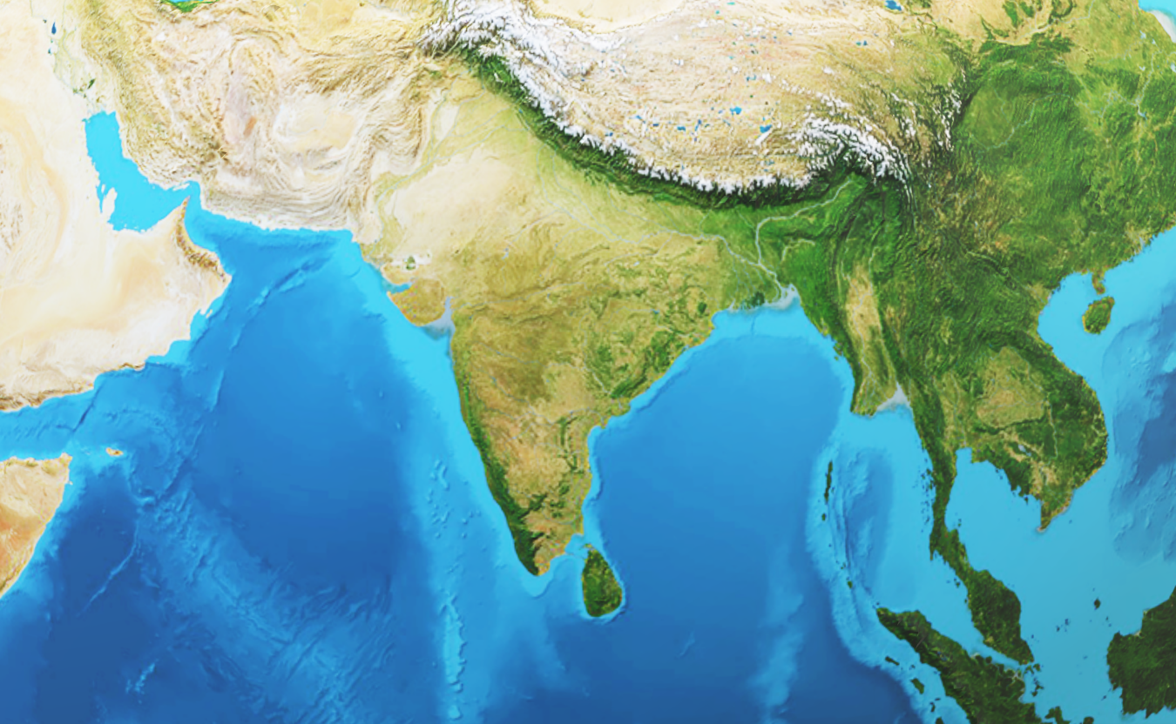

Earth View
India

Slide 11
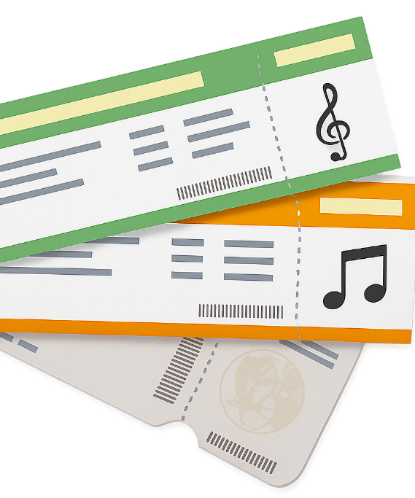




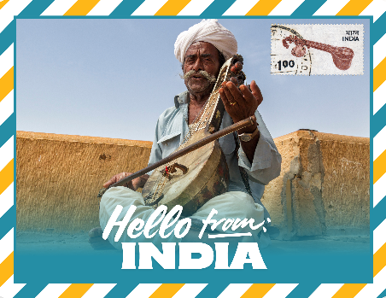


Slide 12


First Name
________________
Last Name
________________
Birthday
________________
Christopher
I am from
________________
Columbus
Australia
September 3

Slide 13

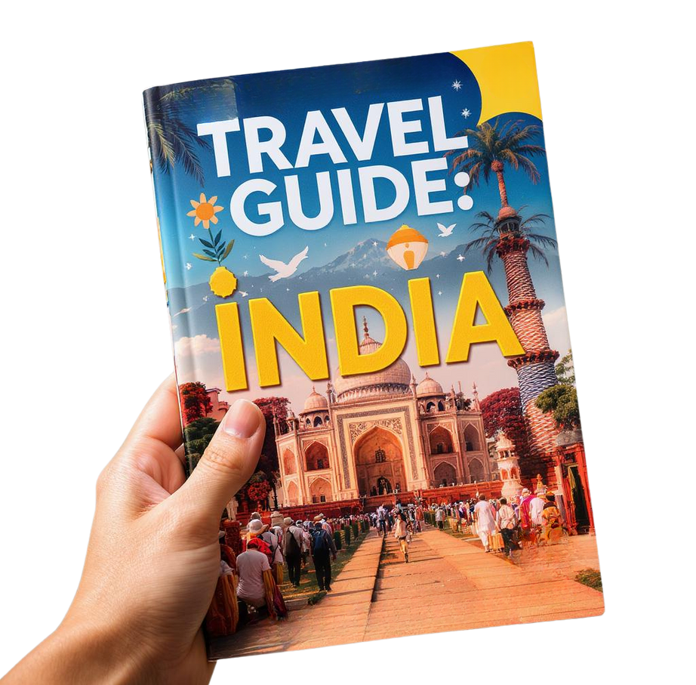
18

Slide 14
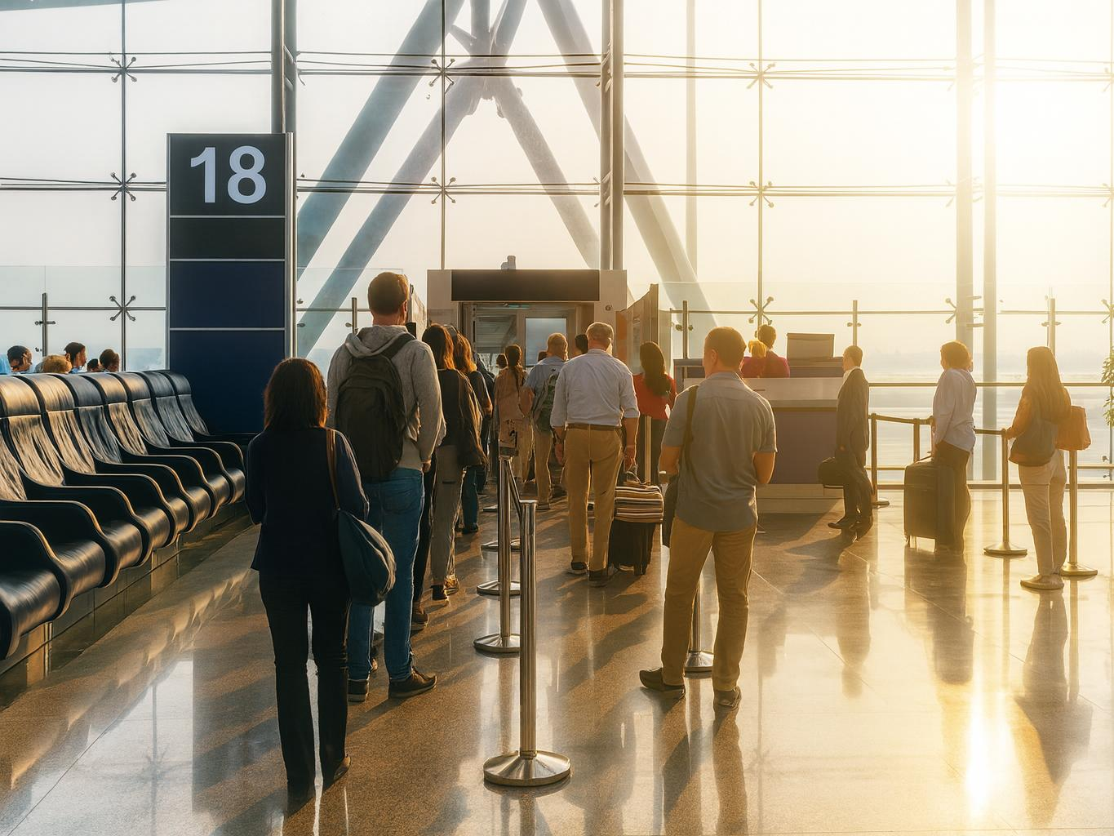
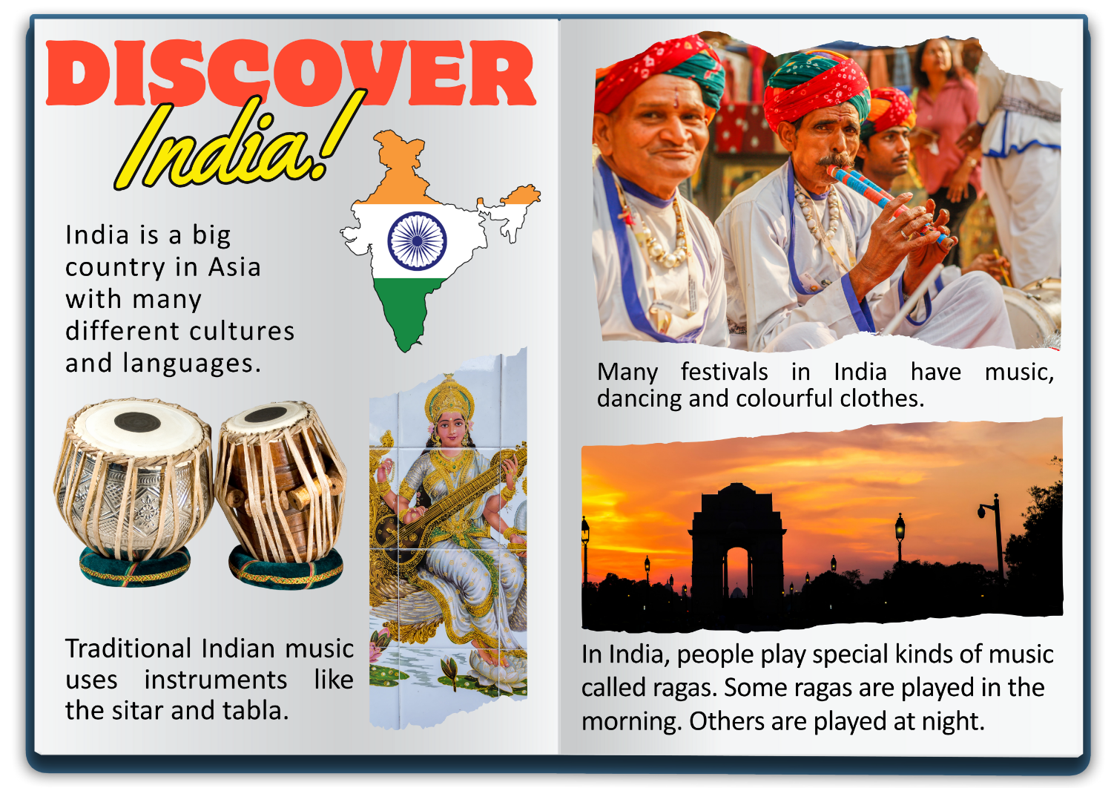
H8

Slide 15

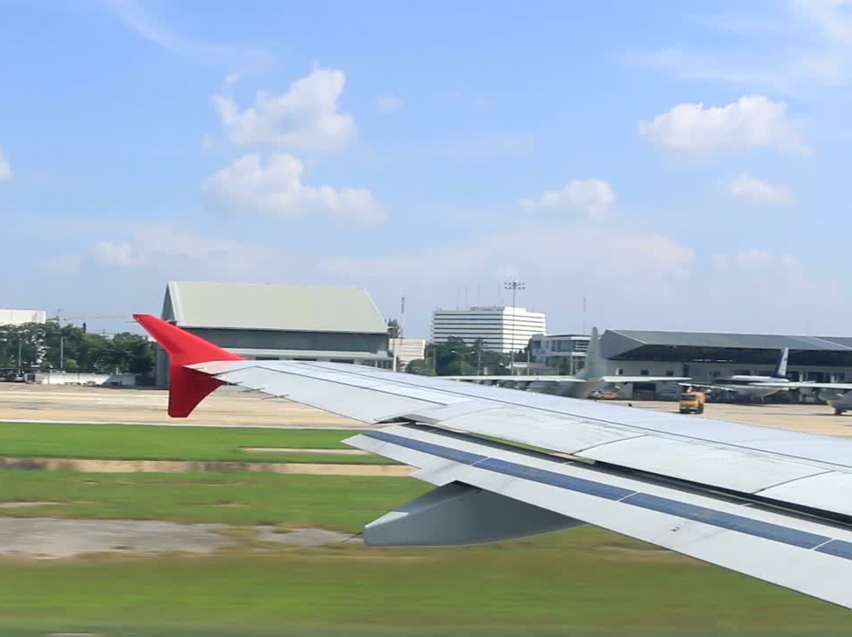
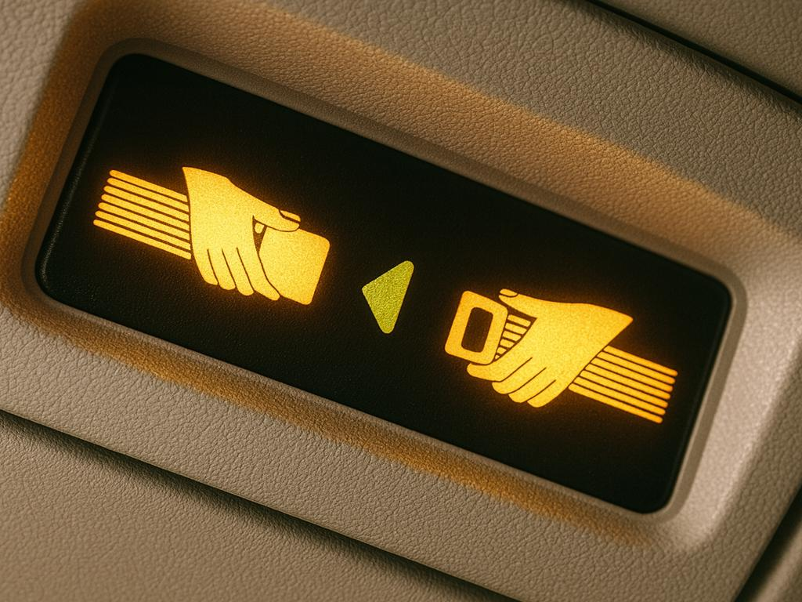

Slide 16

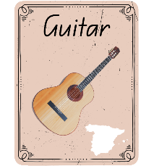

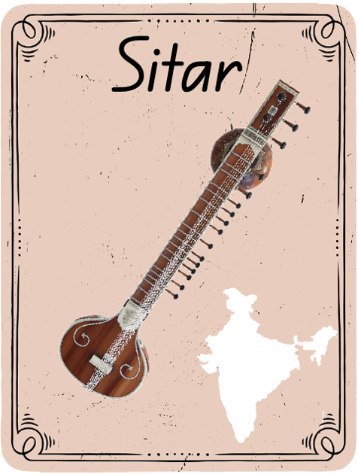
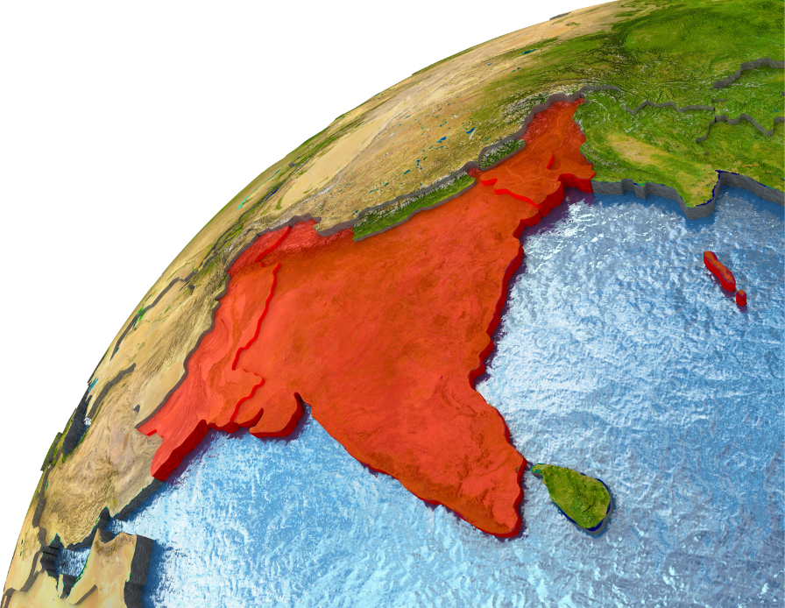

Slide 17
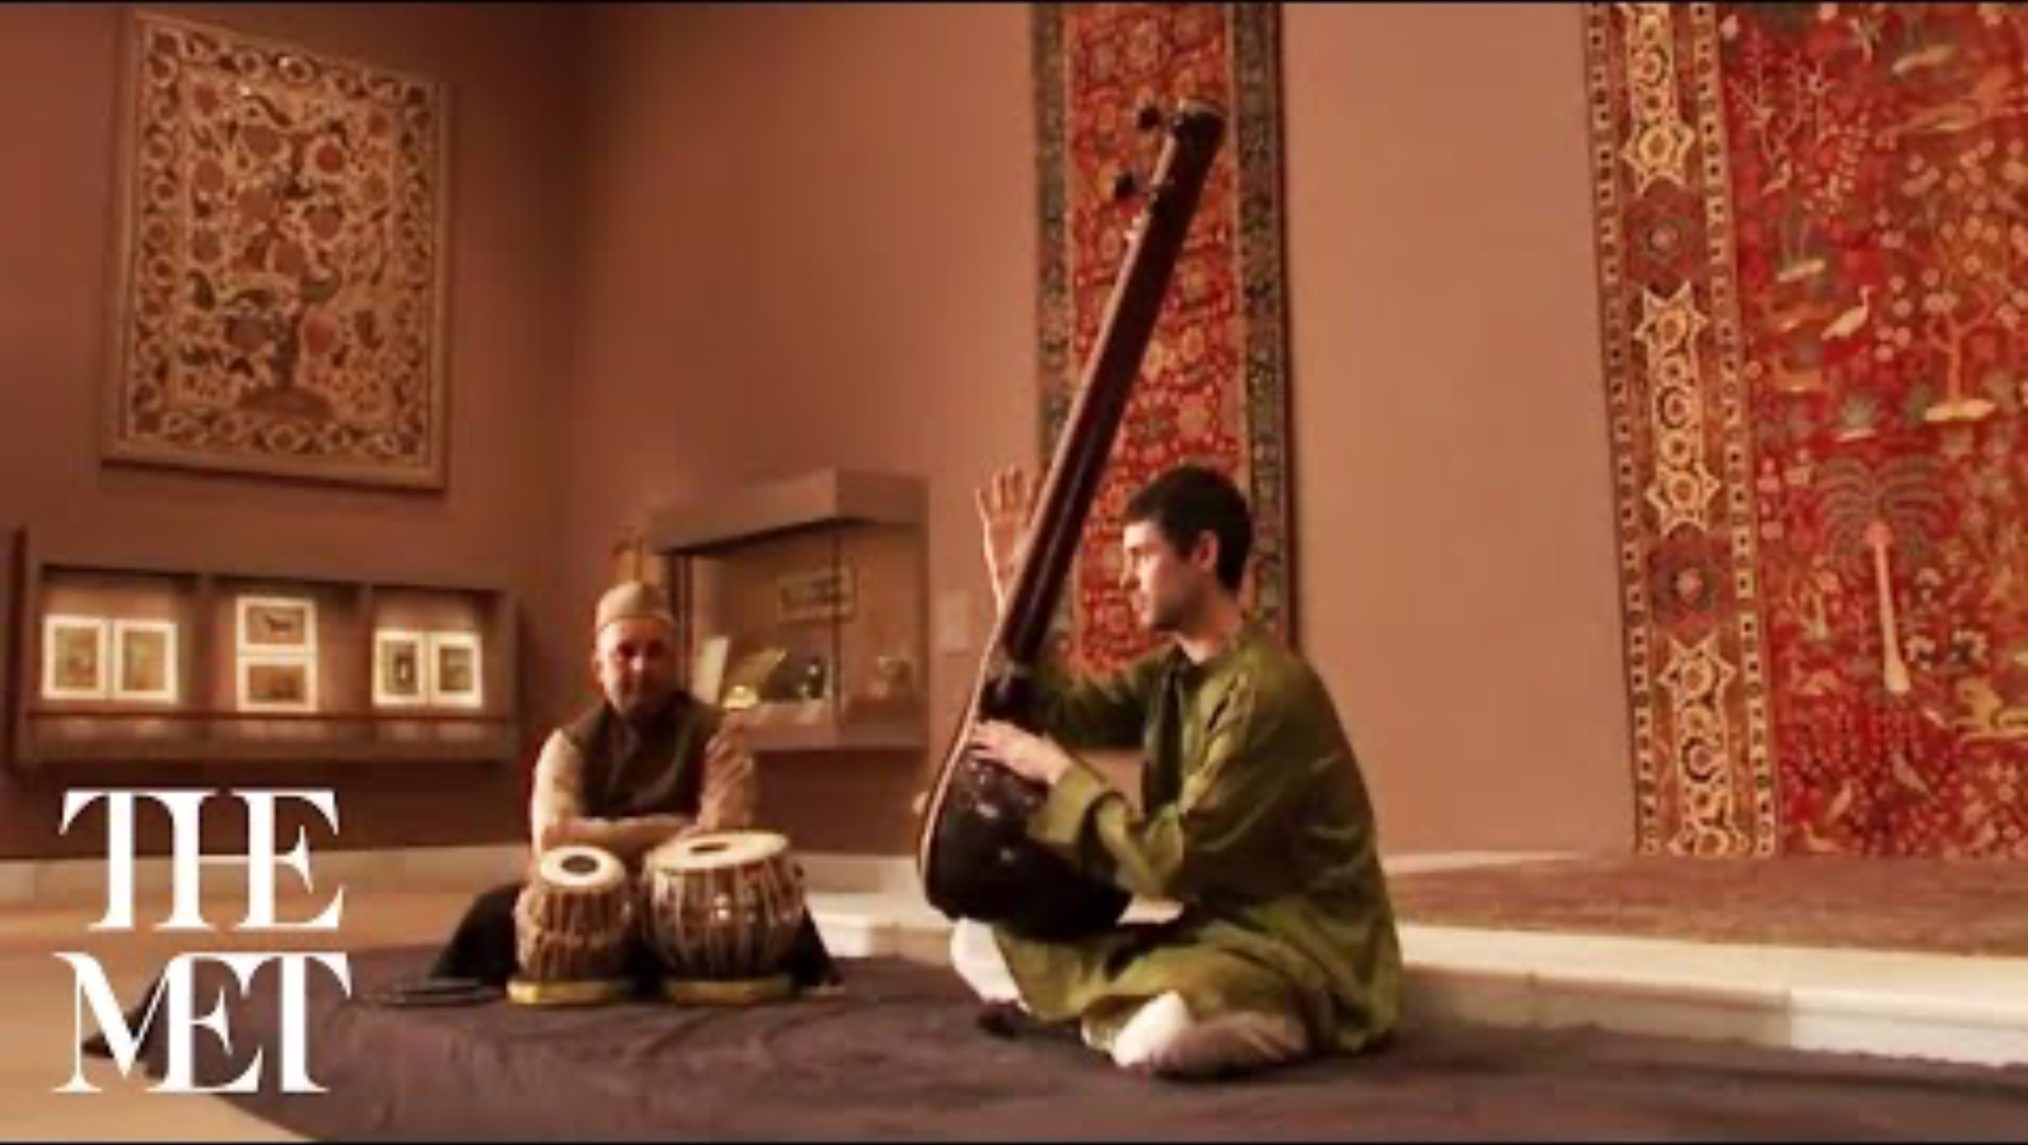

Slide 18
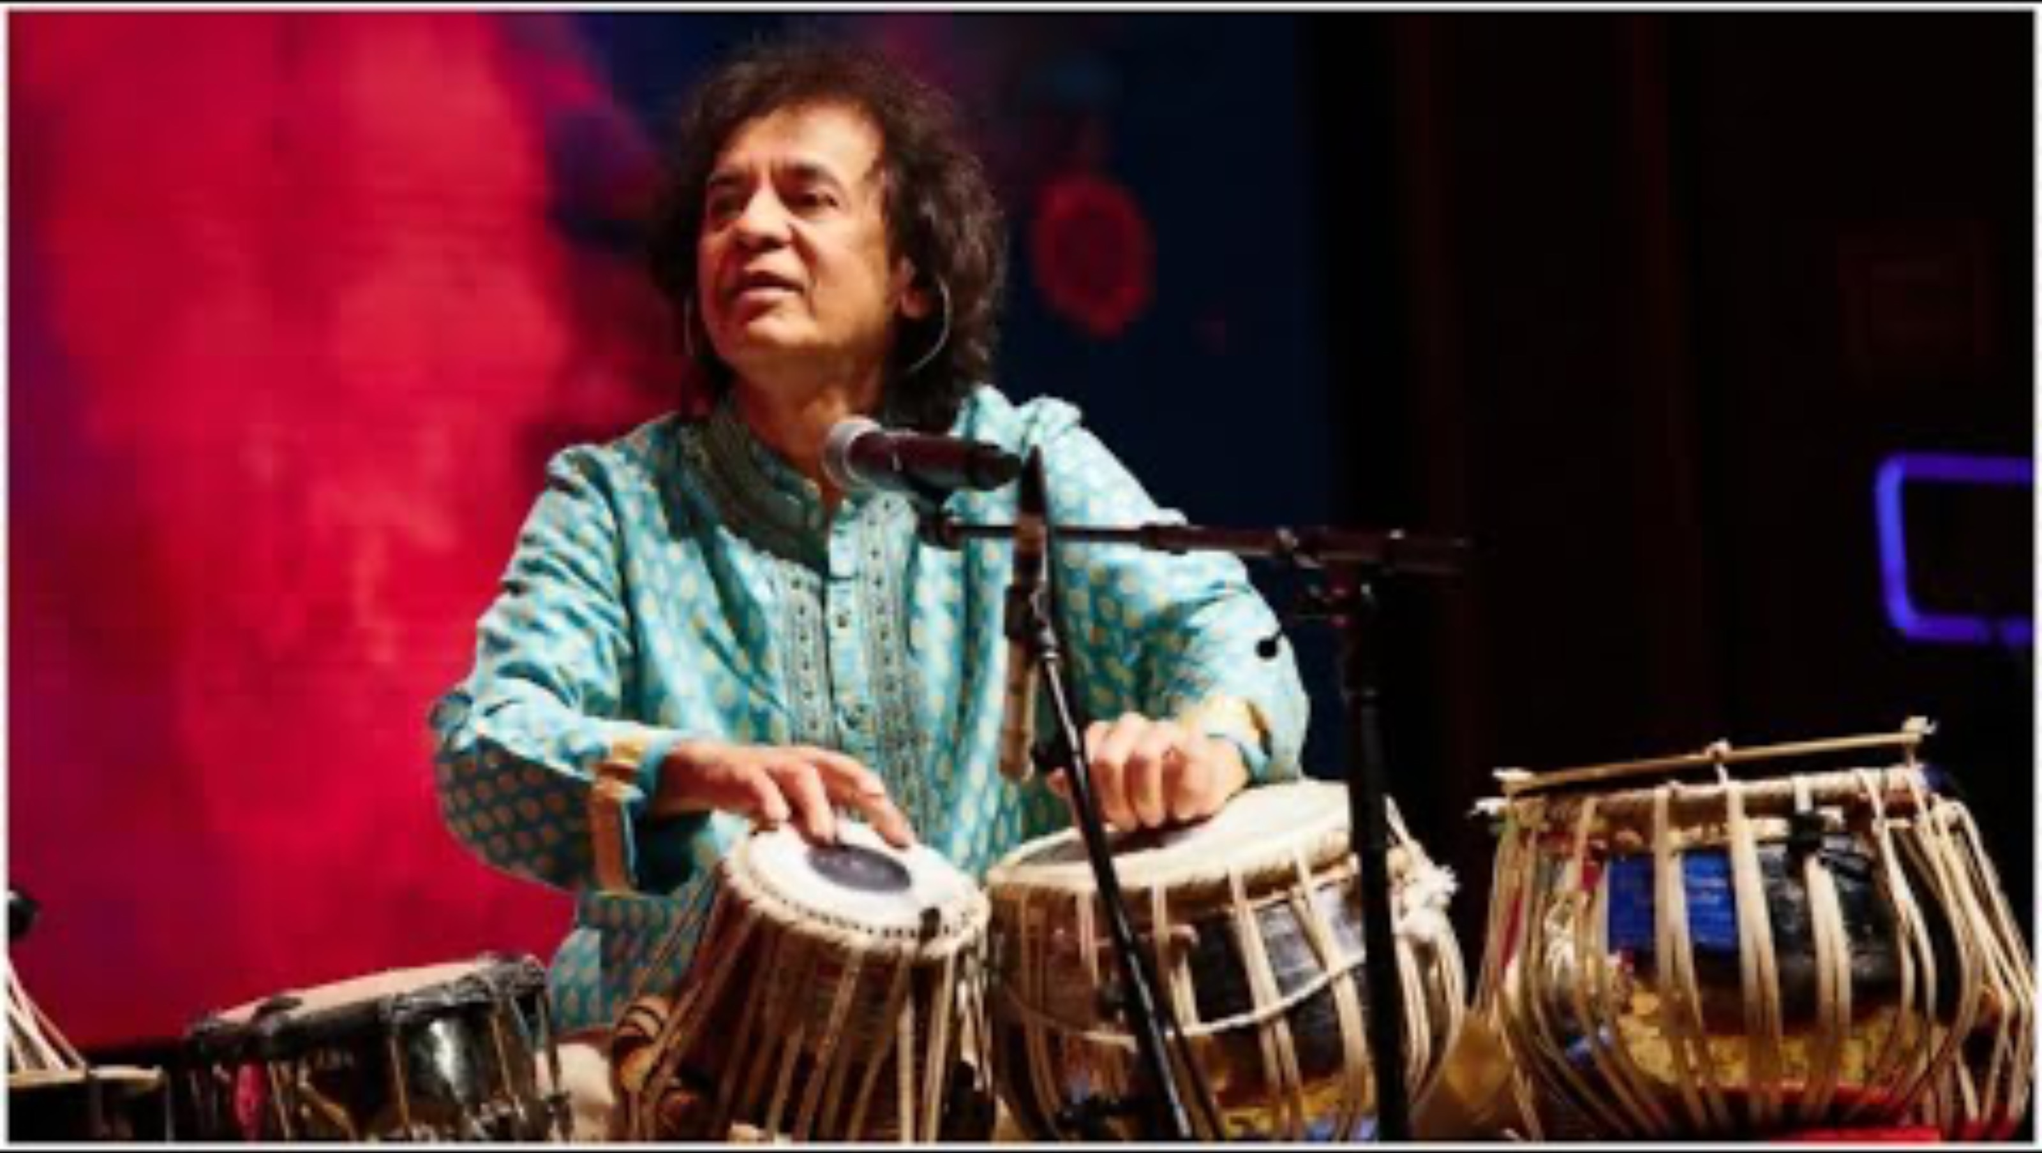

Slide 19
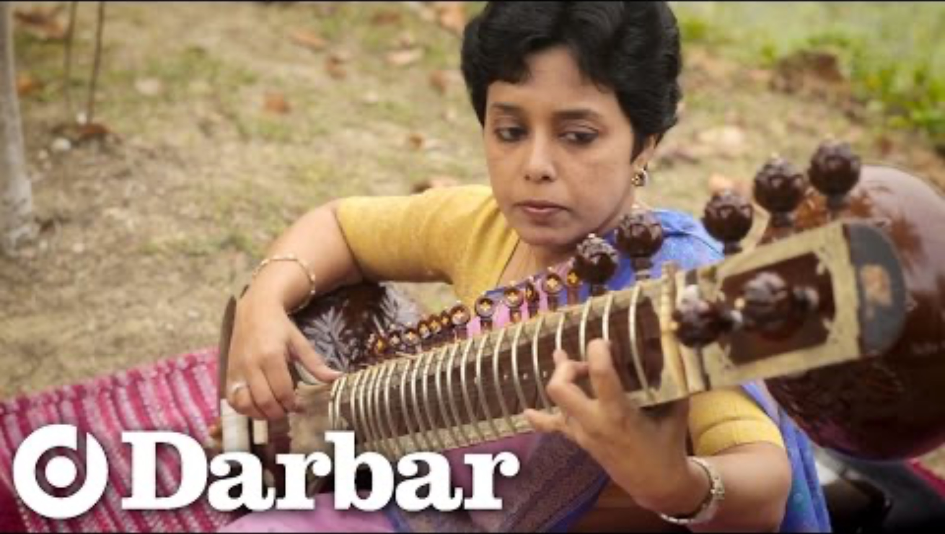

Slide 20
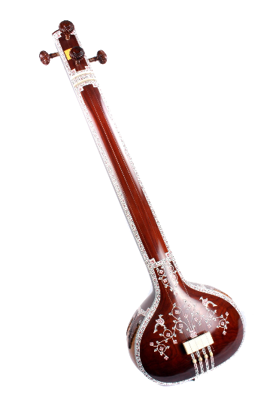
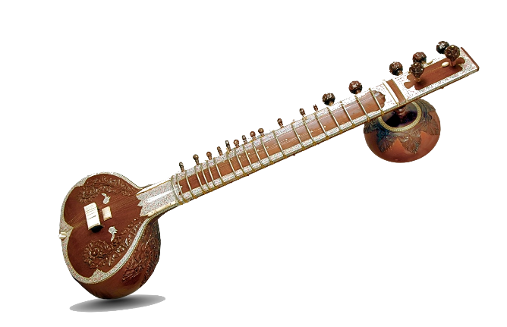
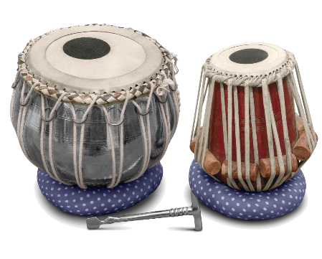


Guess the Instrument
Sitar
Sitar
Tabla
Tanpura
Tanpura
Tabla

Slide 21
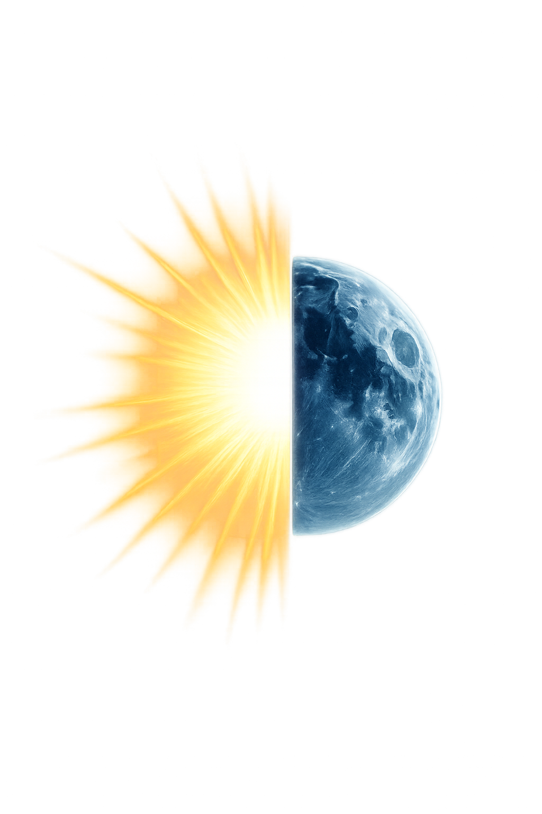
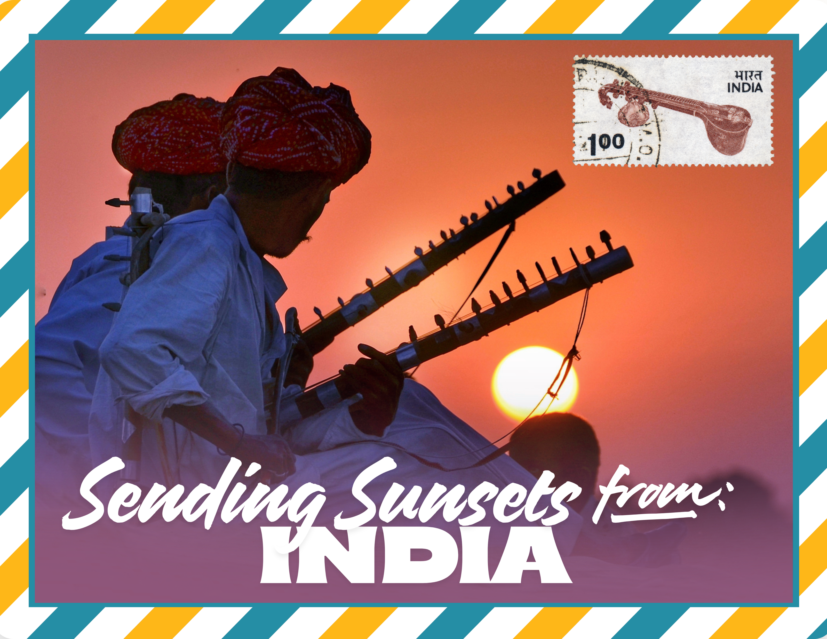
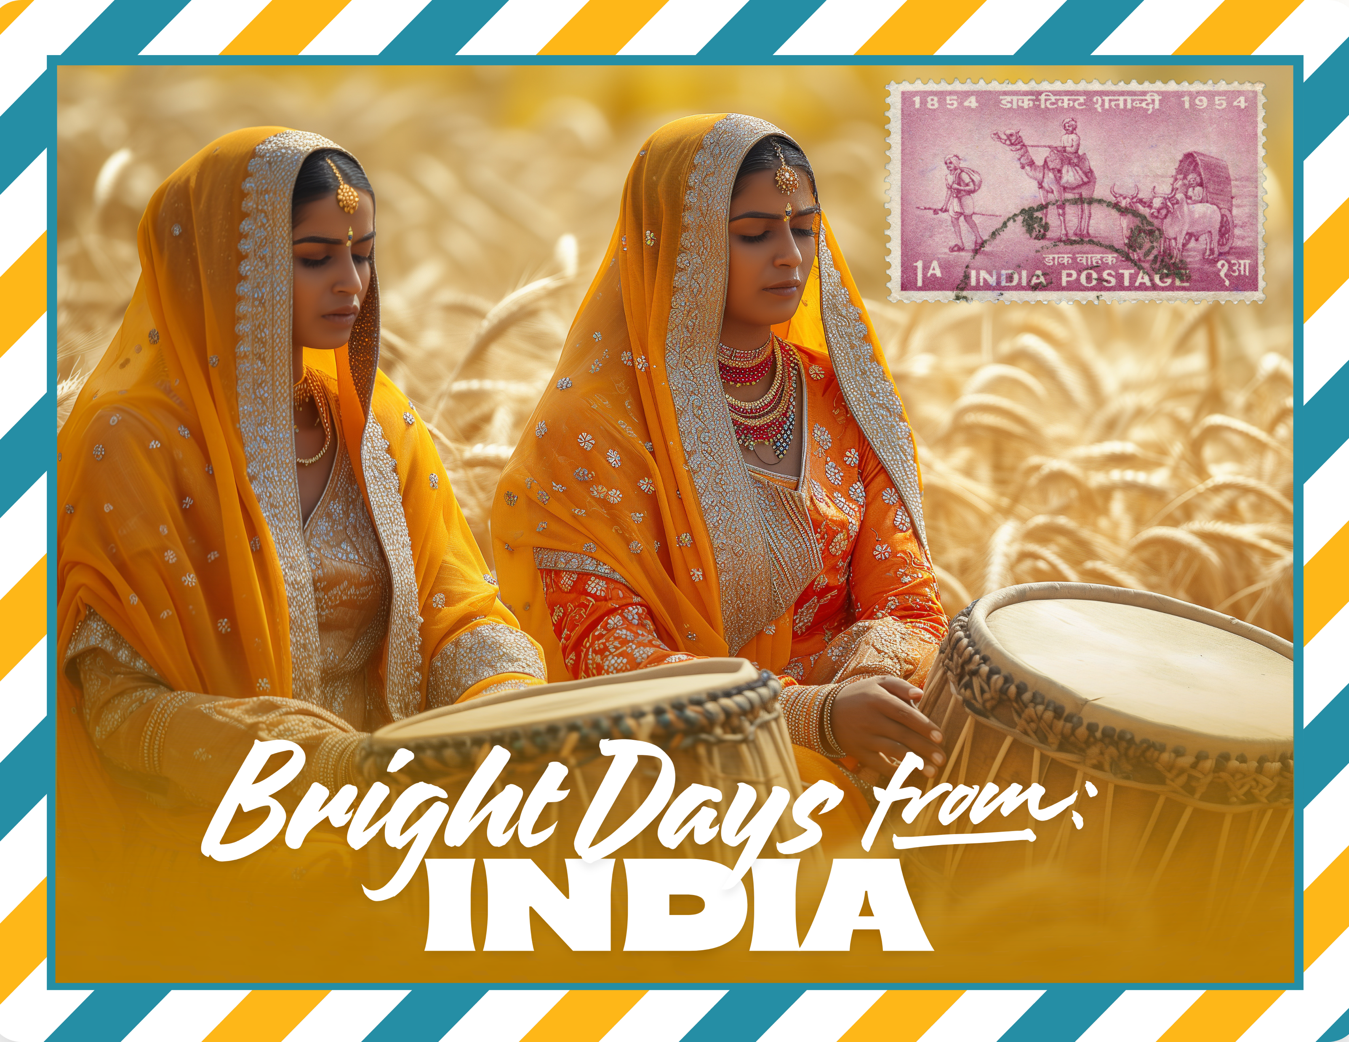
Ragas

Slide 22
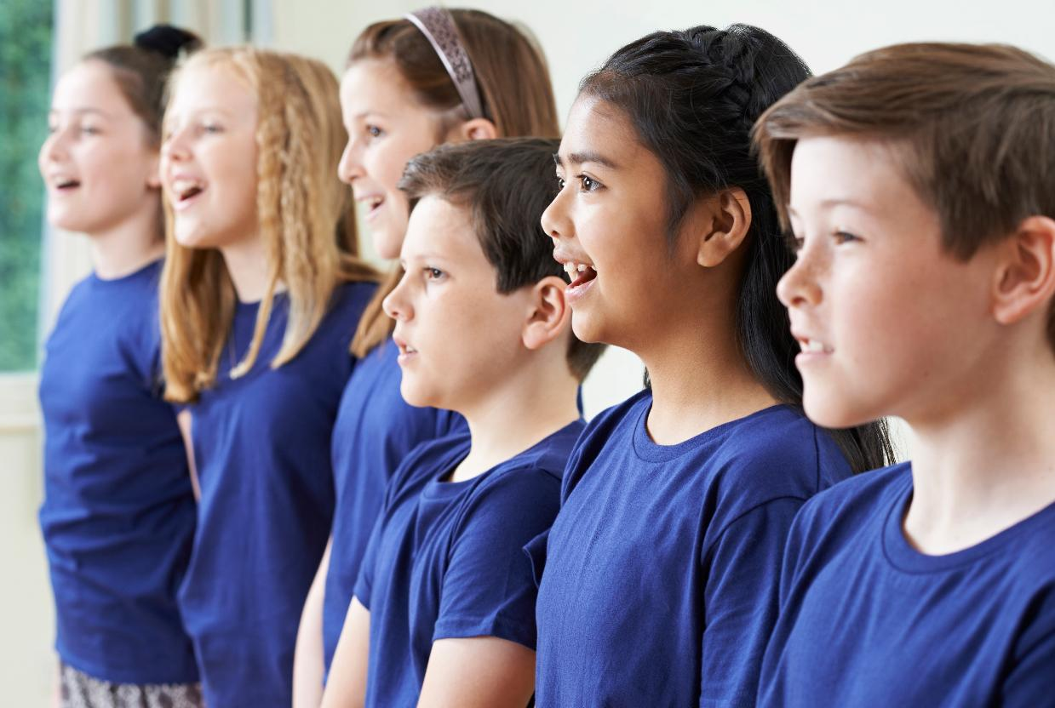
Musicians Sing in a Group

Slide 23

Singing a Drone

Slide 24

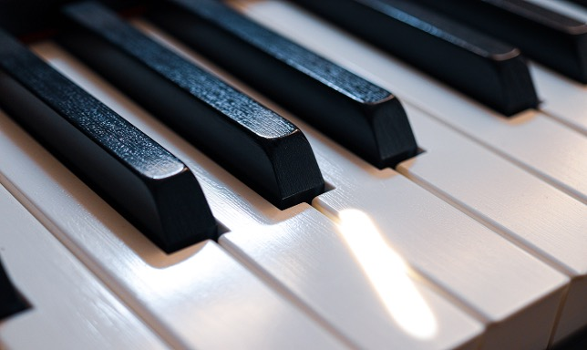
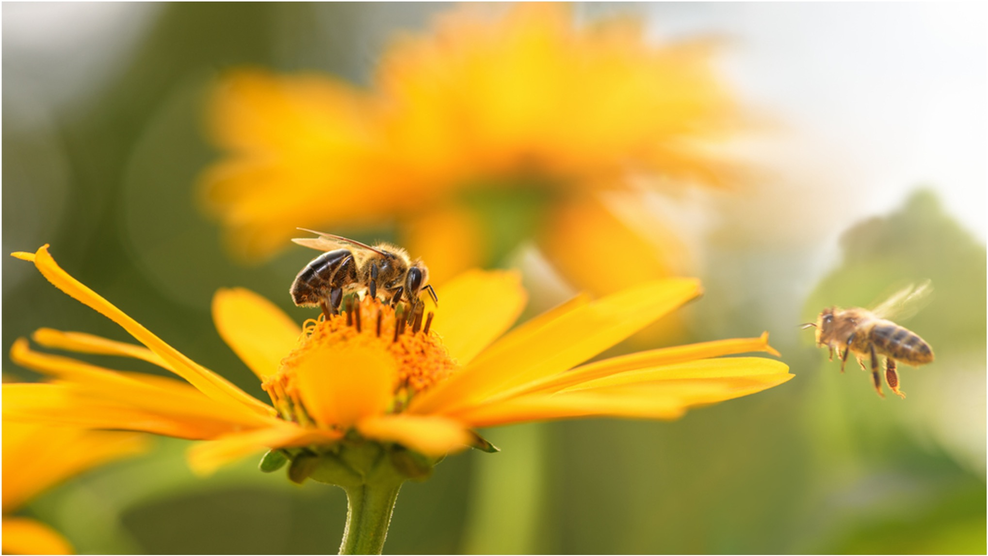

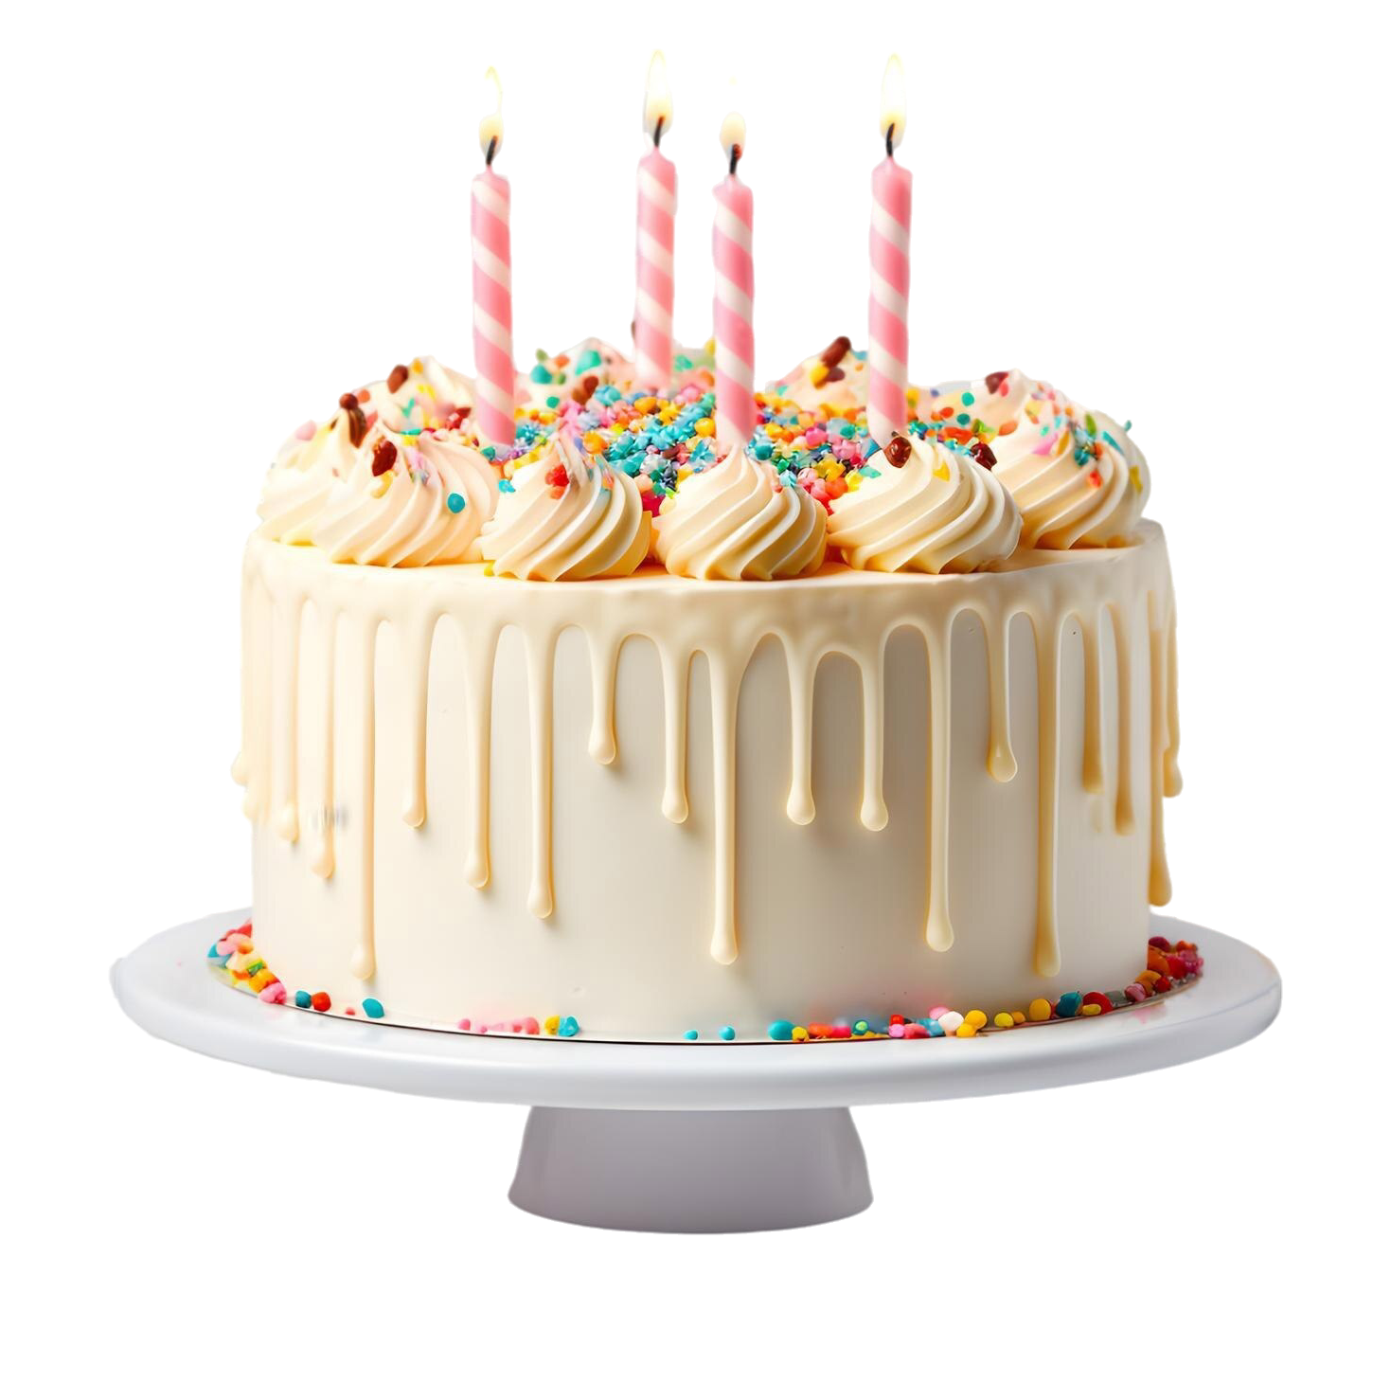
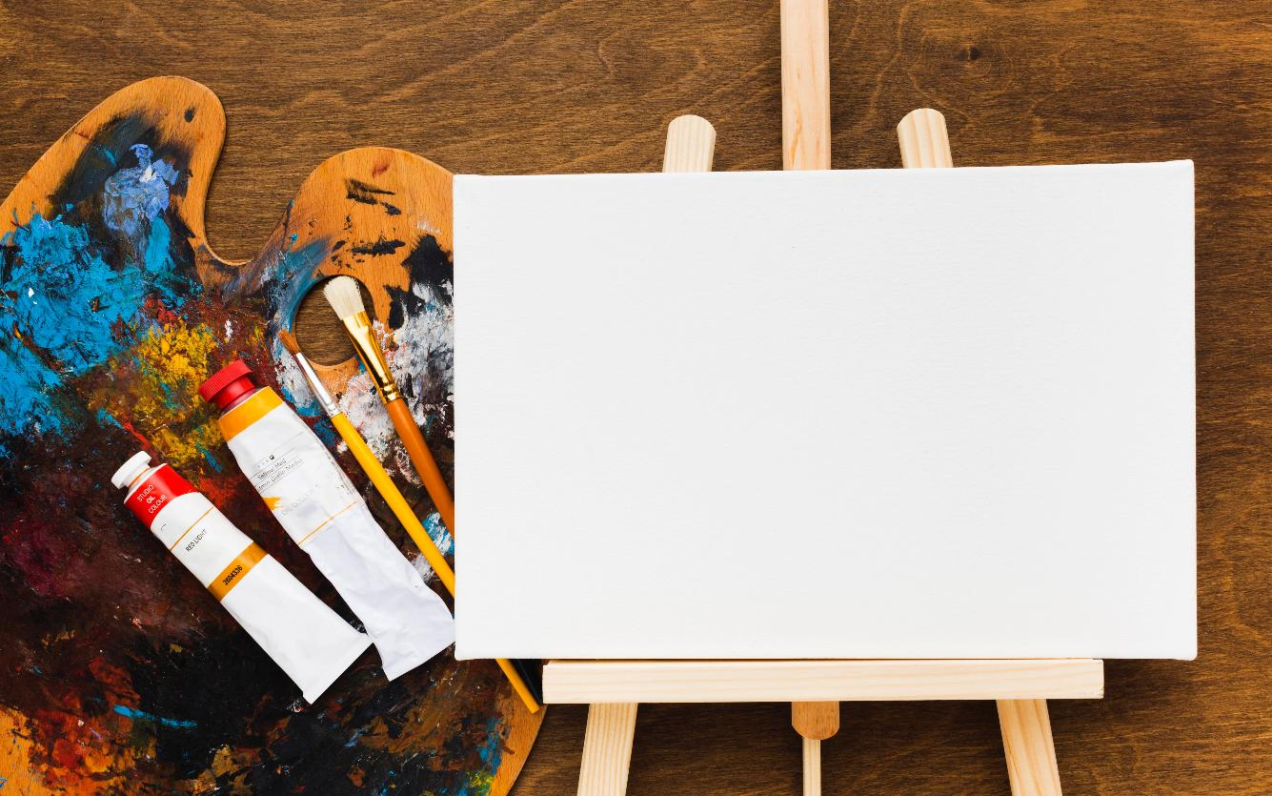


Scales

Slide 25




I Do:
The Pentatonic Scale
VIRTUOSITY

Slide 26




Making Music with the Keyboard

Slide 27
I Do/We Do:
Playing Scales on the Keyboard
VIRTUOSITY

Slide 28



I Do/We Do:
Making Indian Music

Slide 29








Slide 30





Tanpura
Sitar
Tabla

Slide 31
People in India use special instruments to make music.
People make music that matches the time of day.
Musicians use scales to make music.

Slide 32


Exit Ticket
Date: _________
Lesson 1A
Lesson 2
In India, people use special _____________ to make music.
People in India make music that:
  matches the food they eat
  matches the time of day
  matches the colour of their clothes.
Instruments from India include Tanpura, Tabla and S_____.
instruments
instruments
ragas
passports
itar
3
I know _____ out of 3 answers.

Slide 33

In the next lesson, we will explore music from Japan.

Slide 34
Slide 31, Image, By Ssolbergj (talk) - This vector image was created with Inkscape by v ., CC BY-SA 3.0, https://commons.wikimedia.org/w/index.php?curid=5123101
Slides 26 and 28, Playable Piano, By Playable Piano — Virtuosity, https://drive.google.com/file/d/1_HZpF7ut1rDVG2KZet0WQqOAamluMtde/view, Used with permission; logo retained as requested.

