Slide 1

Rock Band
Lesson 1
Let’s Rock!
Unit 4 Version 3

Slide 2

In this lesson, we will learn to identify the key features of rock music.

Slide 3


You will be able to: ​
identify the features of rock music in listening examples
play G and Em chords on the guitar in time with a steady beat.
Identify: To pick out or recognise something by noticing its important features.
Play: To make a musical sound on your instrument.

Slide 4





Slide 5


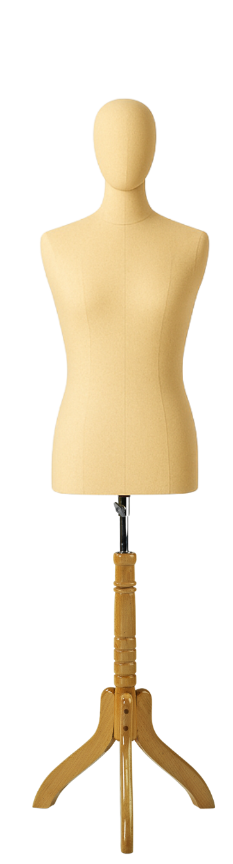

Music Genres

Slide 6

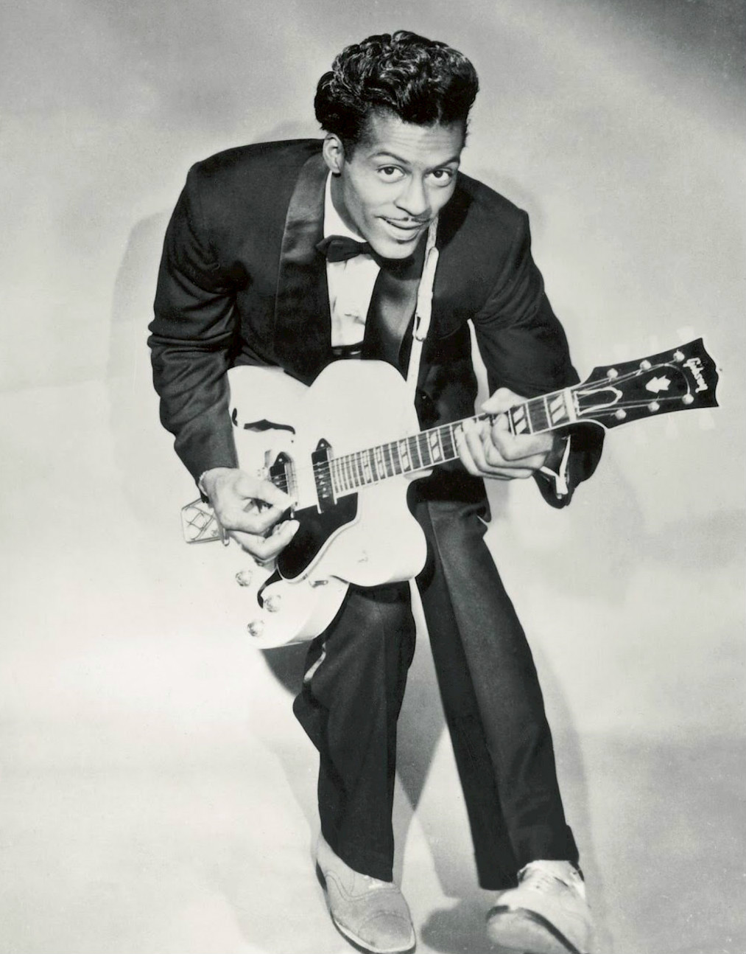



History of Rock

Slide 7

History of Rock

Slide 8


Unique Characteristics of Rock
repeating patterns
steady beat
clear song structure
full band sound

Slide 9



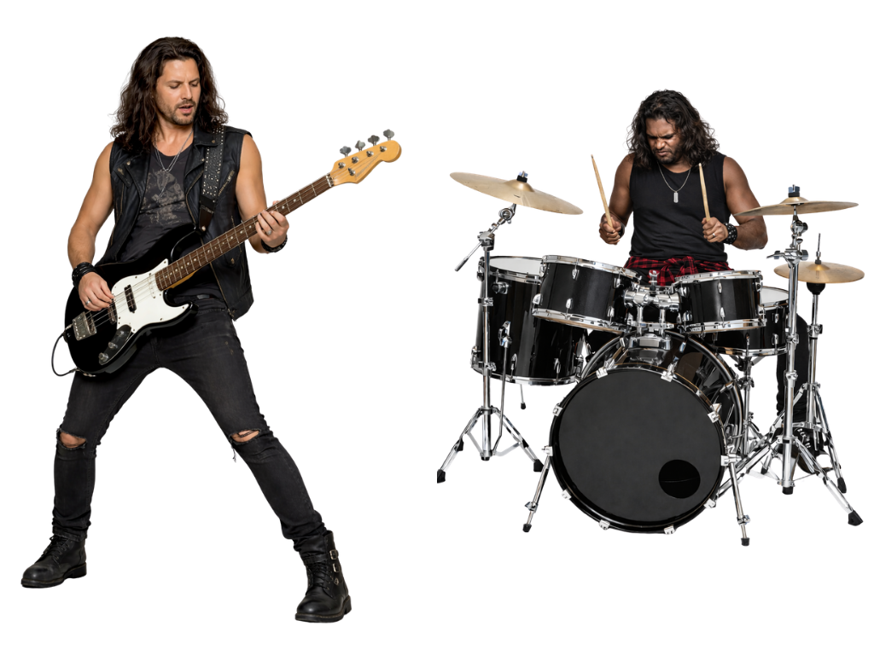



1, 2, 3, 4
verses
chorus
repeating patterns
clear song structure
steady beat

Slide 10

verses
chorus
clear song structure

Slide 11
verses
chorus
full band sound

Slide 12

Unique Characteristics of Rock
steady beat
repeating patterns
clear song structure
full band sound

Slide 13

Characteristics of Rock
Which of these tunes sounds like rock music?

Slide 14
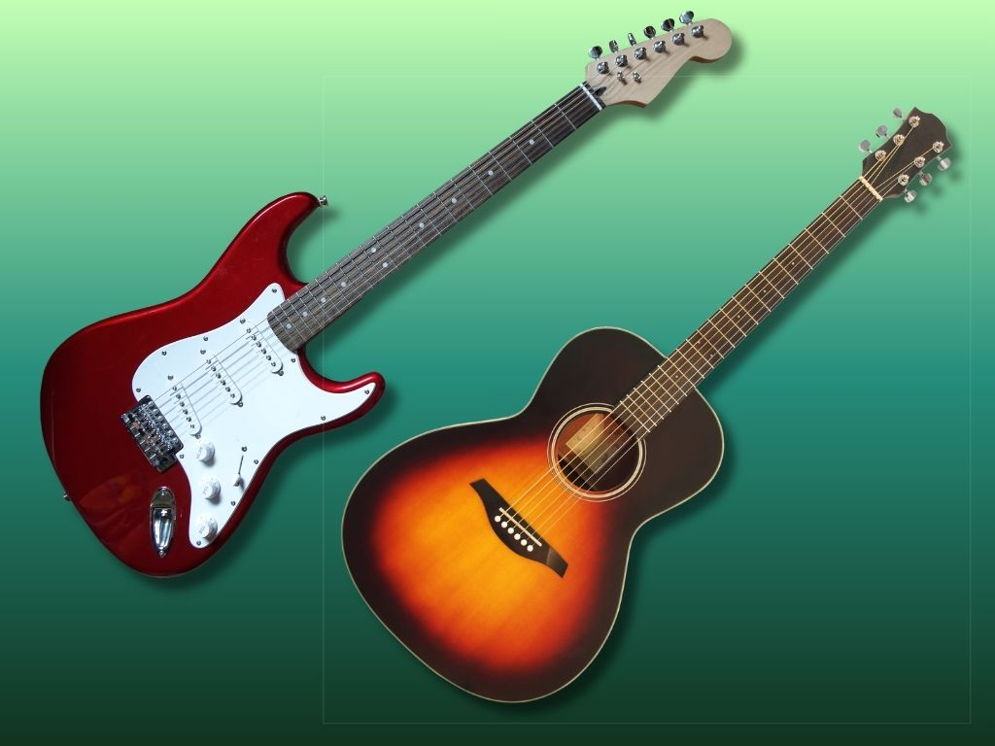


Introducing the Guitar

Slide 15
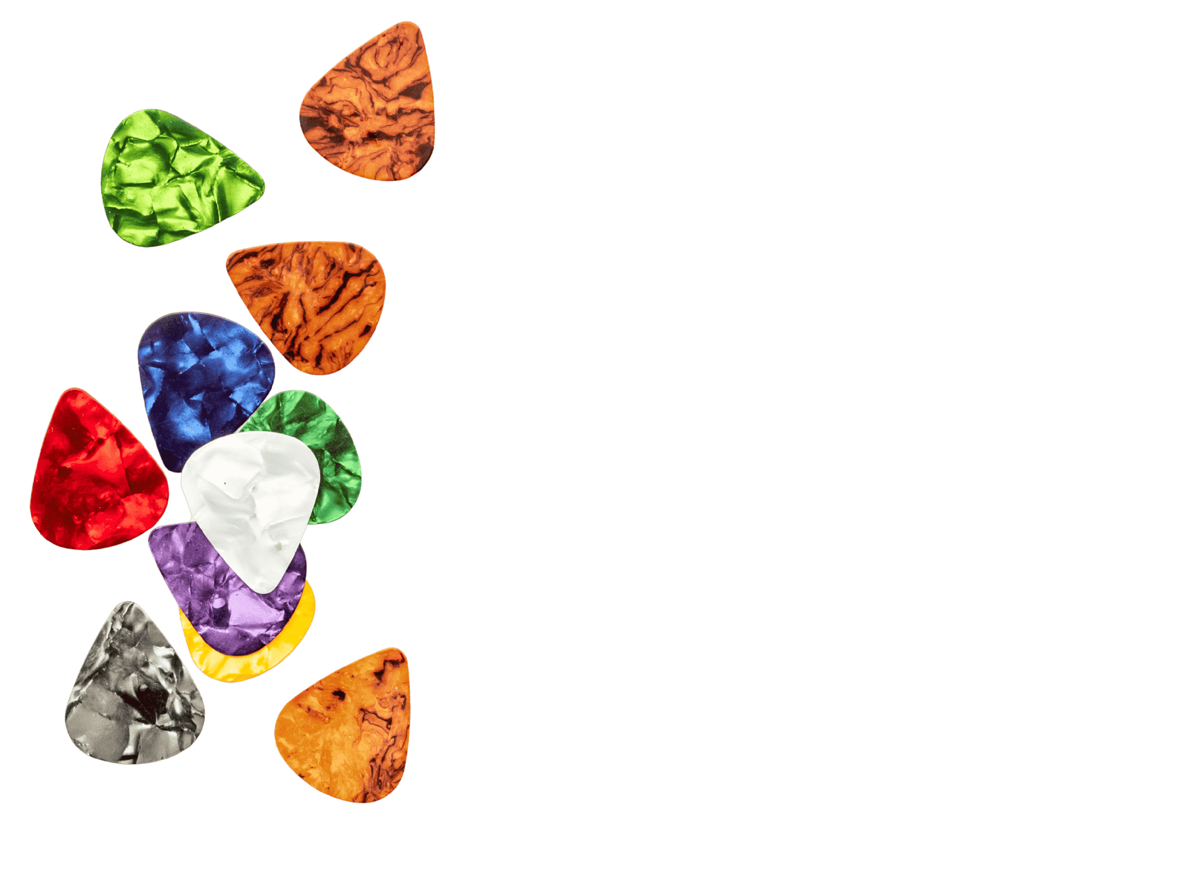
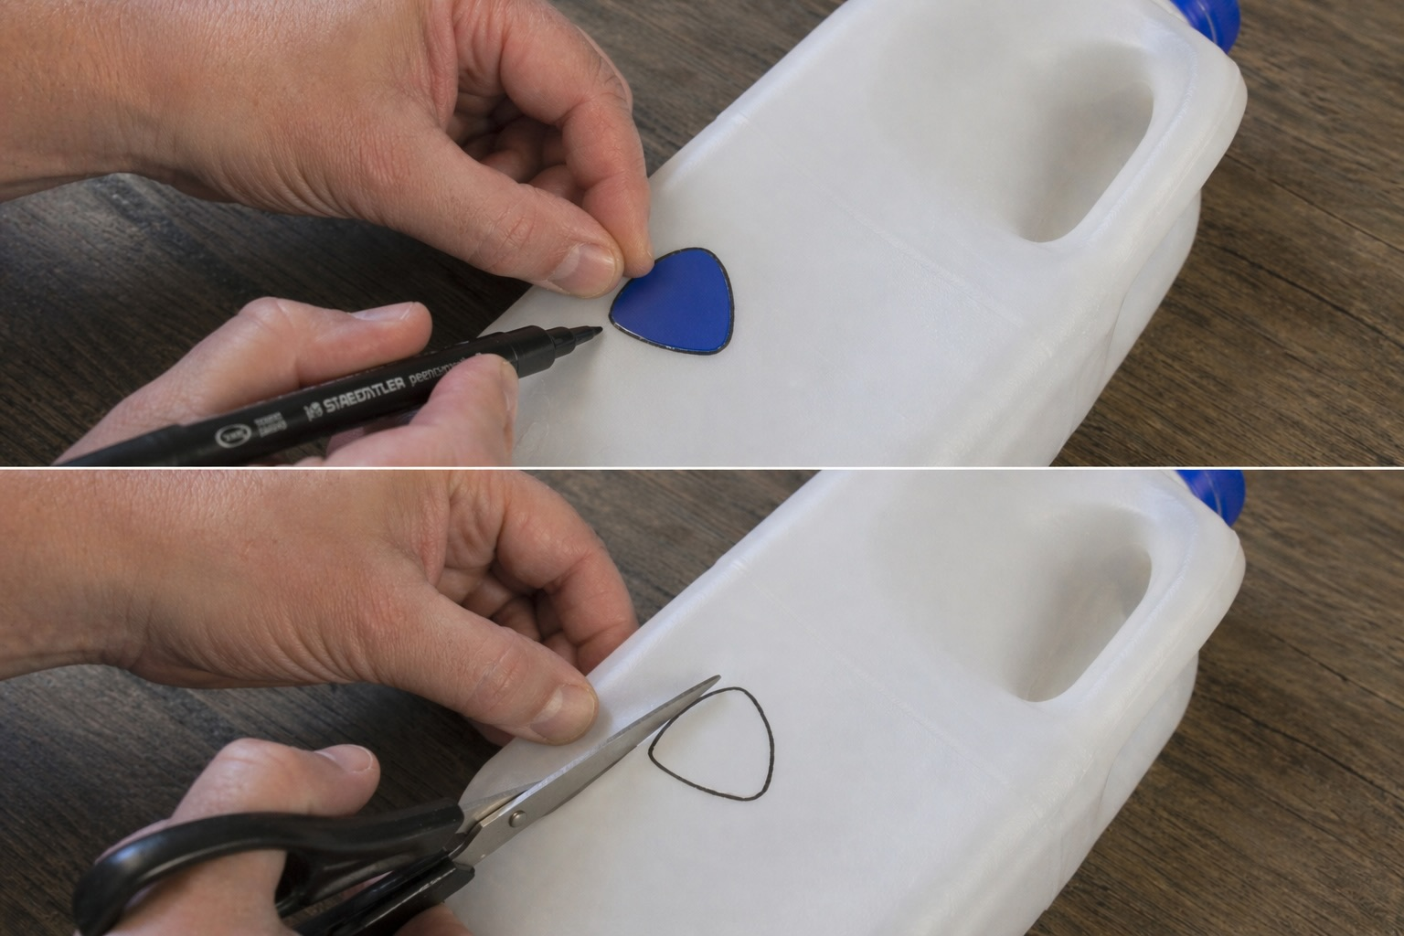

Making Guitar Picks

Slide 16
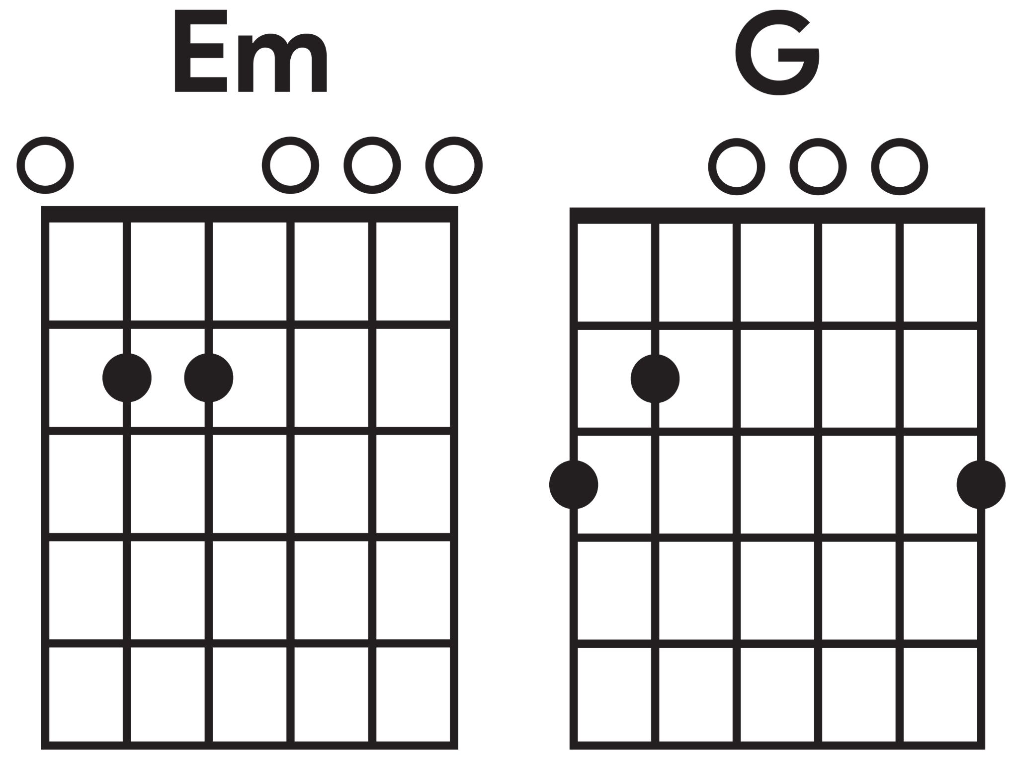
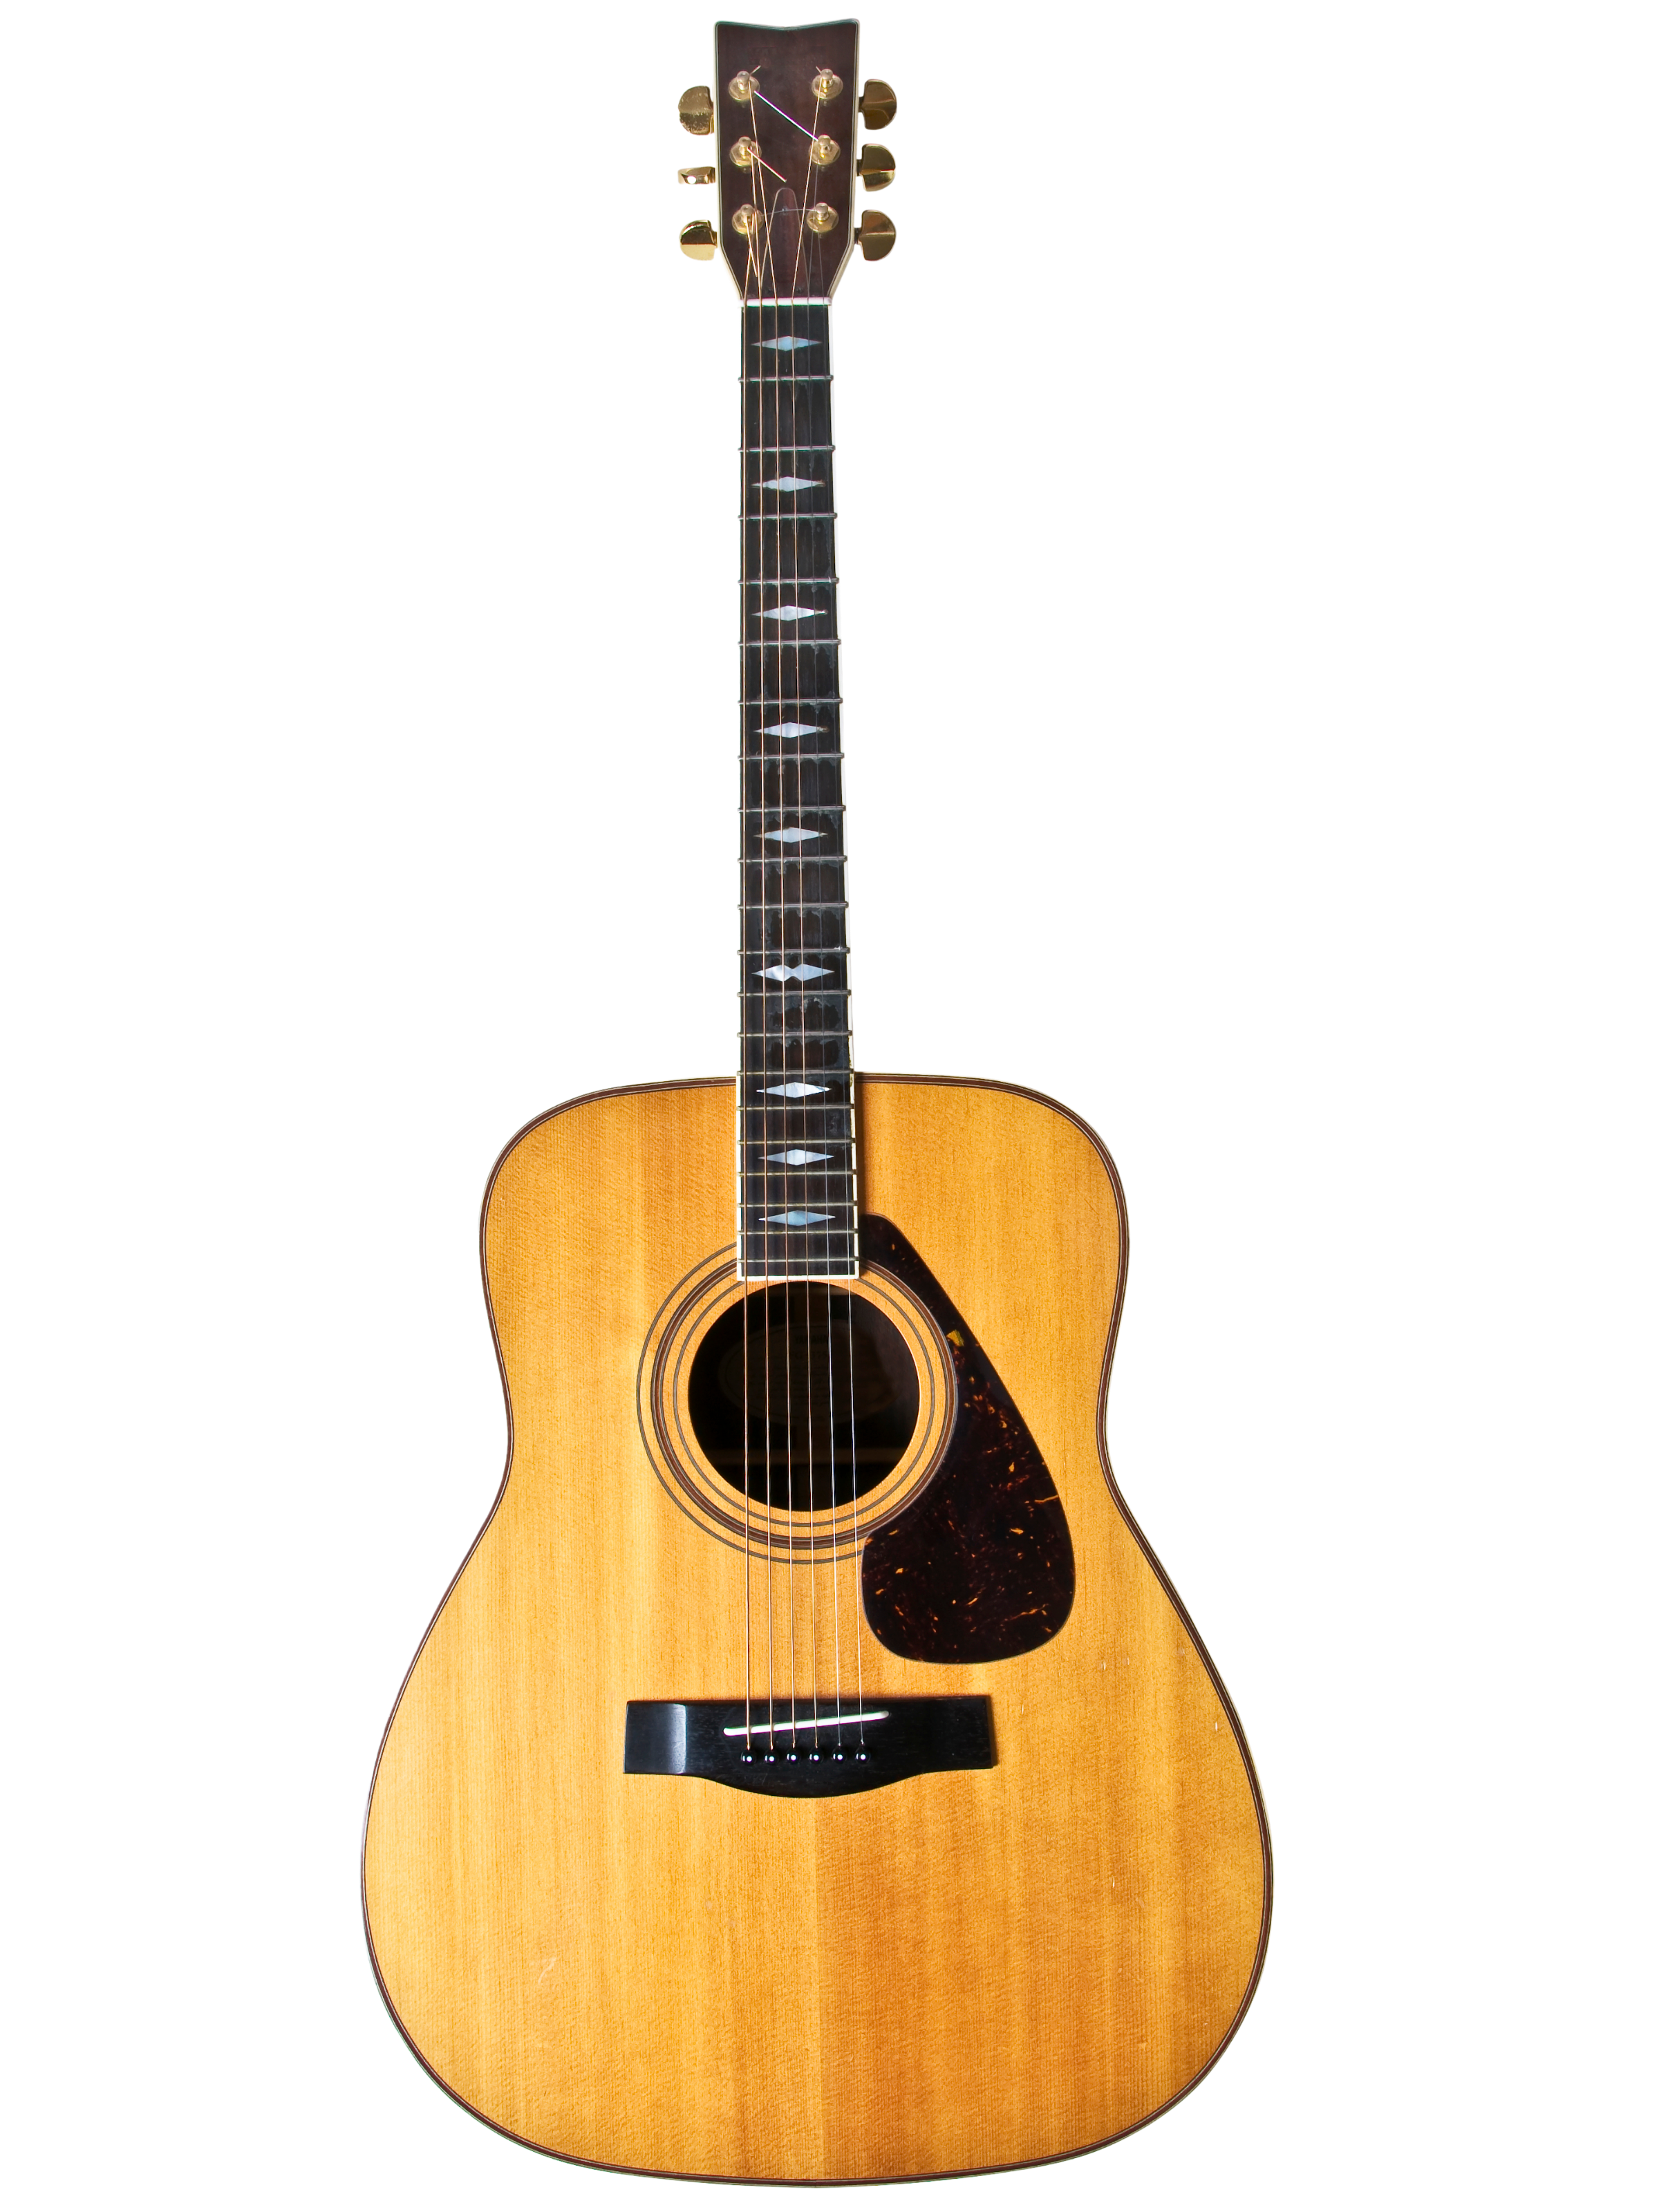
Play Em

Slide 17

Play Em

Slide 18
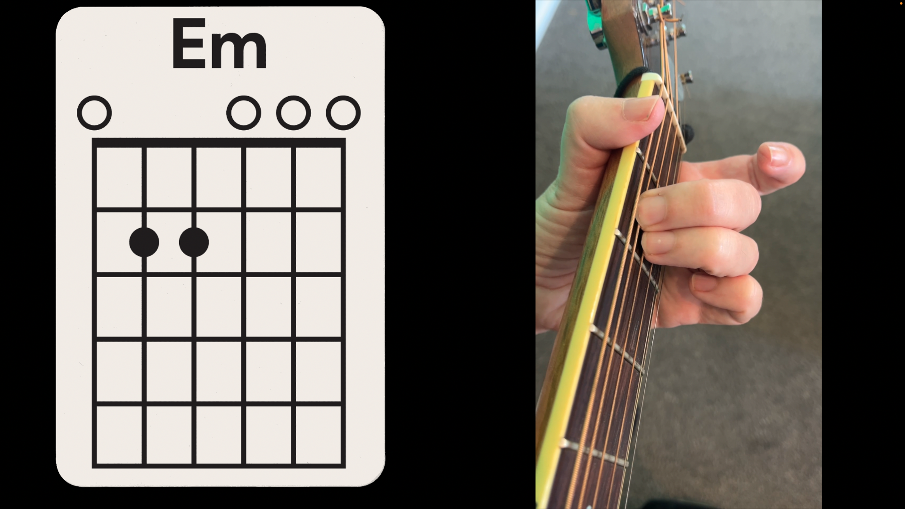
Play Em

Slide 19
Play G

Slide 20

Play G

Slide 21
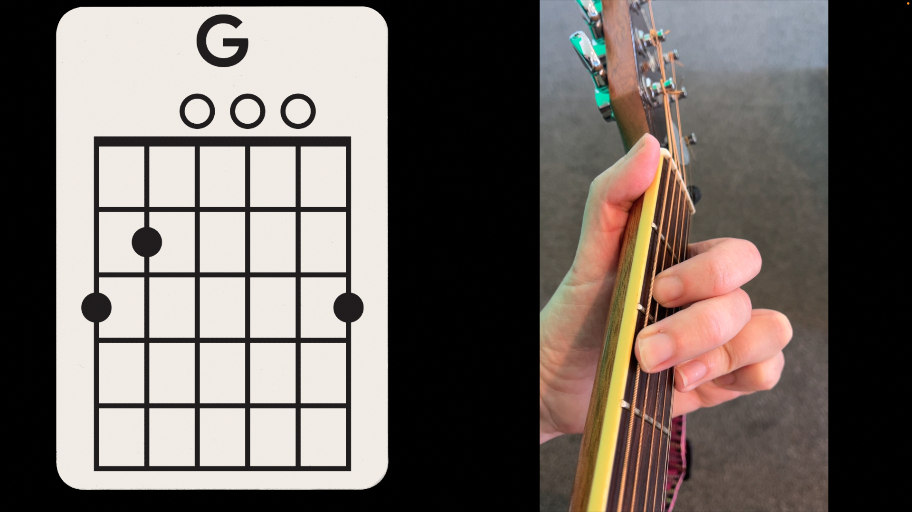
Play G

Slide 22
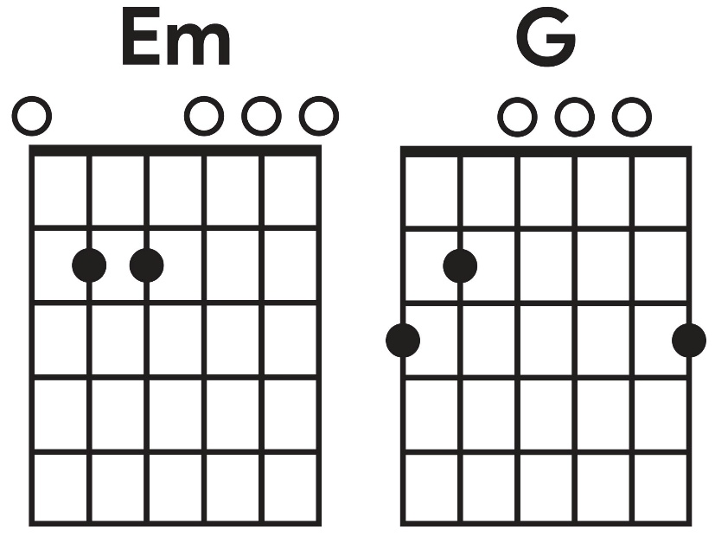
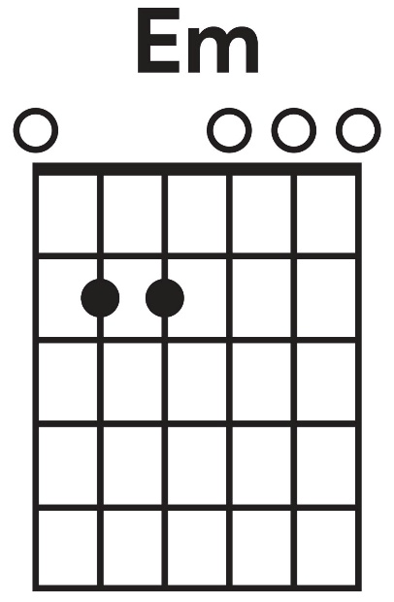
Play Em and G

Slide 23
Playing Em to the Beat

Slide 24
Playing G to the Beat

Slide 25
Changing Chords to the Beat

Slide 26

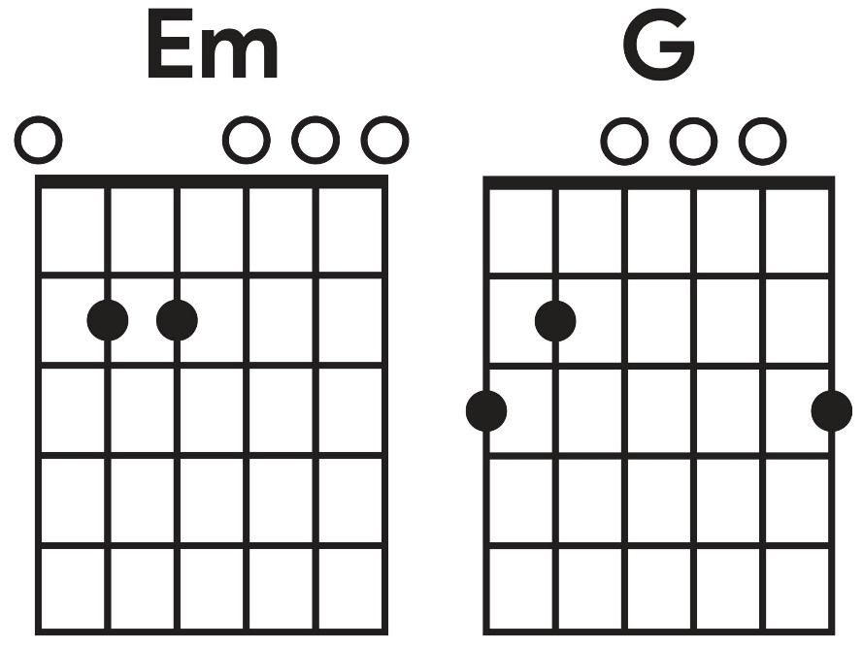
Practise Em and G

Slide 27
Practise Em and G
Play Em and G

Slide 28


Rock music is a genre with a steady beat and repeating patterns.
Rock music uses guitars, bass and drums together and follows a clear structure with repeating sections.

Slide 29


Chords are formed with the left hand while the right hand strums a steady beat. G uses three fingers and Em uses two.

Slide 30




Exit Ticket
Date: _________
Lesson 1
genre
Rock is a style, or _______ of music.
.
Which of these is a feature of rock music?
A steady beat.
Repeating patterns.
A full band sound.
All of the above.
Most rock music is played using drums, vocals, bass and g_______.
instrument
rhythm
genre
uitars
3
I know _____ out of 3 answers.

Slide 31

In the next lesson, we will learn how chords are used to build songs in rock music.

