Slide 1

Rock Band
Lesson 2
Learning Chords
Unit 4 Version 3

Slide 2





Revise
Exit Ticket
Lesson 1
genre
Rock is a style, or _______ of music.
.
Which of these is a feature of rock music?
A steady beat.
Repeating patterns.
A full band sound.
All of the above.
Most rock music is played using drums, vocals, bass and g_______.
instrument
rhythm
genre
uitars

Slide 3
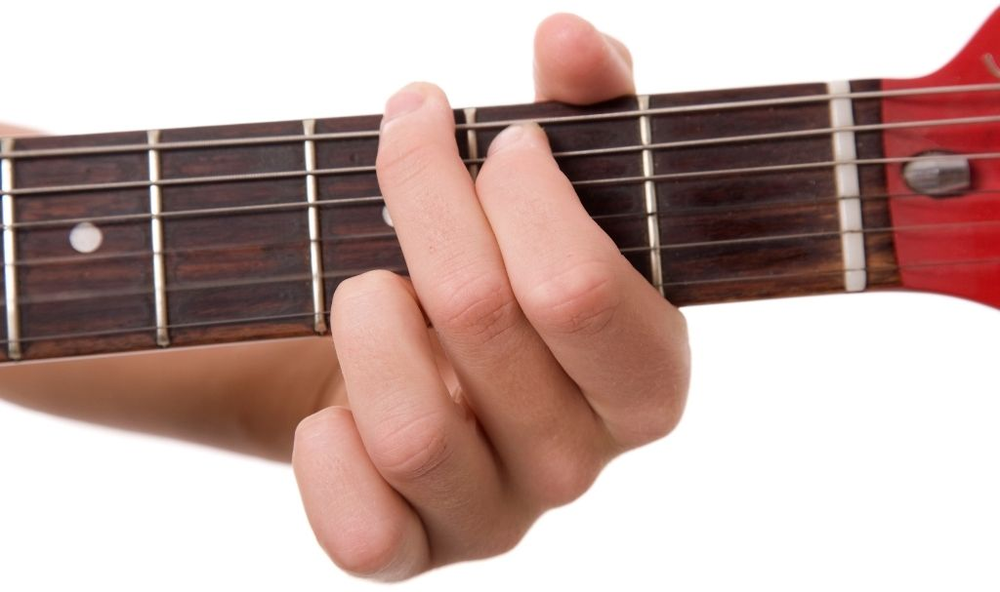
How many fingers do you use to make the G chord on the guitar?

Slide 4
In this lesson, we will learn how chords are used to build songs in rock music.

Slide 5
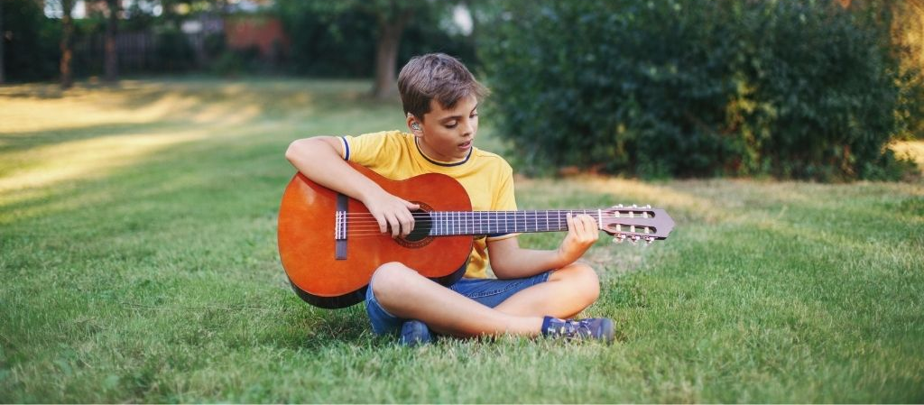
You will be able to: ​
identify chords in rock songs
change between G, Em and C while keeping a steady rhythm.
Identify: To pick out or recognise something by noticing its important features.
Change: To make something different from what it was before.

Slide 6

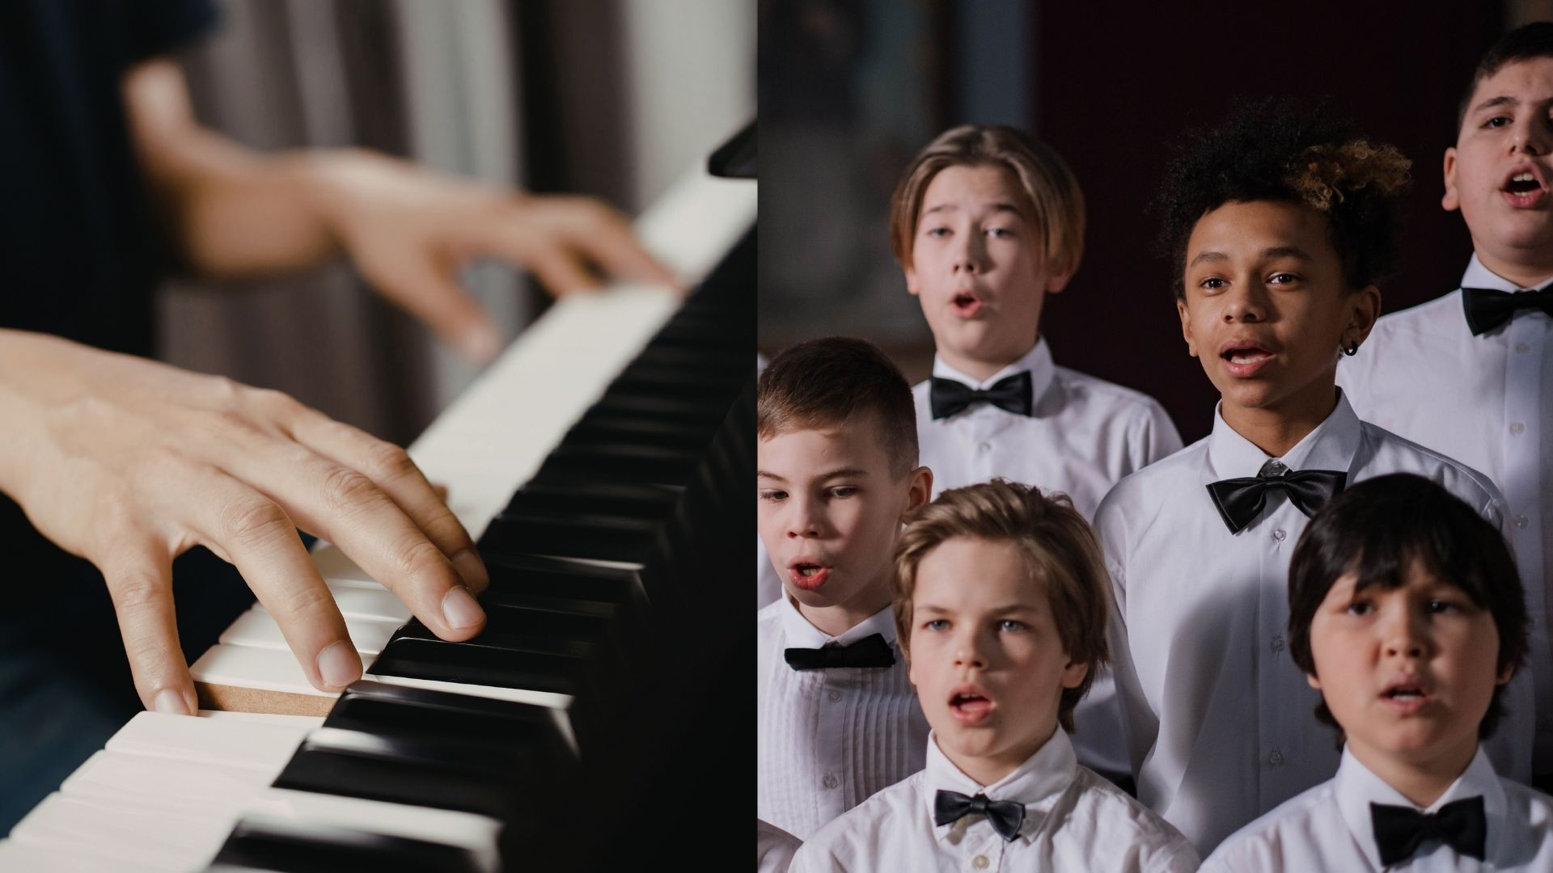

Slide 7

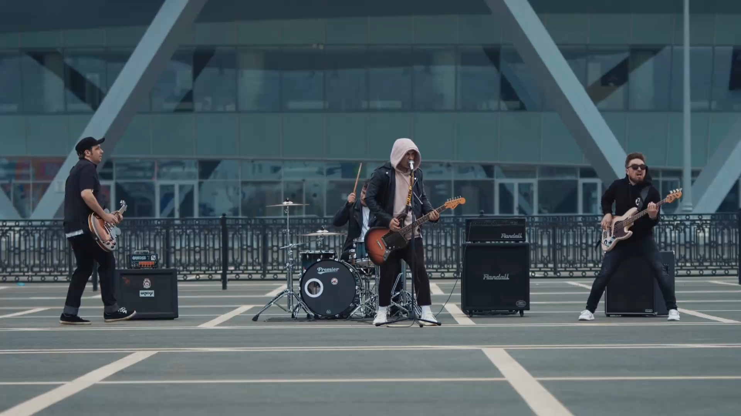
Unique Characteristics of Rock
repeating patterns
steady beat
clear song structure
full band sound

Slide 8

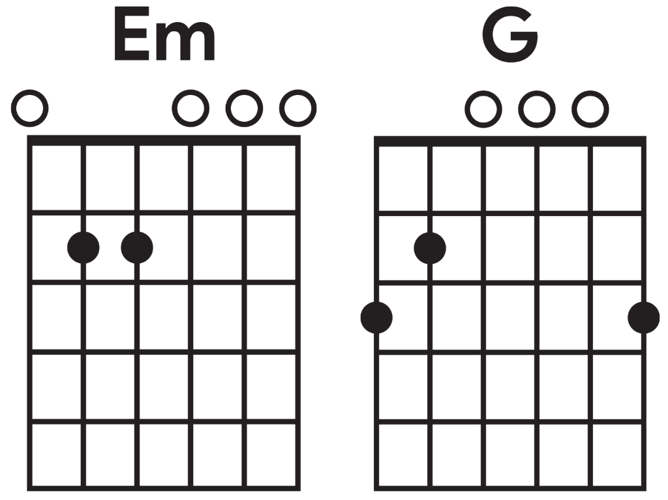
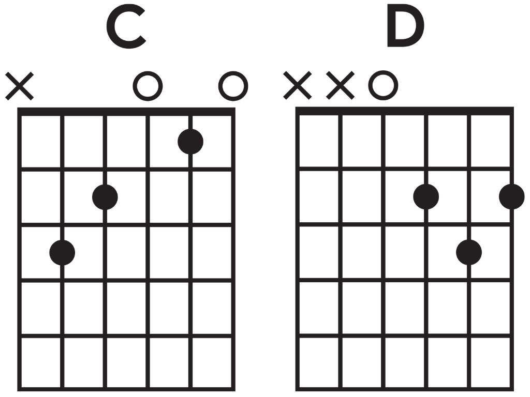
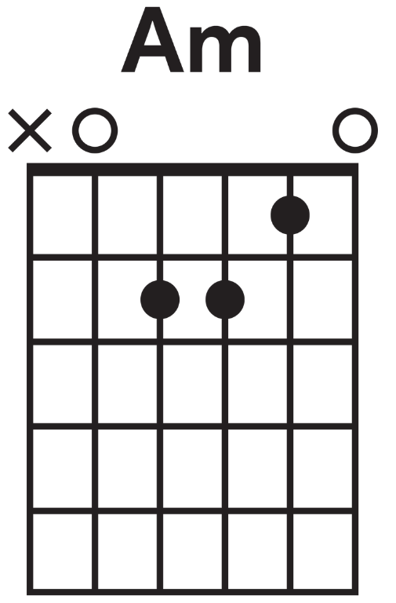
Chords

Slide 9

Chords in Repeating Patterns

Slide 10

Chords in Repeating Patterns

Slide 11

Chords in Repeating Patterns

Slide 12
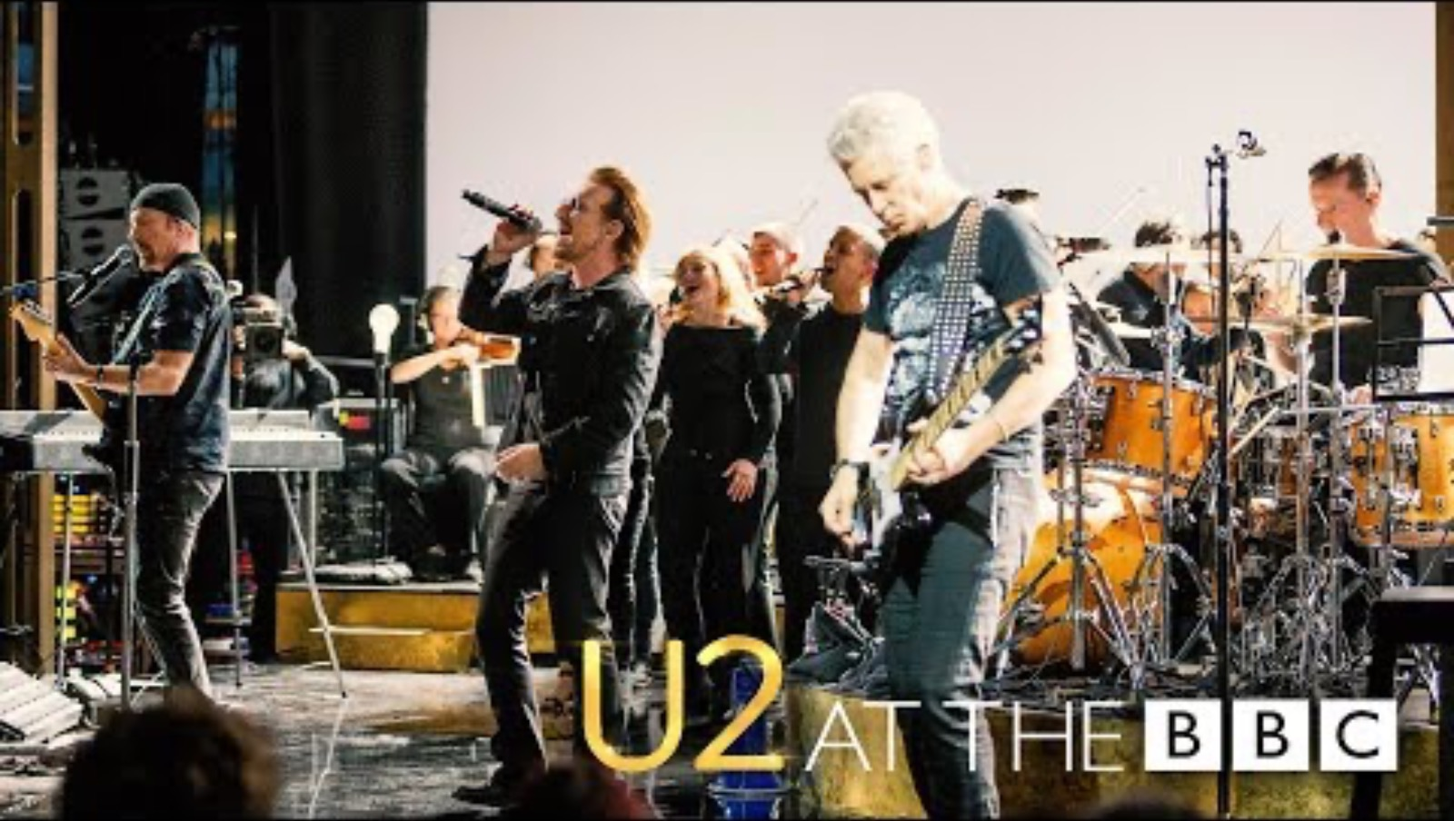
Chords in Repeating Patterns

Slide 13
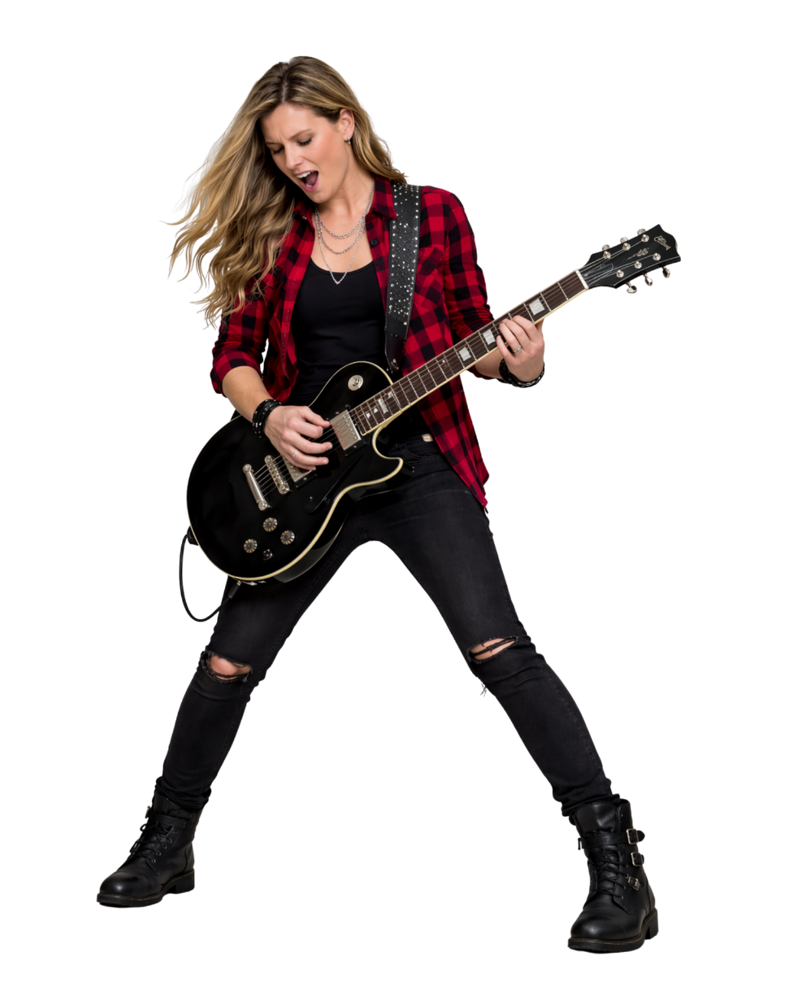
Chords
A chord is:
a group of notes played together
a pattern of beats in music
the speed of music.

Slide 14
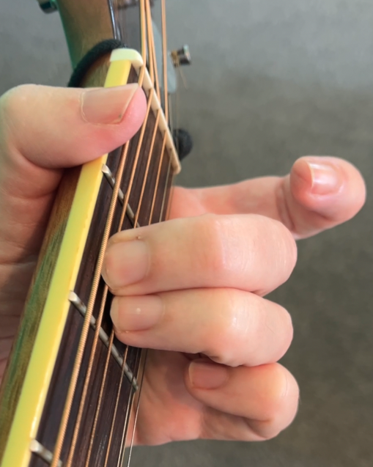
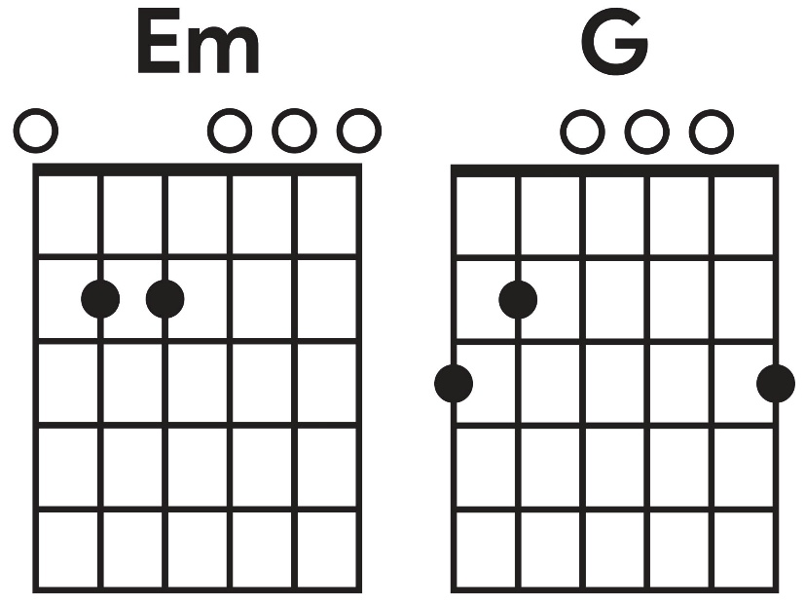
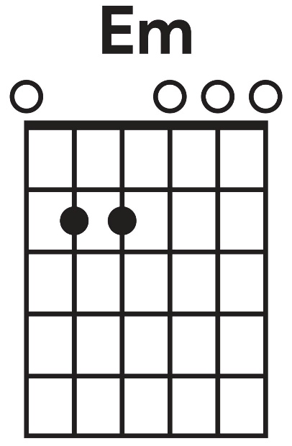
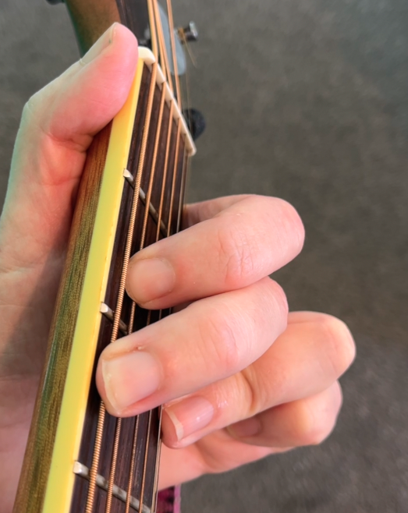
Play Em and G

Slide 15
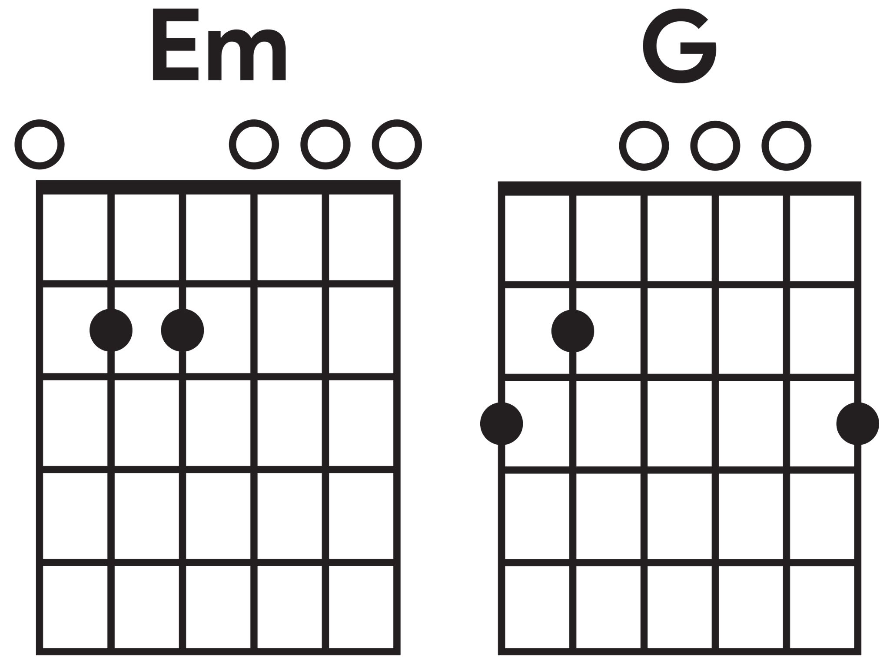
Changing Chords to the Beat

Slide 16
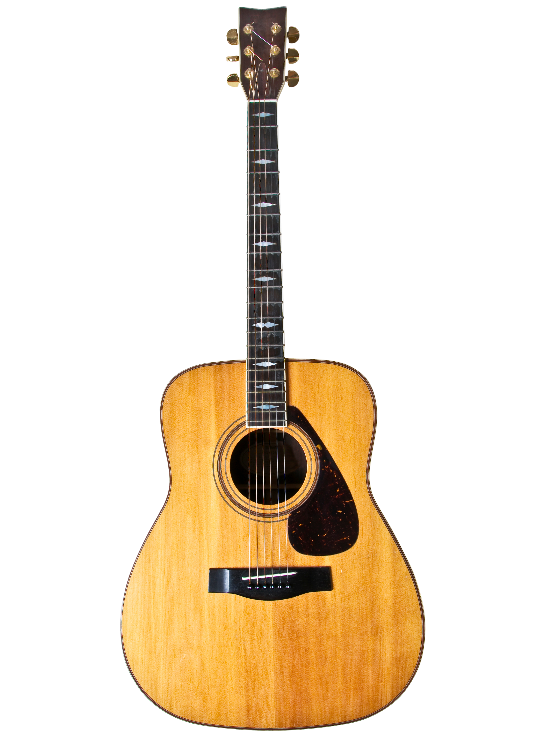
Play C

Slide 17
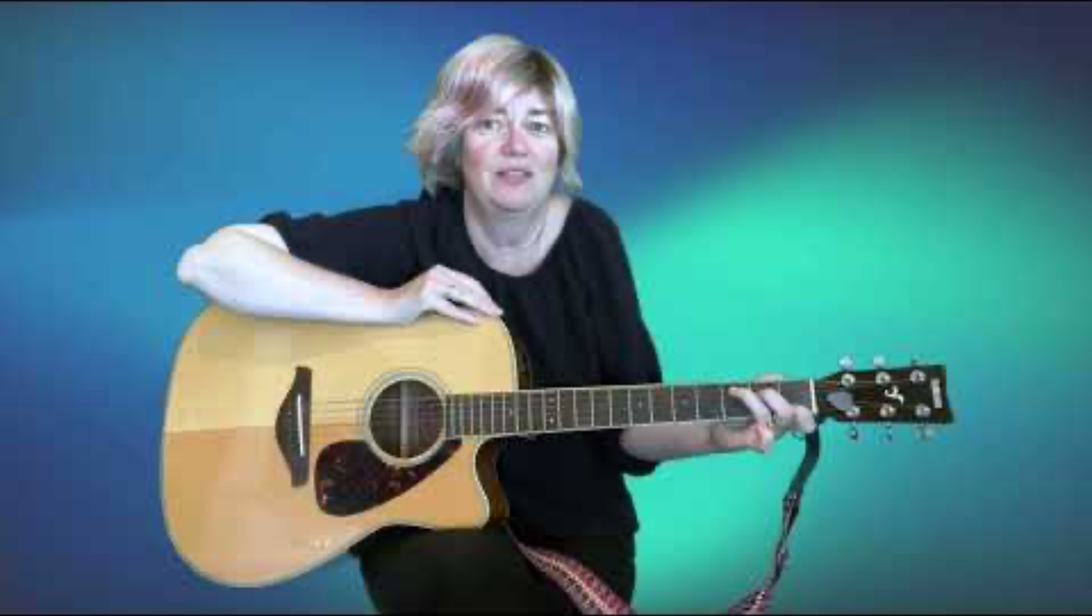
Play C

Slide 18
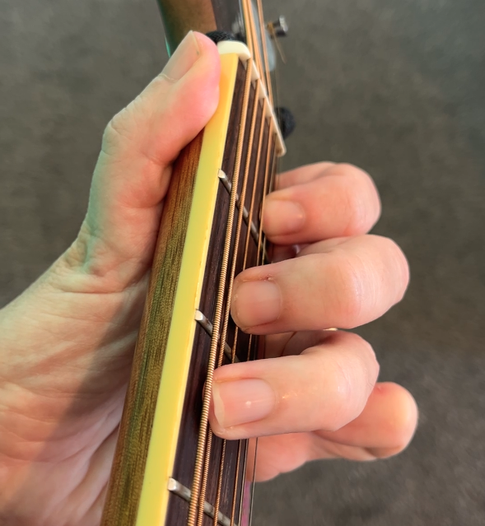
Play C

Slide 19
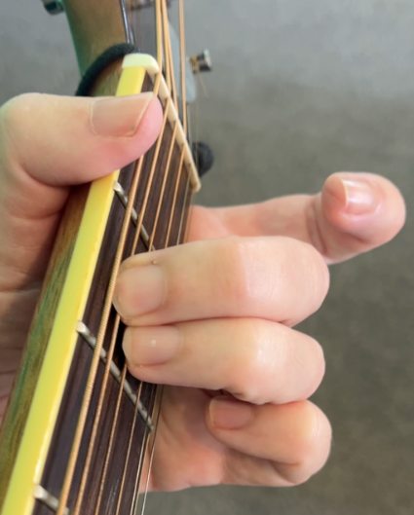
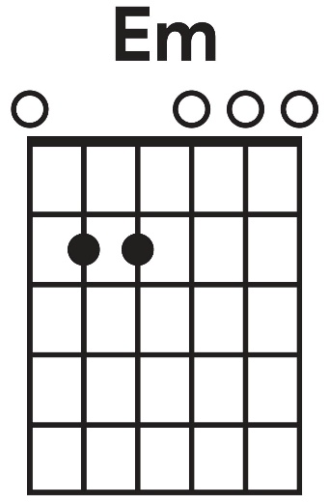
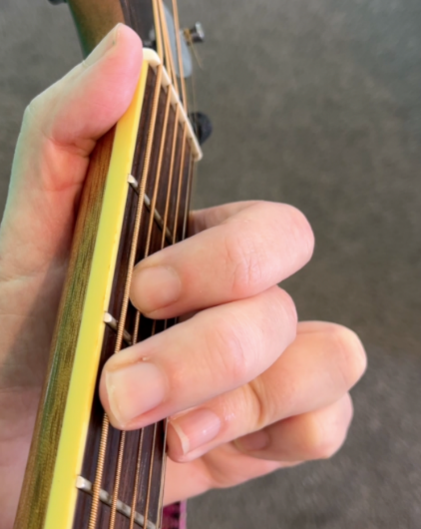
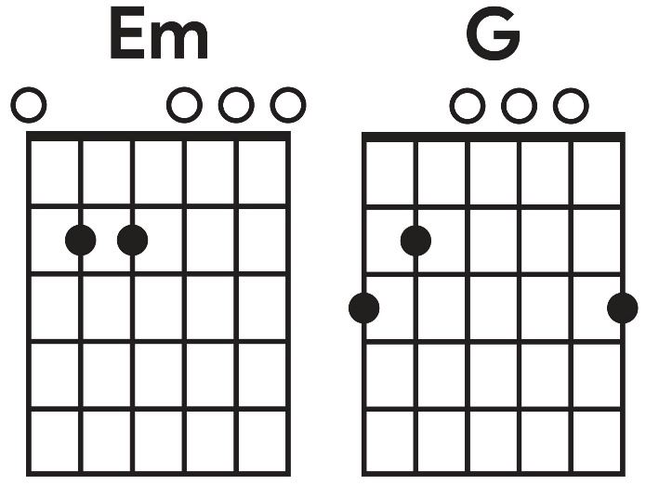
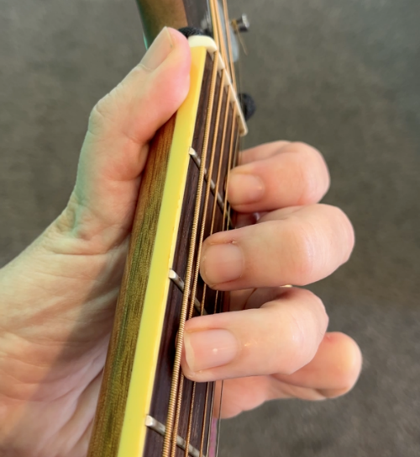
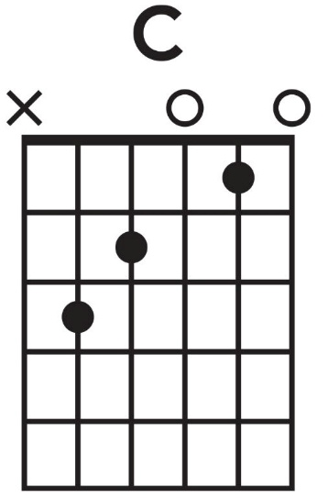
Play Em, G and C

Slide 20
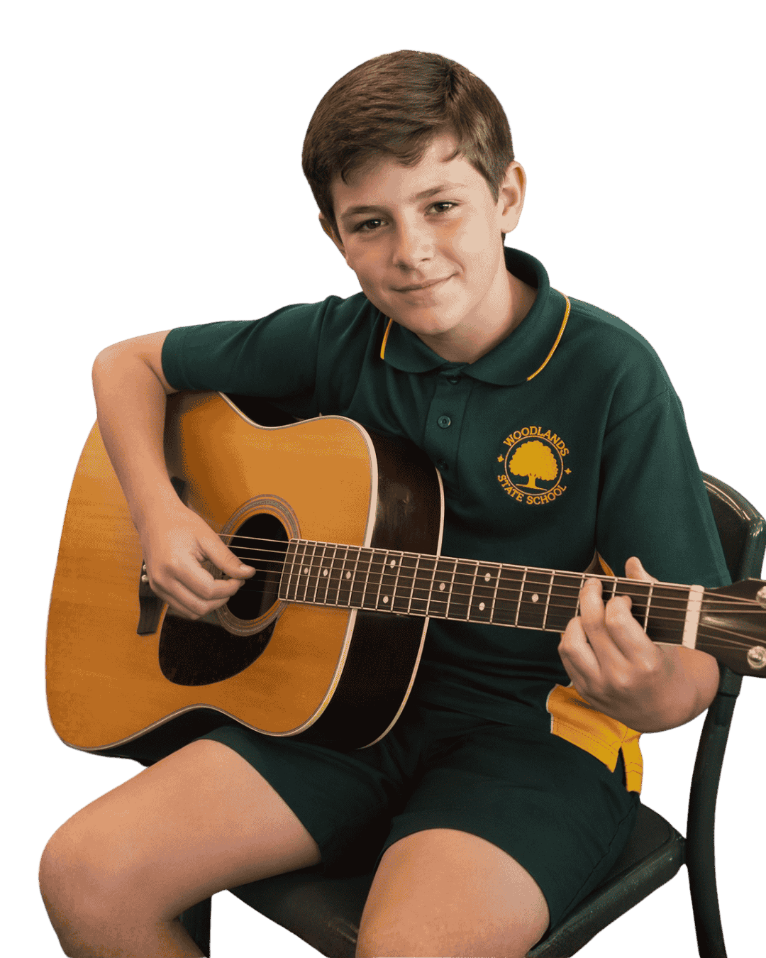
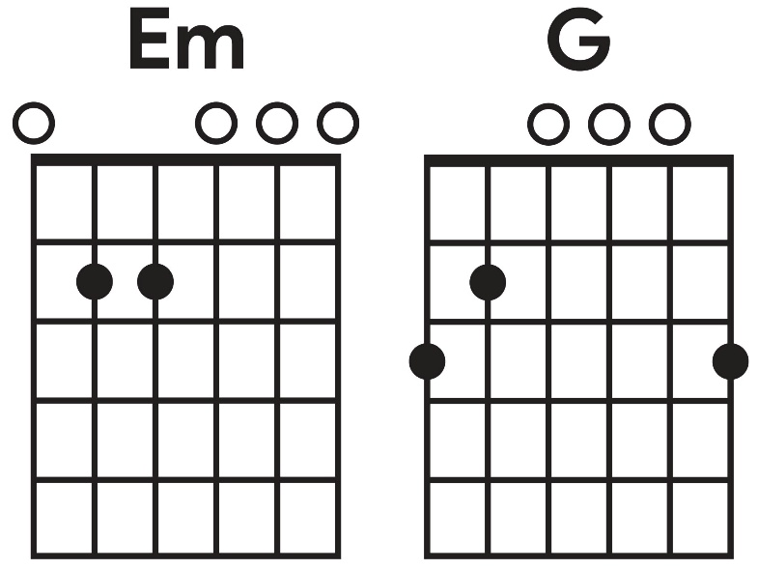
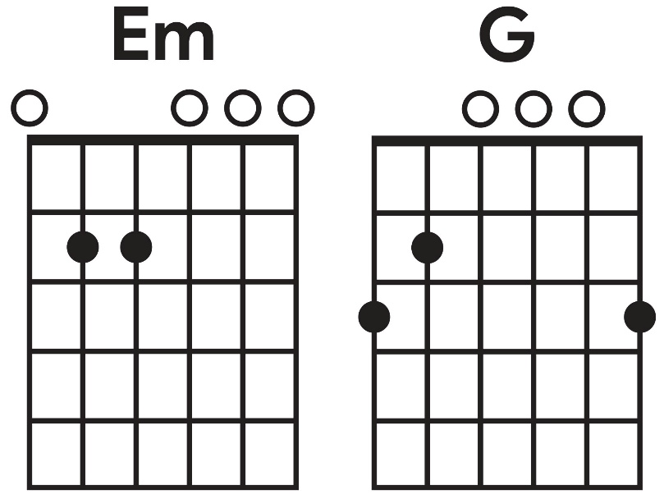
Practise Em, G and C

Slide 21

Play a Rock Song - All I Want is You

Slide 22
Play a Rock Song - All I Want is You

Slide 23
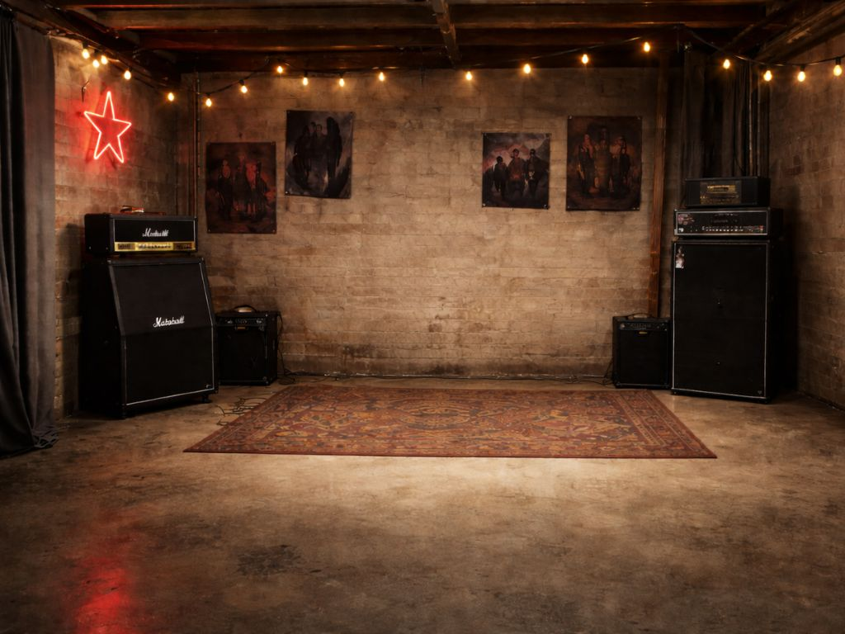

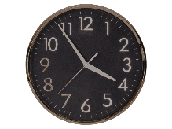
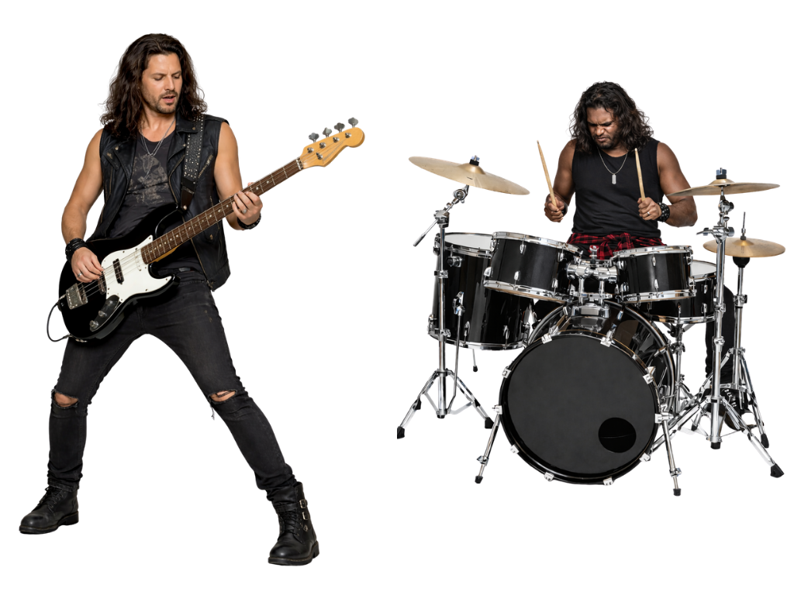

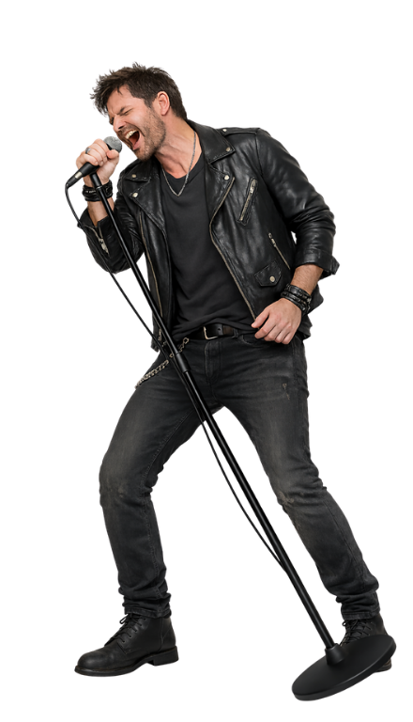
Chords are groups of notes played together. They are named using letters.

Slide 24


Rock songs use a small number of chords that repeat.

Slide 25


Exit Ticket
Date: _________
Lesson 2
notes
A chord is a group of _______ played together.
Rock songs often use:
a different chord every time
a repeating pattern of chords
one chord for the whole song
no chords at all.
On a guitar, chords are made by pressing the s_______ with your fingers.
notes
beats
words
trings
3
I know _____ out of 3 answers.

Slide 26
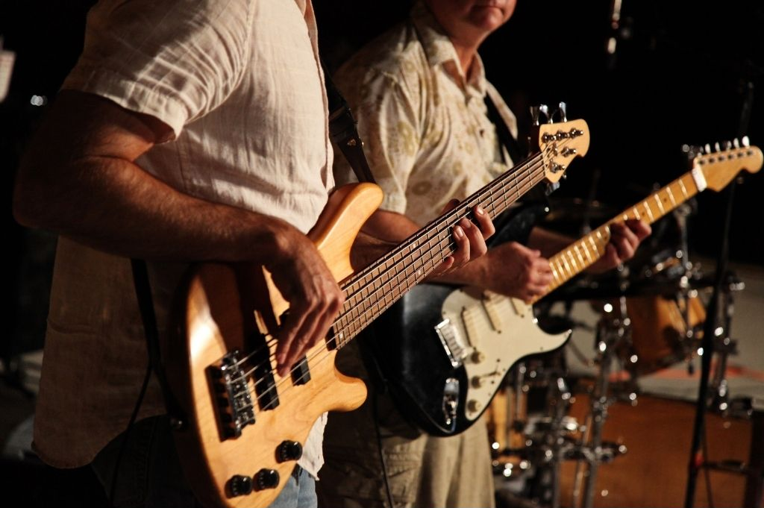
In the next lesson, we will learn how riffs and basslines are used in rock music.

