Slide 1
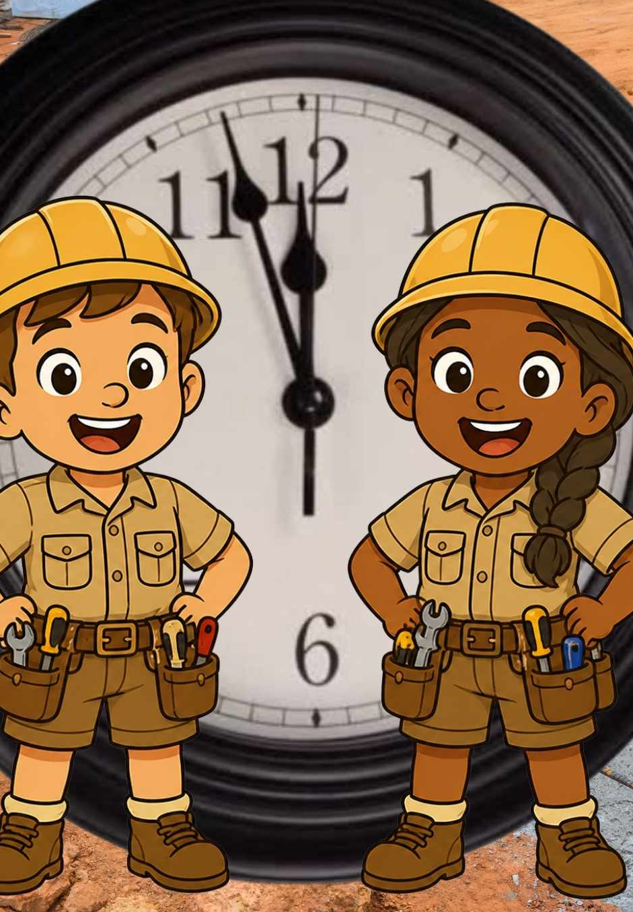
Building Music Together
Lesson 1
The Beat is the Foundation
Unit 4 Version 3

Slide 2


In this lesson, we will keep a steady beat.

Slide 3

You will be able to: ​
move to the beat.
Move means to change your body position.

Slide 4
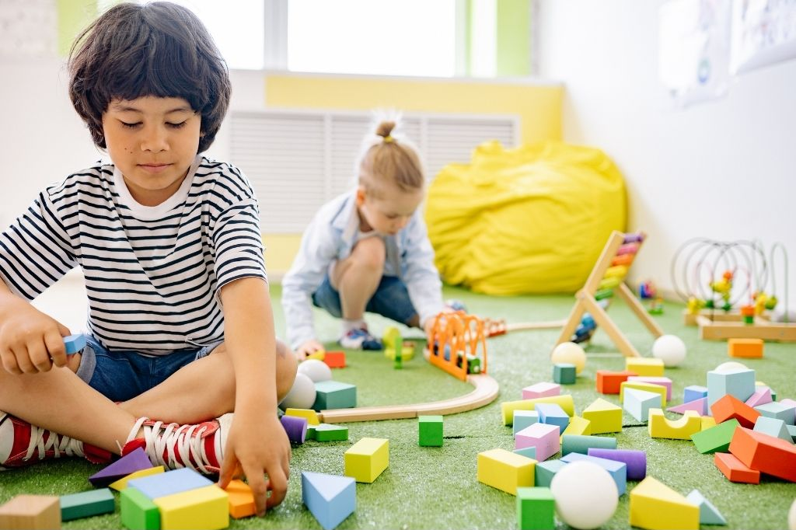
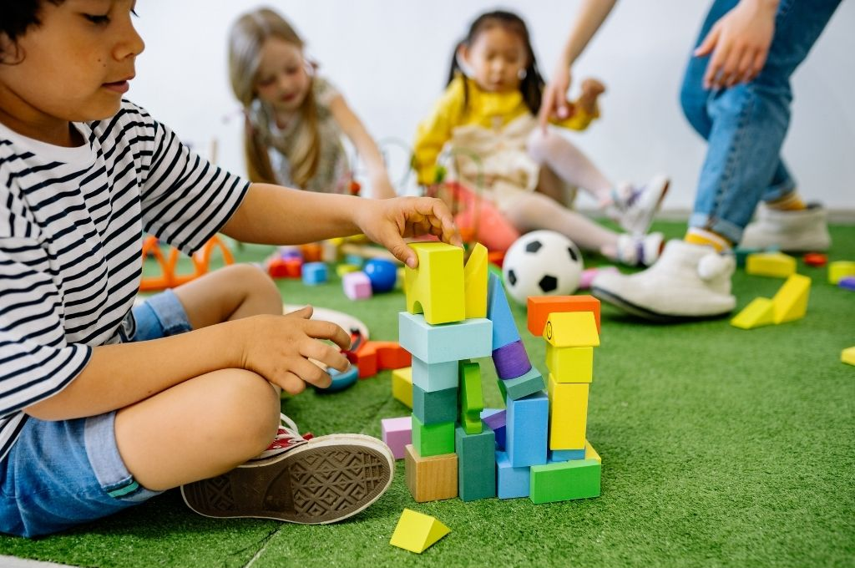

Slide 5

The Beat

Slide 6


Copy the Beat
The Beat

Slide 7


The Beat
The beat always changes speed.
Yes
No

Slide 8

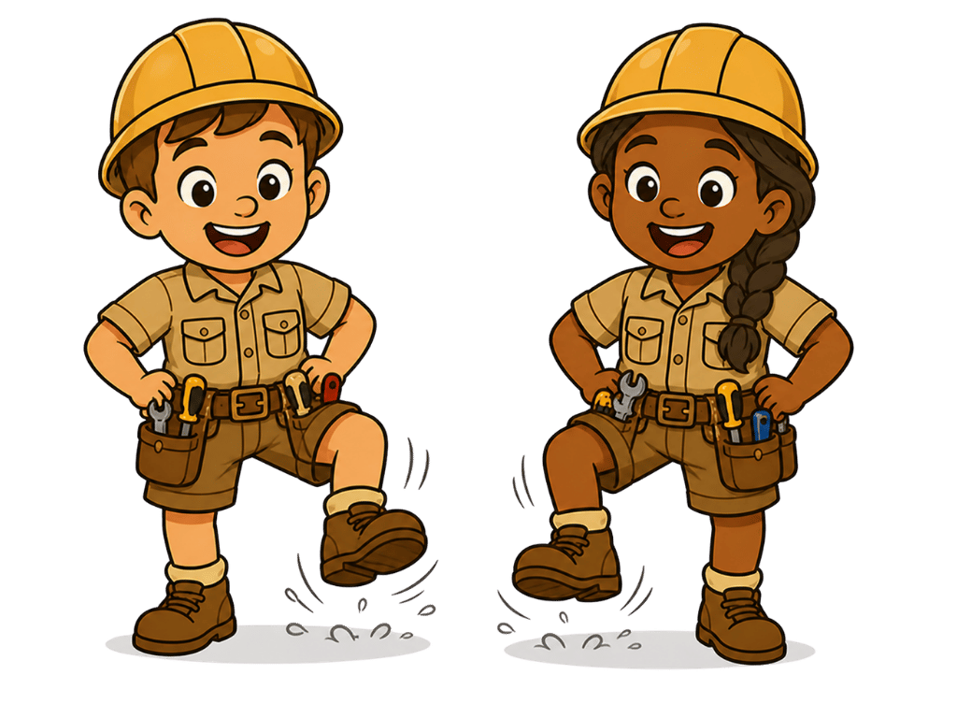
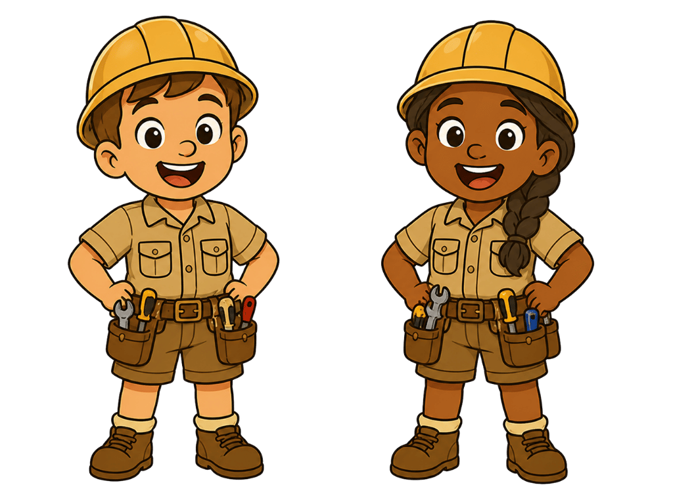
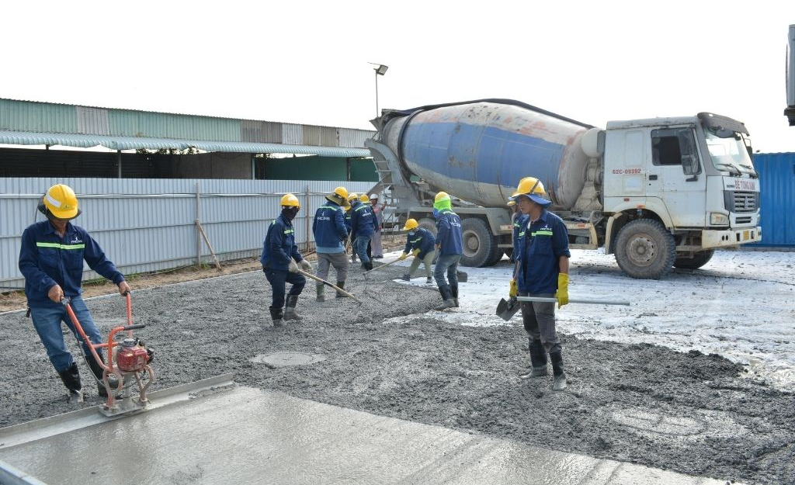
Building the Foundation

Slide 9
Building the Foundation

Slide 10
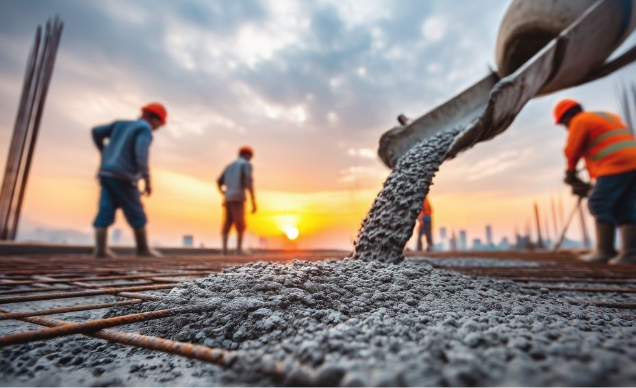
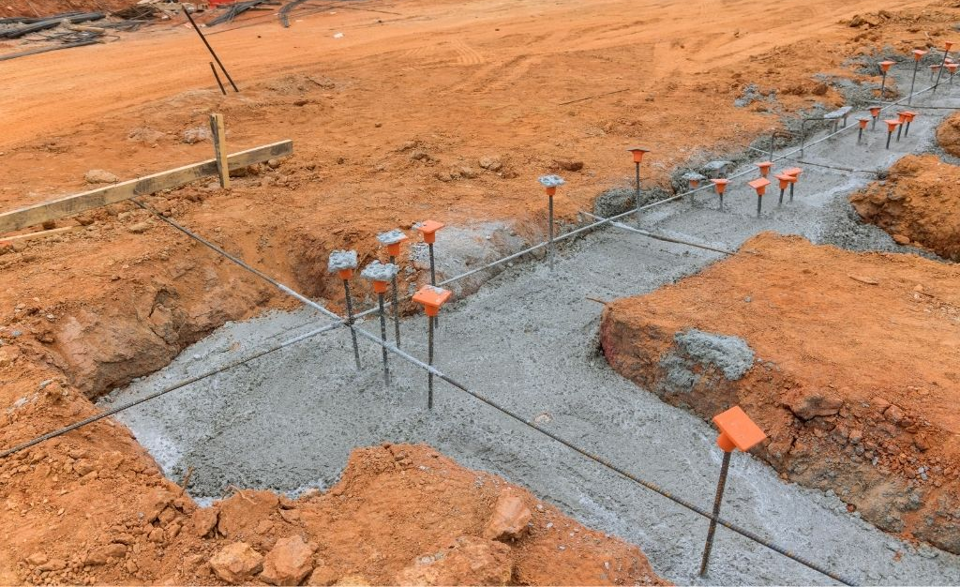
Different Music has Different Beats

Slide 11
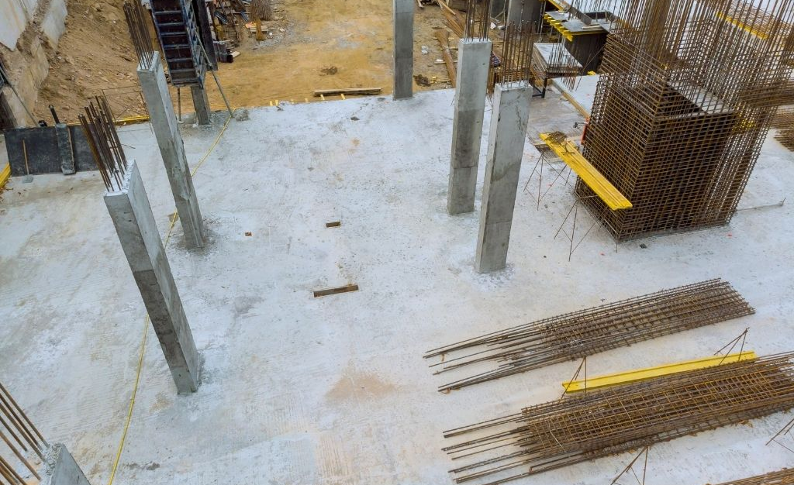
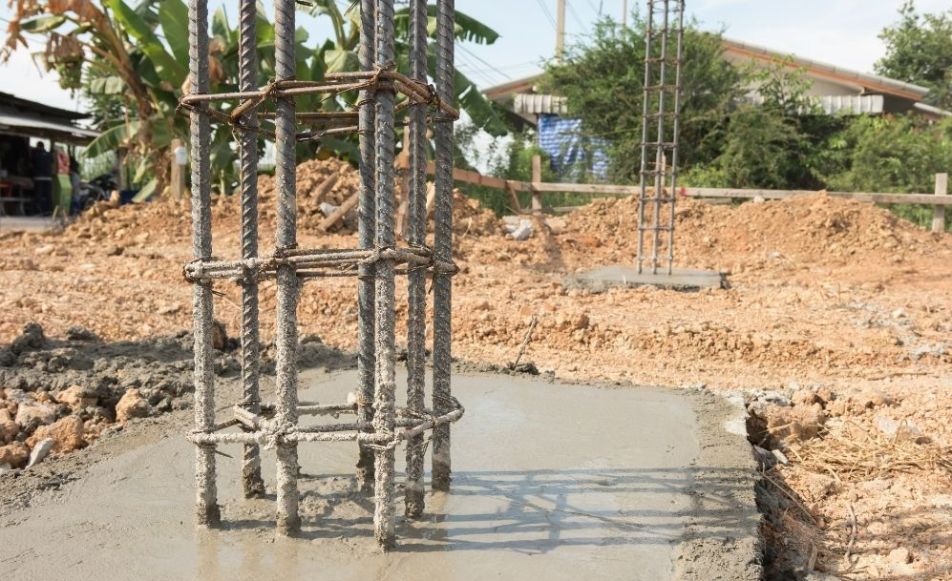
Different Music has Different Beats

Slide 12


Find the Beat

Slide 13



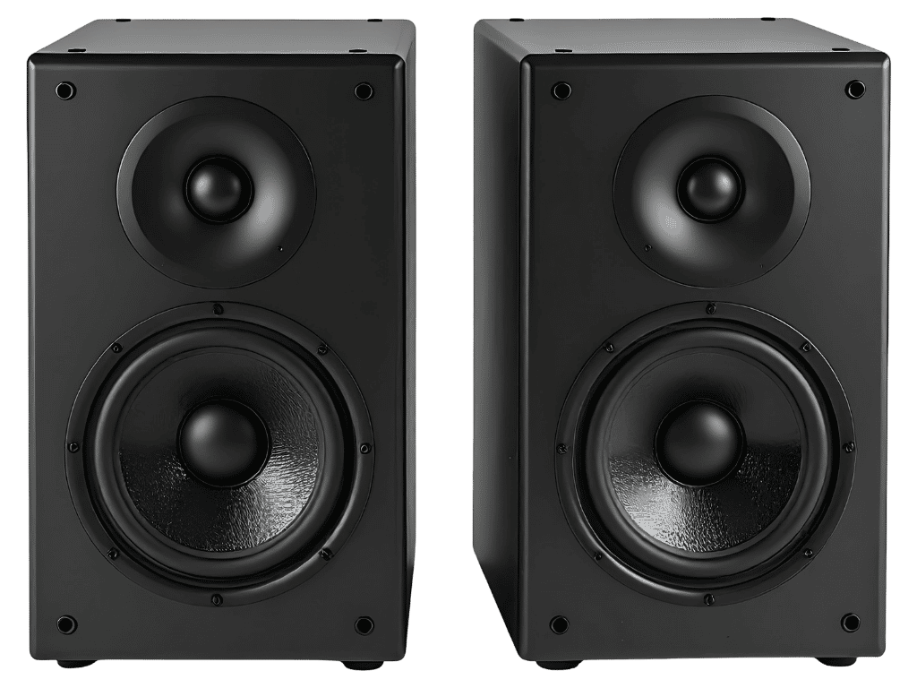
Move and Freeze

Slide 14
Move and Freeze

Slide 15

Move and Freeze

Slide 16
Move and Freeze

Slide 17
Move and Freeze

Slide 18
Music has a steady beat.
The beat stays at the same speed.

Slide 19


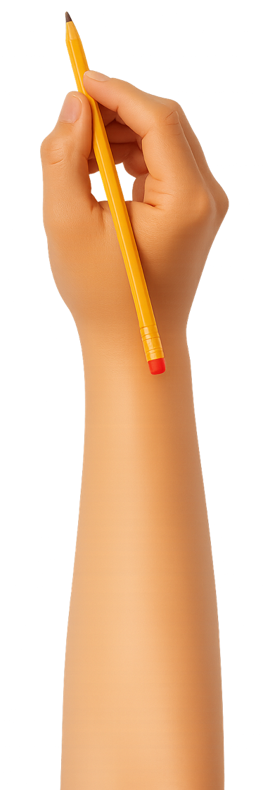


Exit Ticket
Date: _________
Lesson 1
steady
The beat in music is ________.
The beat is like the:
  builder of the house
  new house
  foundation of a building.
The beat stays the s_____ in a song.
sleepy
bumpy
steady
ame
3
I know _____ out of 3 answers.

Slide 20
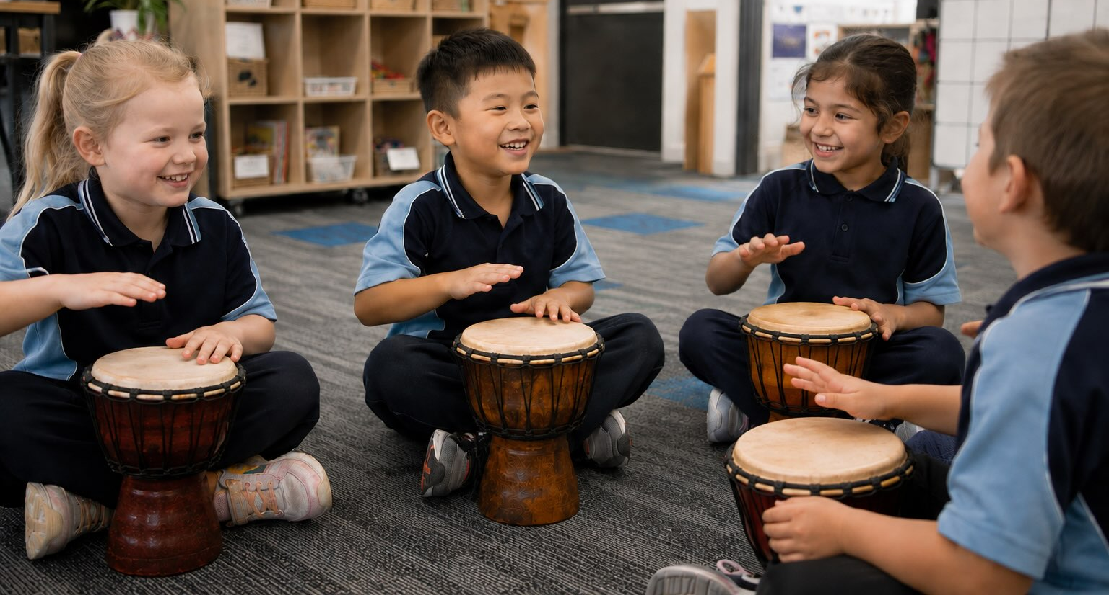
In the next lesson, we will play a steady beat on instruments.

