Slide 1
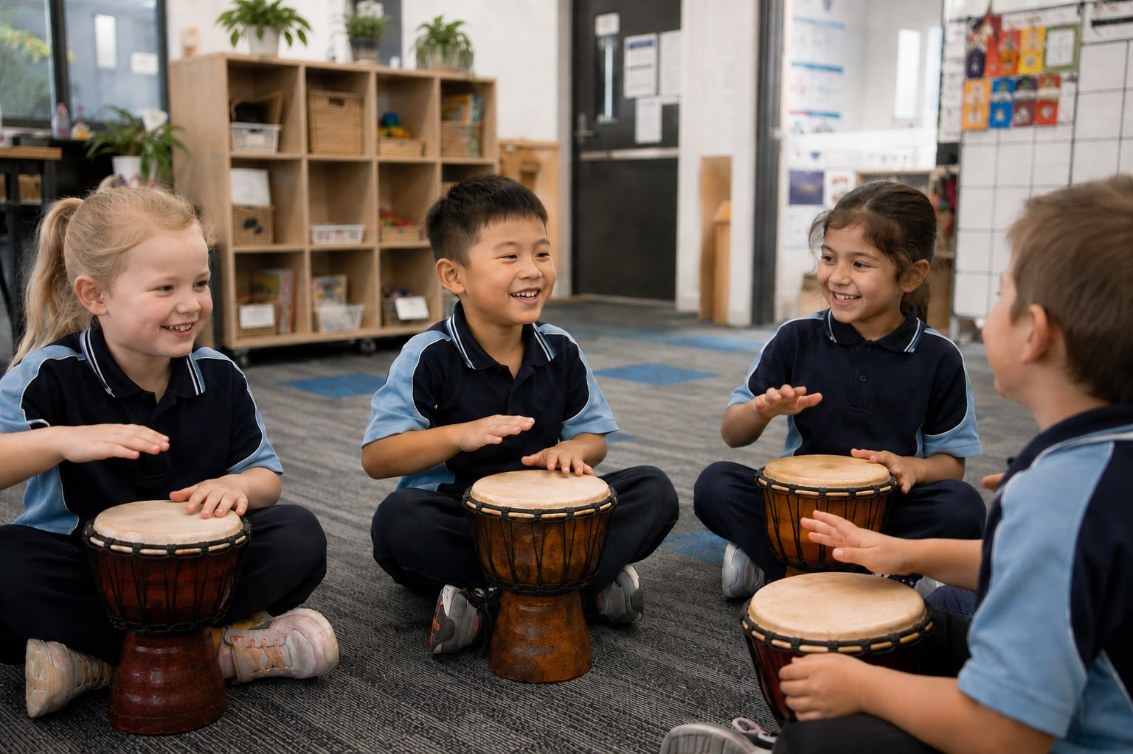
Building Music Together
Lesson 2
Keeping the Beat Strong
Unit 4 Version 3

Slide 2




What We Learnt
Exit Ticket
Lesson 1
steady
The beat in music is _______.
The beat is like the:
  builder of the house
  new house
  foundation of a building.
The beat stays the s_____ in a song.
sleepy
bumpy
steady
ame

Slide 3



Slide 4
In this lesson, we will play a steady beat on instruments.

Slide 5
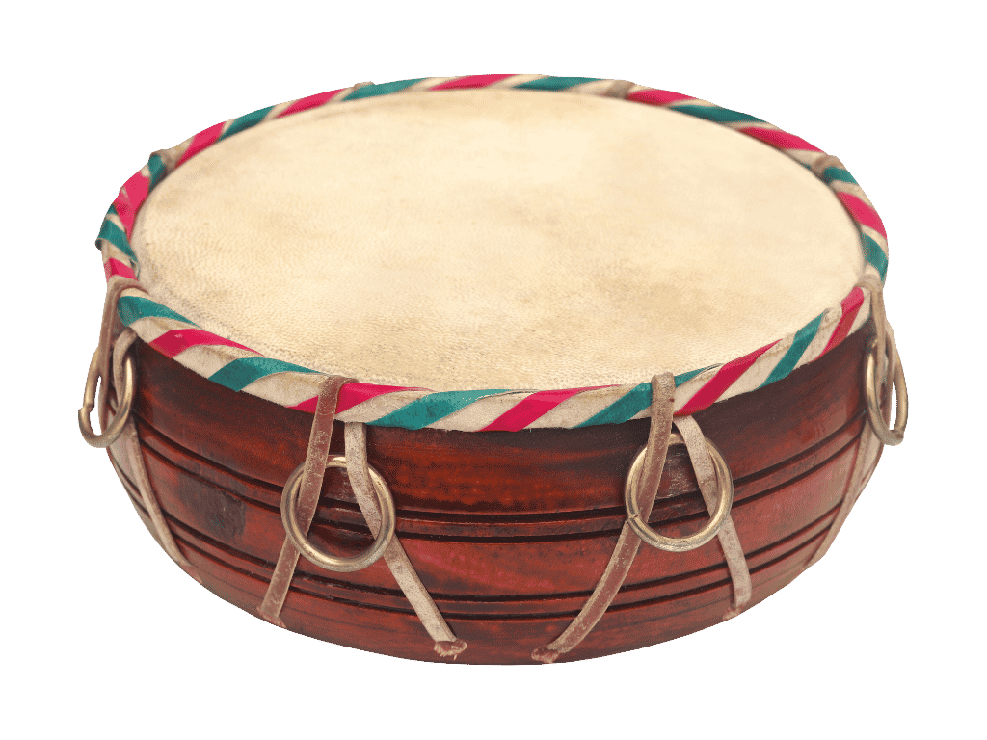
You will be able to: ​
play a steady beat on instruments.
Play means to make a musical sound on your instrument.

Slide 6
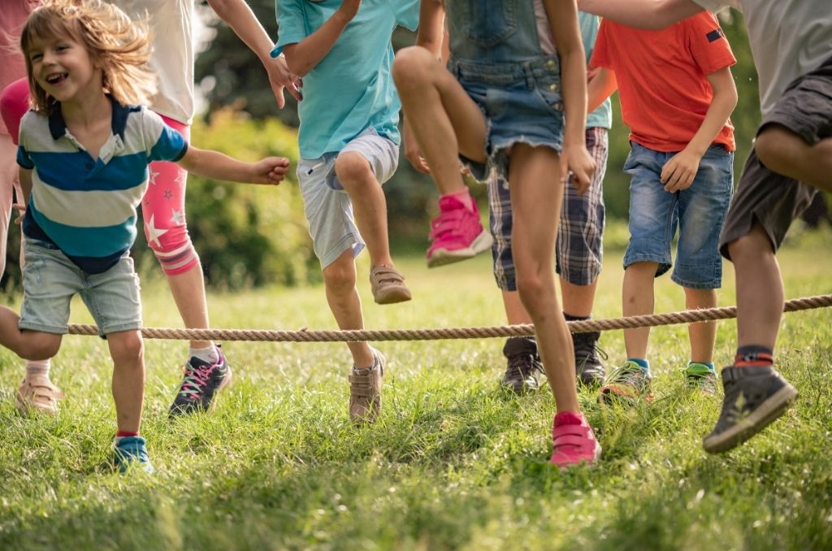


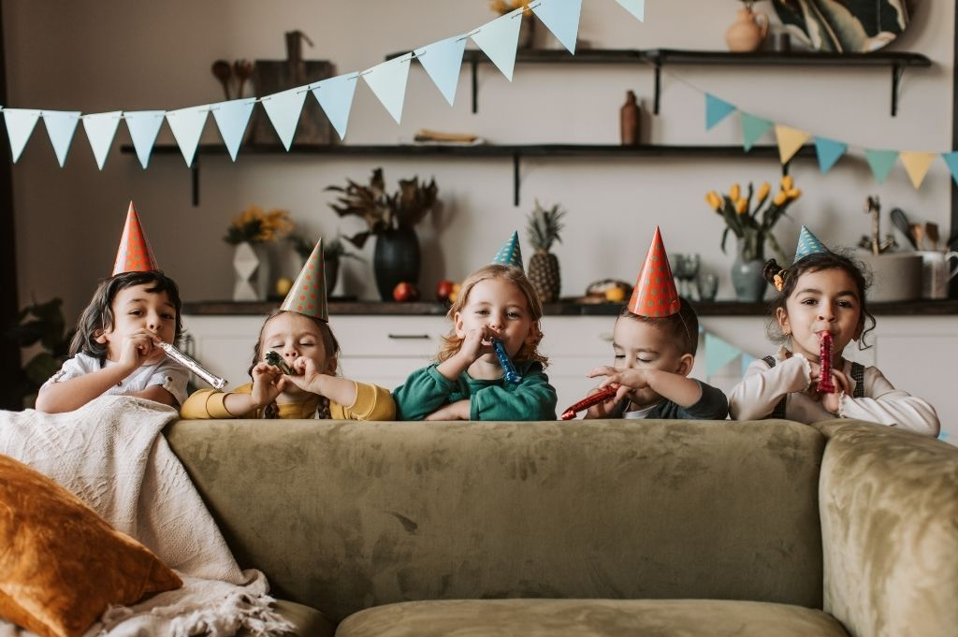

Slide 7

Many Tools Make Many Sounds

Slide 8
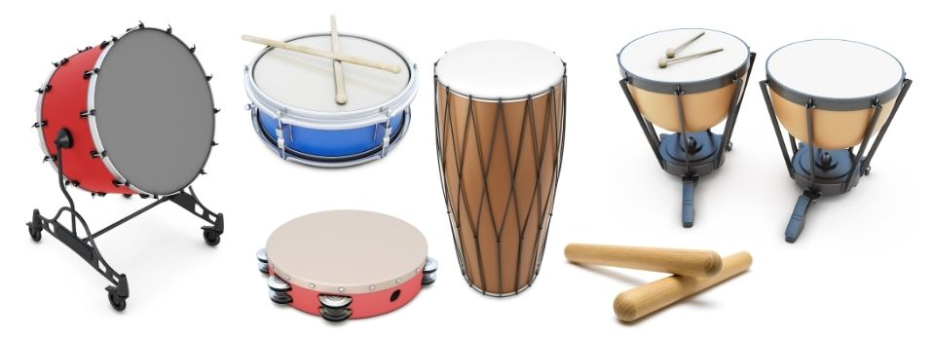
Many Instruments Make Many Sounds

Slide 9

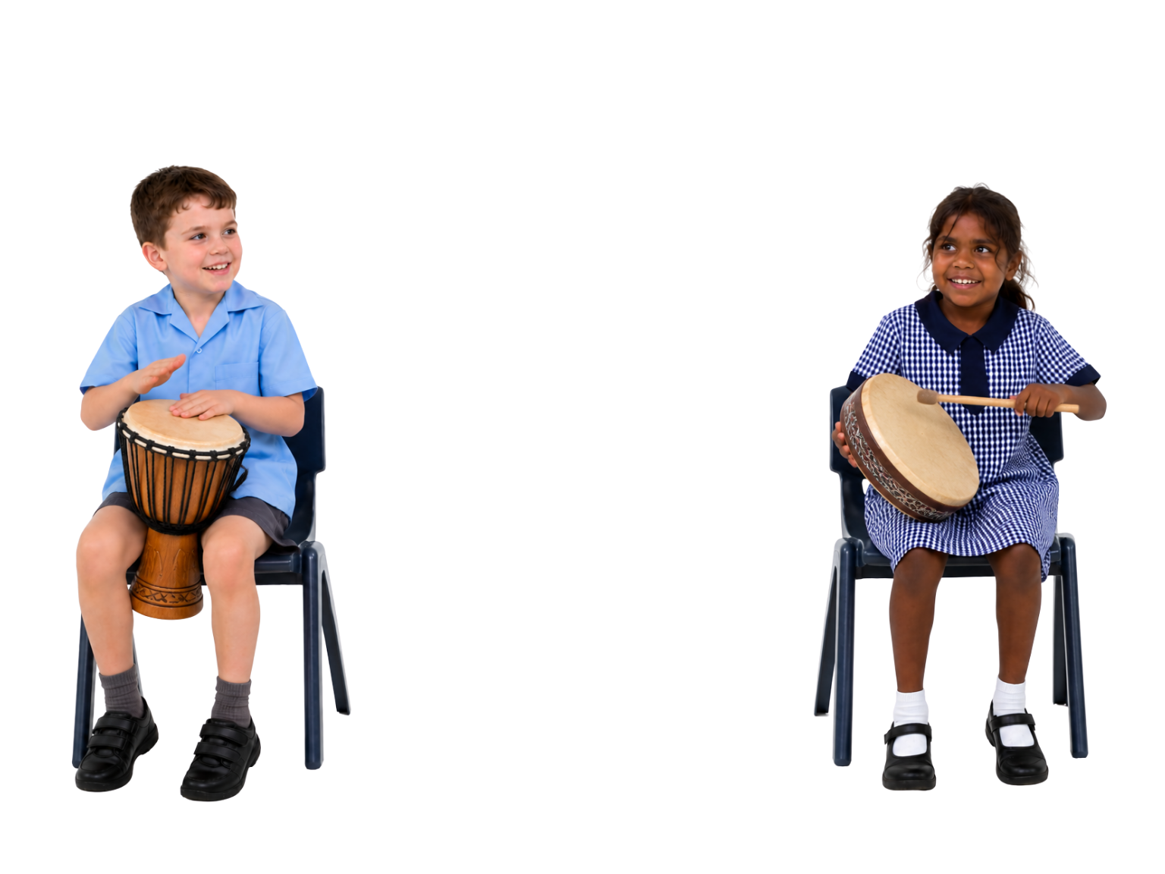

Copy the Beat
The Beat

Slide 10


Drums Playing the Beat
Different drums must play different beats.
Yes
No

Slide 11

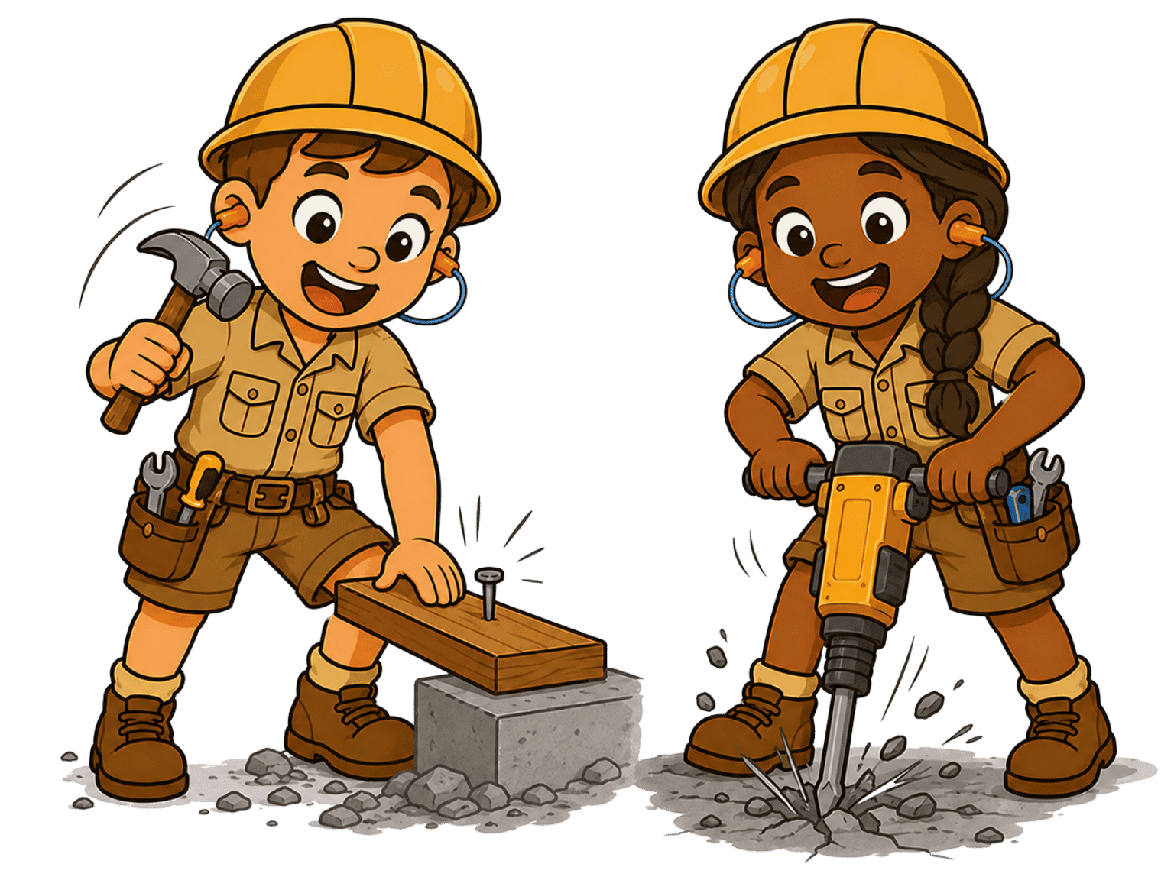
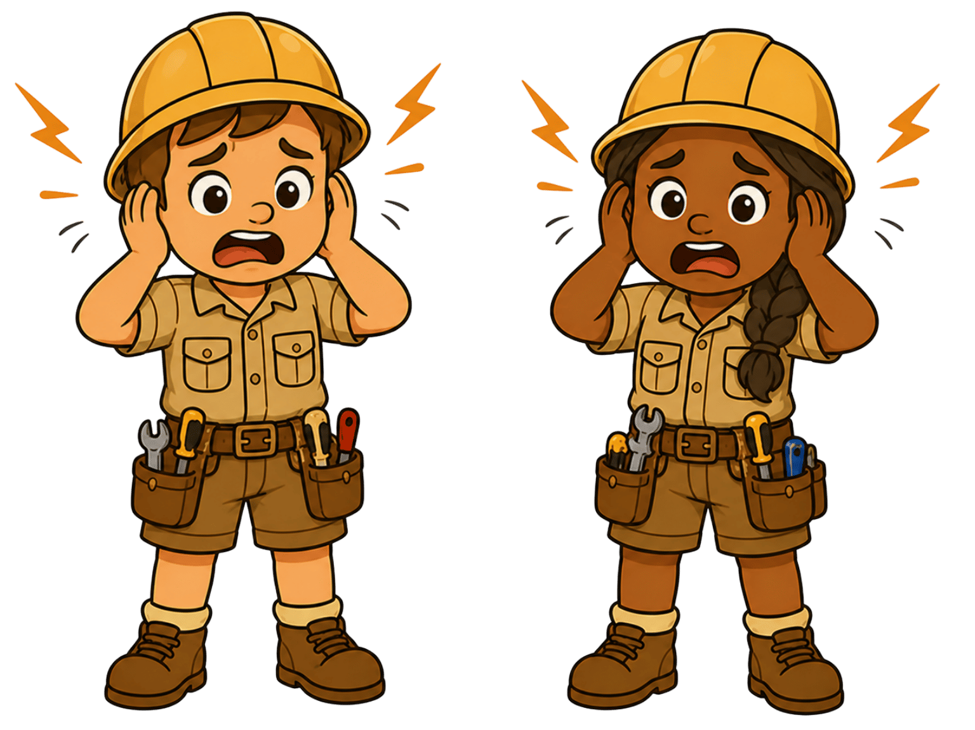
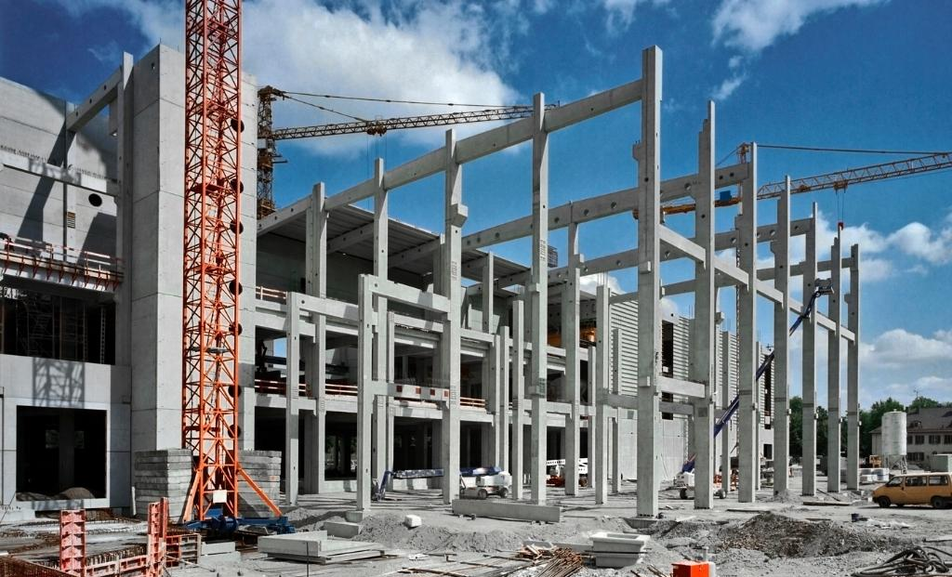
Building the Foundation

Slide 12
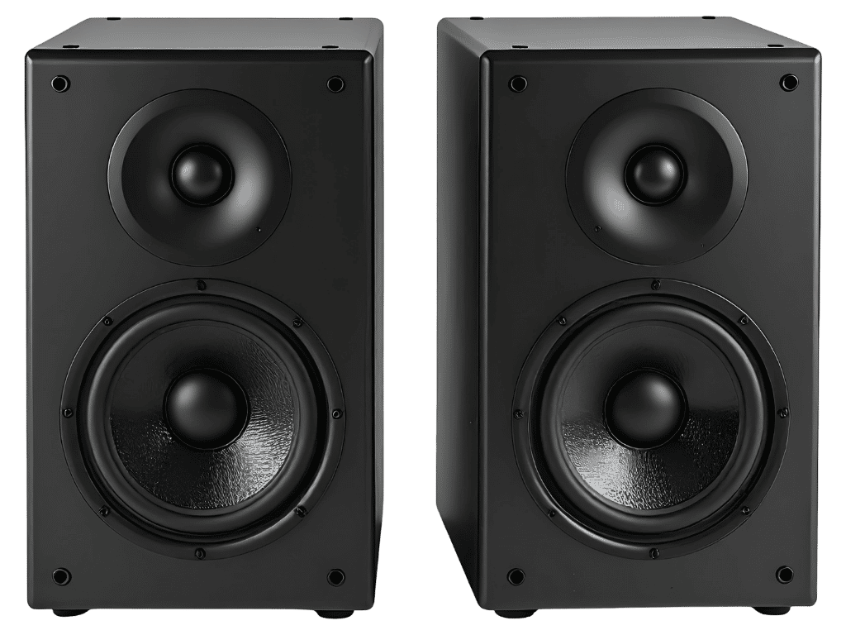
Playing the Beat Together

Slide 13
Playing the Beat Together

Slide 14
Playing the Beat Together

Slide 15
Playing the Beat Together

Slide 16


Move and Build Game

Slide 17
Counting the Beat

Slide 18
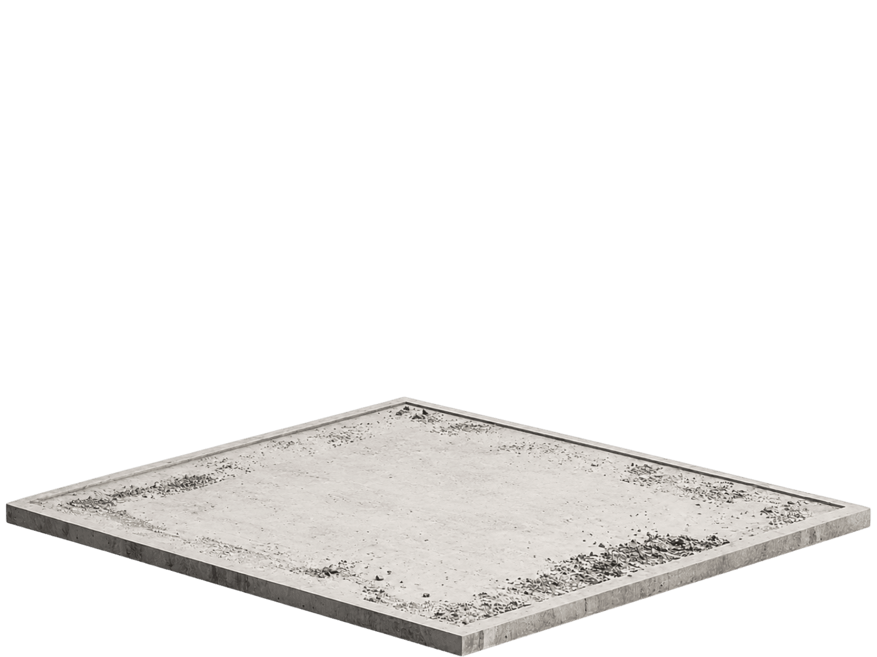
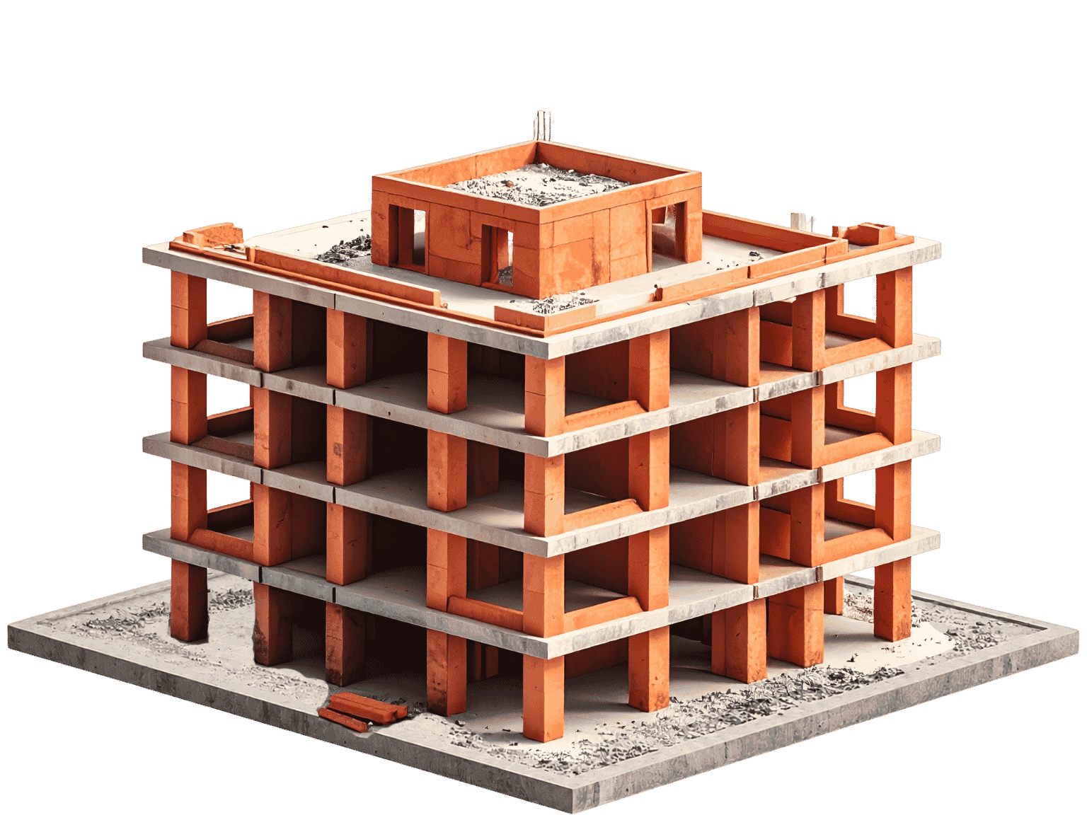

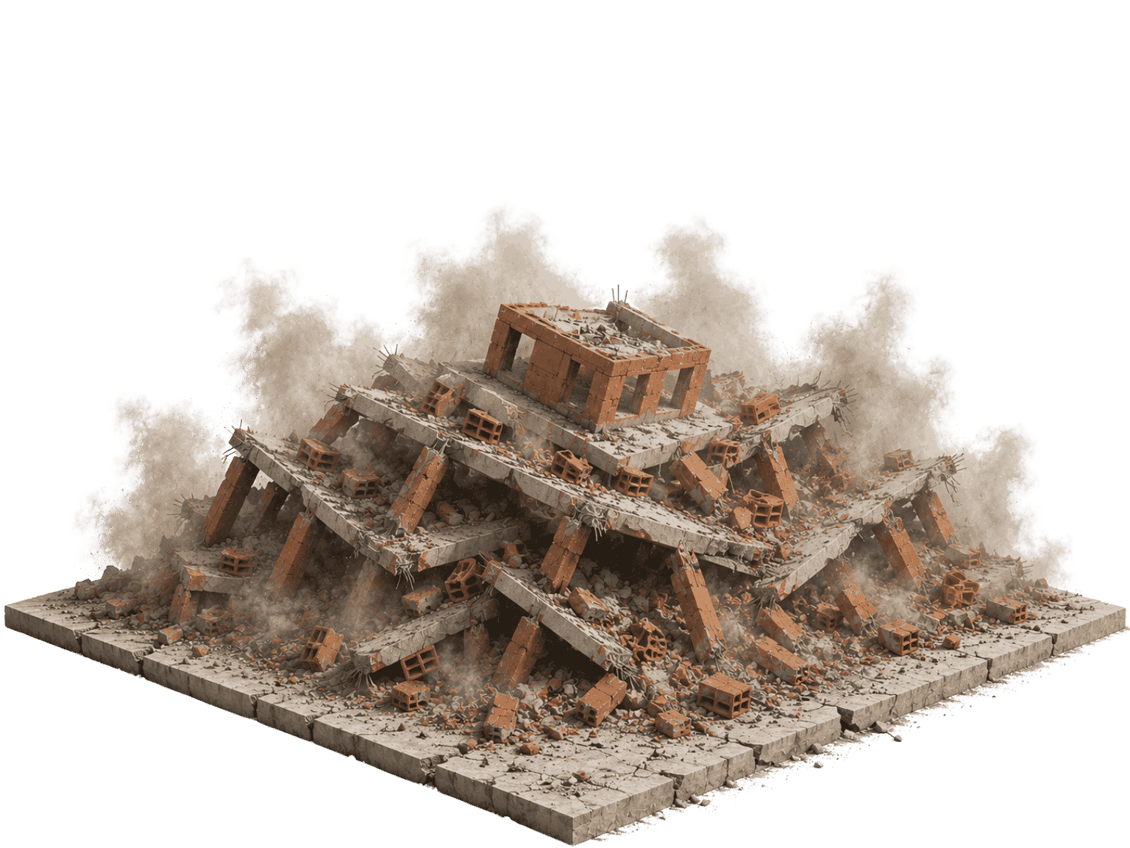
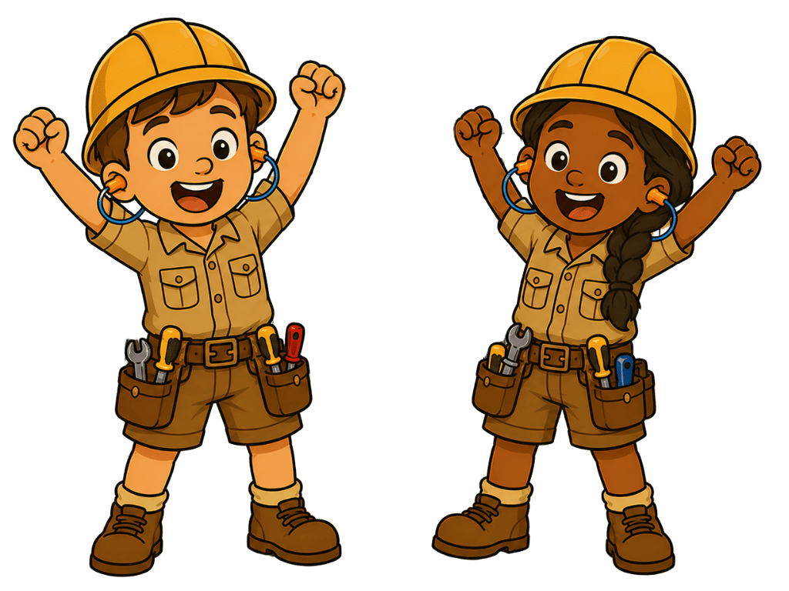
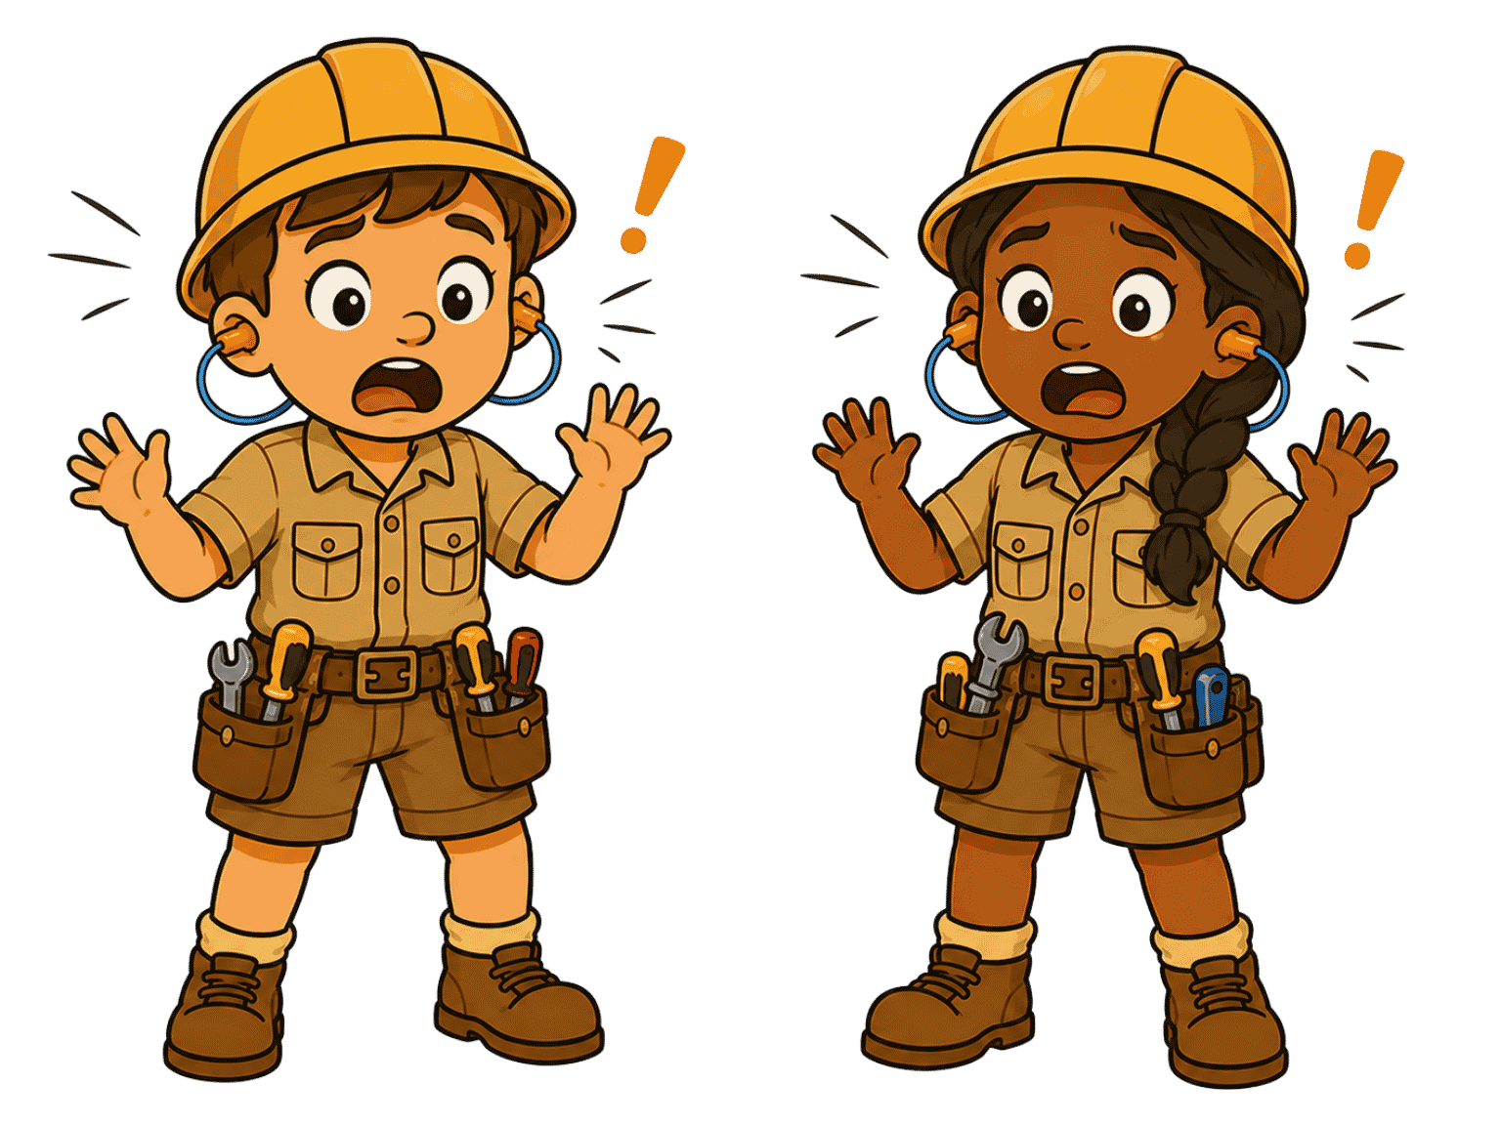
Construction Game

Slide 19
Construction Game

Slide 20
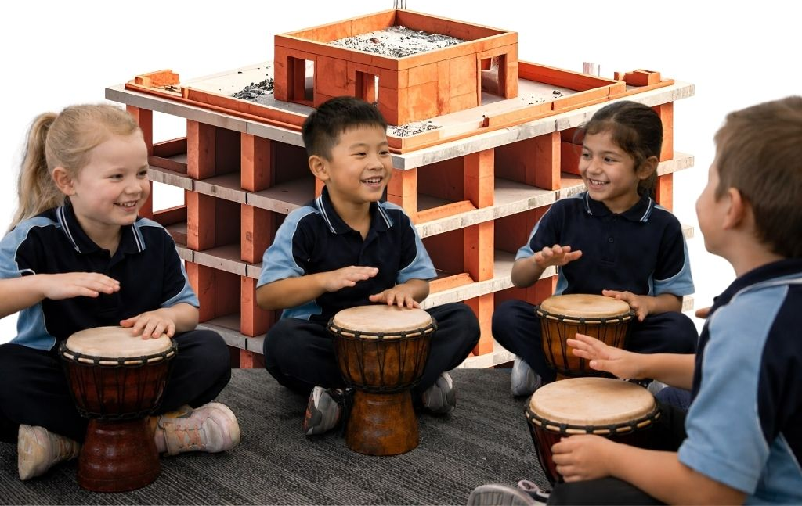
Construction Game

Slide 21
Drums can keep a steady beat.
Different instruments can make different sounds.
Musicians play
together to keep
the beat strong.

Slide 22


Exit Ticket
Date: _________
Lesson 2
Different drums make different _______.
Good musicians play:
  together
  many games
  at their friends’ houses.
Drums can play a steady b____.
sounds
colours
sounds
animals
eat
3
I know _____ out of 3 answers.

Slide 23
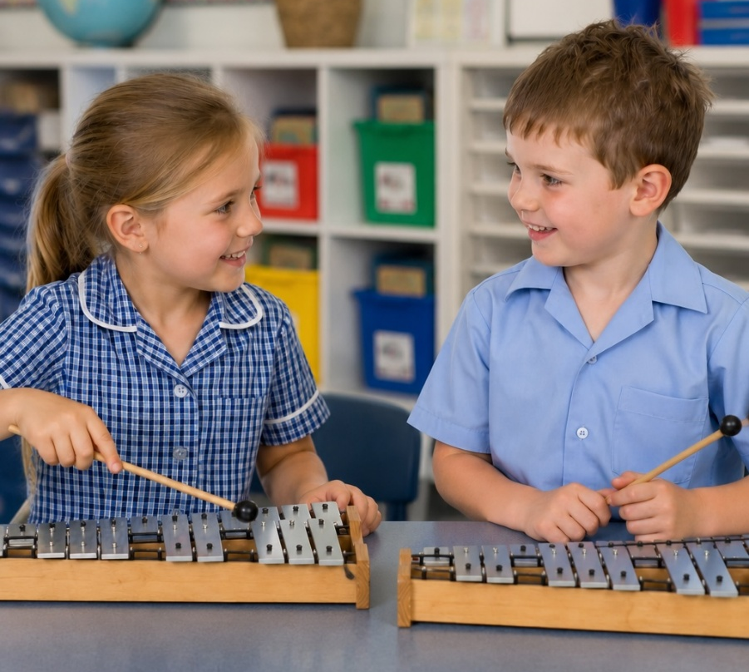
In the next lesson, we will play long and short sounds over a beat.

