Slide 1

Science
Chemistry
Lesson 1 Part A
Objects and Materials
Version 2

Slide 2


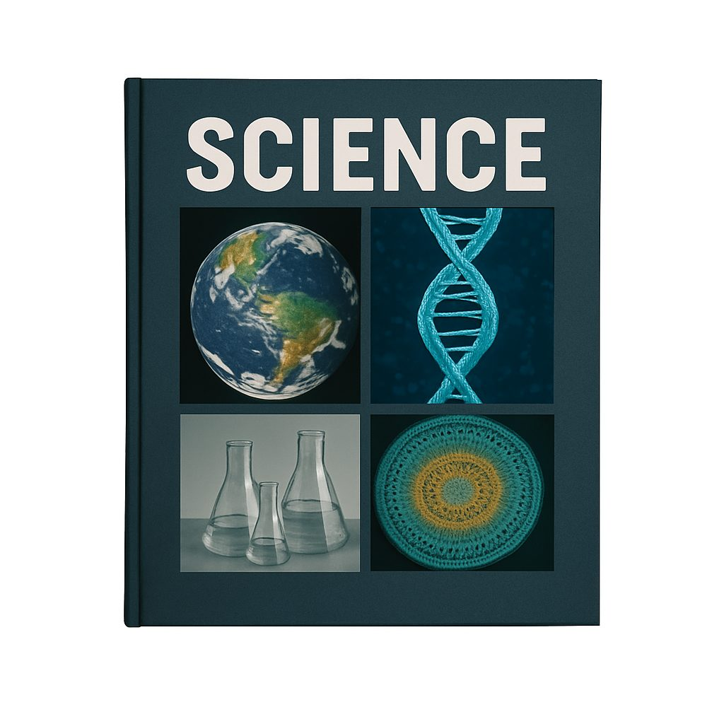











Remember what we’ve learnt
Organise ideas
Helps put information IN
Show thinking
Purpose
Visualise thoughts
Helps take information OUT
Concept maps help us organise information and show how different concepts fit together.
You can see:
Last levels: details or subconcepts
Read information
Radiate outwards
Pictures
Centre circle: key idea
Words
Next level: main concepts

Slide 3
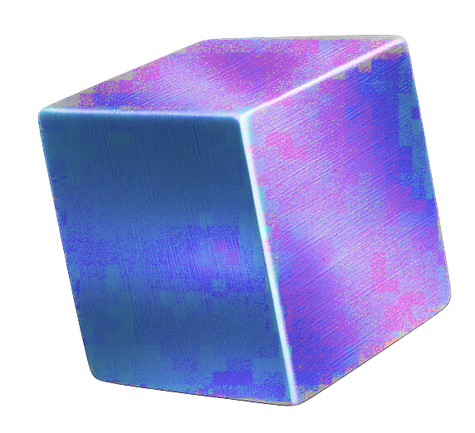
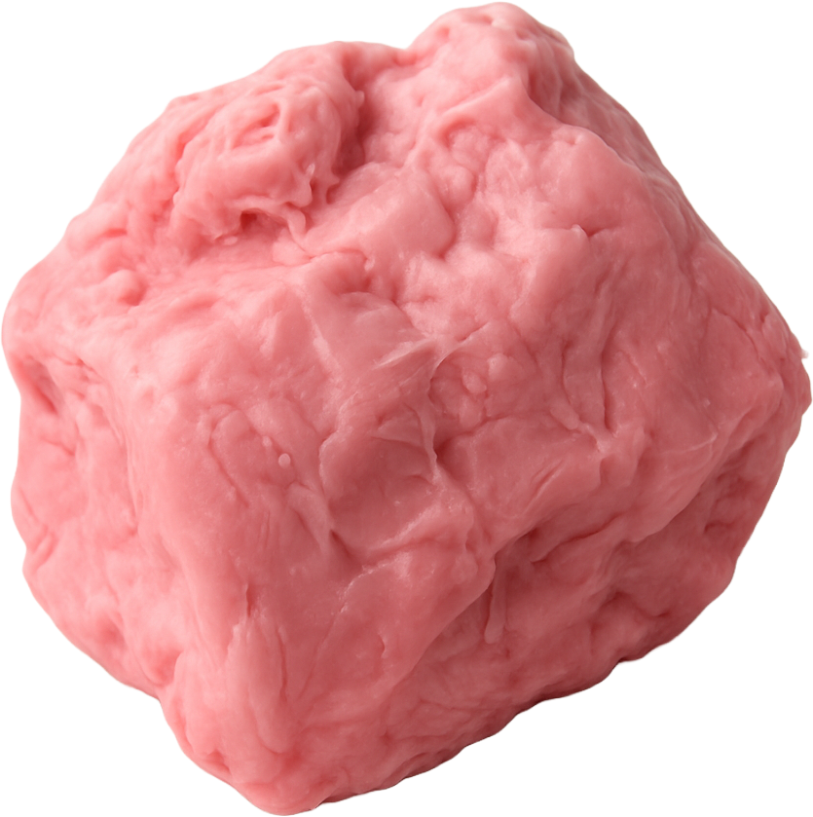
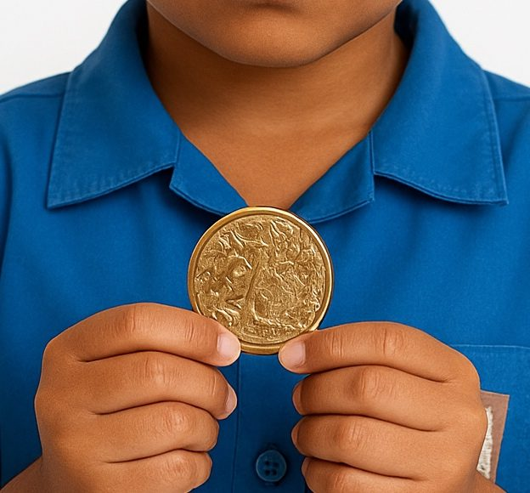

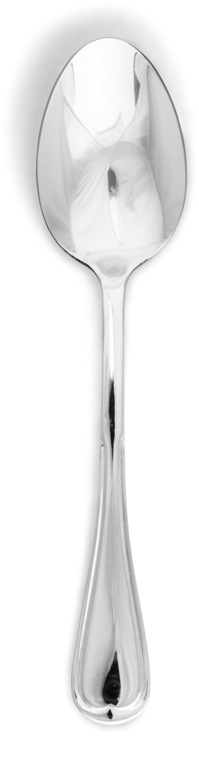
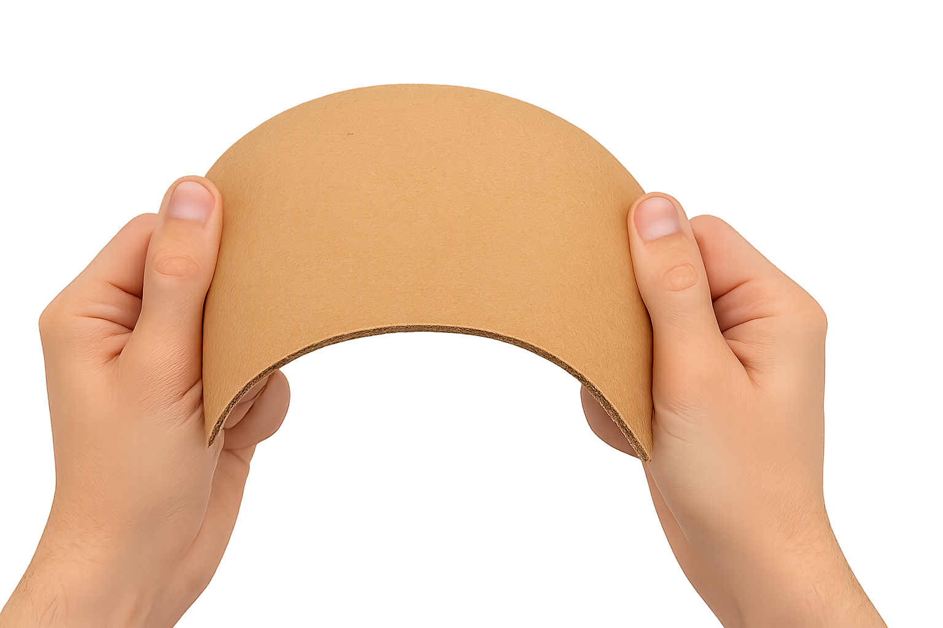
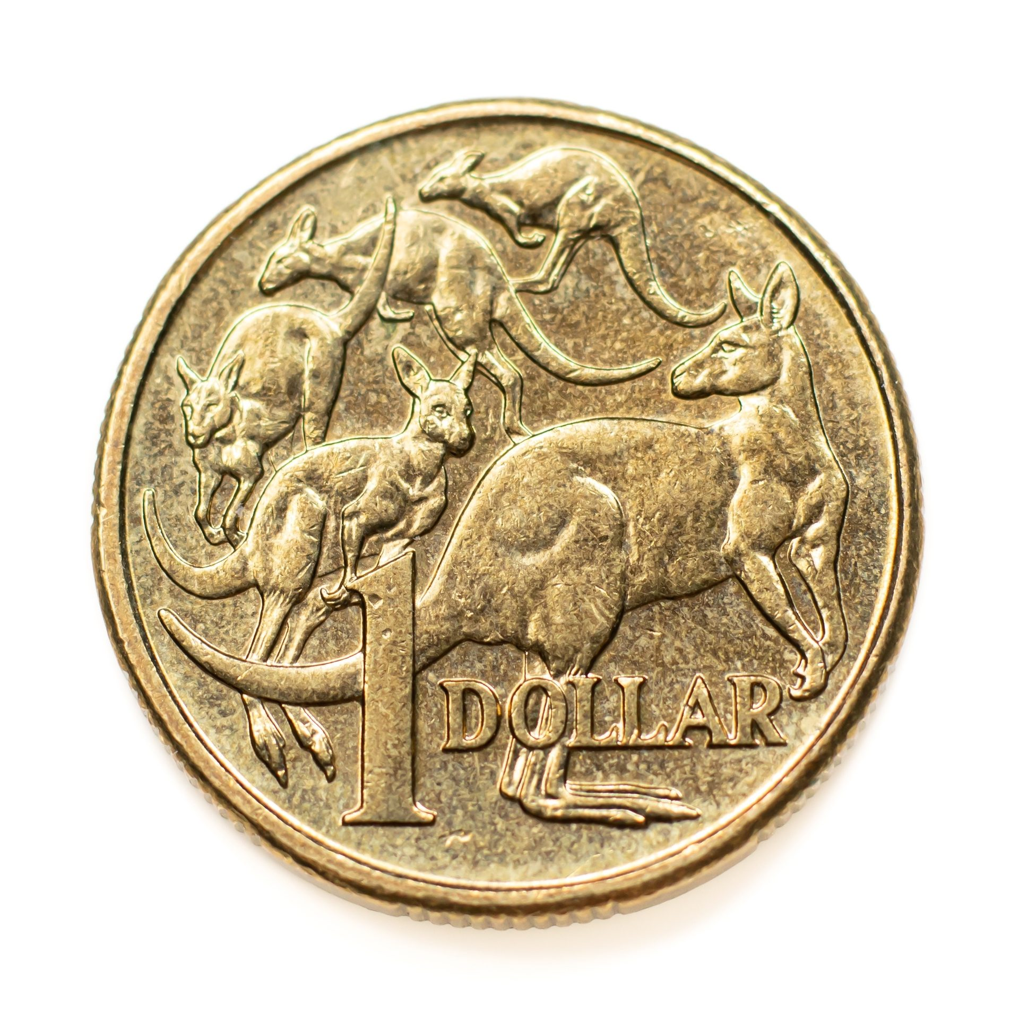
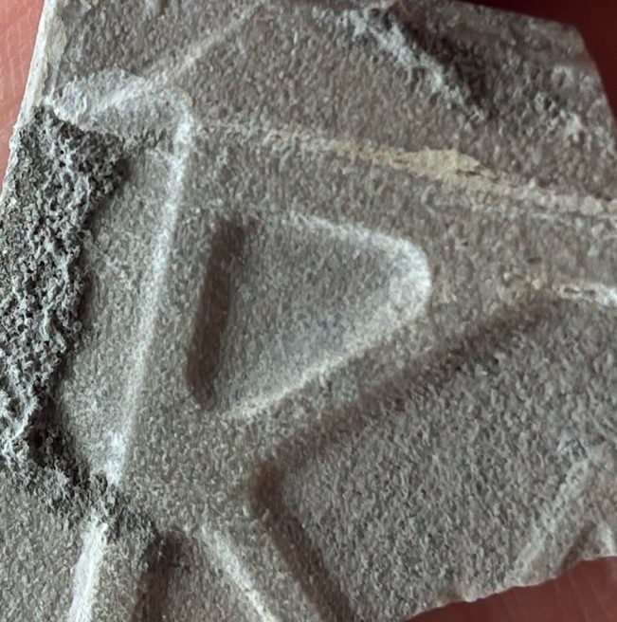
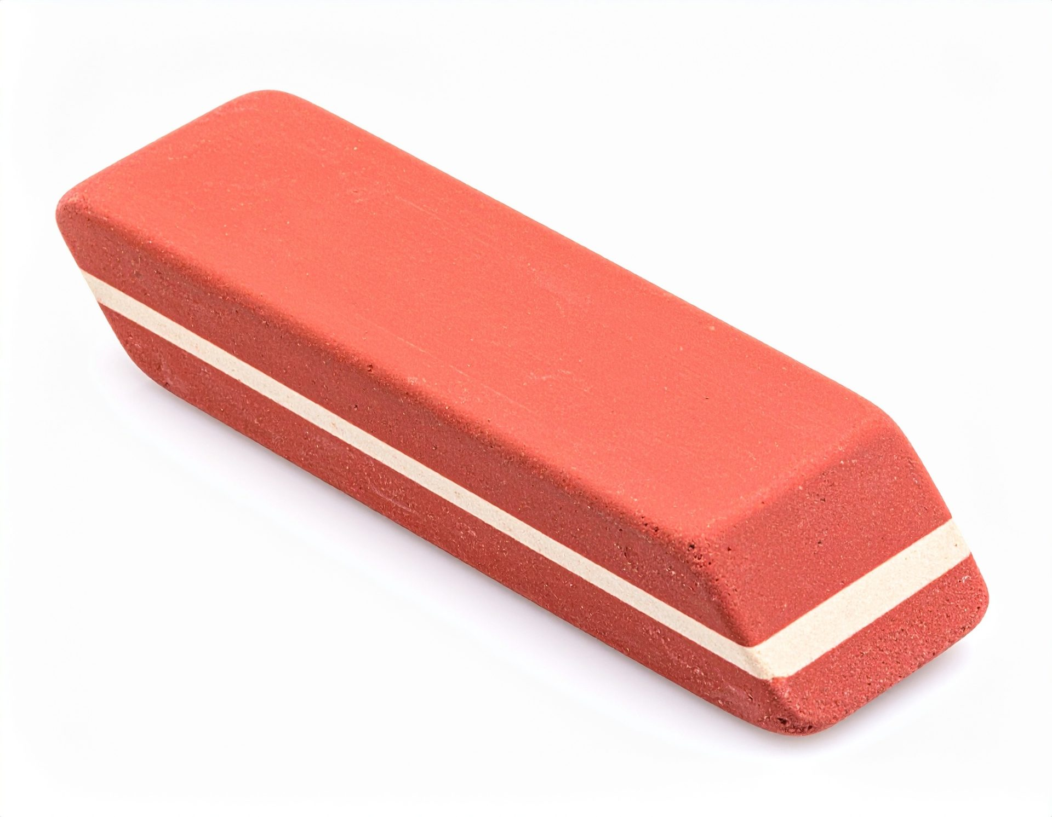
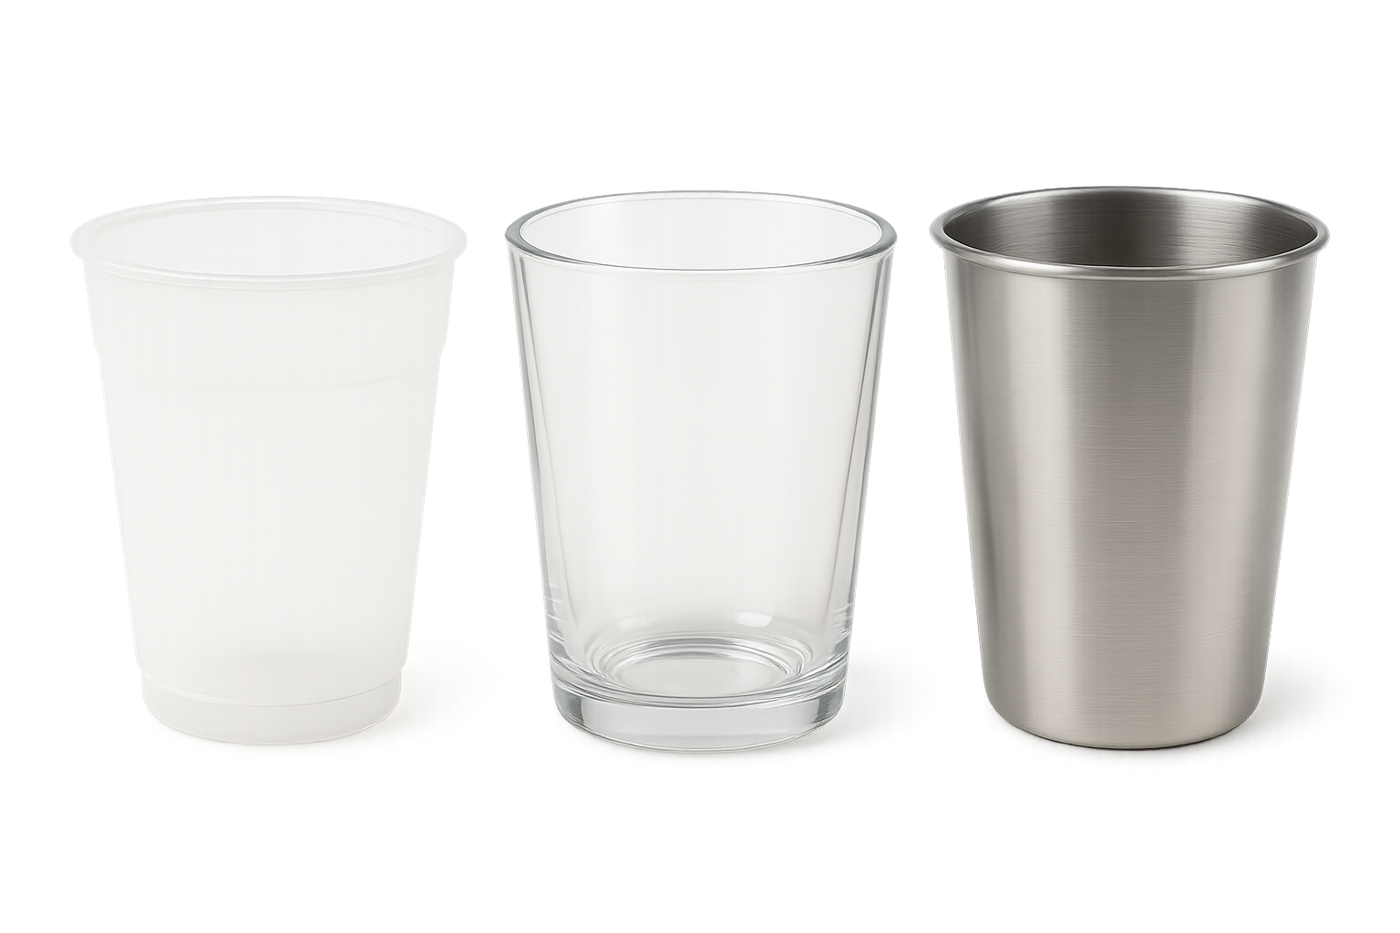








Made of one or more materials
Rubber
Metal
See
Have properties
Touch
Can touch
Smell
Observe
Objects
Shiny or
dull
Taste
Hear
Bendy or stiff
Objects and
materials
have properties.
Coin
Rough or
smooth
Eraser
Same
object,
different
materials
Different
materials,
different jobs
Plastic
Metal
Glass

Slide 4
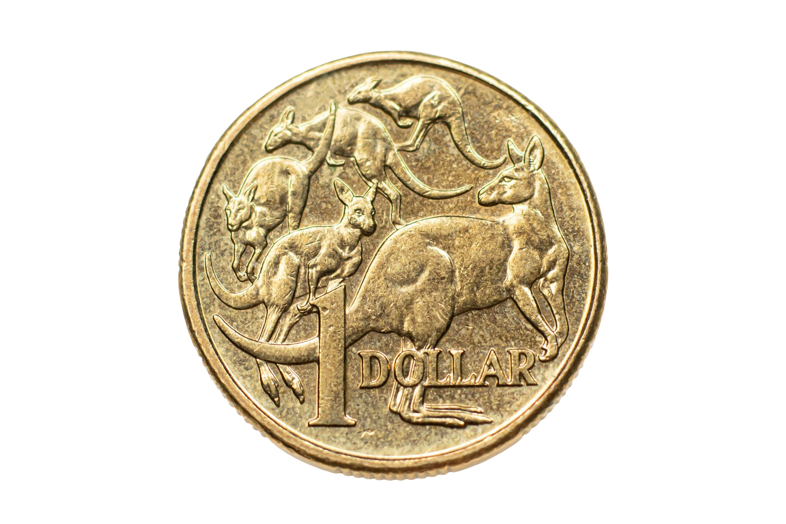
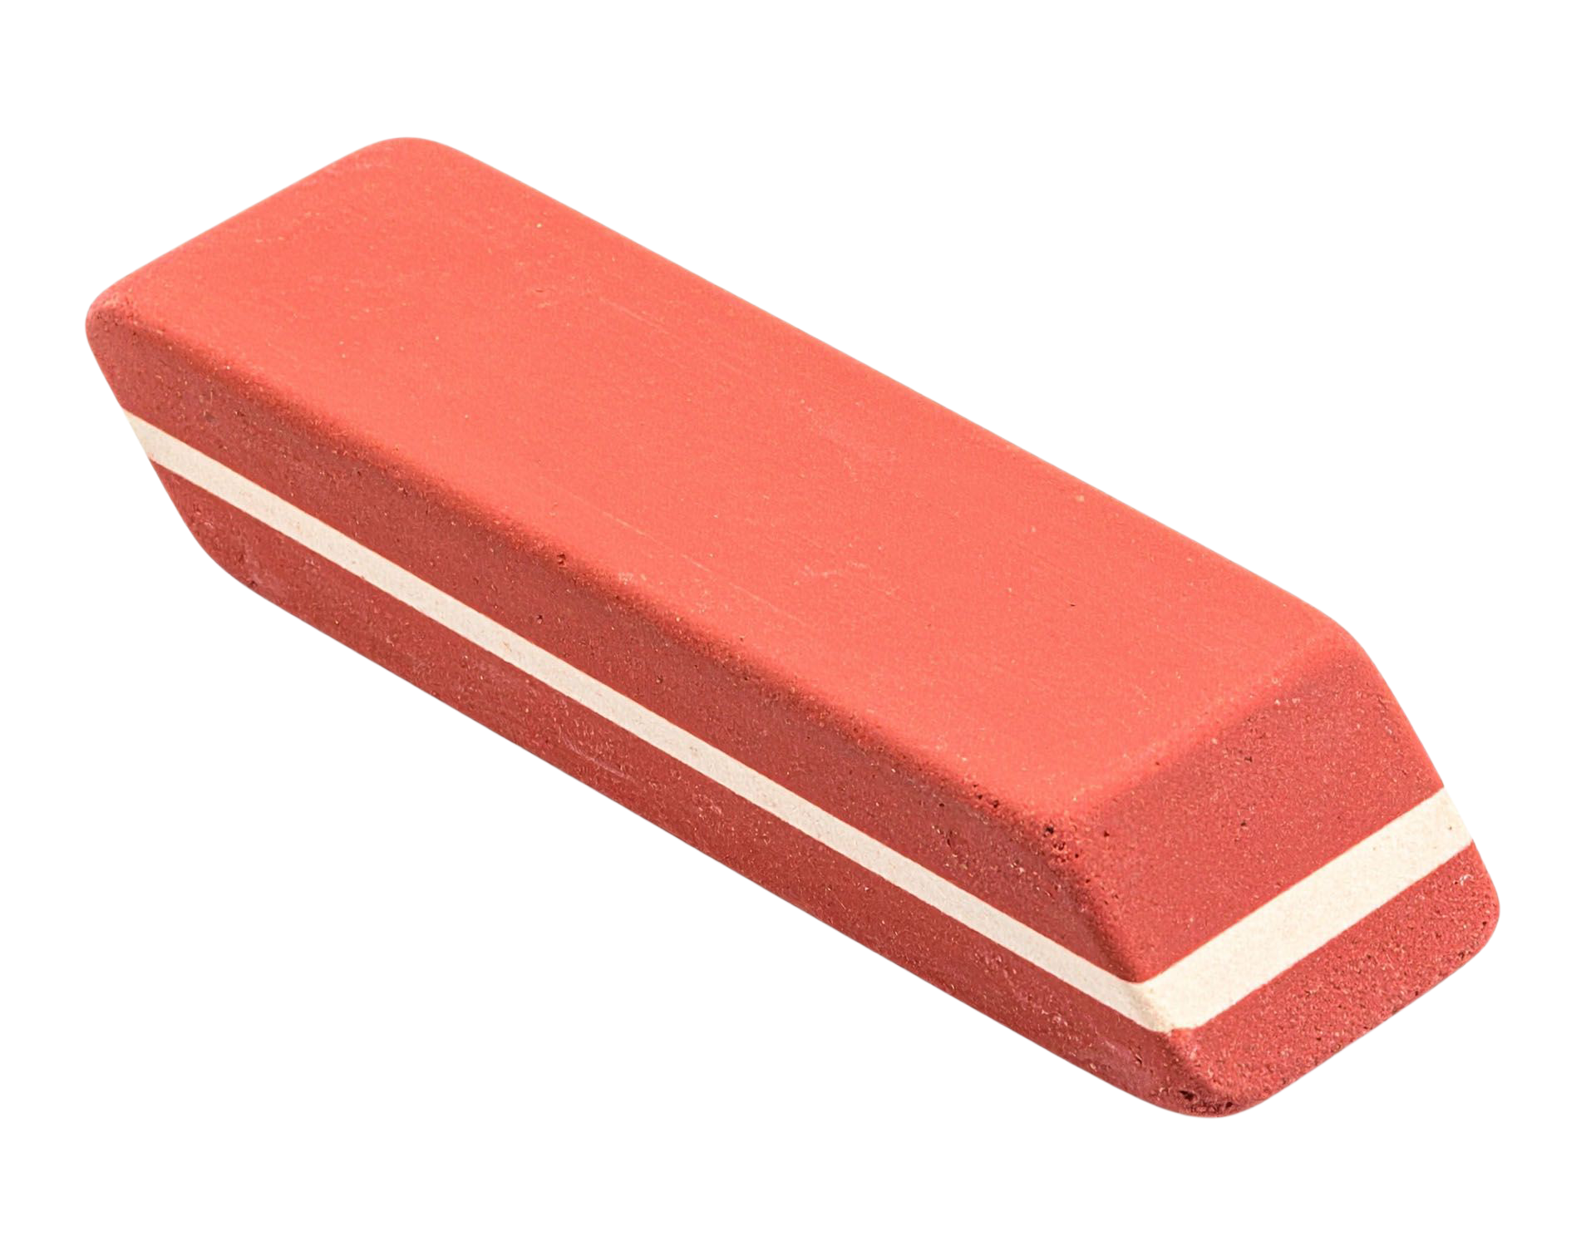





In this lesson, we will learn about objects, materials and their properties.
dull
stiff
bendy
shiny

Slide 5
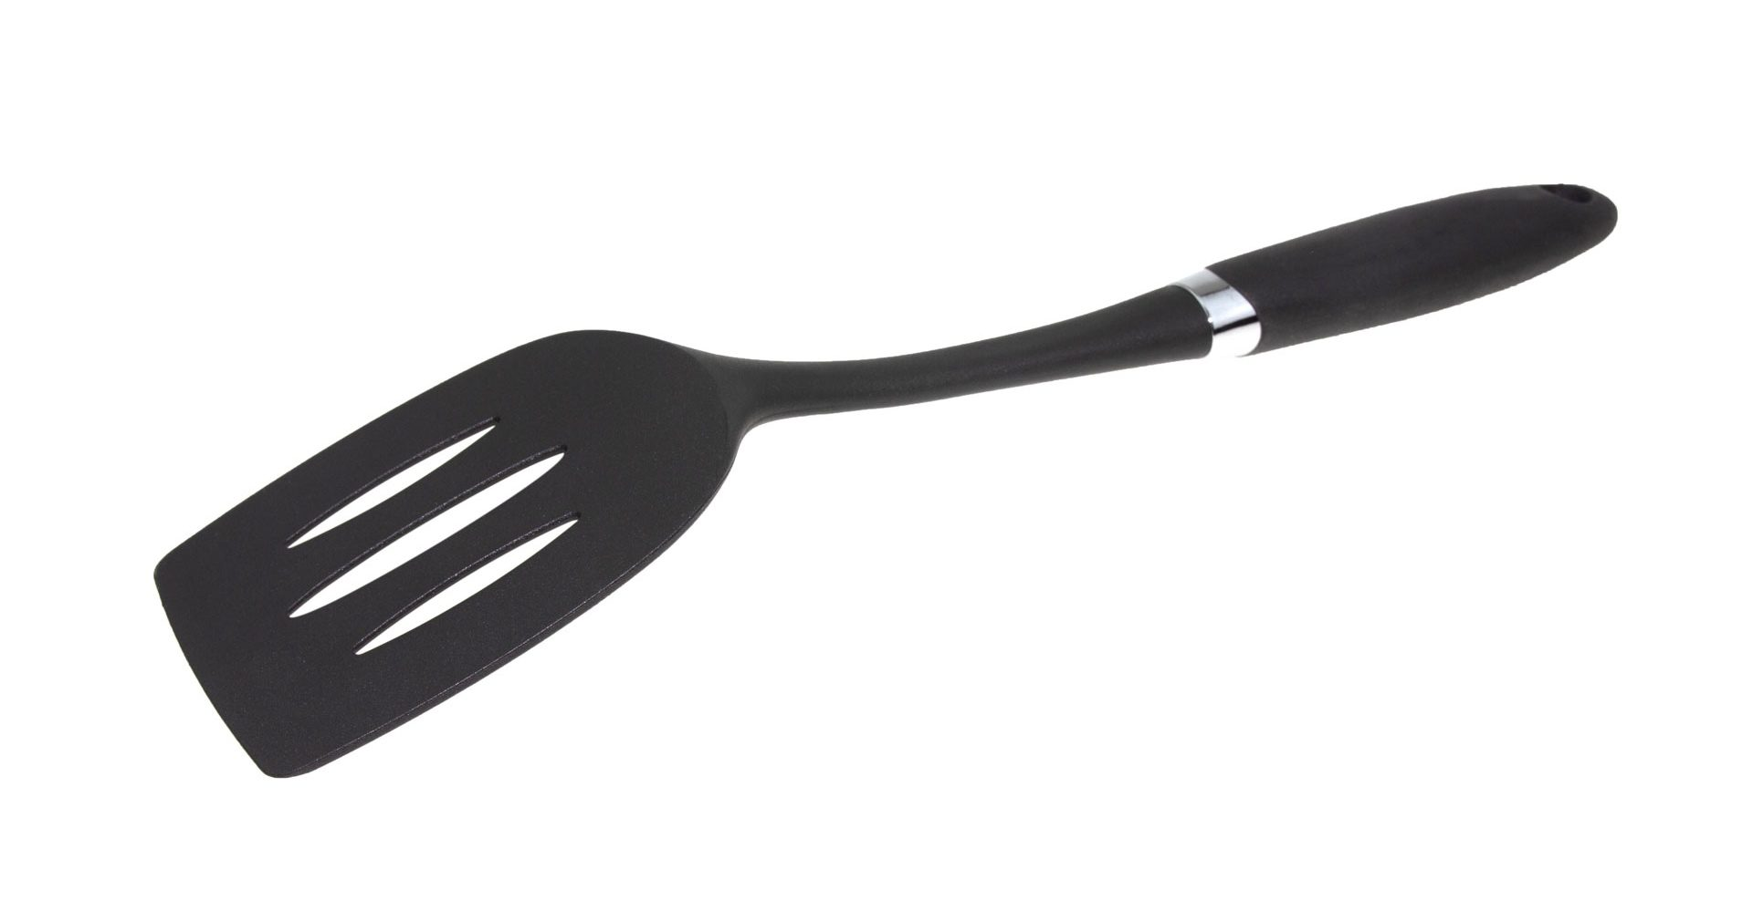



You will be able to: ​
describe properties of objects and materials
identify objects that contain more than one material.
Describe: to tell or show what you notice.
Identify: to find or name something.
shiny
smooth
dull

Slide 6


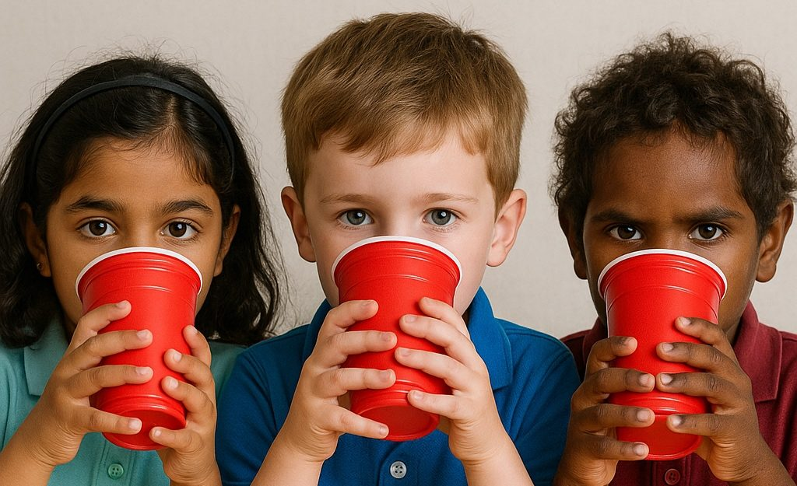





Slide 7

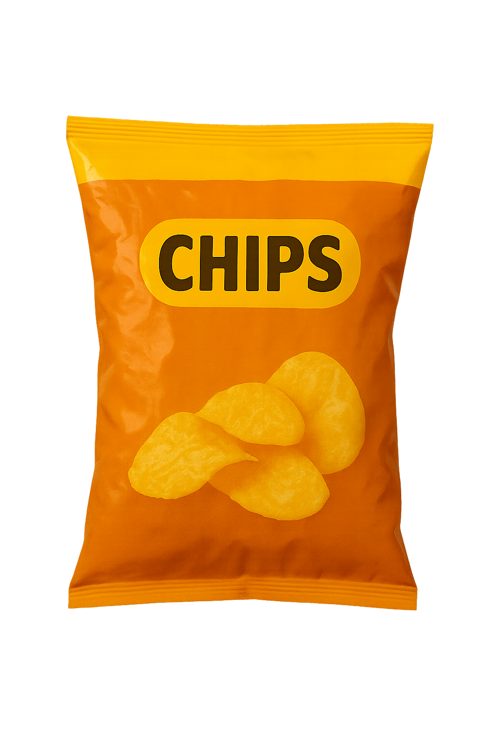
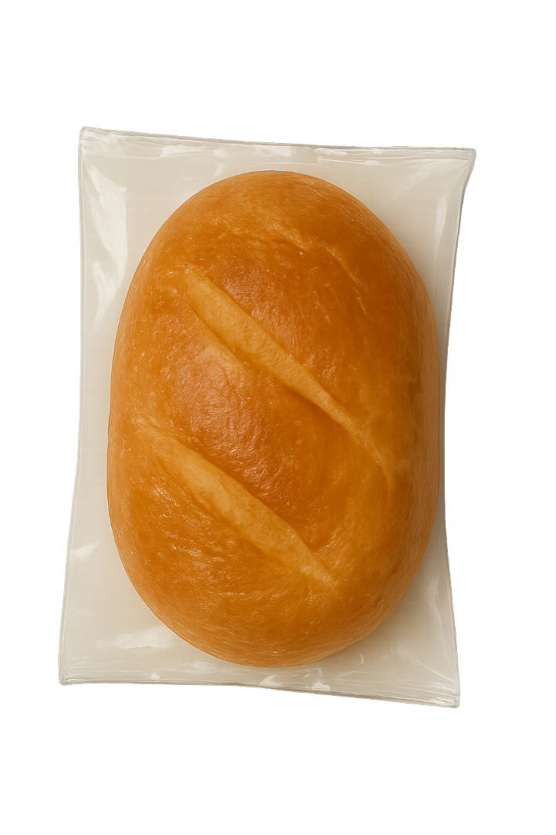
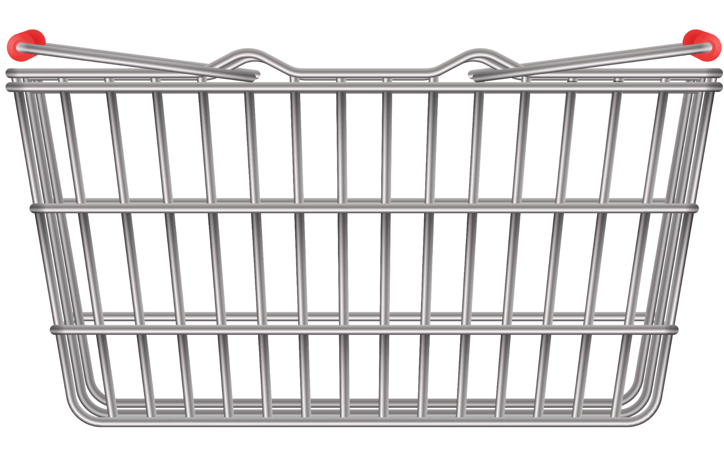
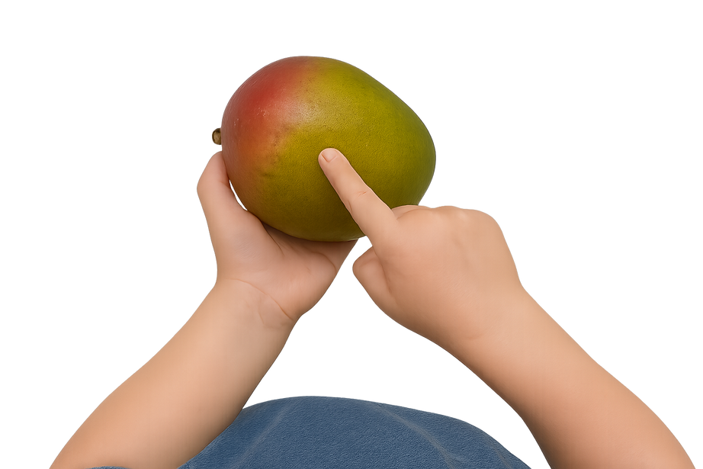
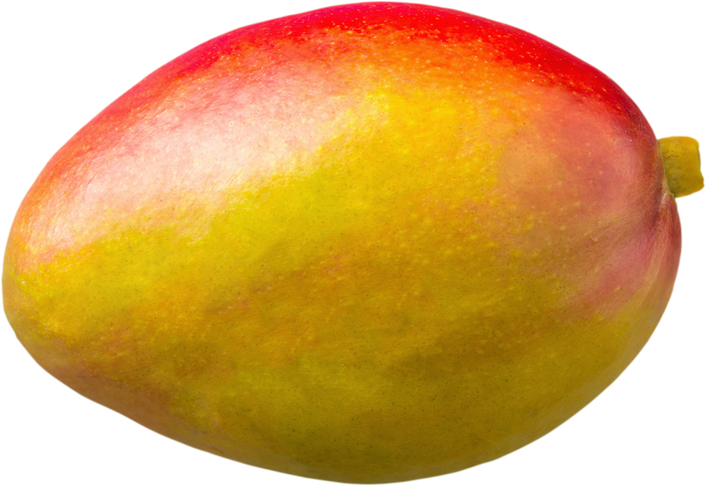
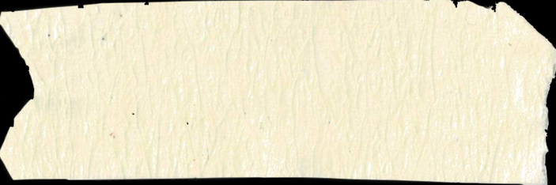
objects

Slide 8


Objects
Which of these is an object?

Slide 9

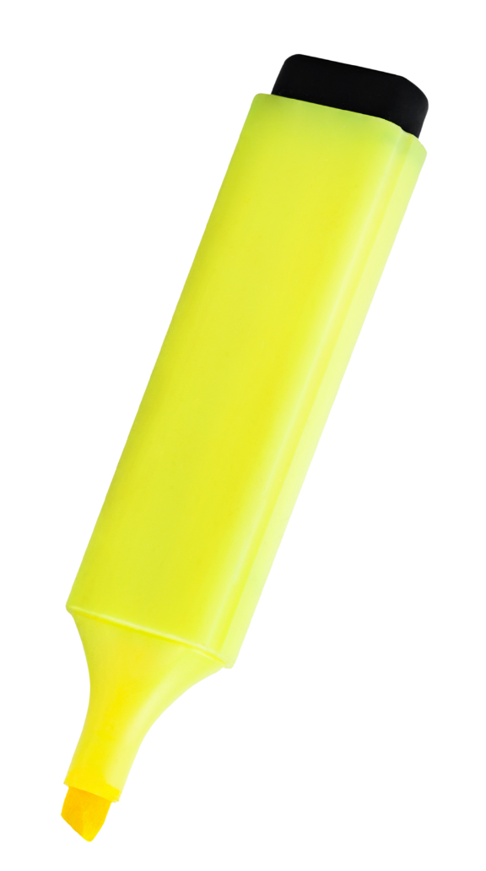
Observing Objects
Observe means to use your senses or tools to notice.
Eyes
Hands

Slide 10

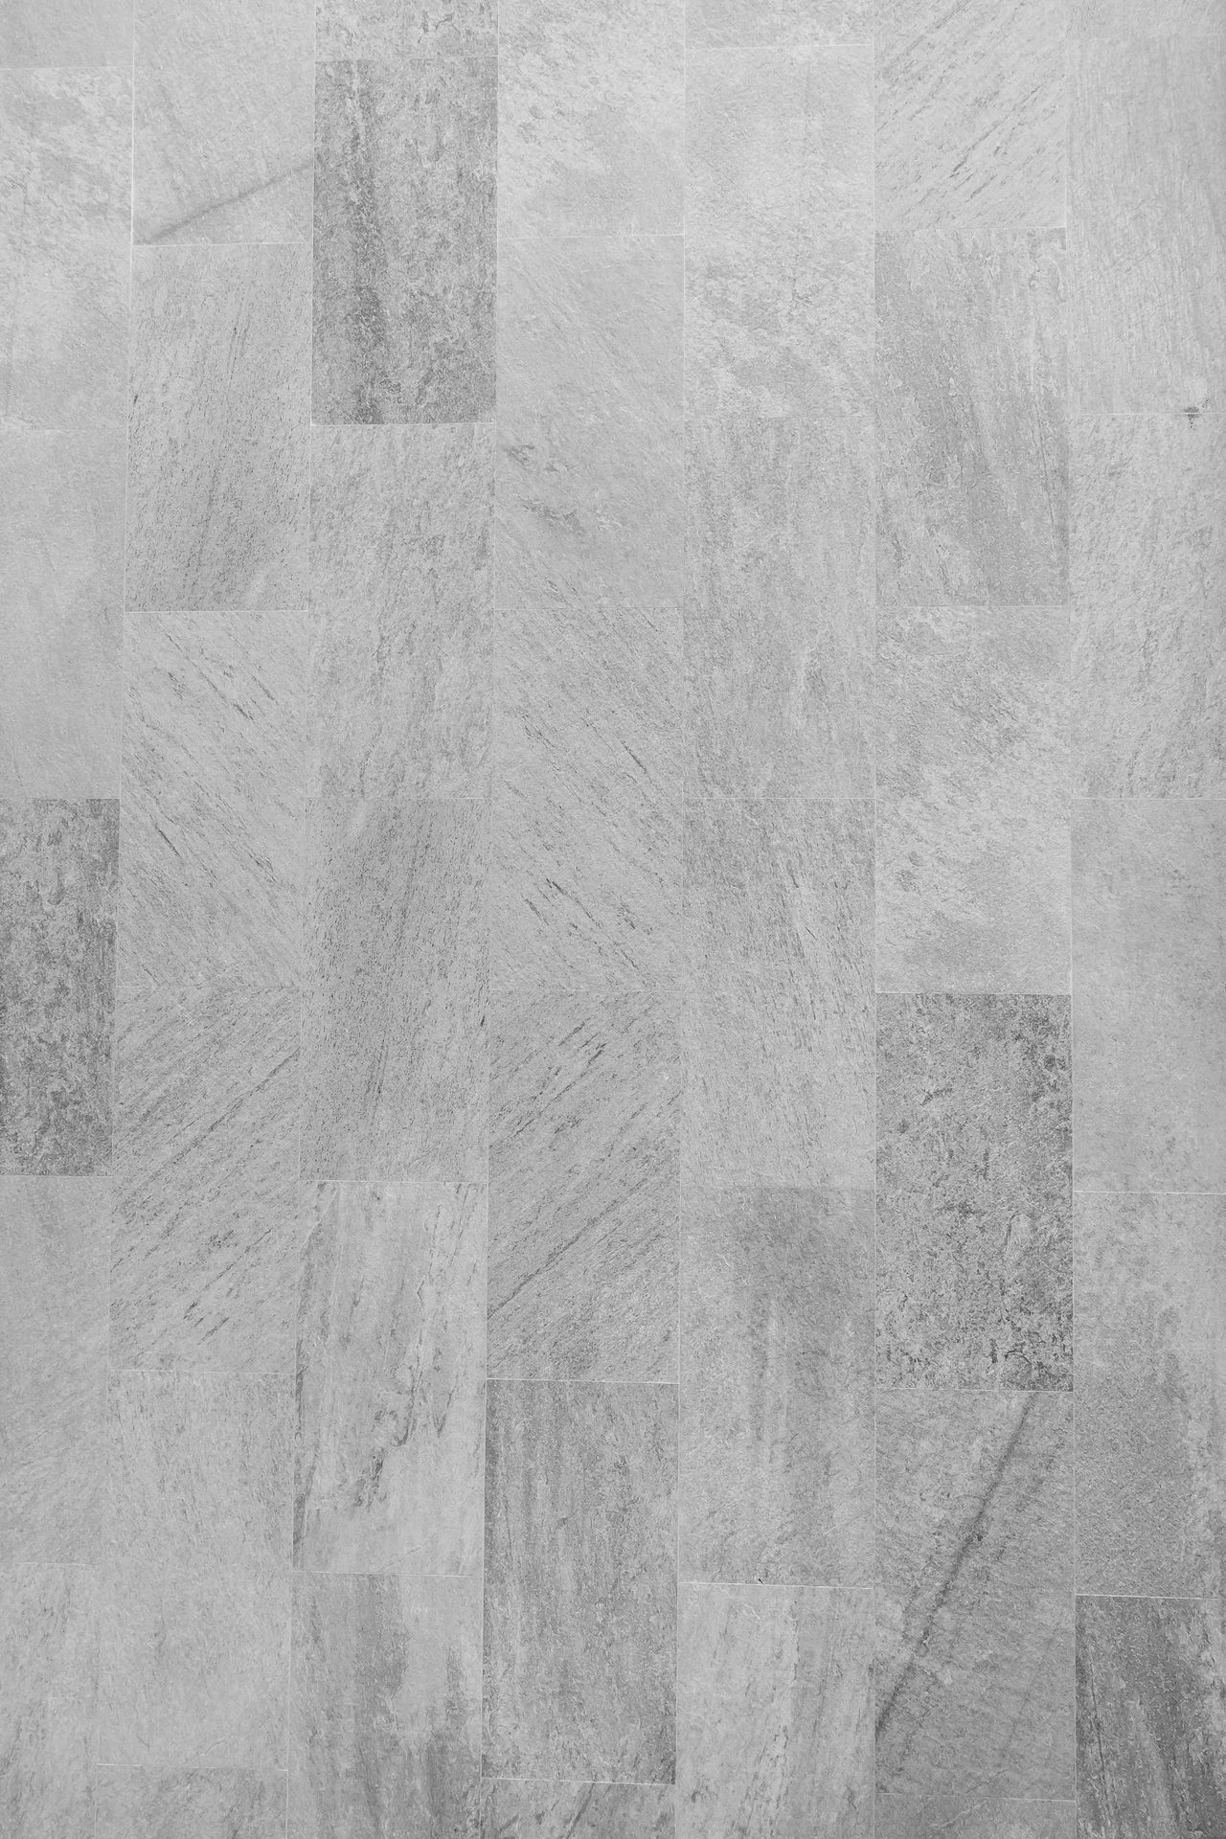
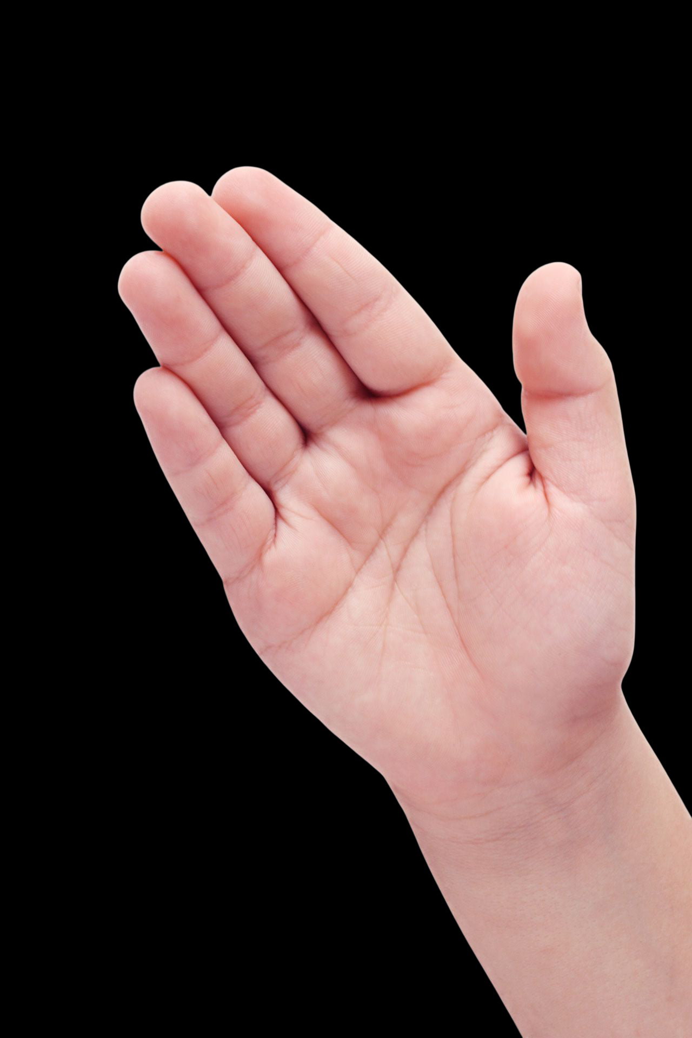

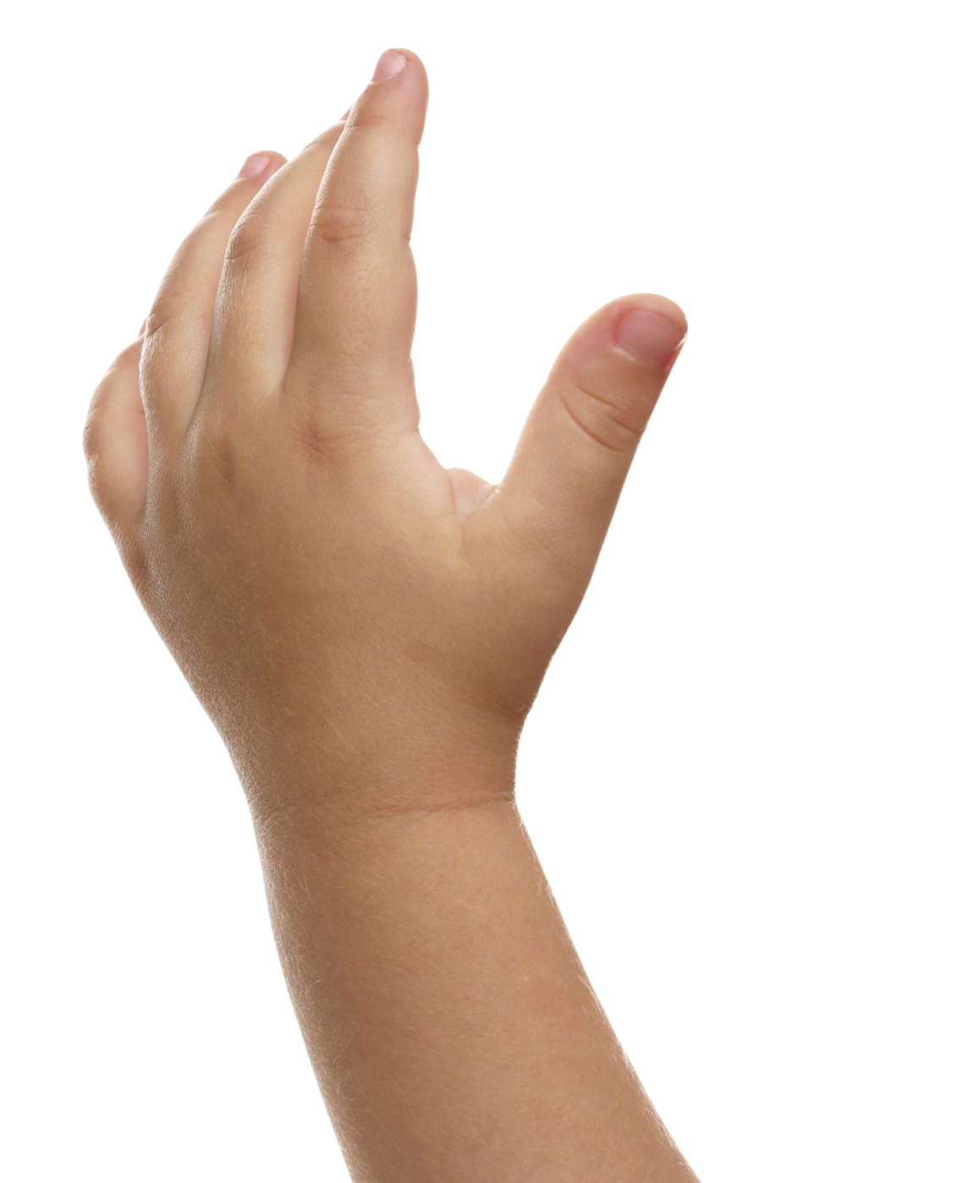
object = coin

Slide 11
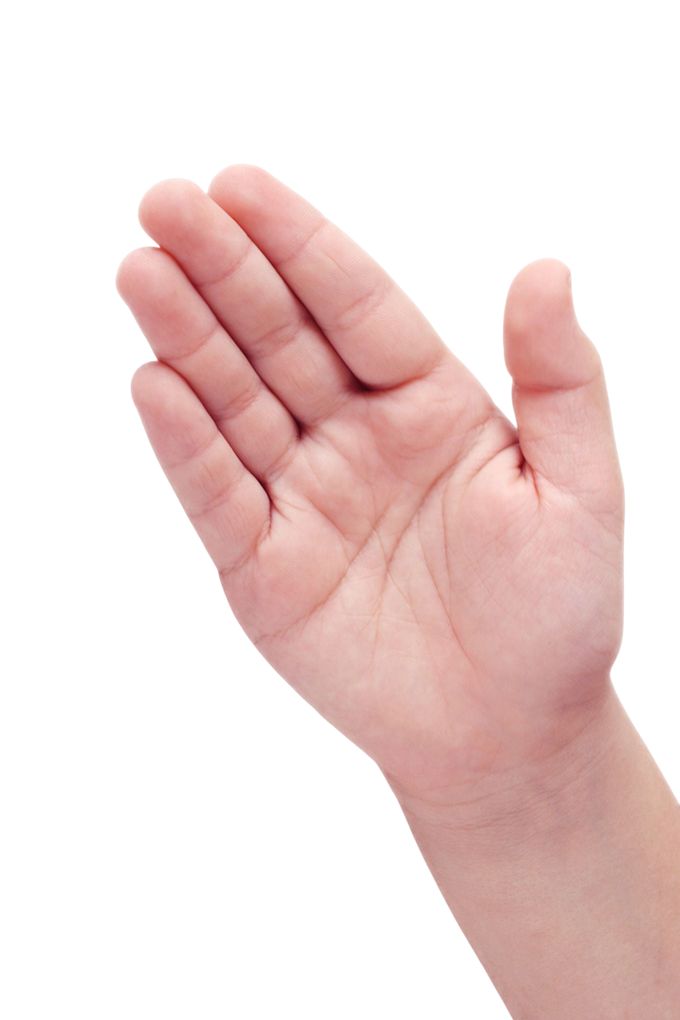
object = rubber

Slide 12
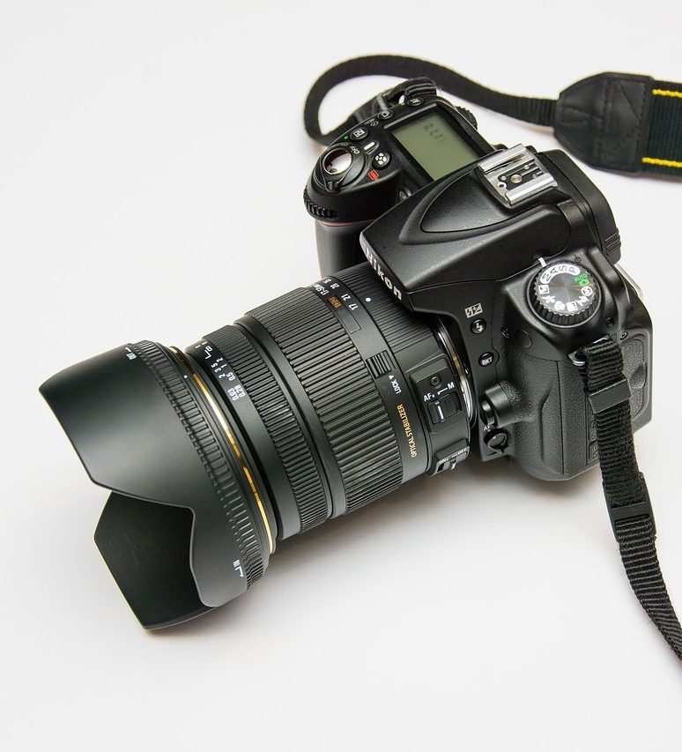

Show of Fingers
I would use this to observe an object:

Slide 13




Objects Have Properties
A property is something about an object we can see, feel, hear or smell.
This coin
looks round!
I could use this to buy candy!
This coin
feels hard!
This coin is pretty!

Slide 14






Objects Have Properties
shiny
strong
smooth
round
bendy
round
bumpy
colourful
heavy
dull
gold
pink
cold
stiff
rough
weak
light

Slide 15
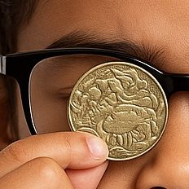
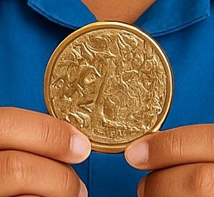
Objects Have Properties
Properties can describe an object’s:
look or feel
look
feel

Slide 16
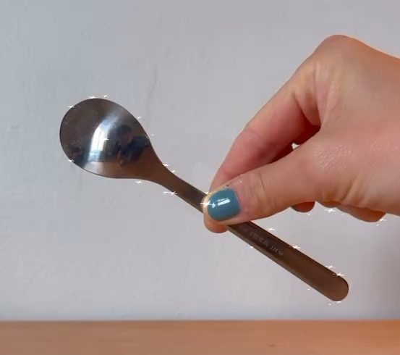
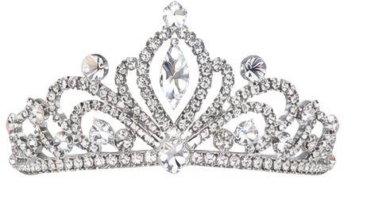
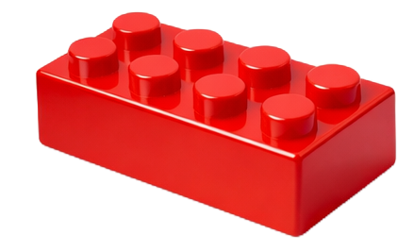
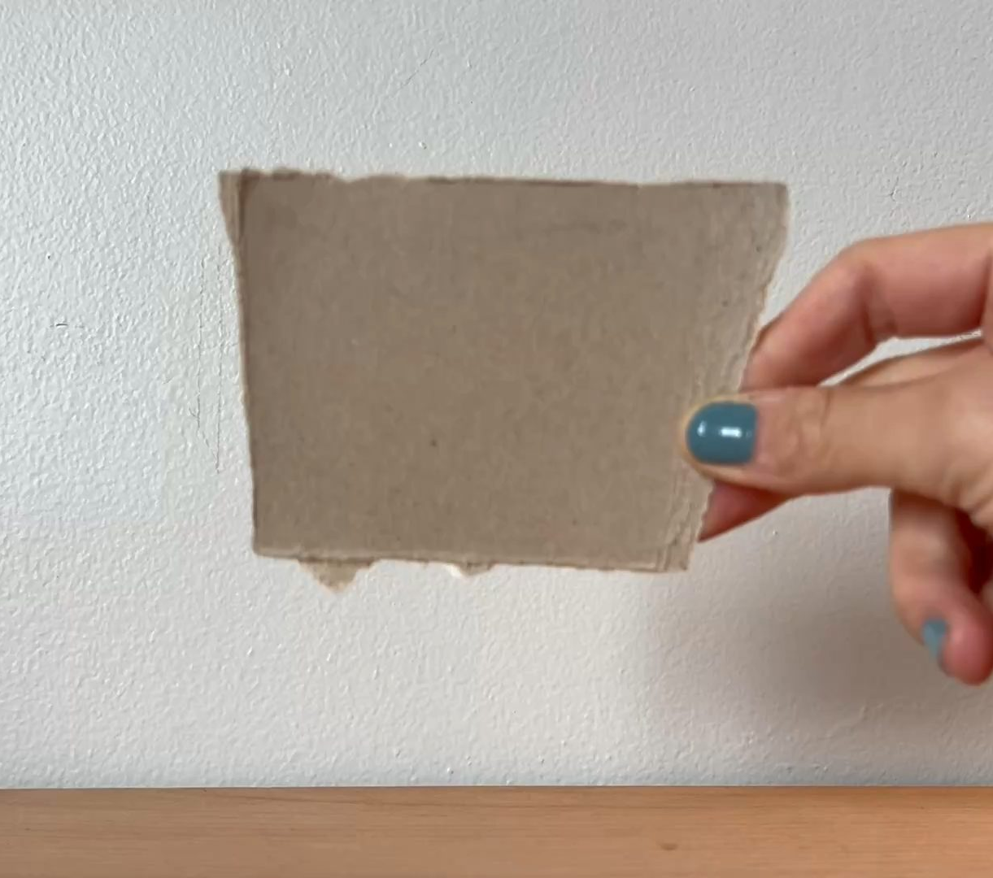
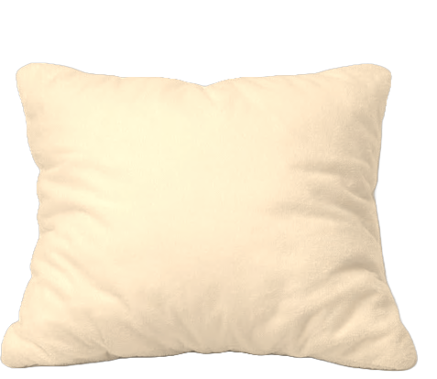

Describing Properties
Shiny
Dull

Slide 17
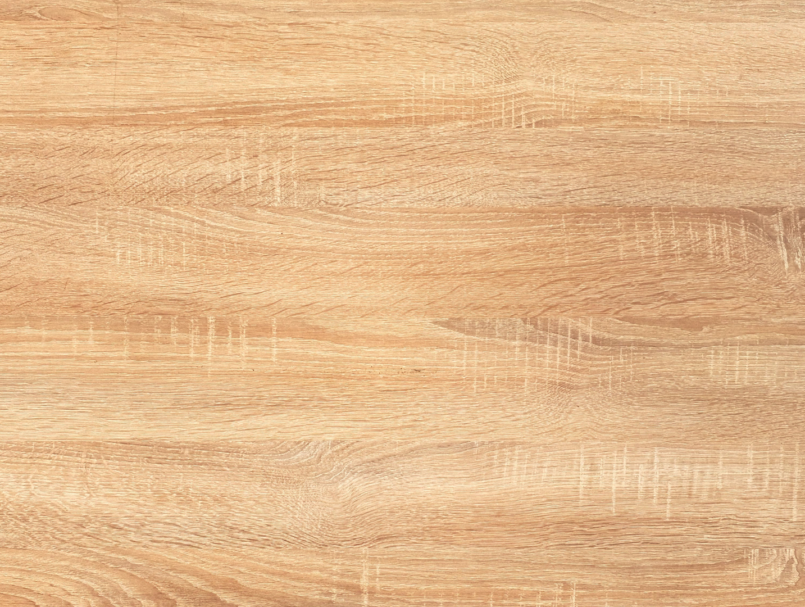


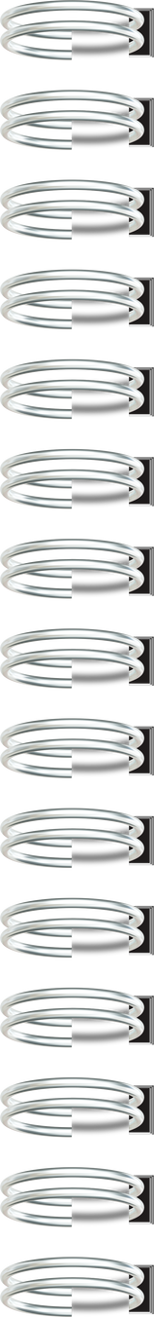

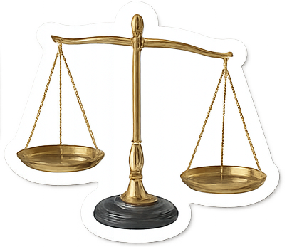

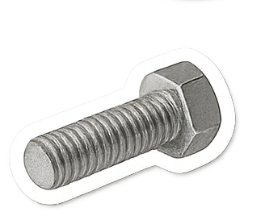
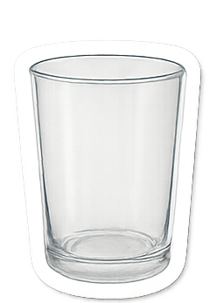
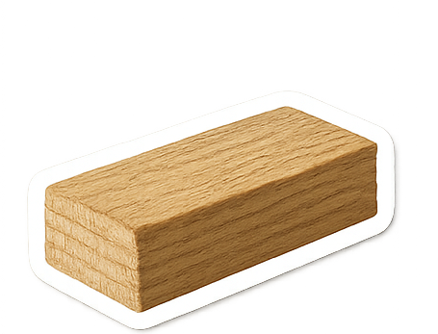

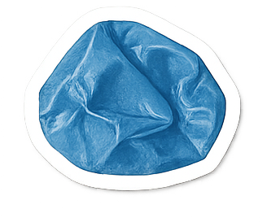
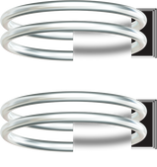

Slide 18

Describing Properties
I Do: Describing Properties
Question: Is this coin shiny or dull?
shiny
dull

Slide 19
Describing Properties
We Do: Describing Properties
Question: Is this rubber shiny or dull?
shiny
dull

Slide 20


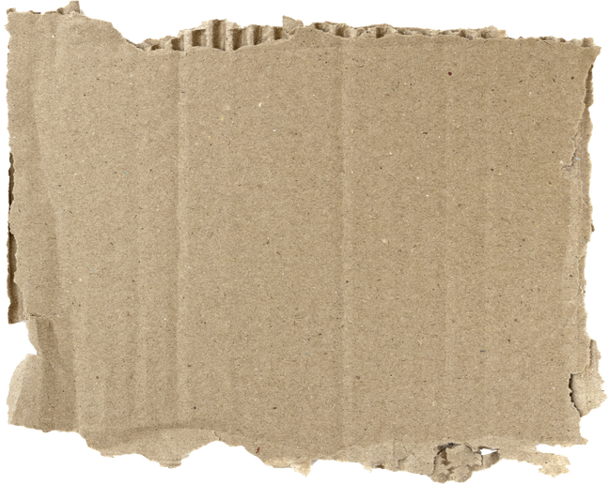
Describing Properties
Dull is the opposite of shiny.

Slide 21
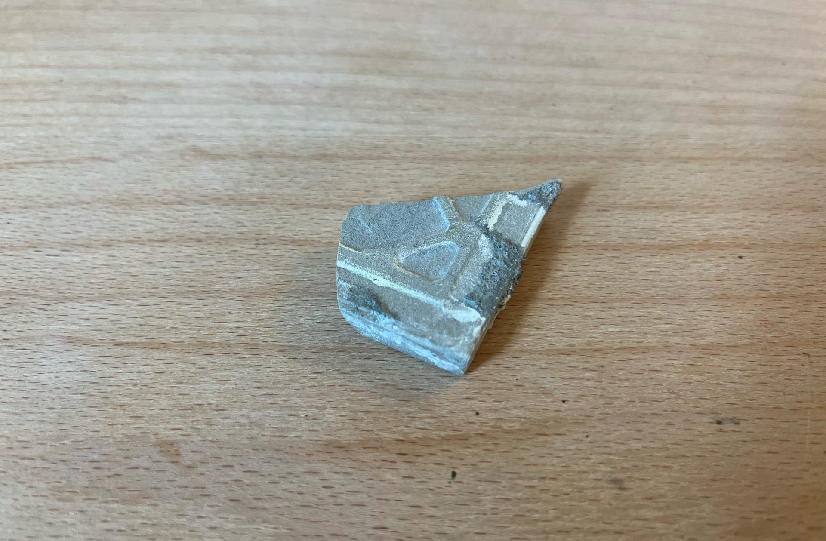
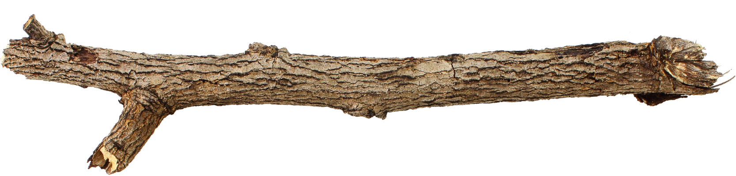
Describing Properties
rough

Slide 22
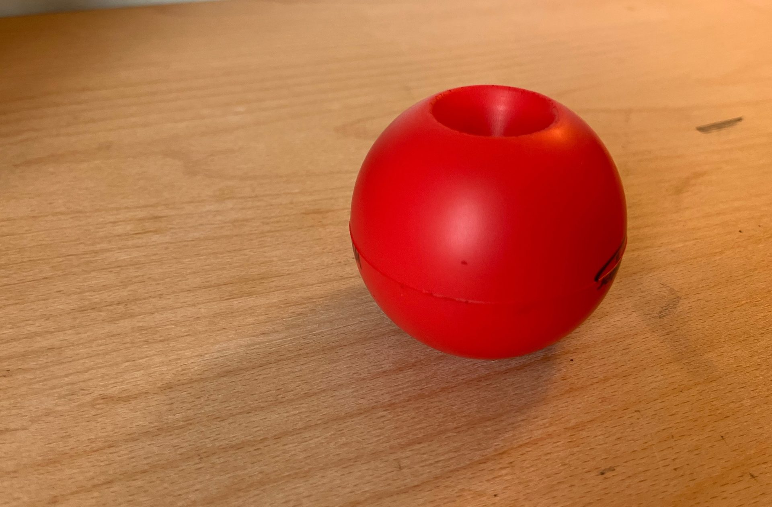
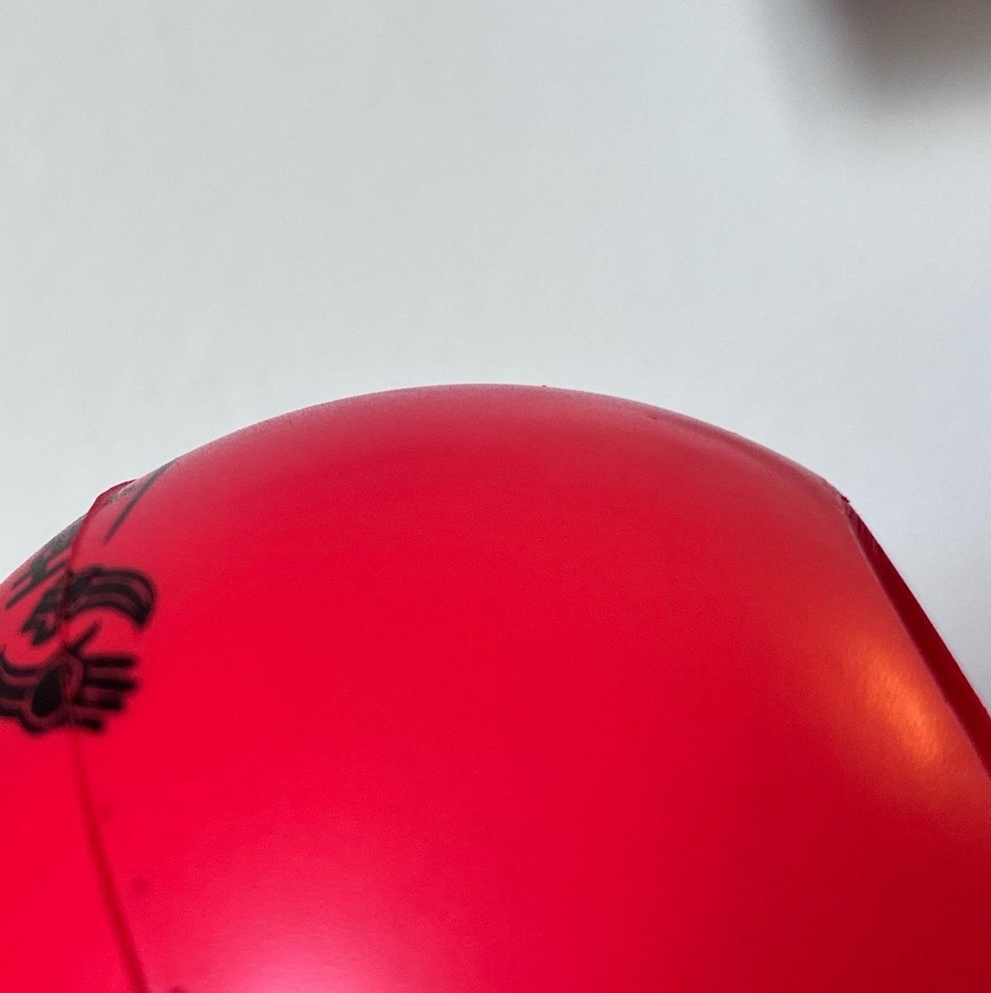
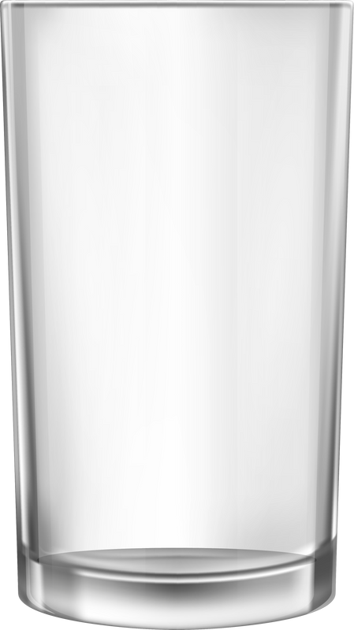
Describing Properties
smooth

Slide 23
Describing Properties
I Do: Describing Properties
Question: Is this coin rough or smooth?
rough
smooth

Slide 24
Describing Properties
We Do: Describing Properties
Question: Is this rubber rough or smooth?
rough
smooth

Slide 25
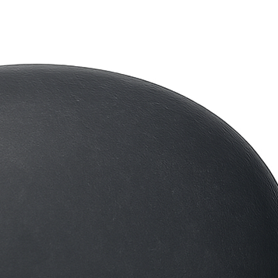
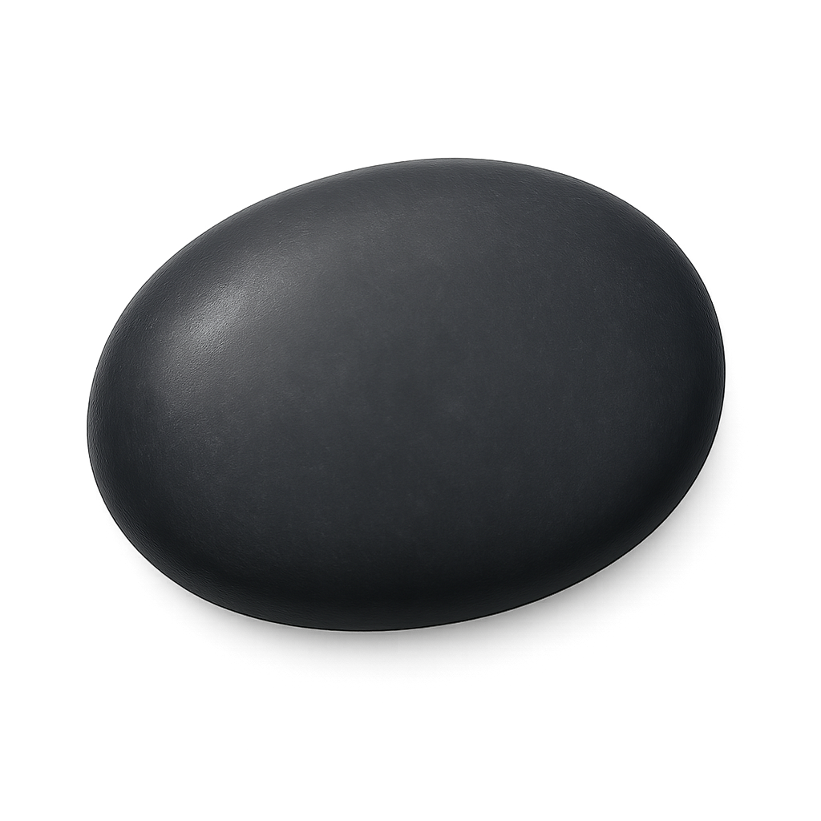

Describing Properties
This object has no bumps.
This means it is rough.
no bumps

Slide 26
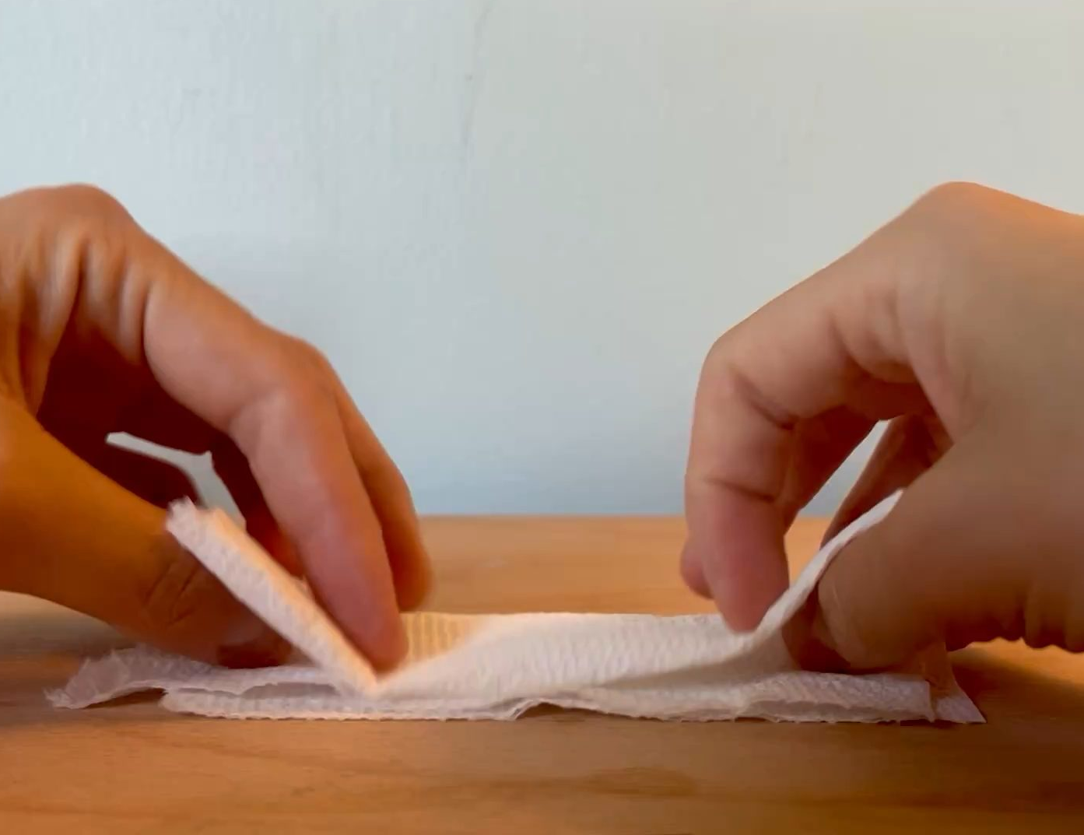



Describing Properties
Bendy
Stiff

Slide 27
Describing Properties
I Do: Describing Properties
Question: Is this coin bendy or stiff?
bendy
stiff

Slide 28
Describing Properties
We Do: Describing Properties
Question: Is this rubber bendy or stiff?
bendy
stiff

Slide 29

Describing Properties
This object is stiff.

Slide 30







Objects Are Made of Materials
sweet

Slide 31


Object = Coin
Objects Are Made of Materials
shiny
stiff
bendy
dull
Material = Metal
Material = Cotton
Object = Coin
Object = Shirt

Slide 32
Objects Are Made of Materials
Wood is stiff. That means a wooden chair has the property:
bendy
stiff
shiny

Slide 33








Objects Are Made of Materials
One Material
More Than One Material
Plastic, rubber and metal
Plastic
Rubber
Wood and metal
Metal

Slide 34




Objects Are Made of Materials
This object is made of only one material.
smooth
sticky
shiny
dull
pink
white

Slide 35





Date: _________
Lesson 1A
I Do: Objects Are Made of Materials
This object is made of:
 | One material | More than one material

Slide 36




Date: _________
Lesson 1A
I Do: Objects Are Made of Materials
This object is made of:
 | One material | More than one material
We Do: Objects Are Made of Materials
This object is made of:
 | One material | More than one material

Slide 37

Objects Are Made of Materials
This chair is almost all one colour. It must be made of only one material.
dull, bendy
shiny, stiff

Slide 38




Slide 39




Objects and materials have properties.
Object = Coin
Material = Metal
shiny
rough
stiff

Slide 40





Learn more
Teach someone
I understand
Challenging

Slide 41









Exit Ticket
Date: _________
Lesson 1A
Lesson 1A
You will be successful when you can:
describe properties of objects
sort objects into property groups.
materials
Objects and __________ have properties.
Examples of properties include:
  bendy
  not bendy
  shiny
  all of the above.
We o______ something by looking at it closely and touching it.
Describe means to tell what something looks like, sounds like, feels like or what it is.
senses
materials
colours
Sort to put things that are the same together.
red
round
crunchy
bserve
3
I know _____ out of 3 answers.

Slide 42
In the next lesson, we will learn how the same object can be made from different materials.

