Slide 1
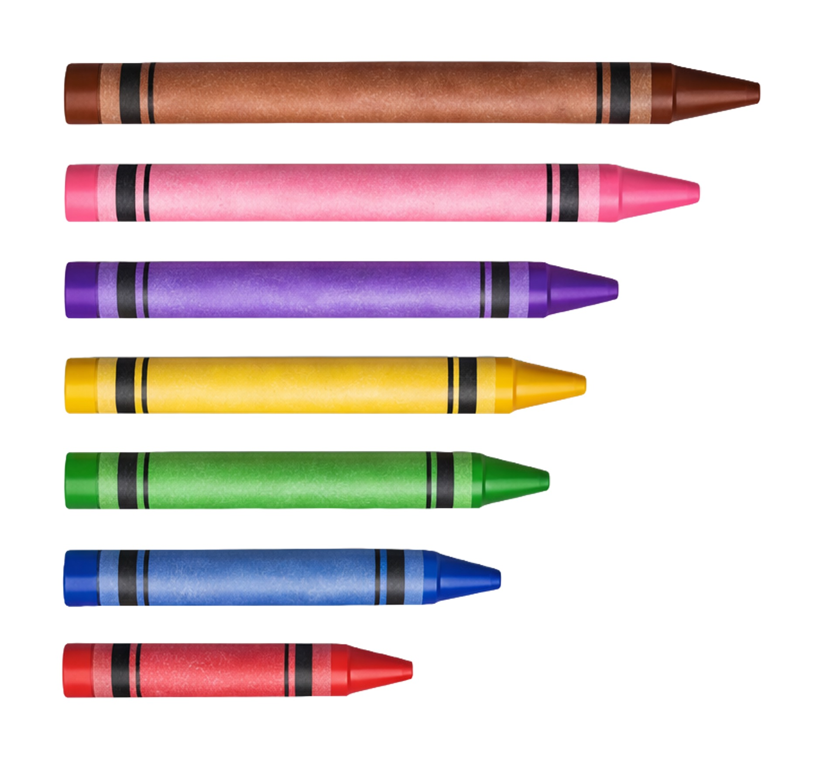
Science
Chemistry
Lesson 2 Part A
Property: Length
Version 2

Slide 2


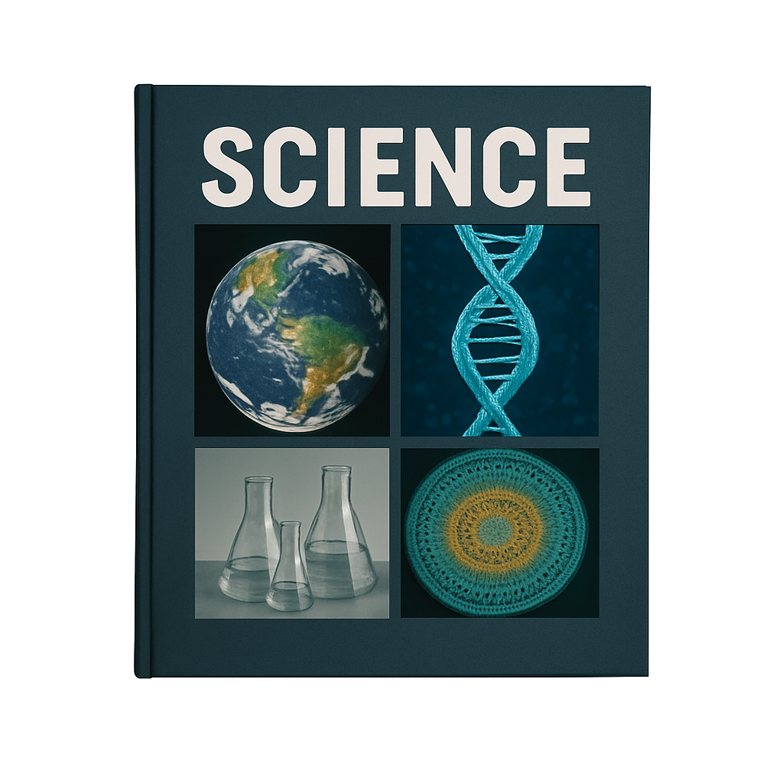









Remember what we’ve learnt
Organise ideas
Helps put information IN
Show thinking
Purpose
Visualise thoughts
Helps take information OUT
Concept maps help us organise information and show how different concepts fit together.
You can see:
Last levels: details or subconcepts
Read information
Radiate outwards
Pictures
Centre circle: key idea
Words
Next level: main concepts

Slide 3
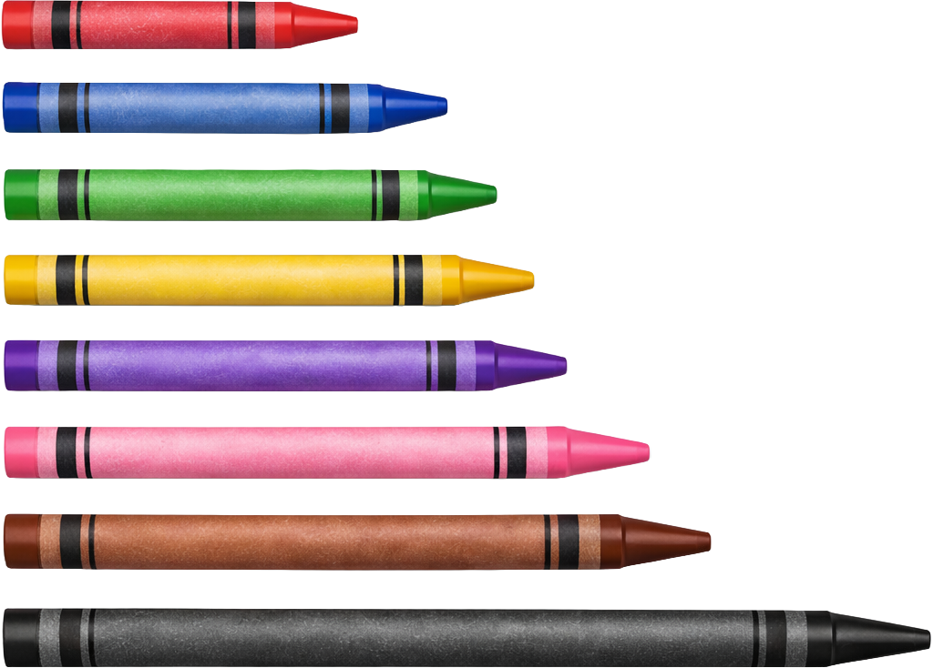
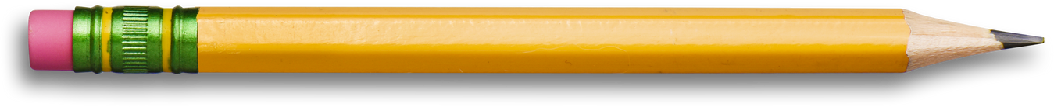
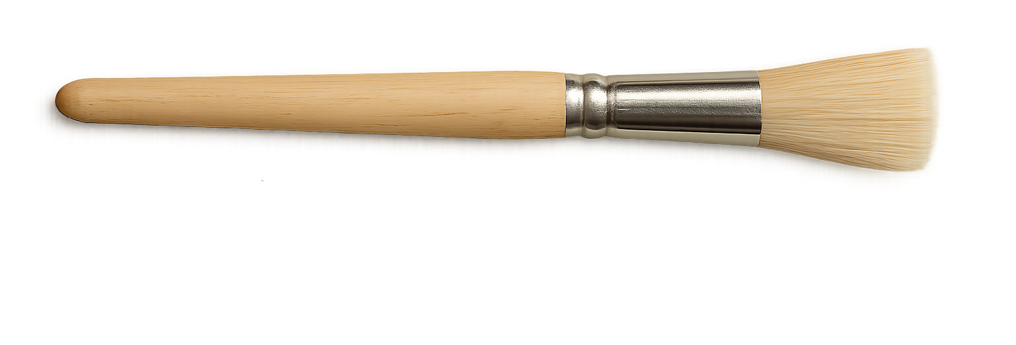
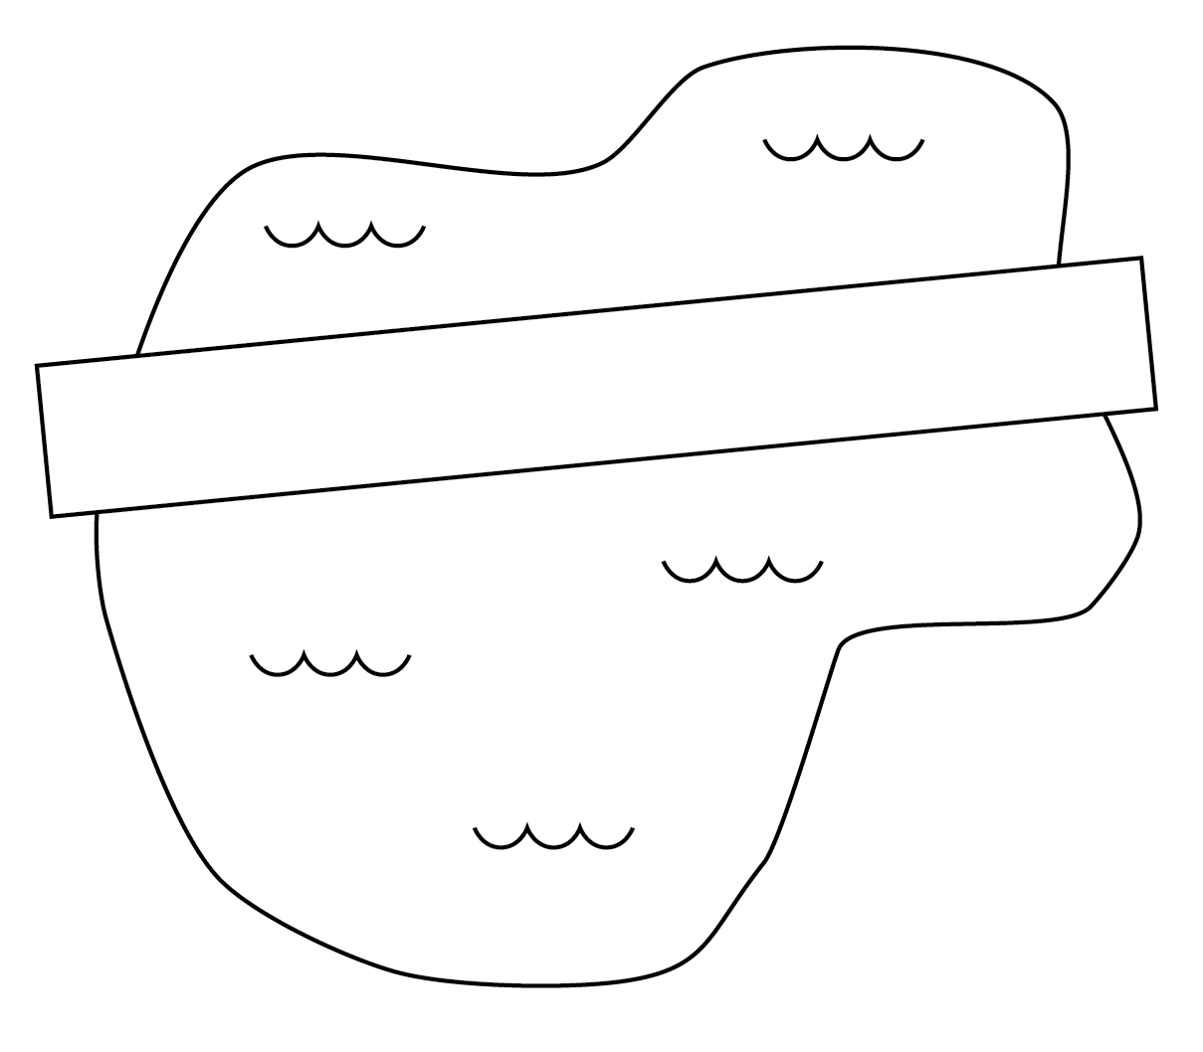
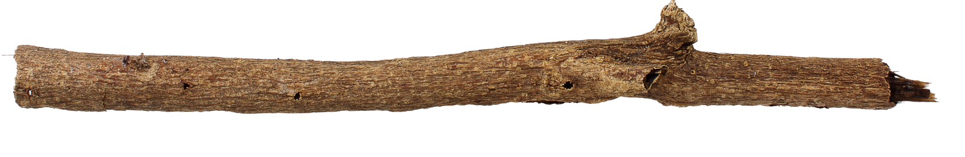
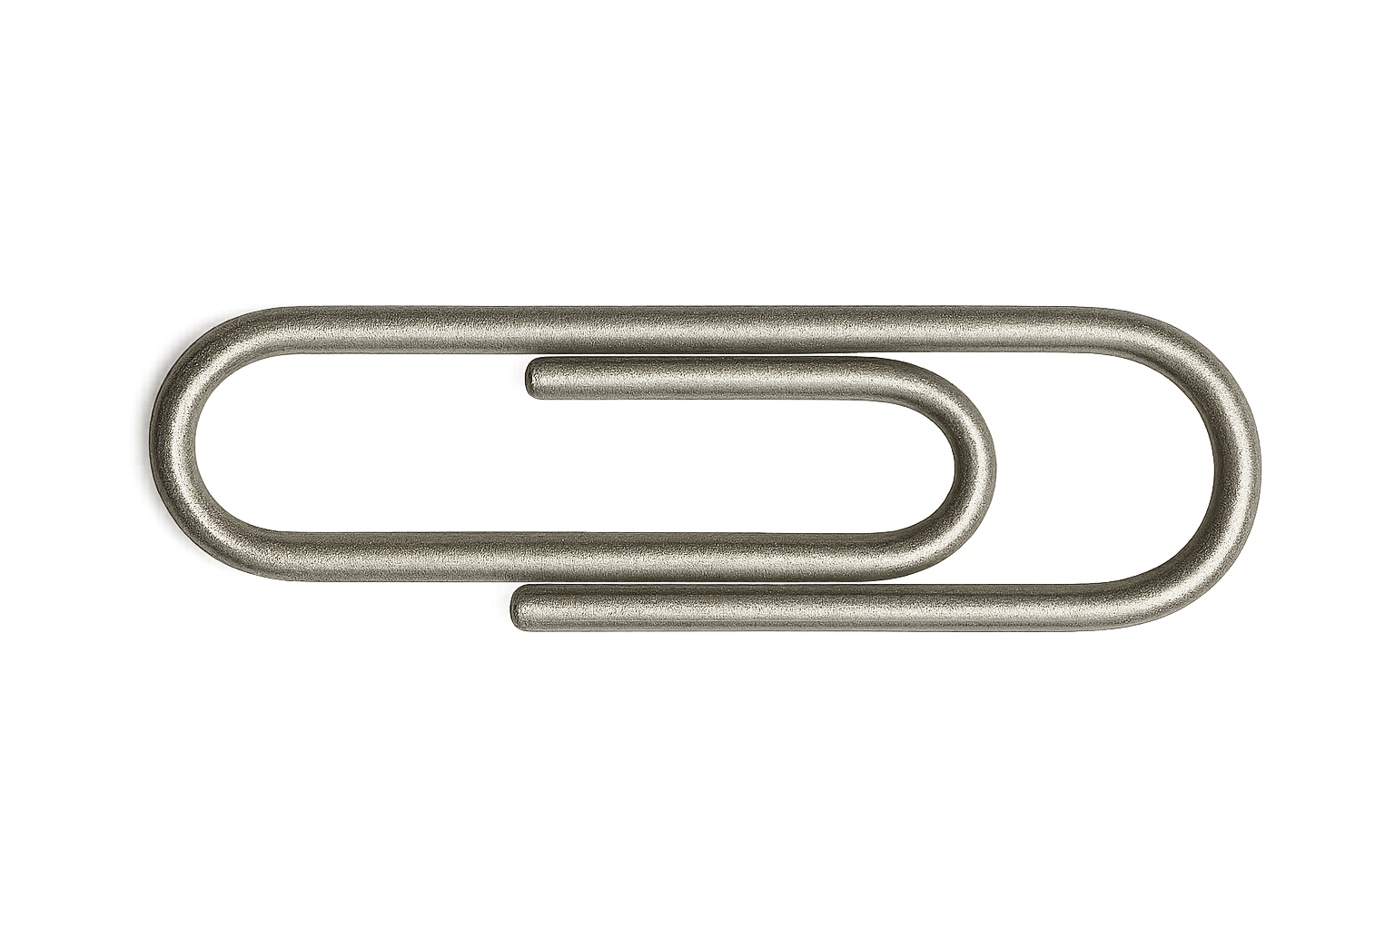











End
Can order
Length = space between ends
Objects have
length
Shortest
Longer
Length is how
long an object is
End
Longest
Can compare
Measure length for a job
Shorter
Longer
Can measure
Bridge’s length
=
longer than lake’s length
Same length
Bridge
Lake
Use units
Pencil’s length = 5 paperclips

Slide 4


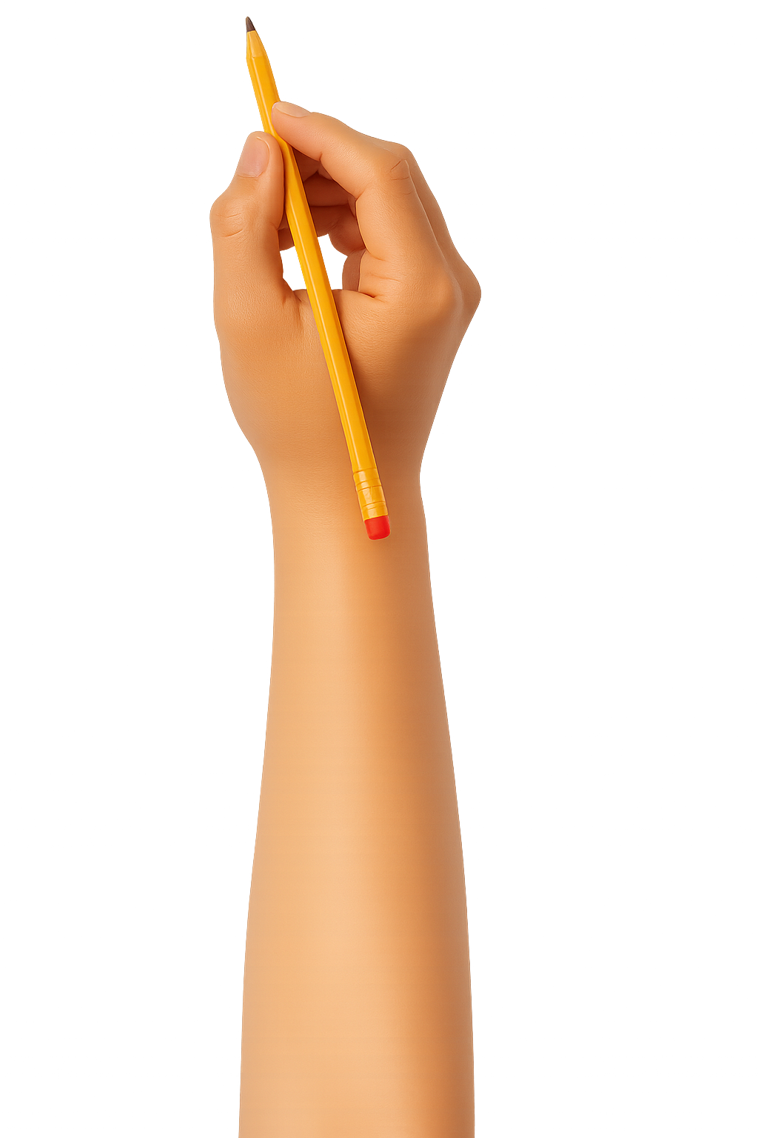
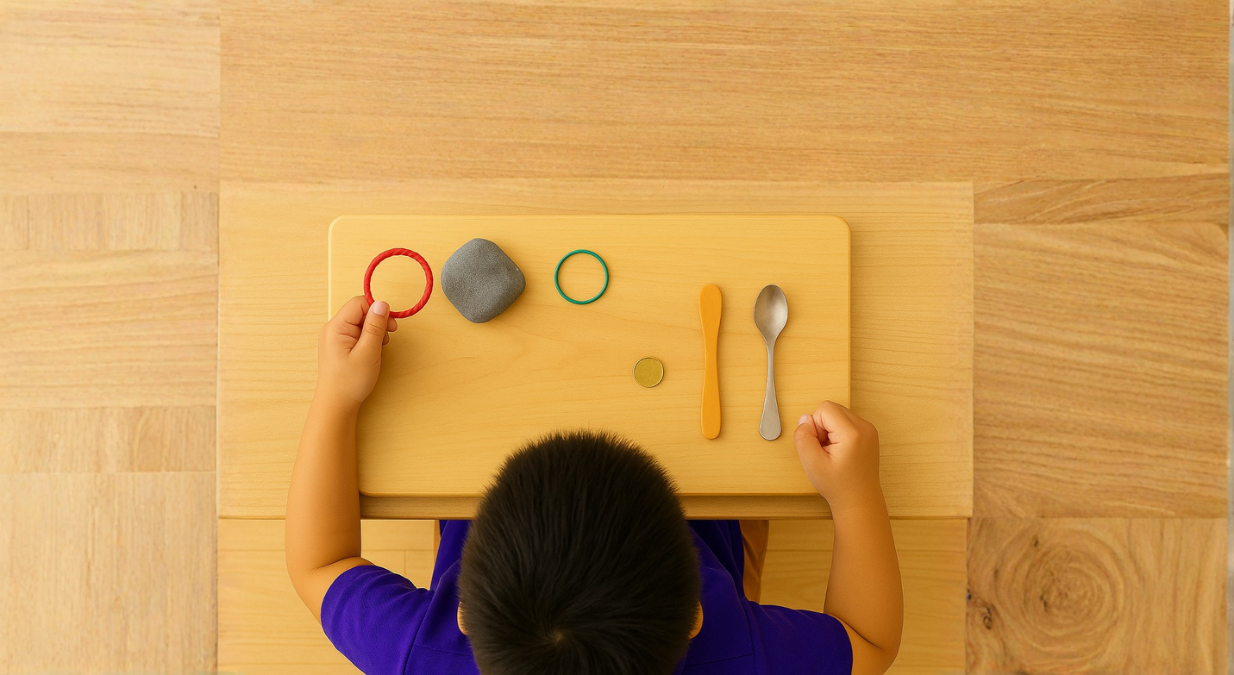


What We Learnt
Exit Ticket
Date: _________
Lesson 1B
You will be successful when you can:
describe properties of objects
sort objects into property groups.
Objects and materials have __________.
Look at the data.
What material was dull?
  A. foil
  B. gold
  C. stone
  D. all of the above
P__________ are guesses about what will happen in the future.
properties
results
shapes
properties
✓= shiny 𝗫 = dull
foil | ✓
gold | ✓
stone | 𝗫
redictions
3
I know _____ out of 3 answers.

Slide 5
Look at the data. What material or materials were shiny?
✓= shiny 𝗫 = dull
foil | ✓
gold | ✓
stone | 𝗫
1
Foil
2
Gold
3
Both gold and foil.

Slide 6
In this lesson, we will learn about length.

Slide 7
You will be able to: ​
compare the length of objects
record comparisons
order objects by length.
Compare: to see how things are the same or different.
Record: to write, draw or mark what you observe or measure.
Order: to line things up based on a rule.

Slide 8
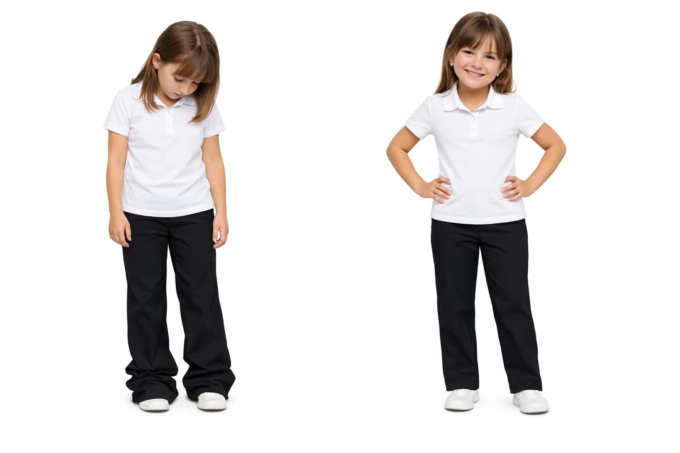


Too long
Shorter

Slide 9

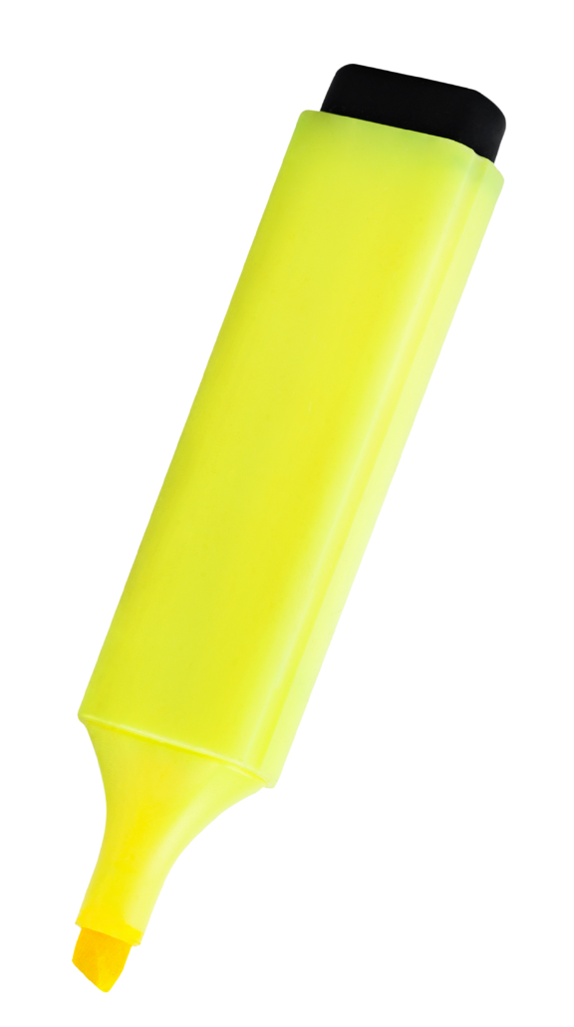


Objects Have Length
end
Length is how long an object is from one end to the other.
Length = space between ends
end

Slide 10
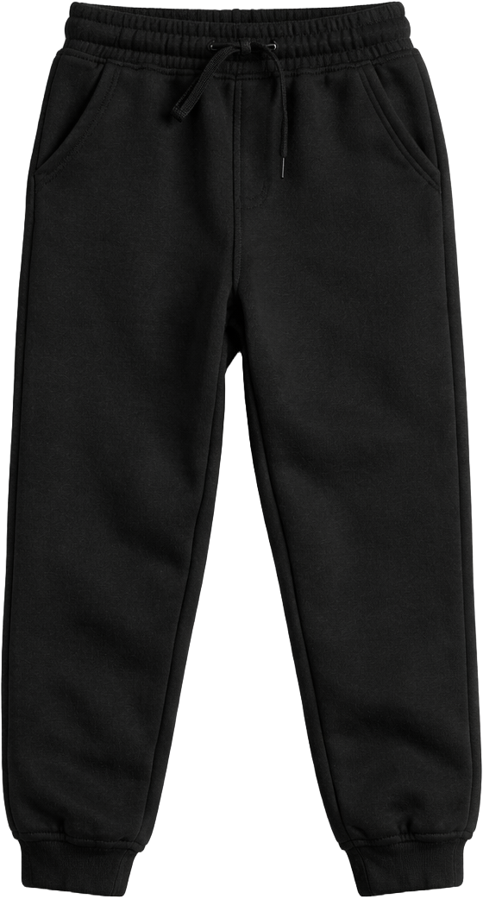
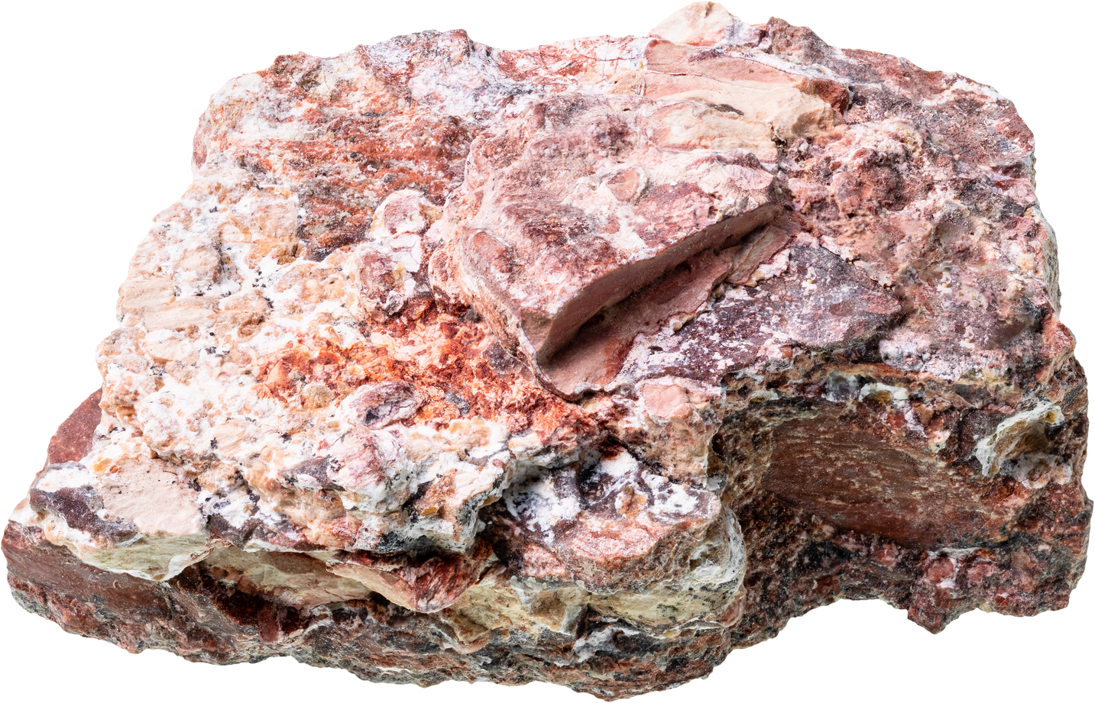
Objects Have Length
Length
Length
Length
Length

Slide 11
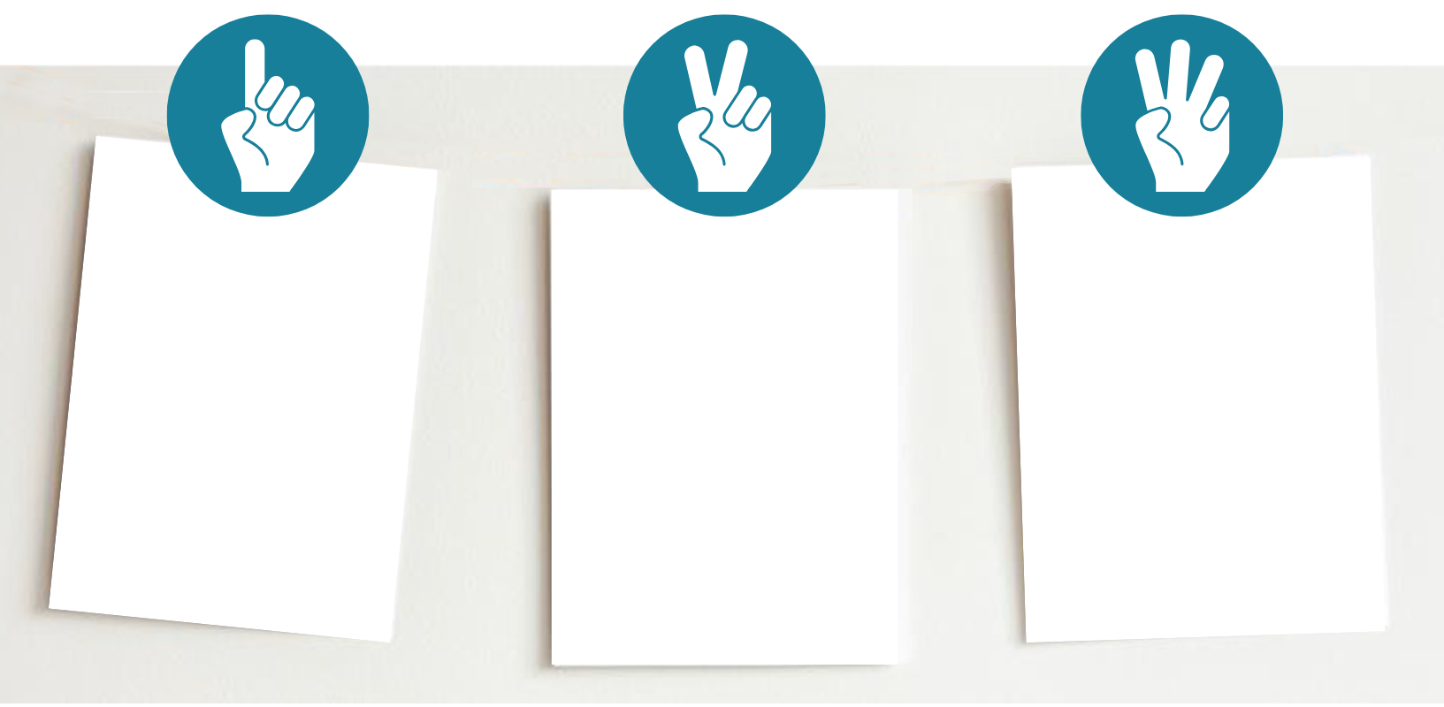
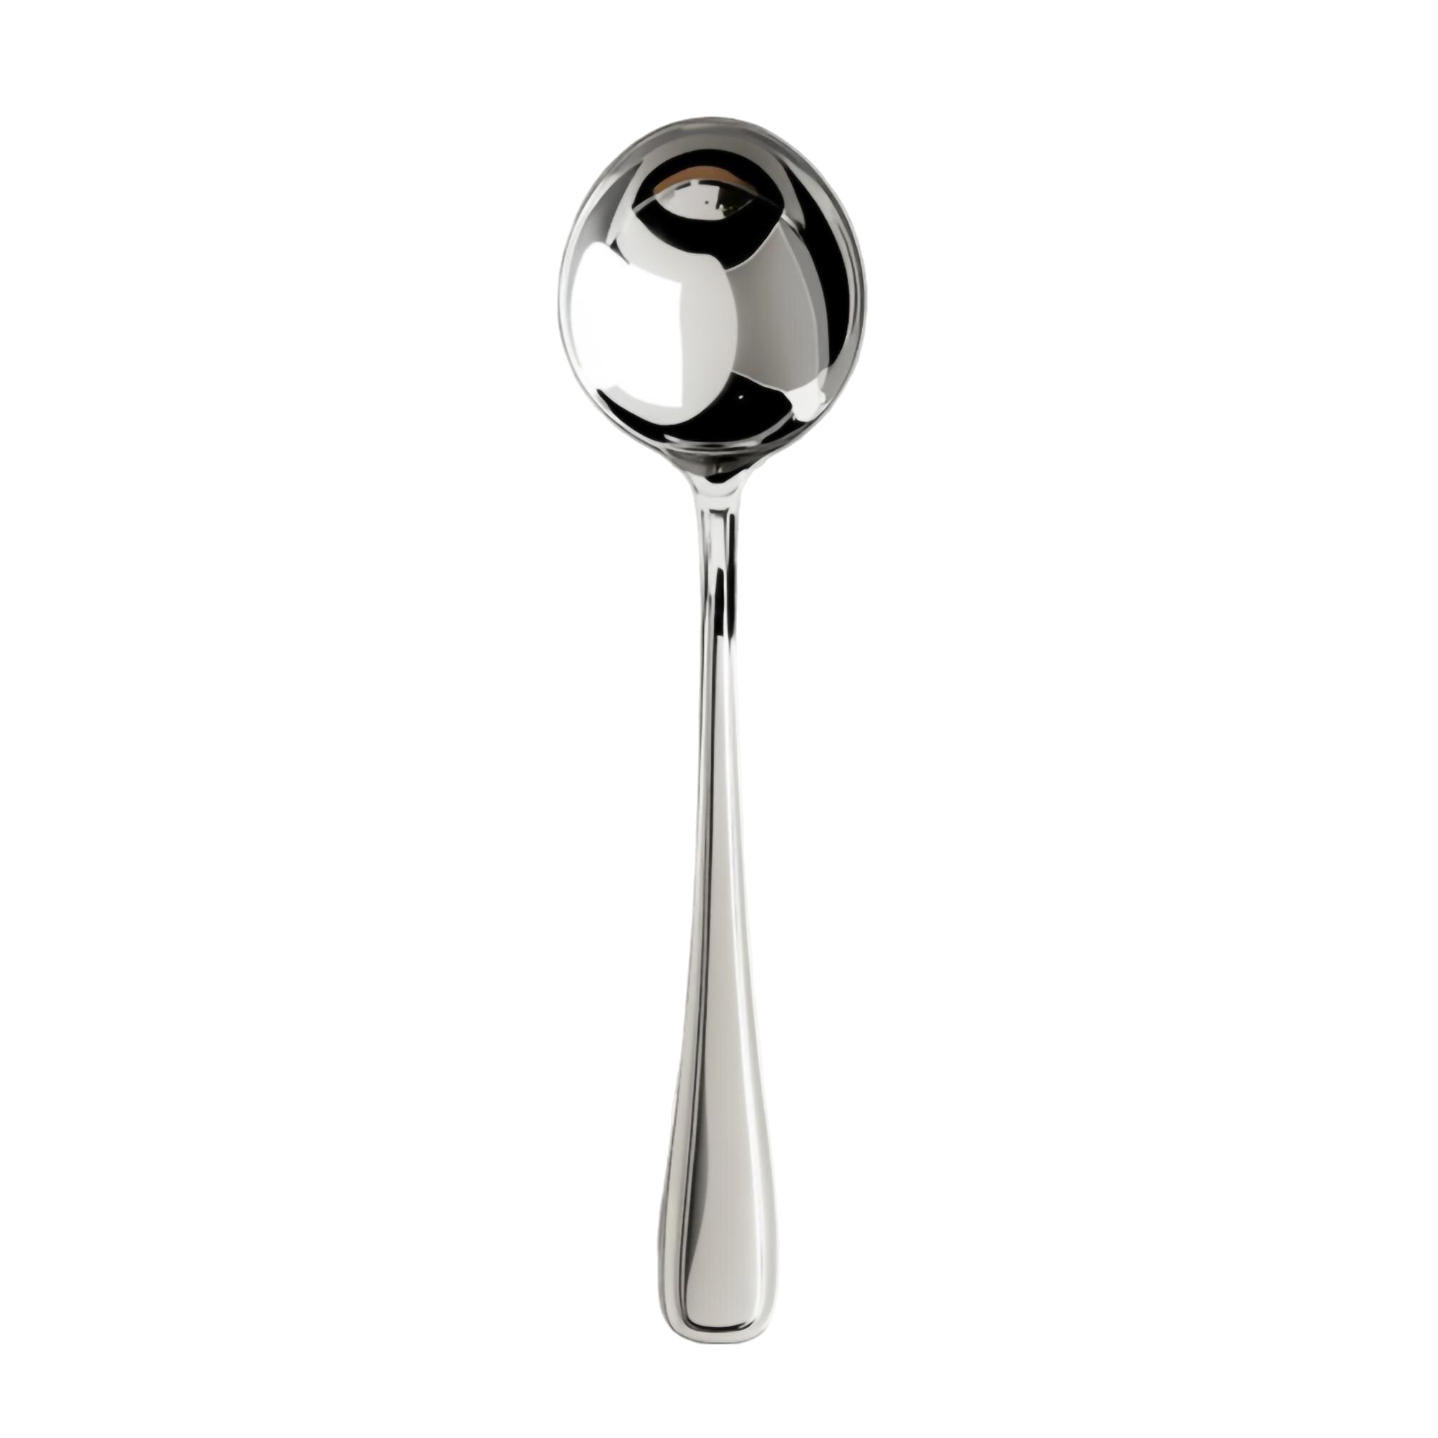
Understanding Data
Which image shows the length of the spoon?

Slide 12
Different Objects, Different Lengths
Shorter Length
Longer Length

Slide 13
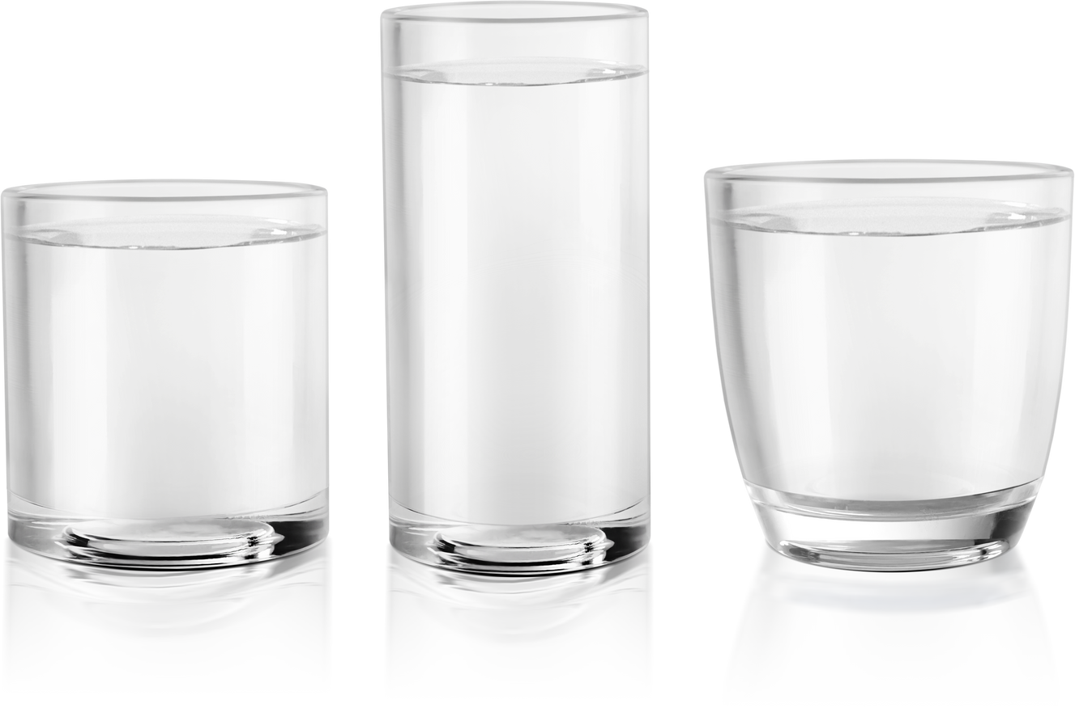
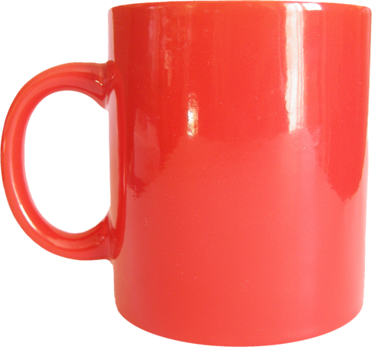
Different Objects, Different Lengths
Shorter
Longer
Longer
Shorter
Same length
Longer
Shorter

Slide 14
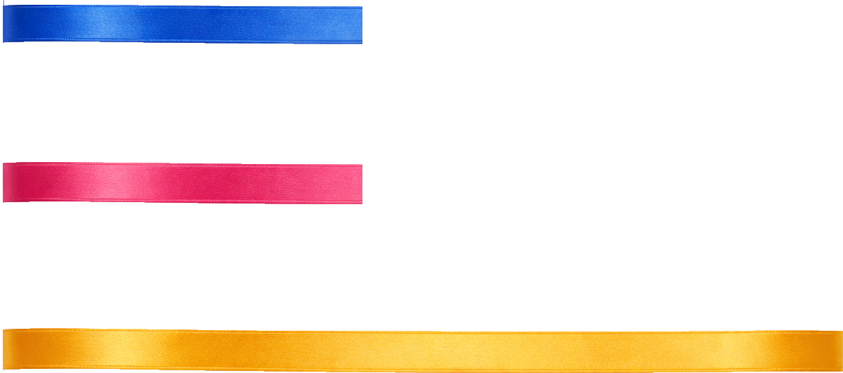
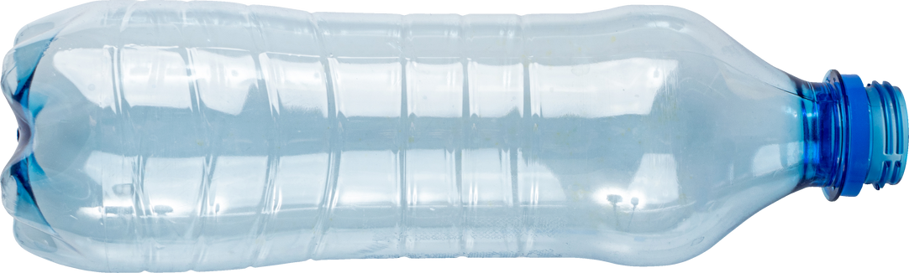
Different Objects, Different Lengths
Which image shows objects with different lengths?

Slide 15
Comparing Lengths
Which object is longer?

Slide 16


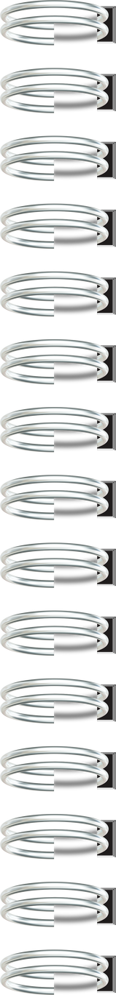

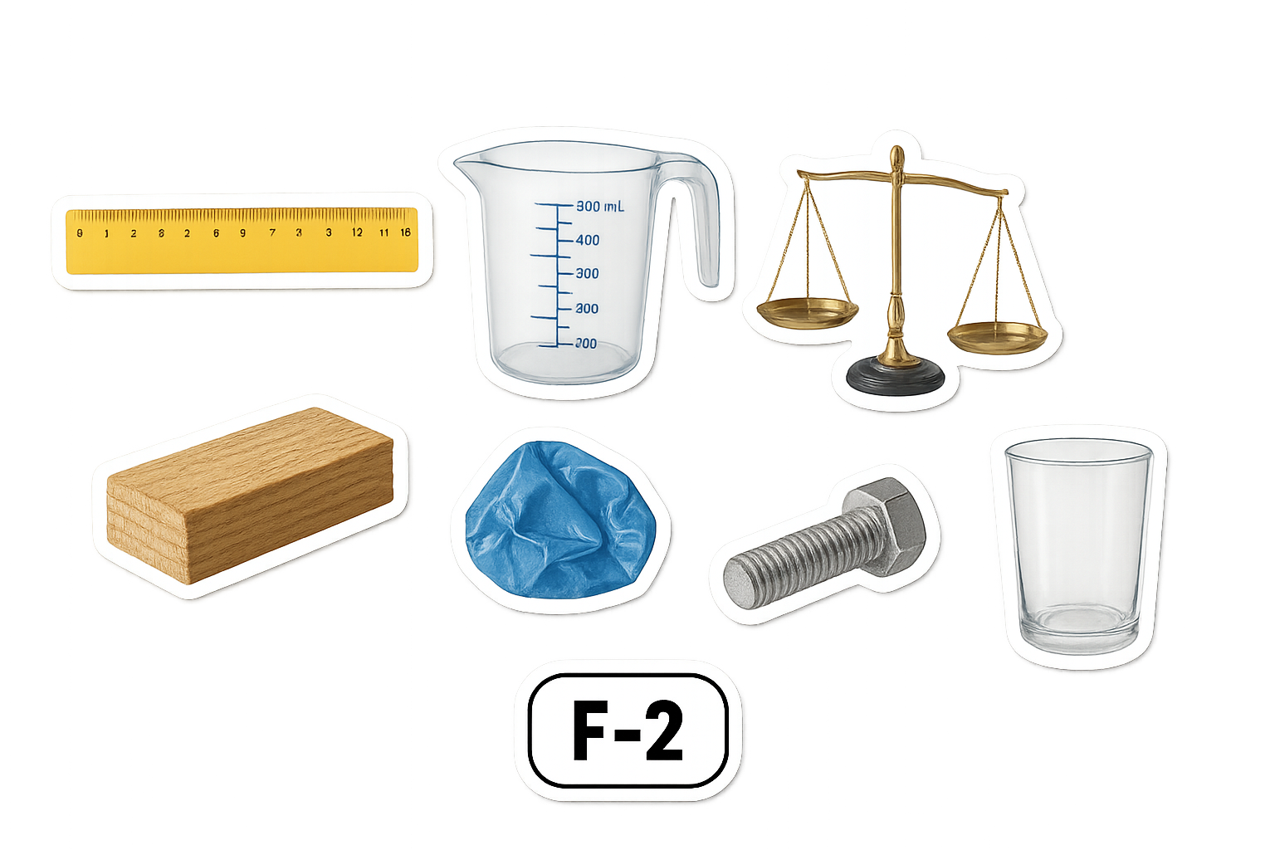
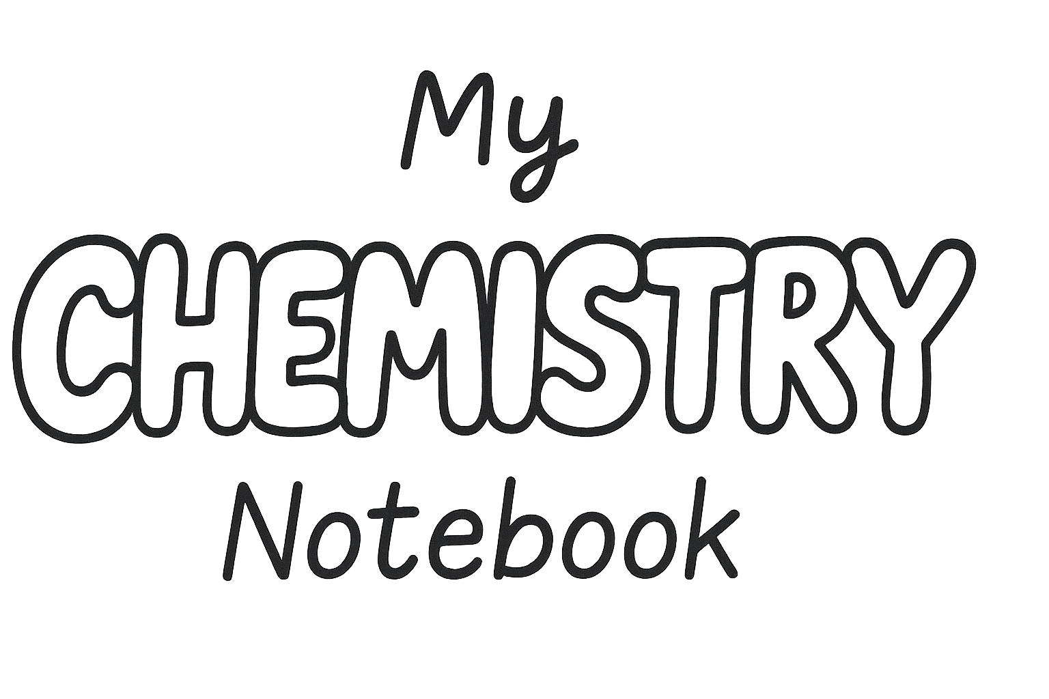
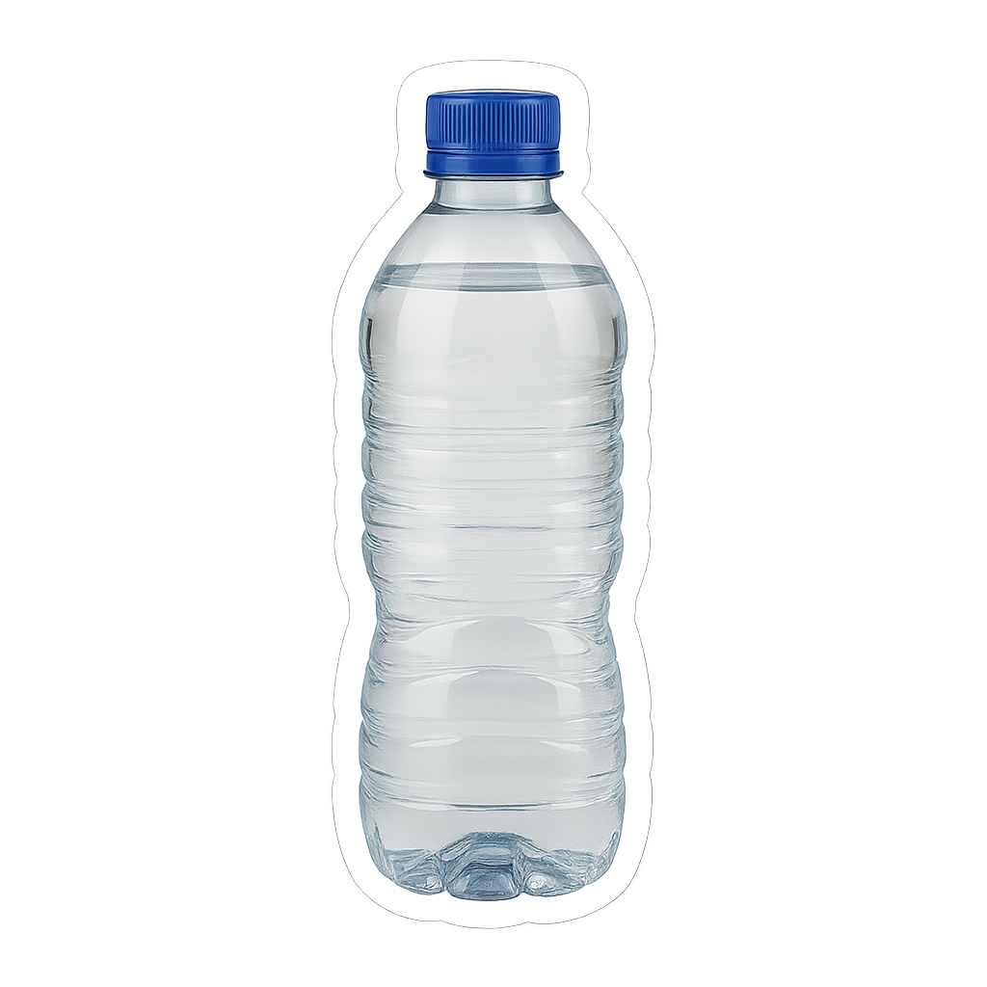

Slide 17

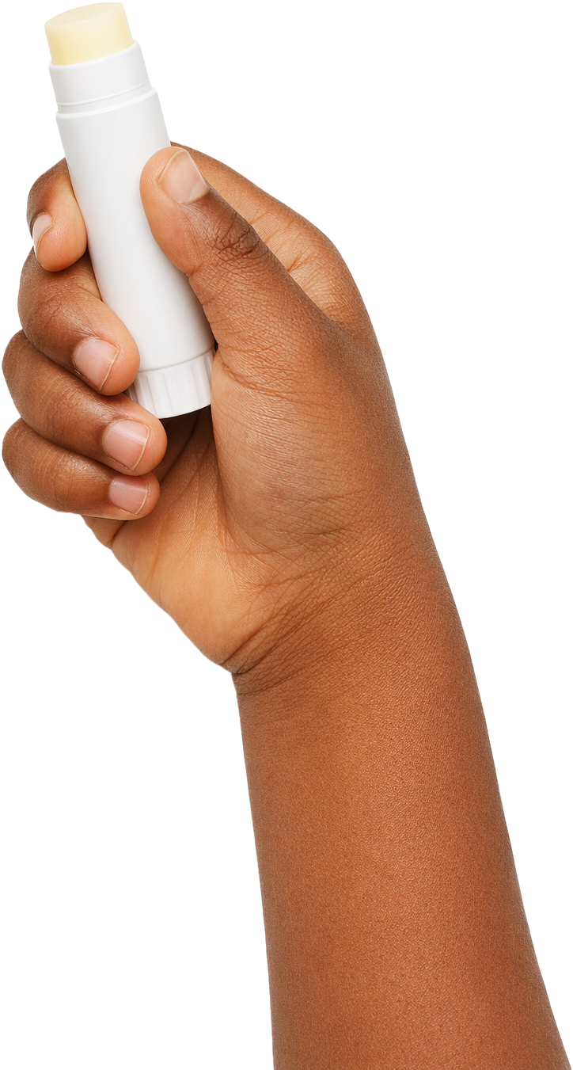
Length
I Do: Comparing Lengths
I Do: Comparing Lengths

Slide 18
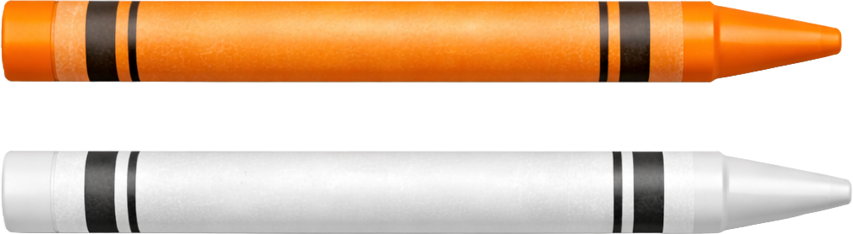
Length
I Do: Comparing Lengths
I Do: Comparing Lengths

Slide 19
Length
We Do: Comparing Lengths
You Do: Comparing Lengths

Slide 20


Comparing Lengths
This is the correct way to place the crayons on the grid.

Slide 21

Length
We Do: Comparing Lengths
You Do: Comparing Lengths
Compare red and green crayons here.

Slide 22
Recording Comparison
Which object is longer?
shorter
longer

Slide 23
Length
I Do: Recording Comparisons
shorter
longer
I Do: Recording Comparisons

Slide 24
Length
I Do: Recording Comparisons
shorter
longer
I Do: Recording Comparisons
same length

Slide 25
Length
We Do: Recording Comparisons
shorter
longer
You Do: Recording Comparisons

Slide 26
Comparing Lengths
These crayons are labelled correctly.
longer
shorter

Slide 27
Length
We Do: Recording Comparisons
shorter
longer
You Do: Recording Comparisons
longer
Label with ‘shorter’ and ‘longer’
or ‘same length
shorter

Slide 28
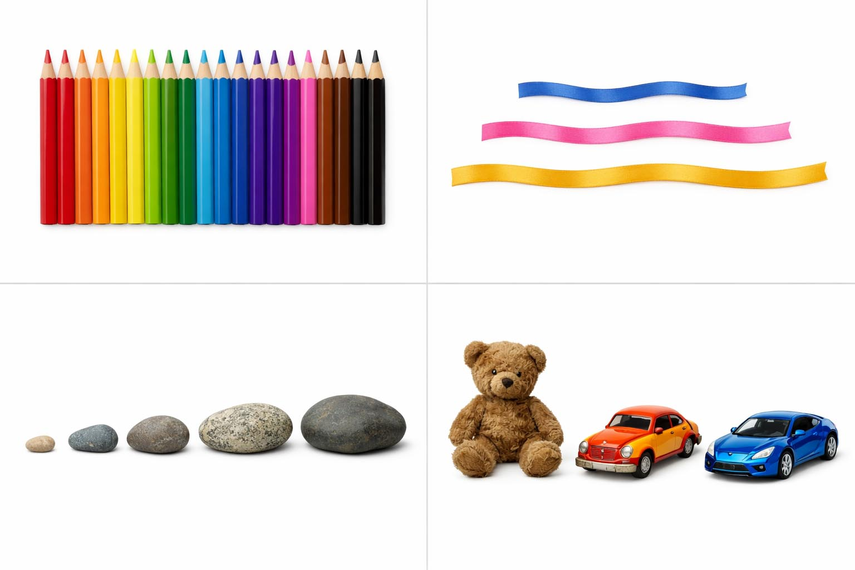

Ordering Objects
Order means to line things up based on a rule.
Length
Colour
Size

Slide 29
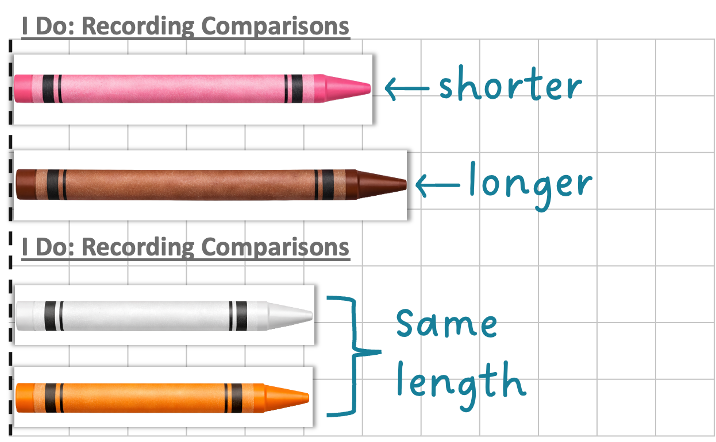
Length
I Do: Ordering Objects
Order of crayons from shortest to longest: __________, _____, _____
white/orange
pink
brown

Slide 30
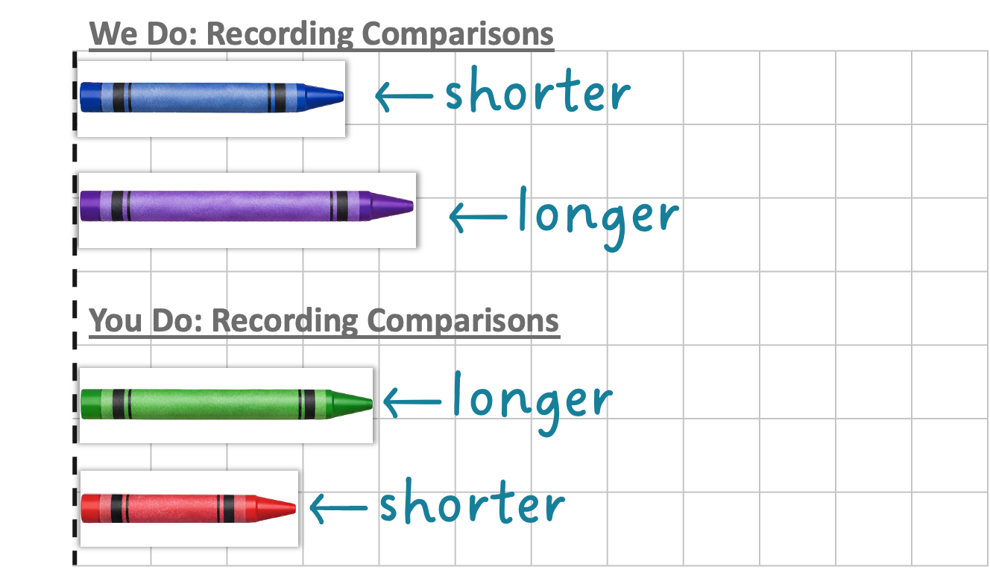
Length
We Do: Ordering Objects
Order of crayons from shortest to longest: _______, _______, _______, _______
red
blue
green
purple

Slide 31
Ordering Objects
The shortest crayon in this image is the brown crayon.

Slide 32

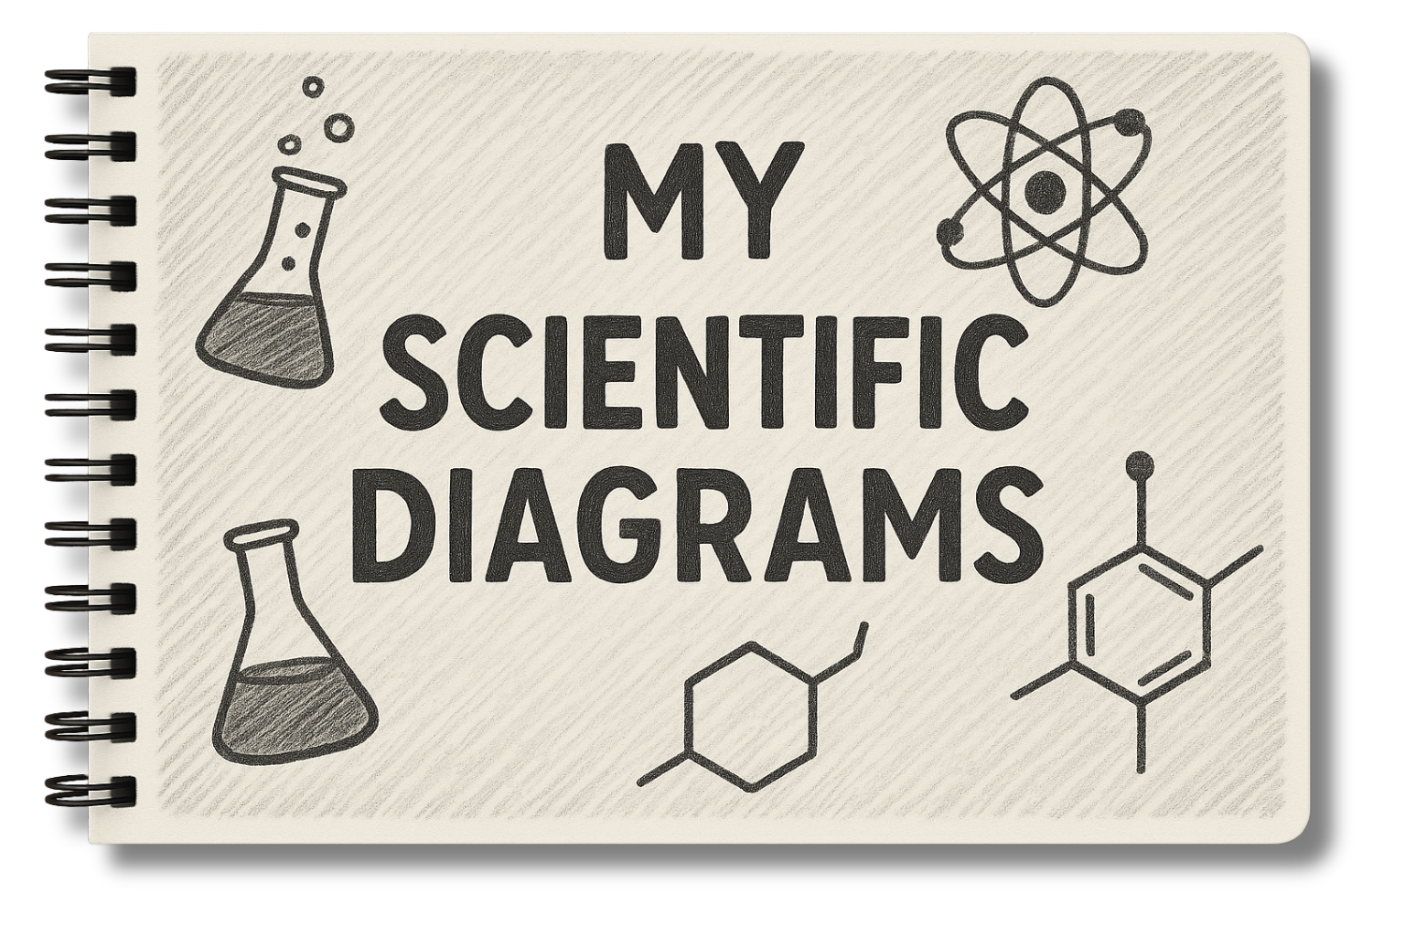
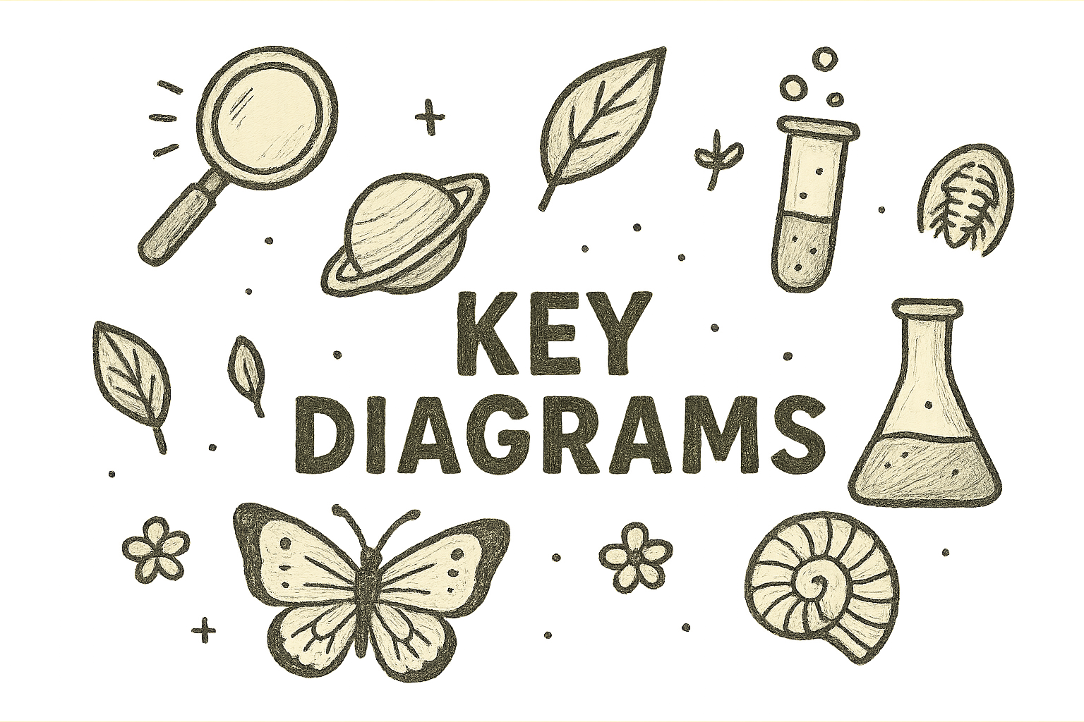

Slide 33



Length is how long an object is.
length
end
end

Slide 34
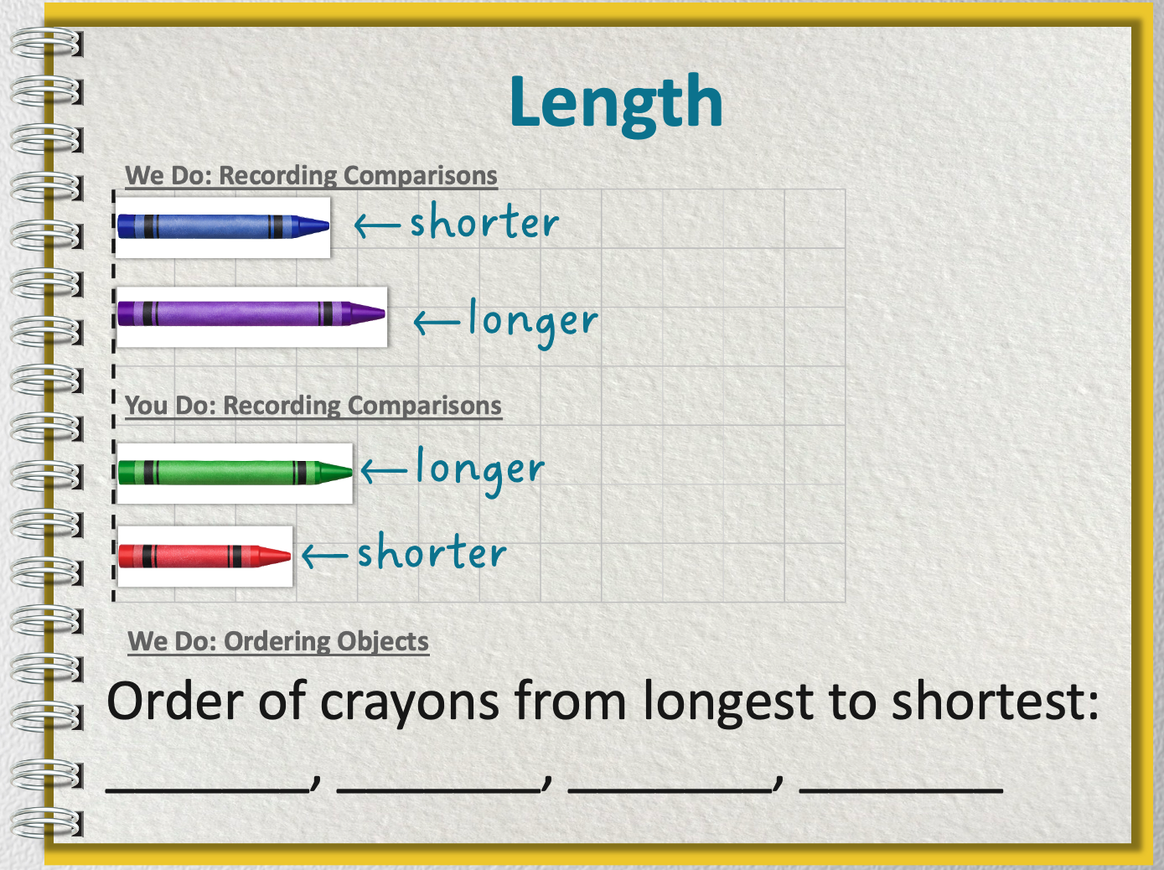

How would be order our crayons from longest to shortest?

Slide 35

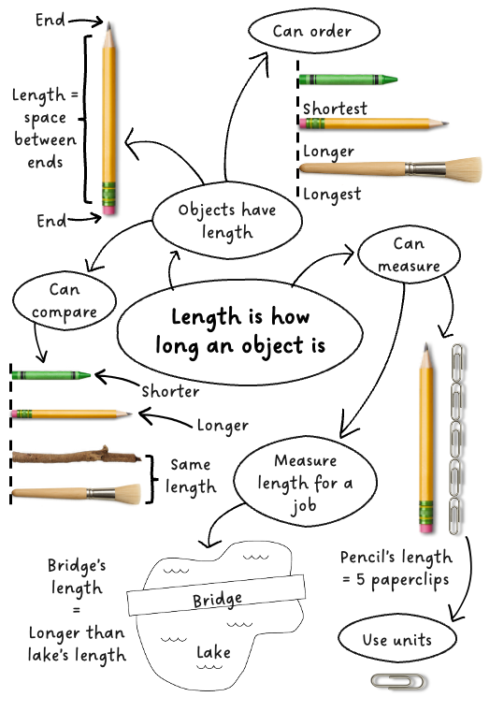



Learn more
Teach someone
I understand
Challenging

Slide 36


Exit Ticket
Date: _________
Lesson 1A
Lesson 2A
long
1. Length is how _____ an object is.
2.
The ribbon is __________ the pencil.
  A. shorter than
  B. longer than
  C. the same length as
Scientists o_____ things by lining them up based on a rule.
shiny
long
bendy
rder
3
I know _____ out of 3 answers.

Slide 37
In the next lesson, we will learn how to measure length.

