Slide 1

Science
Chemistry
Lesson 1A
Objects
Version 2

Slide 2


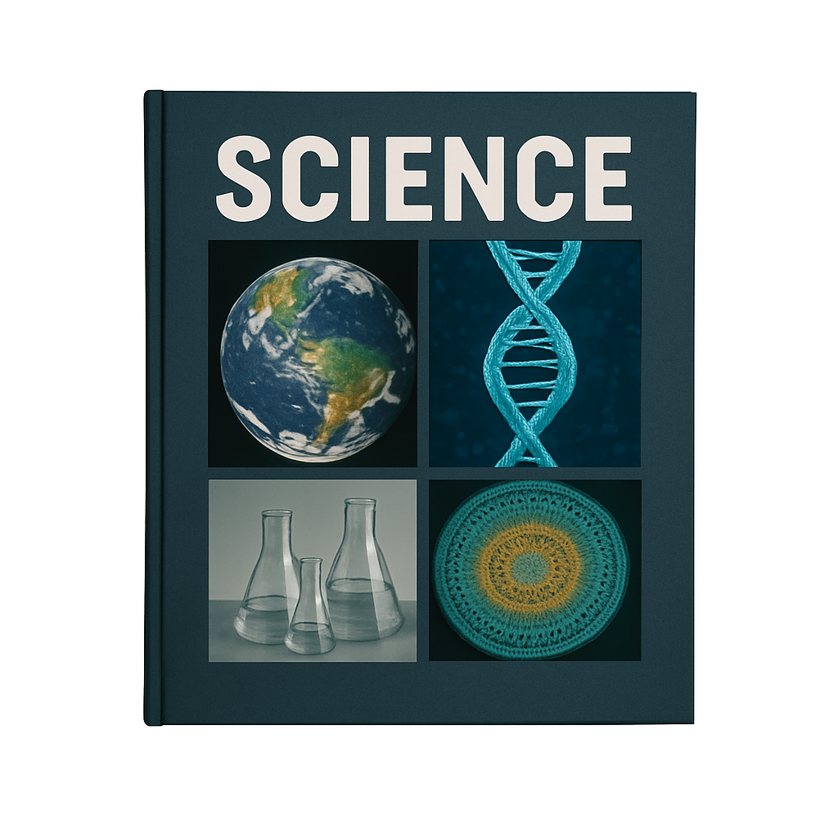
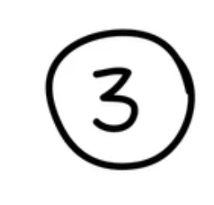















Remember what we’ve learnt
Organise ideas
Helps put information IN
Show thinking
Purpose
Visualise thoughts
Helps take information OUT
Concept maps help us organise information and show how different concepts fit together.
You can see:
Last levels: details or subconcepts
Read information
Radiate outwards
Pictures
Centre circle: key idea
Words
Next level: main concepts

Slide 3
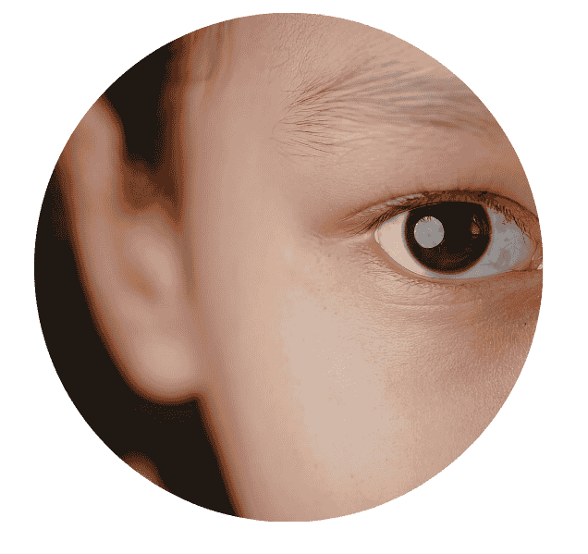
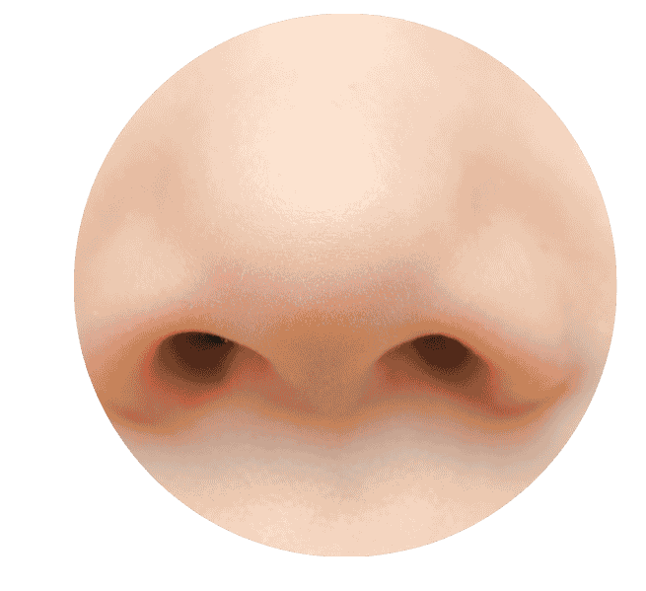
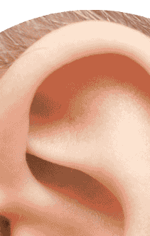
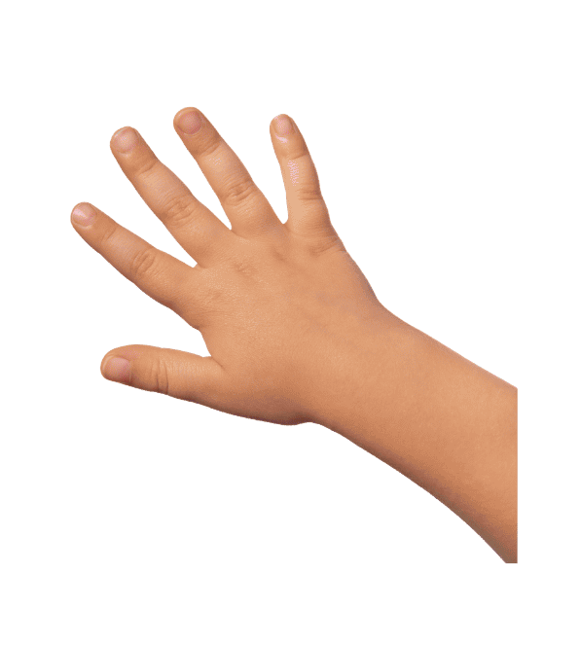
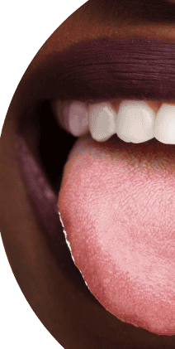

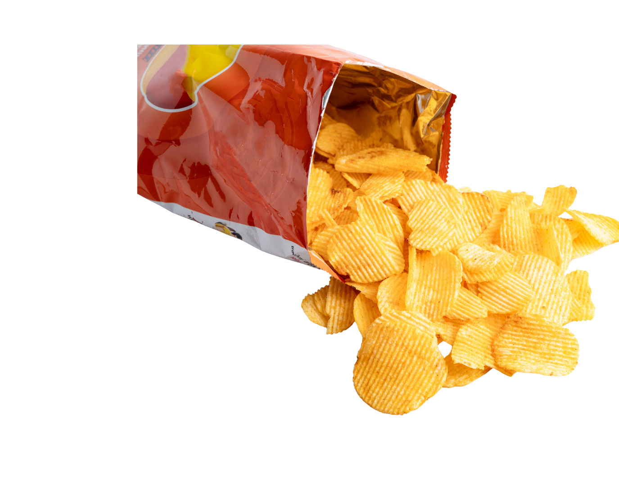
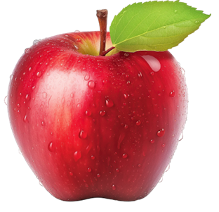


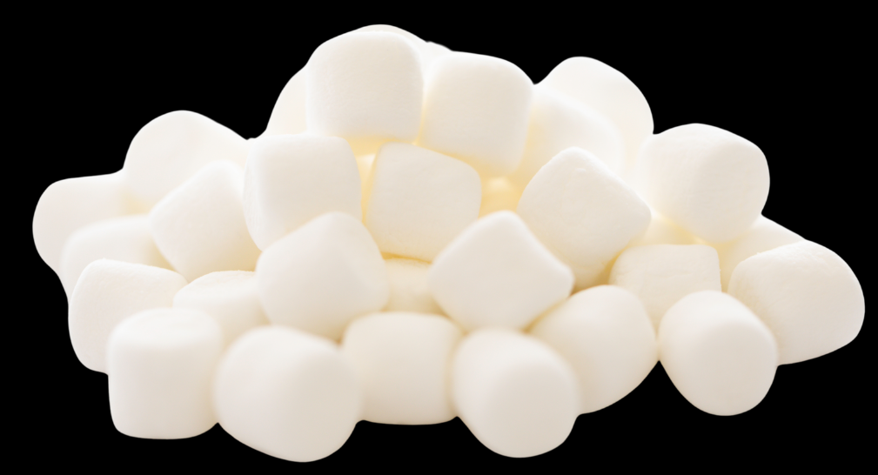


Look
Smell
Hear
Touch
Observe
Feel
Taste
An object is something you can touch and has properties.
Makes a sound
Size
Has a smell
Properties
Big or small
Colours
Hard or soft

Slide 4
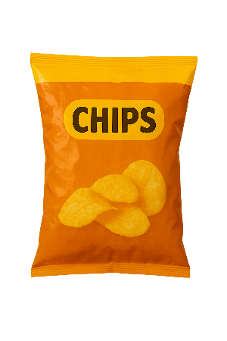
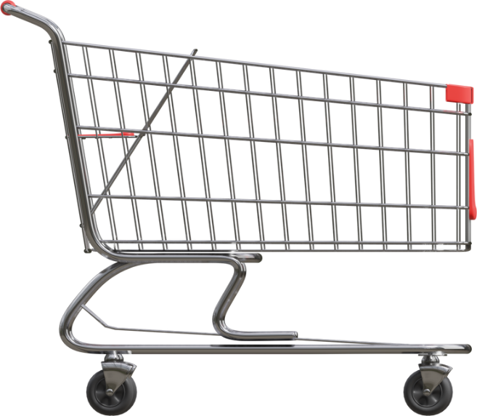
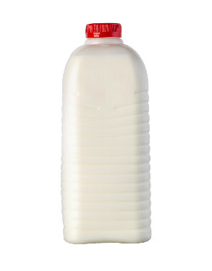

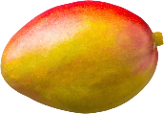
In this lesson, you will learn about objects.

Slide 5
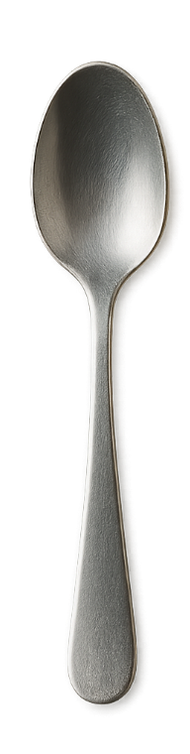
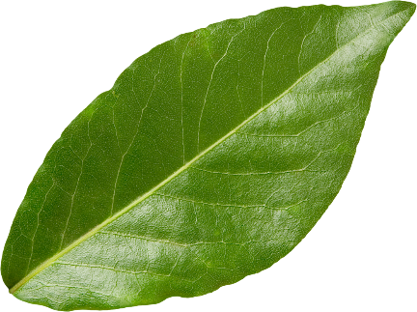
You will be able to: ​
identify objects
make a claim about an object.
Identify: To find or name something.
Make: To create something.

Slide 6
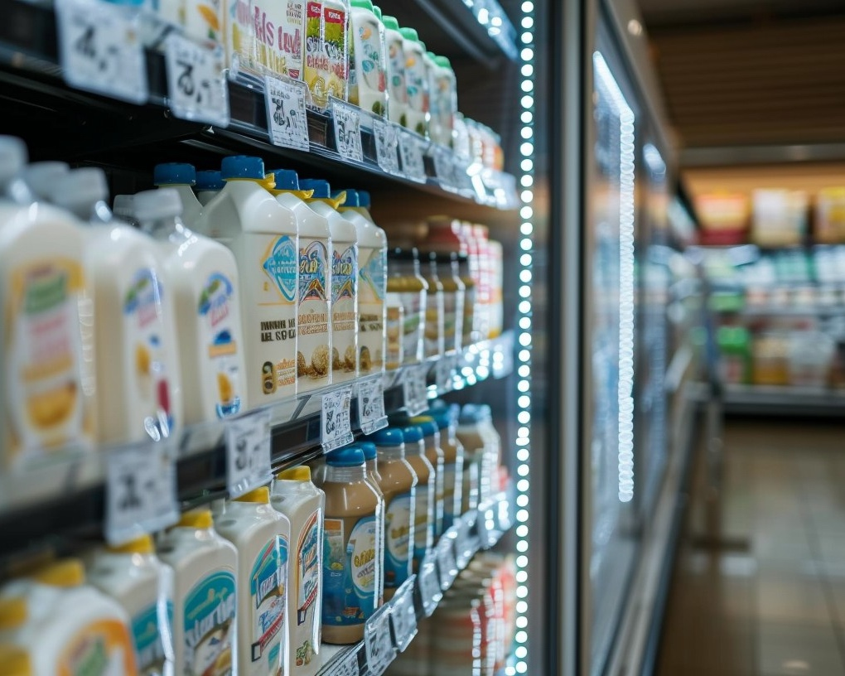
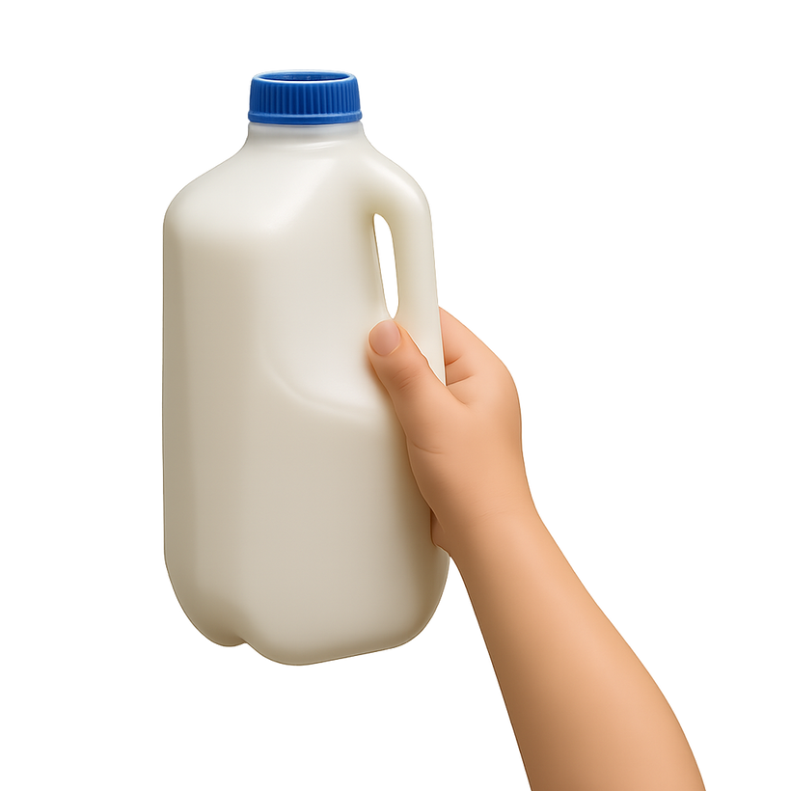
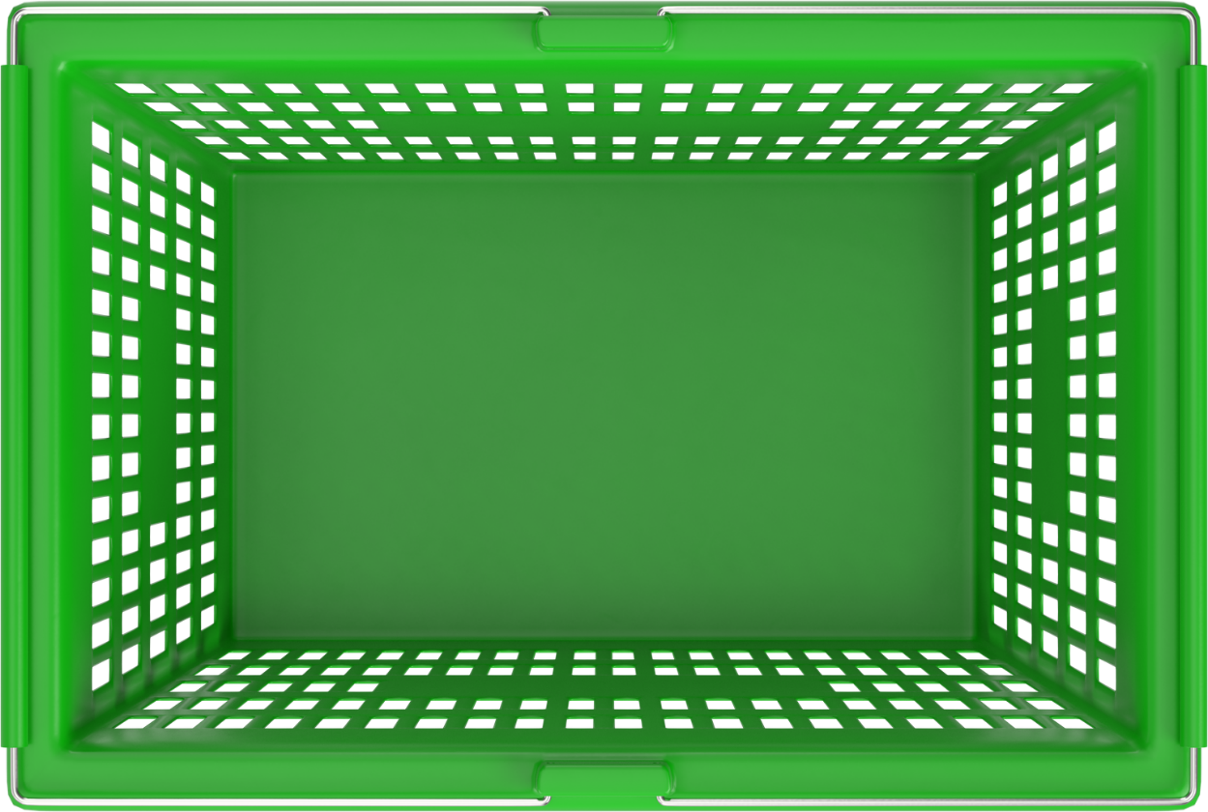
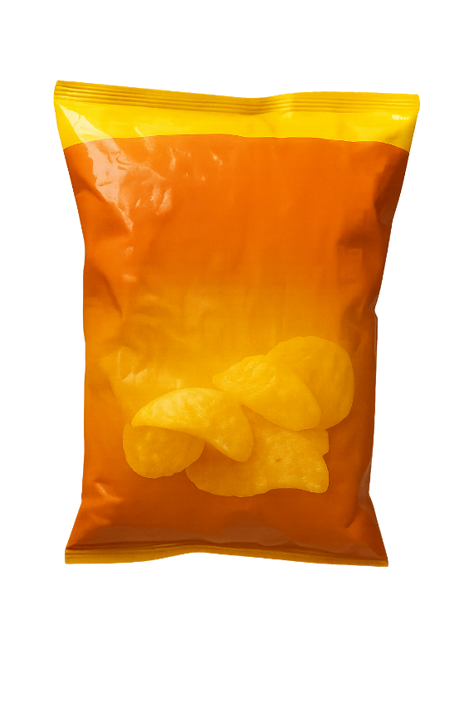
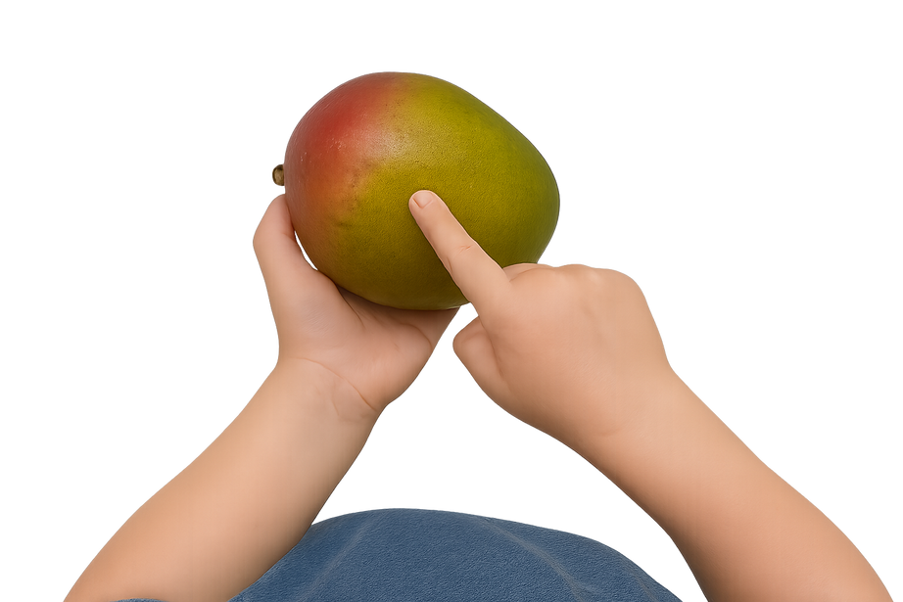
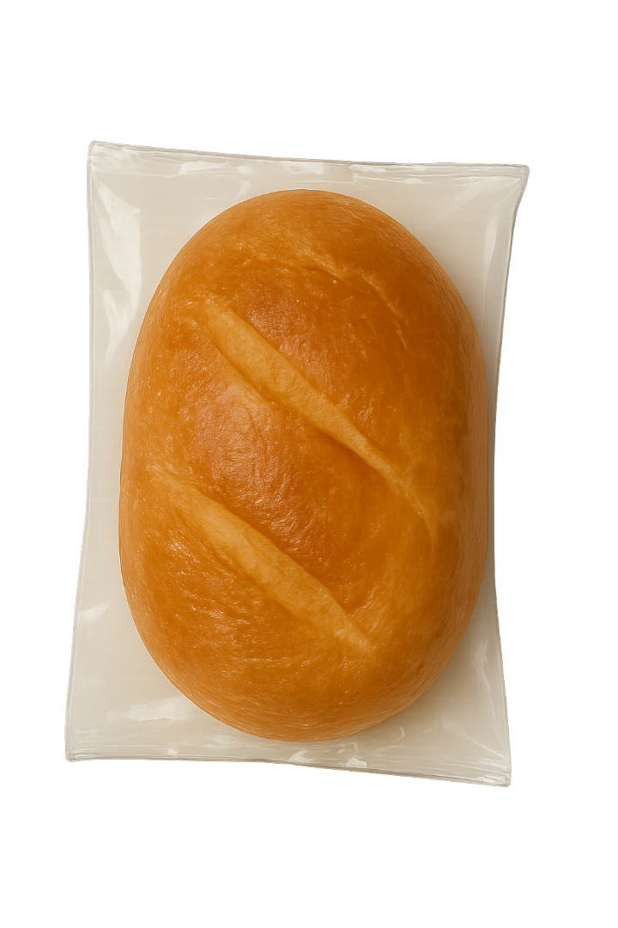
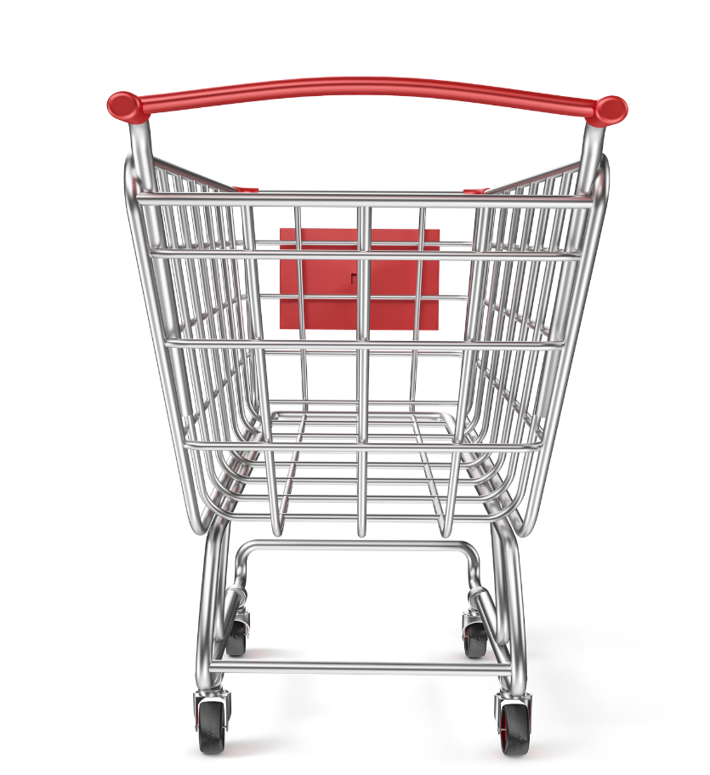

Slide 7
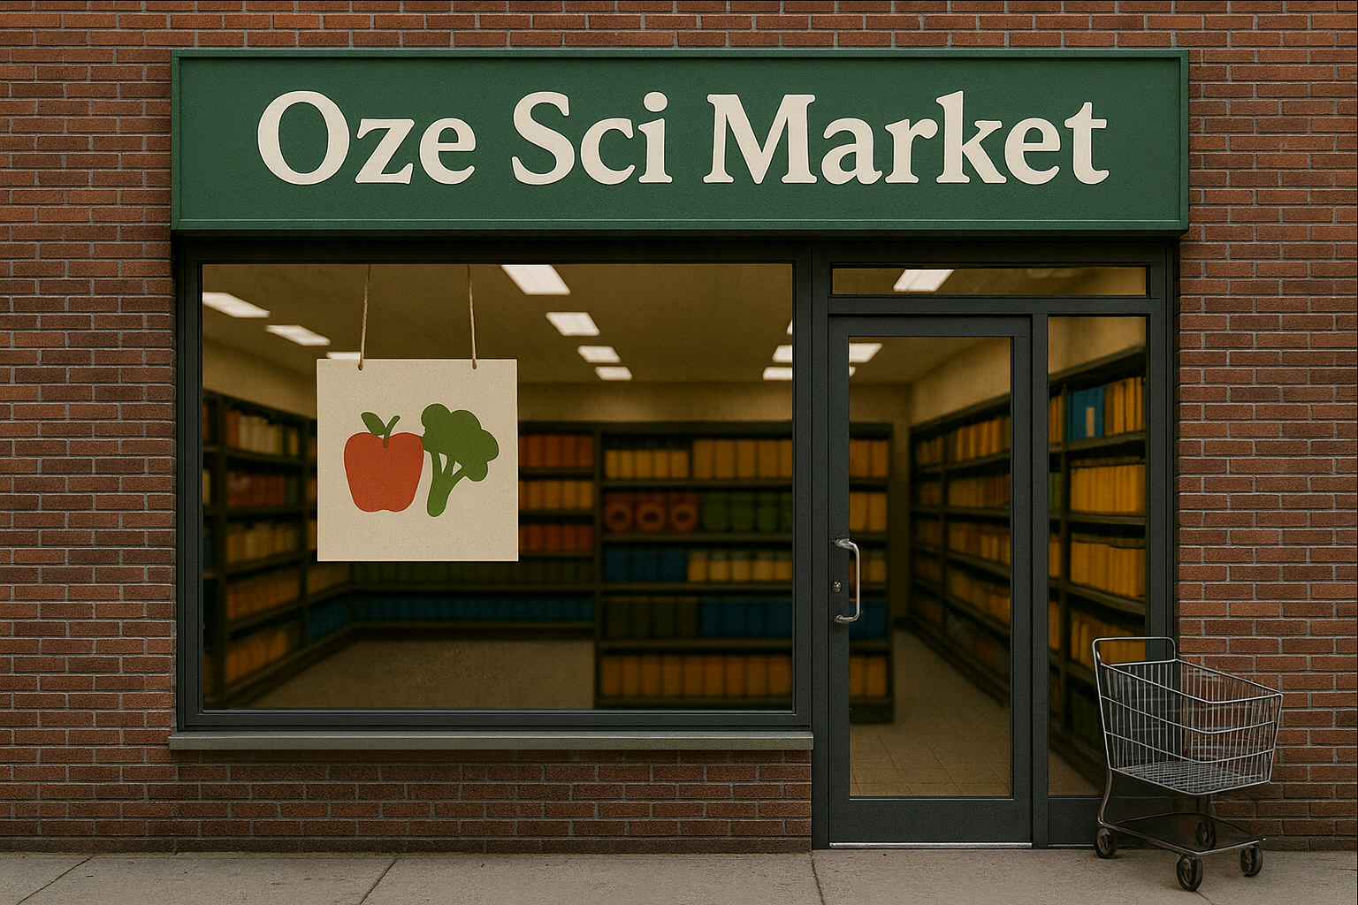
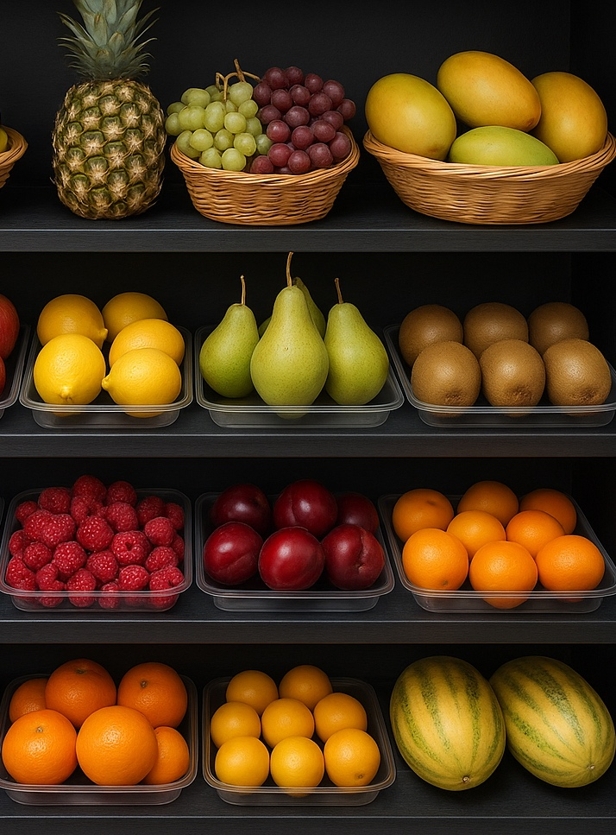
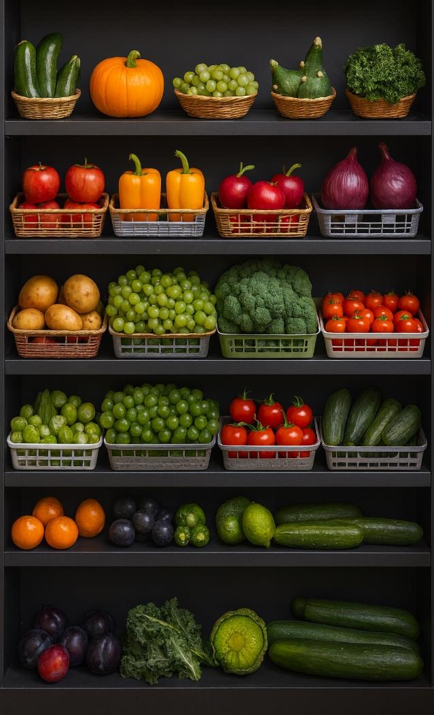
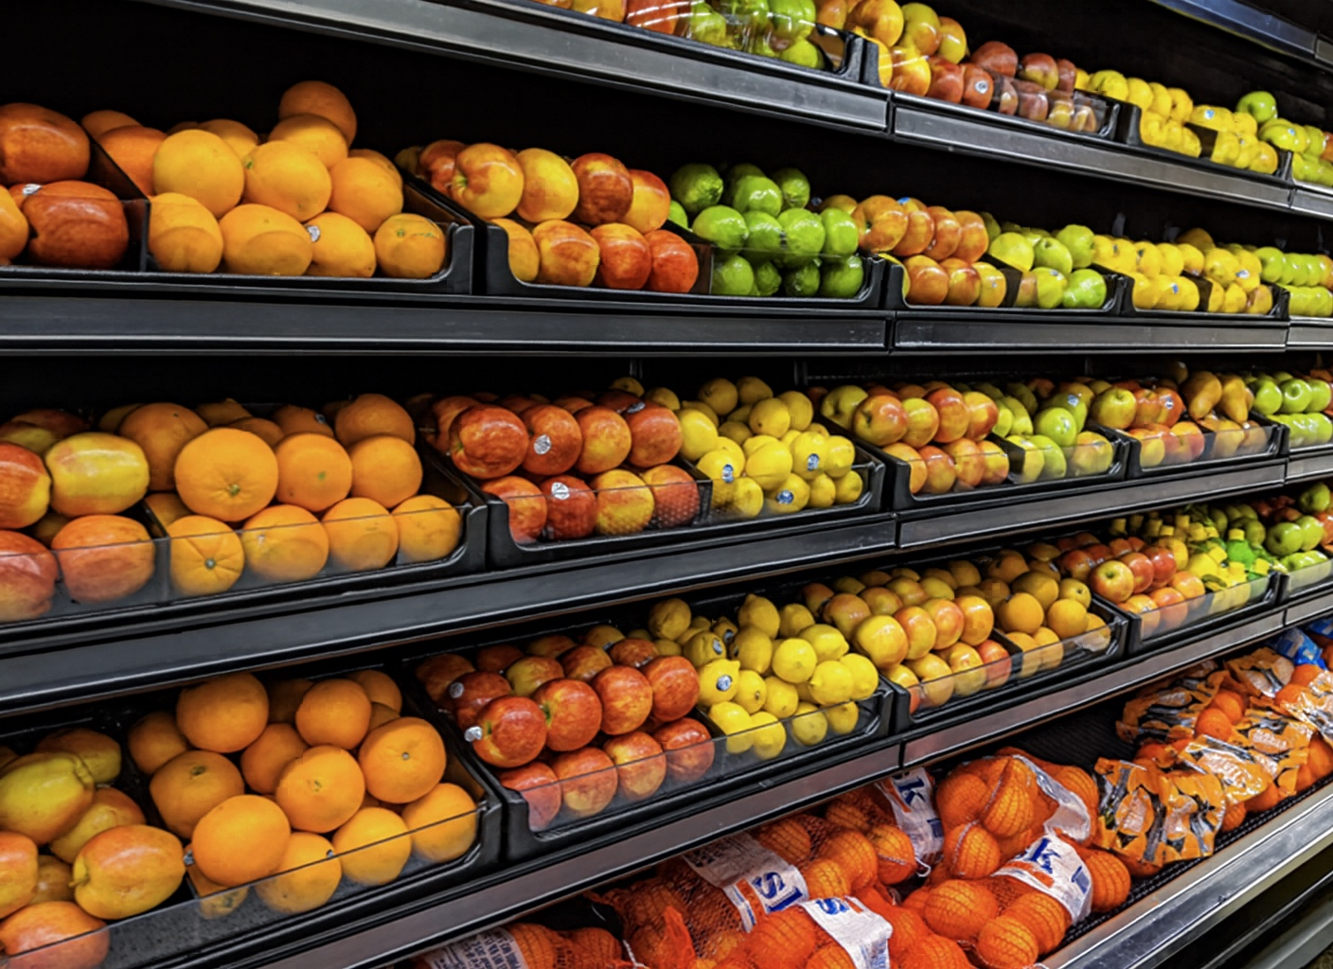

object

Slide 8



object

Slide 9
object

Slide 10


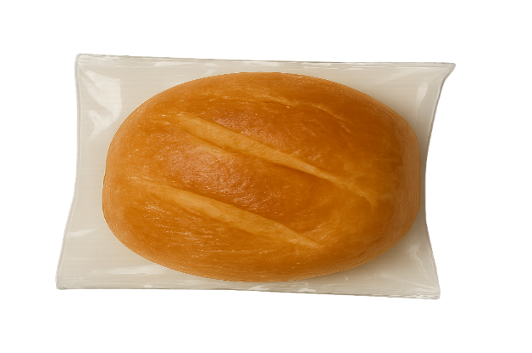
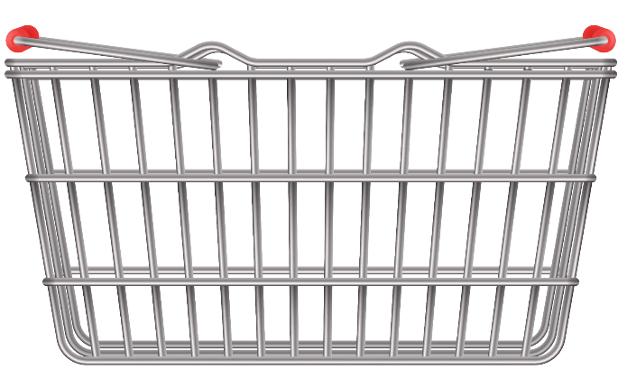
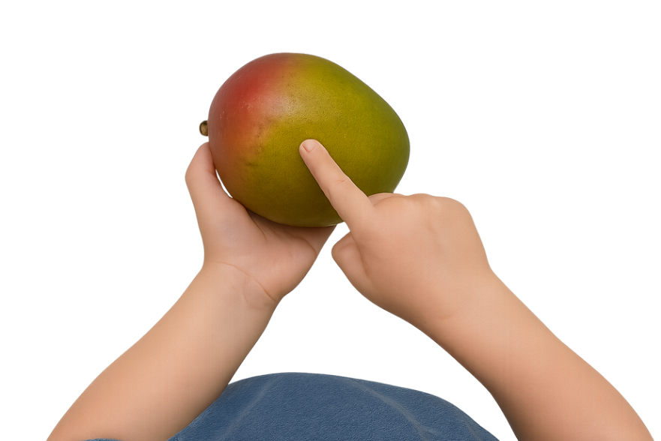
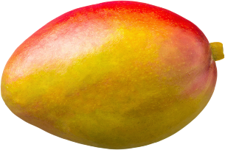
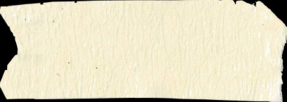
objects

Slide 11
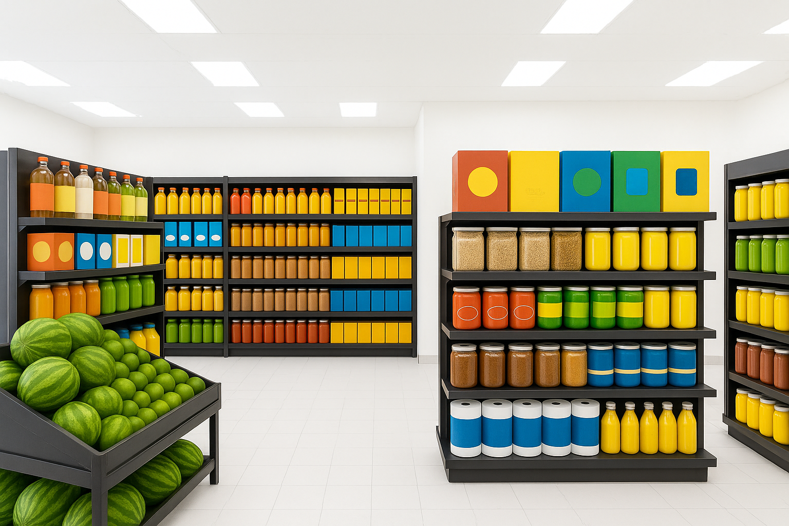
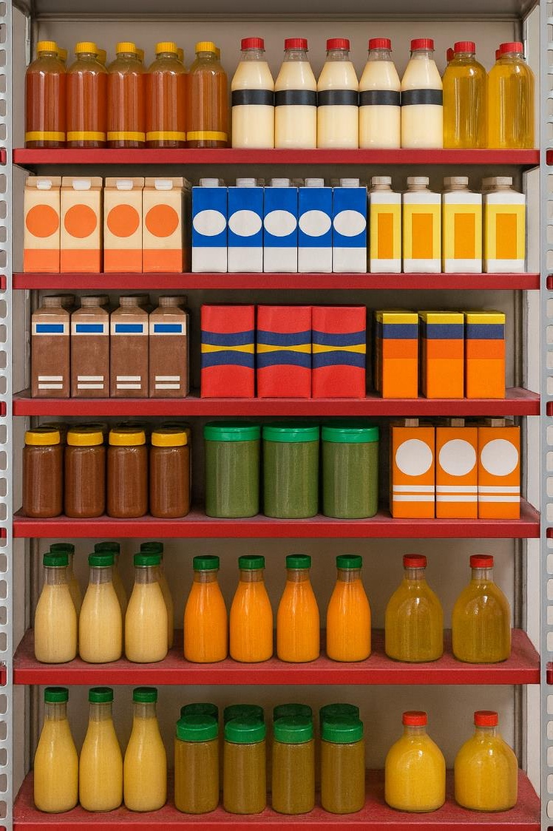
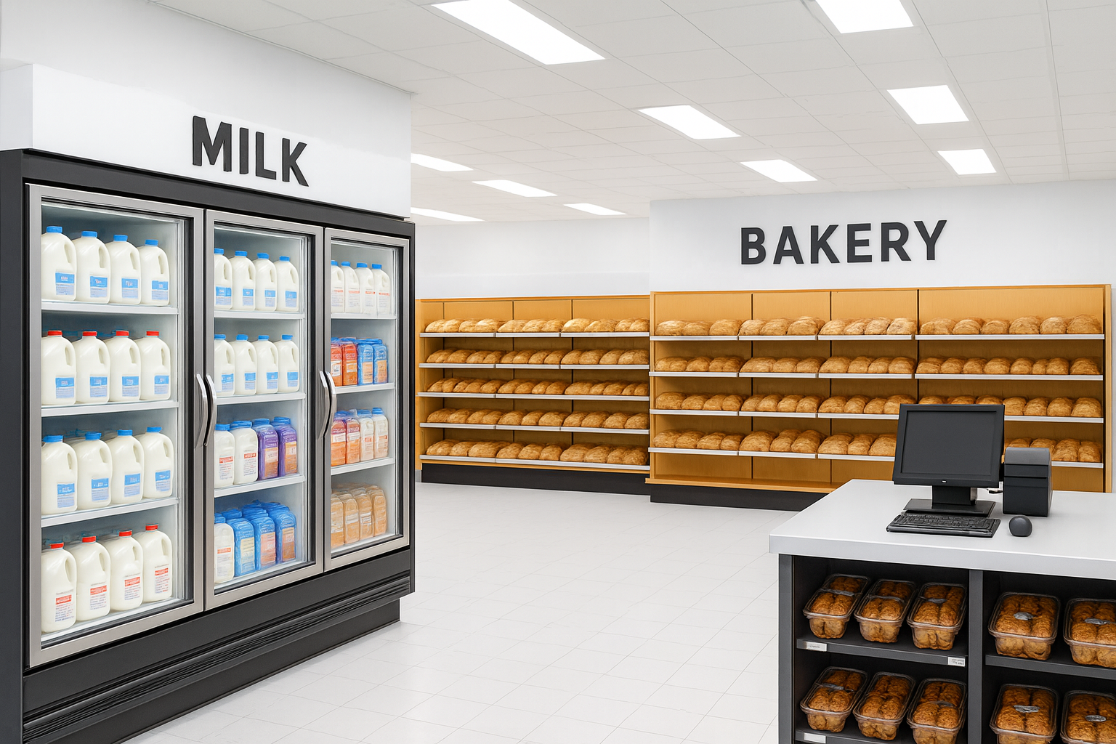
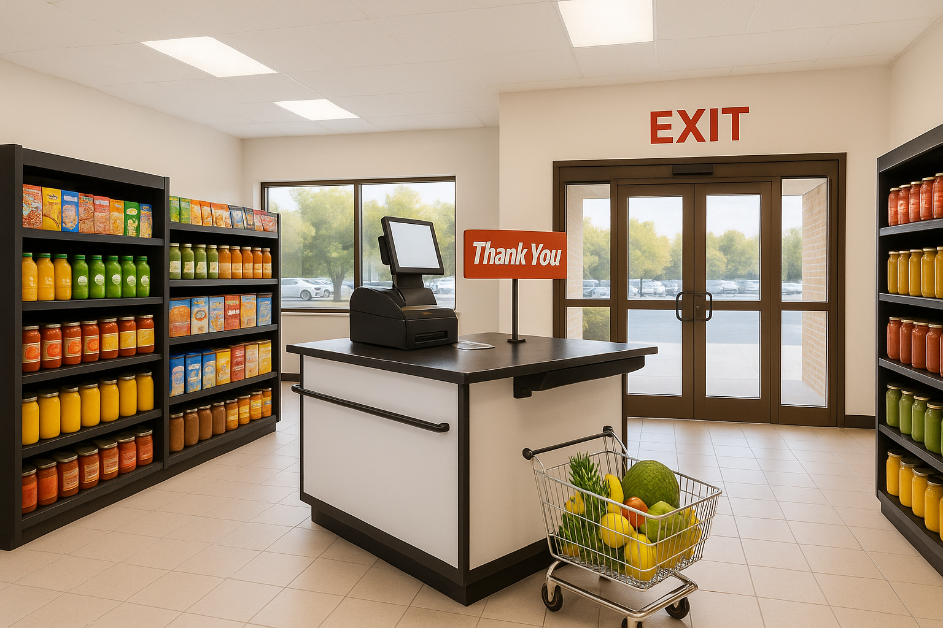
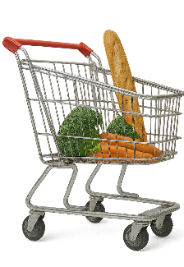
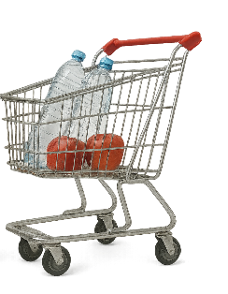
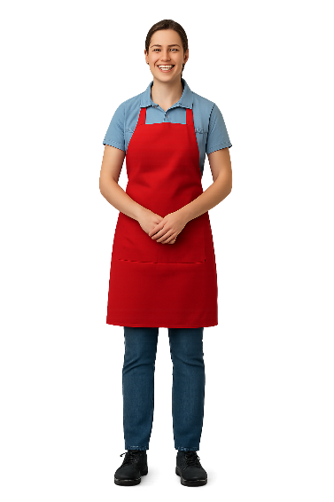

Slide 13



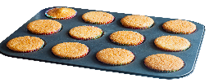

Slide 14


Slide 15

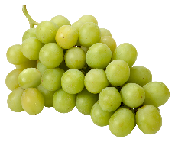
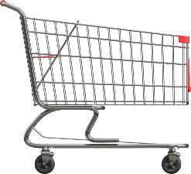
Show of Fingers
Which of these is not an object?

Slide 16

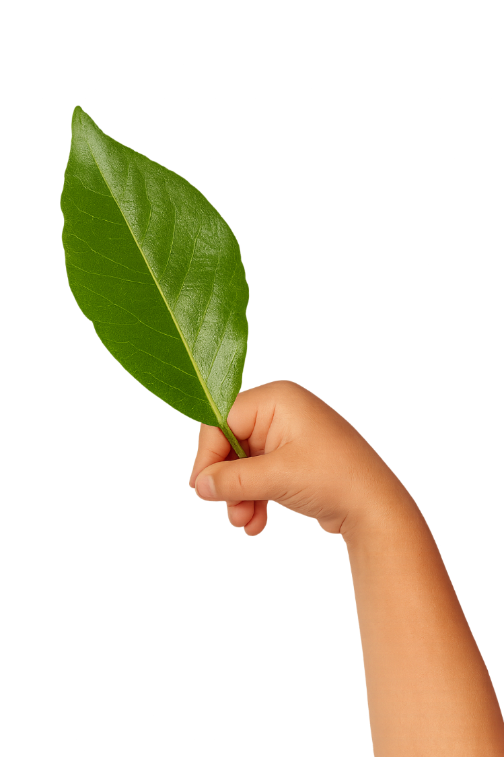
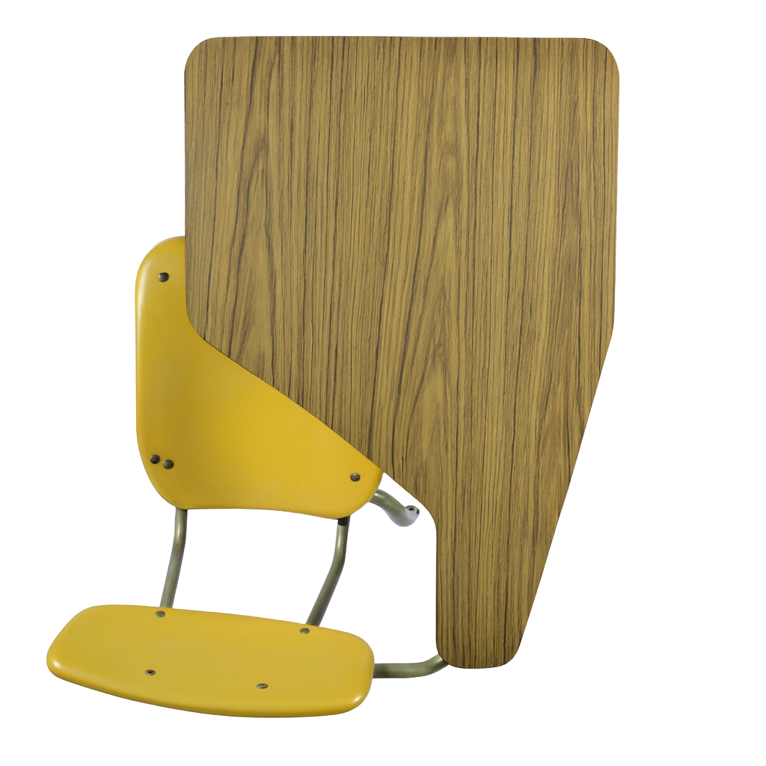

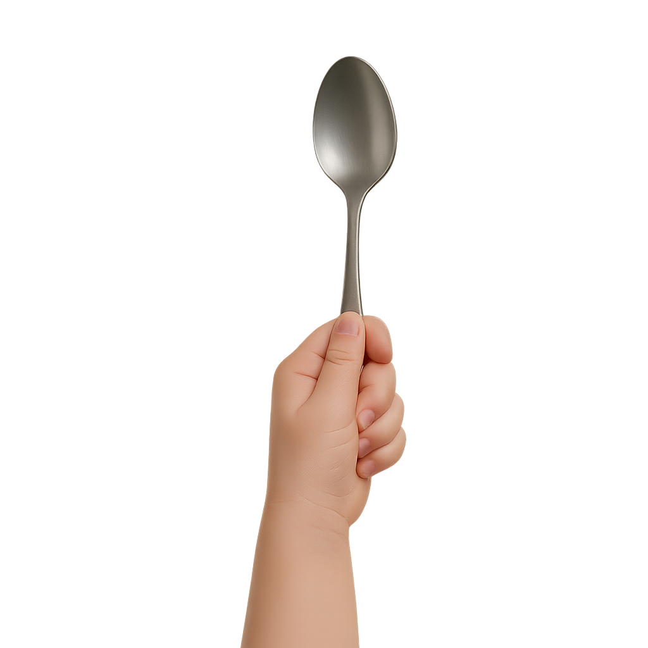
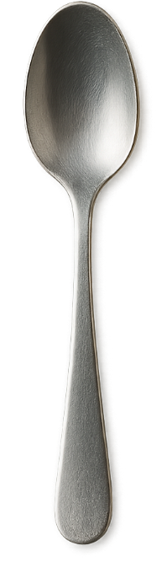
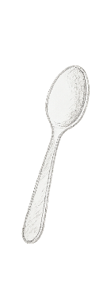
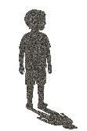
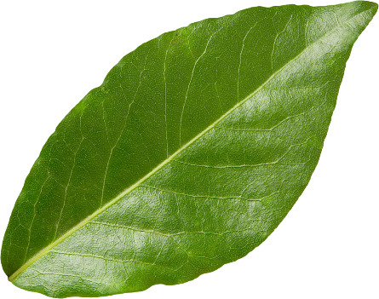
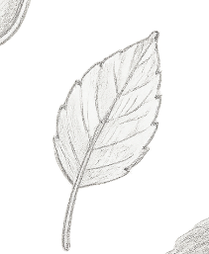


Date: _________
Lesson 1A
I Do: Identify Objects
 | Not an object | Object
 | Not an object | Object
We Do: Identify Objects
 | Not an object | Object
 | Not an object | Object

Slide 17



Date: _________
Lesson 1A
I Do: Identify Objects
 | Not an object | Object
 | Not an object | Object
We Do: Identify Objects
 | Not an object | Object
 | Not an object | Object

Slide 18



If something is not an object, does that always mean that it is not real?

Slide 19




















My claim is…
Scientists Make Claims
My claim is…
My claim is…
My claim is…
My claim is…
My claim is…
My claim is…
My claim is…
My claim is…

Slide 20






Making a Claim
A claim is what you think is true.
What is the healthiest fruit?

Slide 21















Slide 22
Objects
I Do: Making a Claim
Question: Is a spoon an object?
an object.
My claim: _________
A spoon is
Question: Is a shadow an object?
My claim: _____________
A shadow is
not an object.

Slide 23
Objects
We Do: Making a Claim
Question: Is a leaf an object?
My claim: _________
an object.
A leaf is
Question: Is a cow mooing an object?
My claim: _____________.
A cow mooing
is not an object

Slide 24




Slide 25








An object is something we can touch.
object
leaf

Slide 26



























plant
smell
ring
meow
fly
stapler
song
light
keyring
paintbrush
sandwich

Slide 27


Claim Sort
This is not an object.
This is an object.

Slide 28
Answers
This is not an object.
This is an object.

Slide 29





Learn more
Teach someone
I understand
Challenging

Slide 30





Exit Ticket
Date: _________
Lesson 1A
Lesson 1A
An object is something we can ______.
2. Which one is an object?
A book
A rainbow
A laugh
A c_____ is what you think is true.
touch
hear
touch
smell
laim
3
I know _____ out of 3 answers.

Slide 31

In the next lesson, we will learn about the properties of objects.

