Slide 1
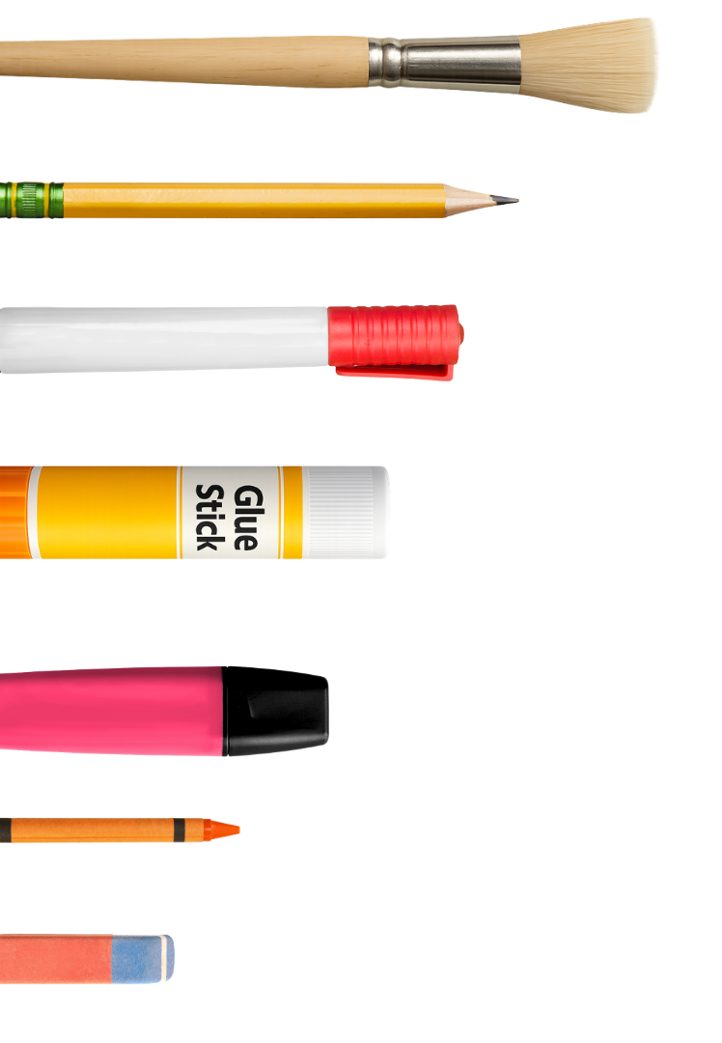
Science
Chemistry
Lesson 2 Part A
Length
Version 2

Slide 2



















Remember what we’ve learnt
Organise ideas
Helps put information IN
Show thinking
Purpose
Visualise thoughts
Helps take information OUT
Concept maps help us organise information and show how different concepts fit together.
You can see:
Last levels: details or subconcepts
Read information
Radiate outwards
Pictures
Centre circle: key idea
Words
Next level: main concepts
Notes:
​

Slide 3
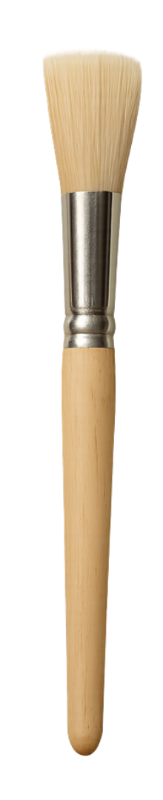
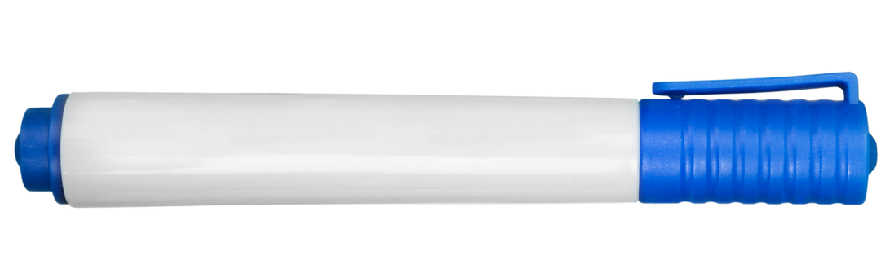
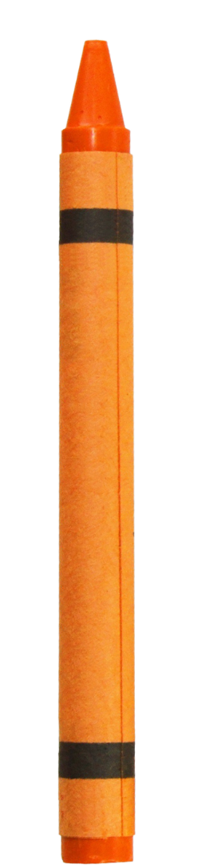

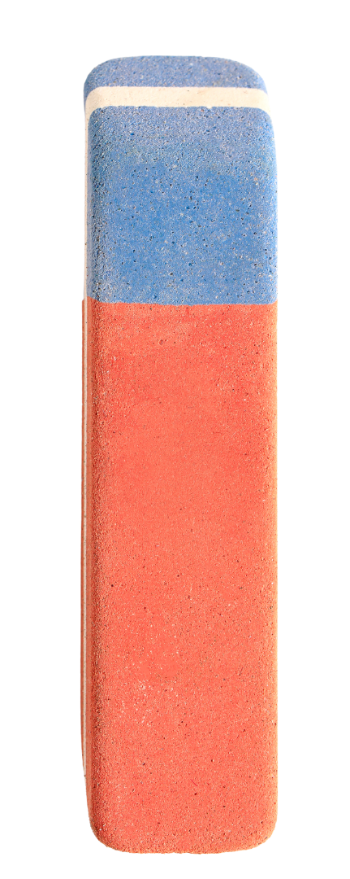
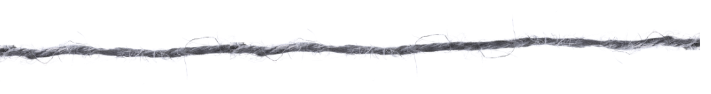
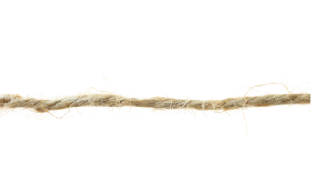
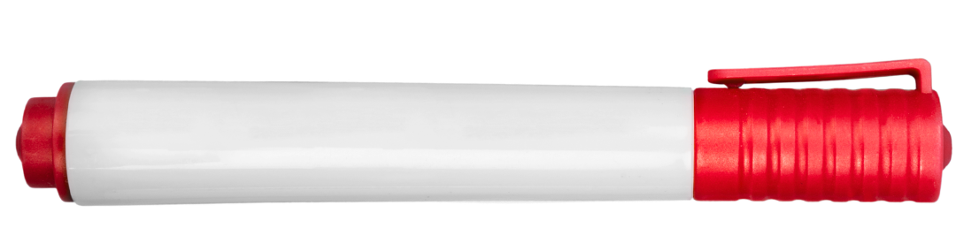





length
length
end
end
Shortest
Longest
Has length
Length is how far an object is from one end to the other.
Order
Object
Compare length
Shorter
Same length
Longer

Slide 4
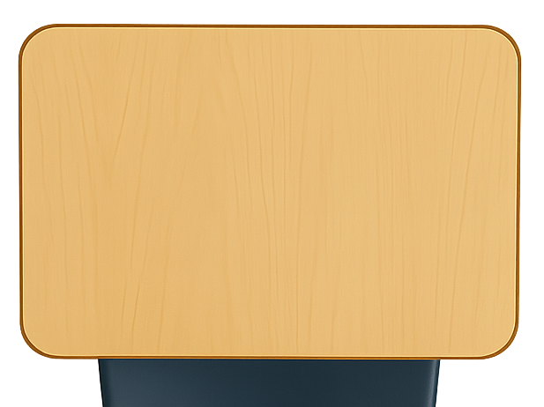

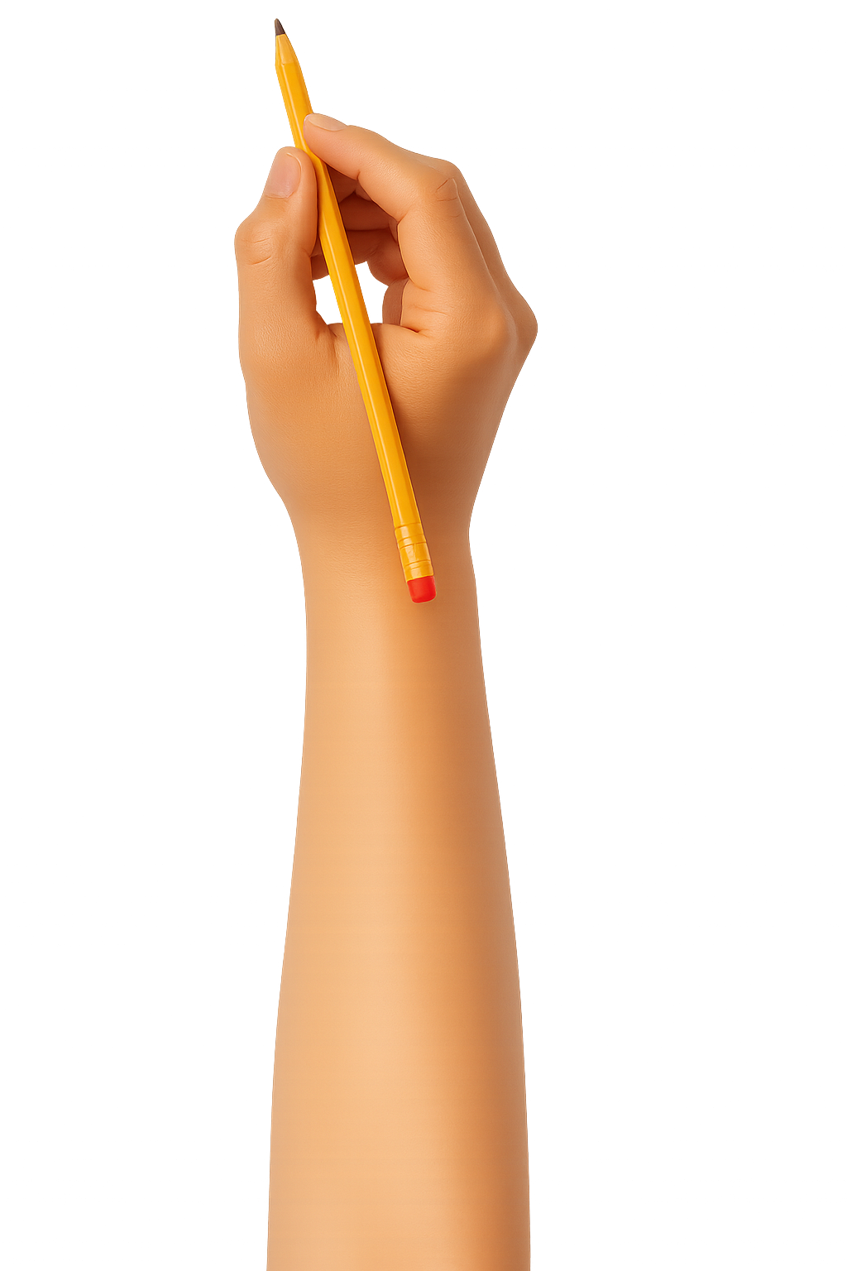


What We Learnt
Exit Ticket
Date: _________
Lesson 1A
Lesson 1B
property
A _________ is something we can notice about an object.
2. Which sense helps us notice if something is hard or soft?
Touch
Smell
Hear
We use our n___ to smell objects.
property
object
sound
ose
3
I know _____ out of 3 answers.

Slide 5

Which sense helps us notice what colour something is?
1
Smell
2
See
3
Hear

Slide 6
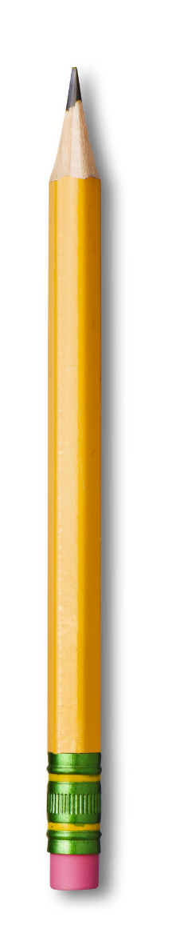
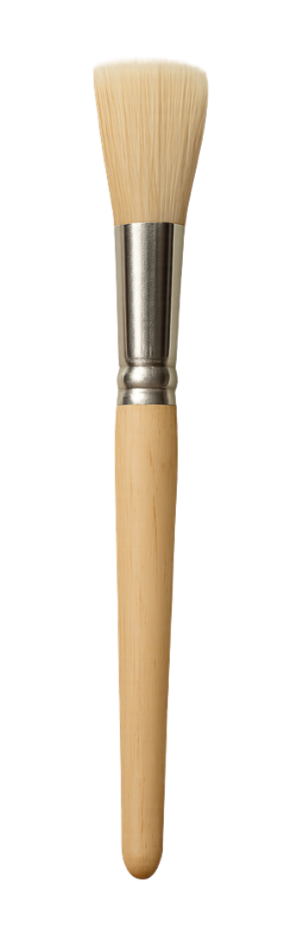
In this lesson, we will learn about length.
starting line

Slide 7
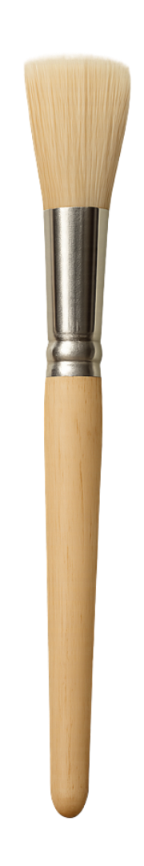
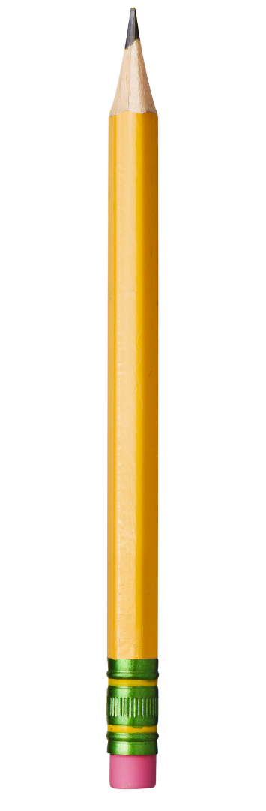
You will be able to: ​
identify the length of an object
compare the length of an object.
Identify: to find or name something.
Compare: to see how things are the same or different.
starting line

Slide 8
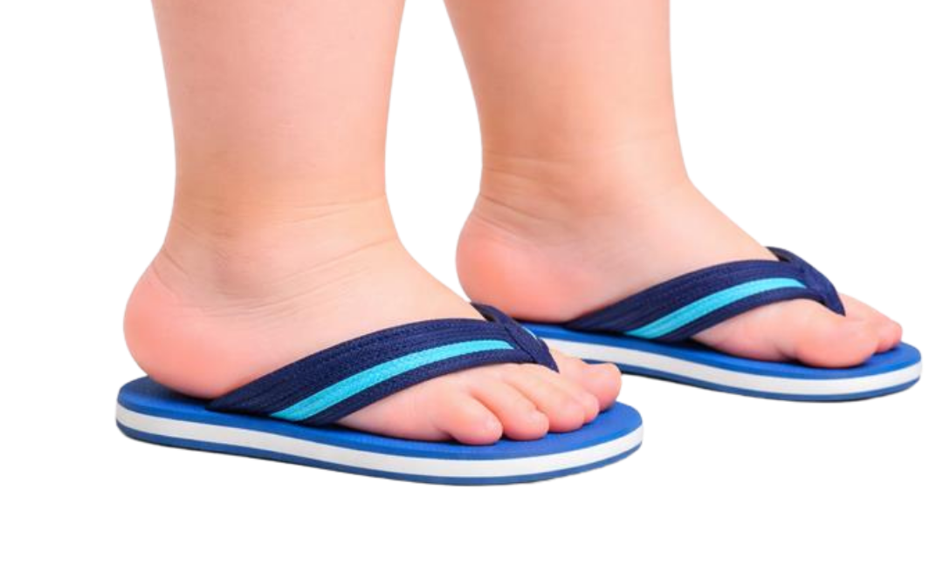
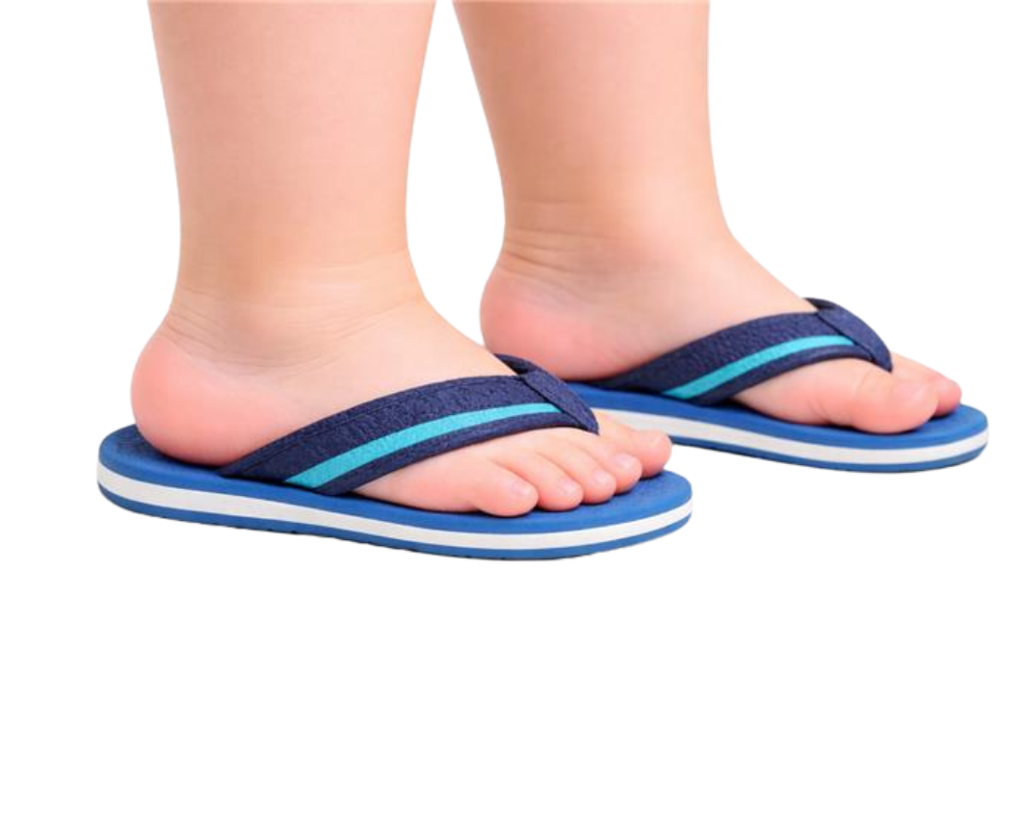
Too small
Just right

Slide 9
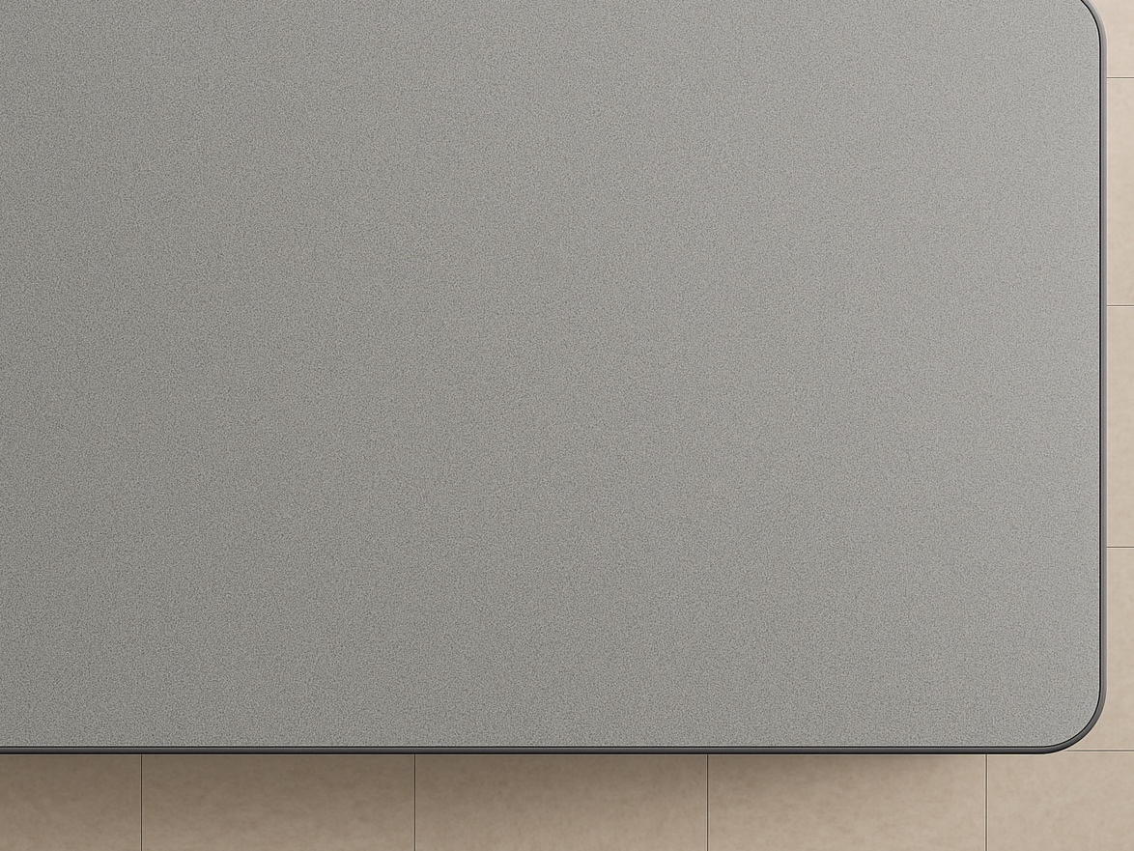

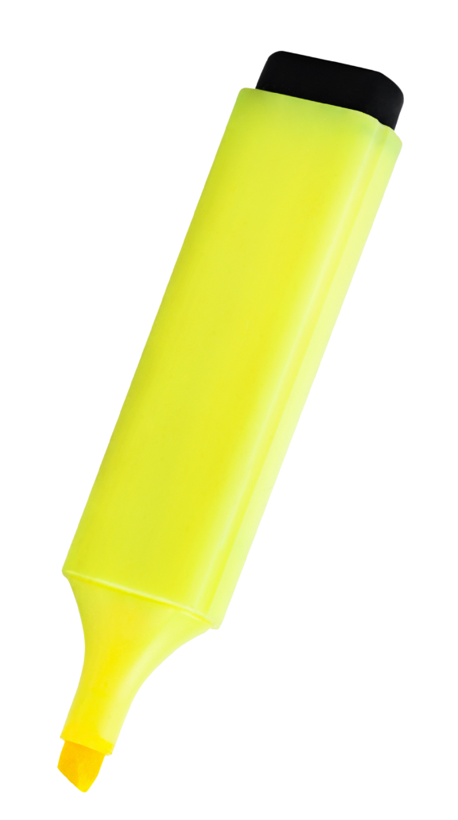
Length
Length is how far an object is from one end to the other.
length

Slide 10


Slide 11


length

Slide 12

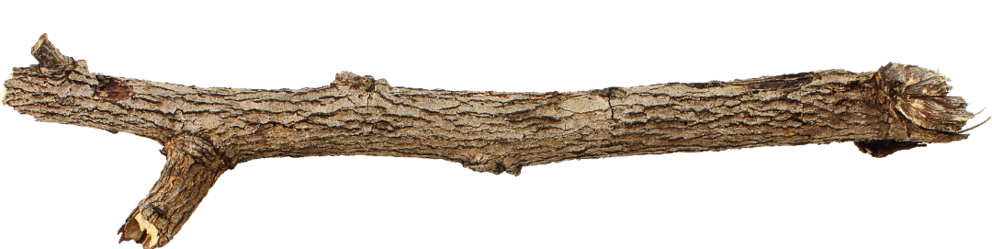
Identify Length
Which image shows the length of an object?

Slide 13

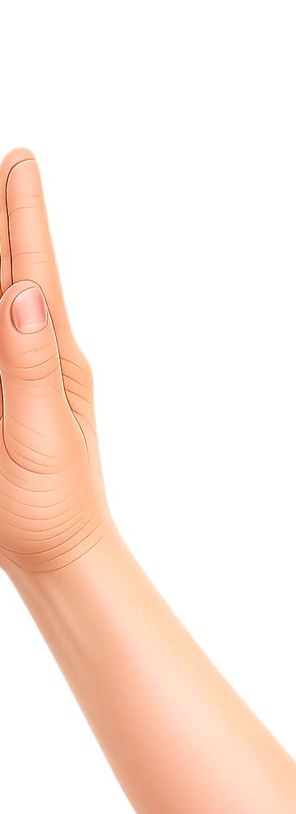
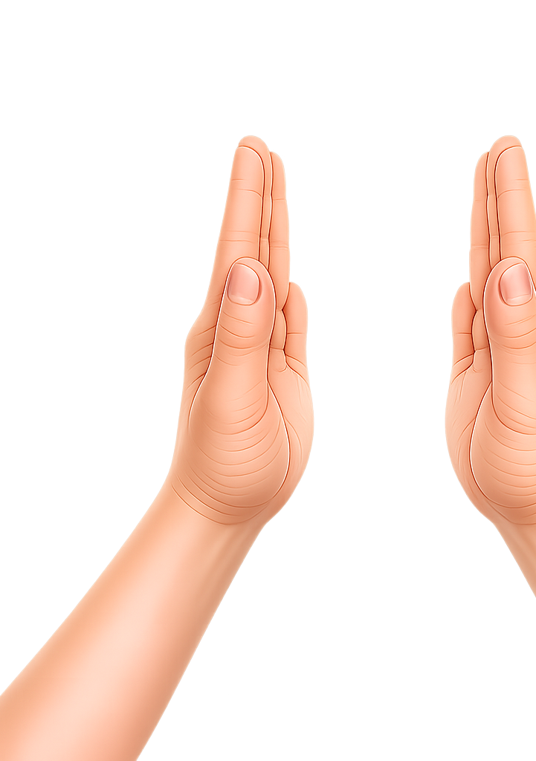
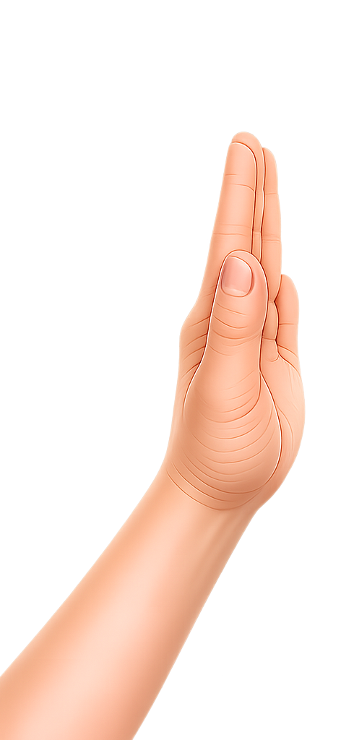
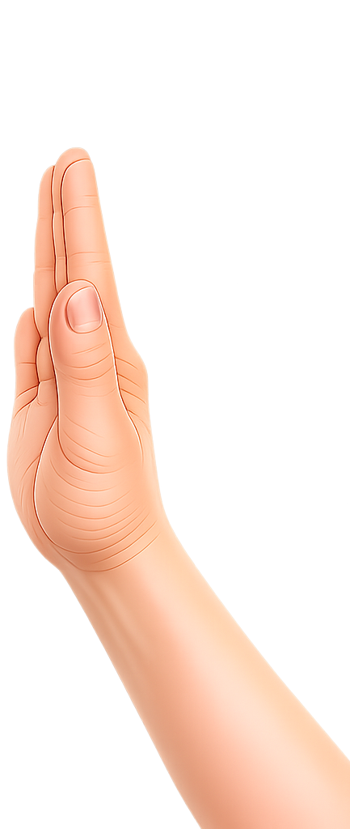
length

Slide 14
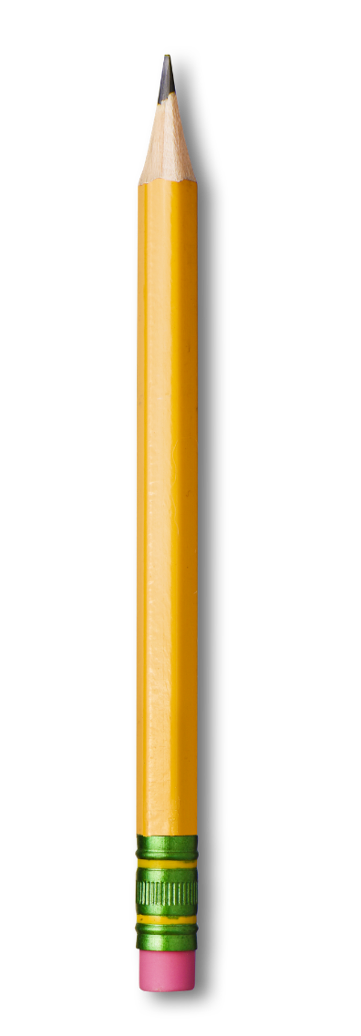
length
Notes:
T

Slide 15



Identify the Length
The length of an object goes from the middle to the end of the object.

Slide 16
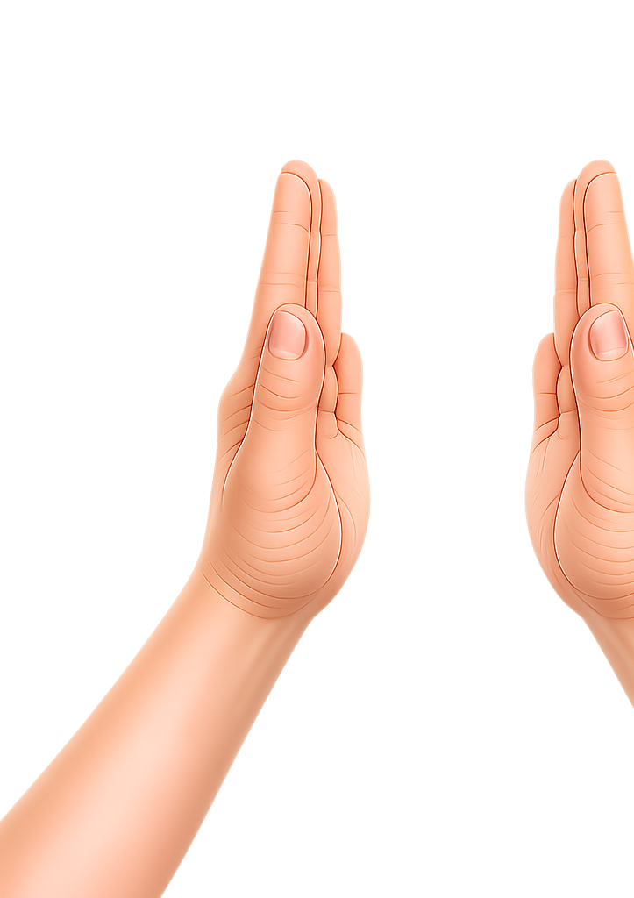
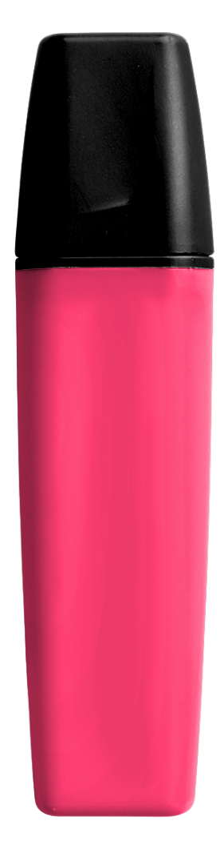
length

Slide 17
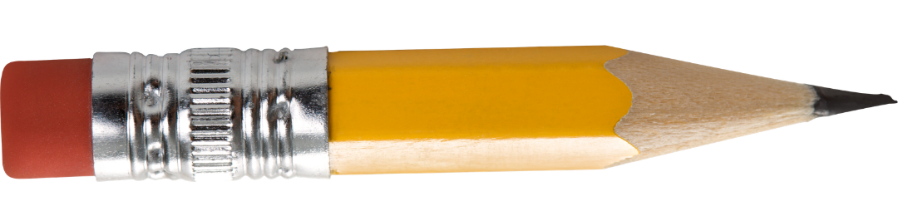
Longer and Shorter
longer
shorter
longer
shorter

Slide 18
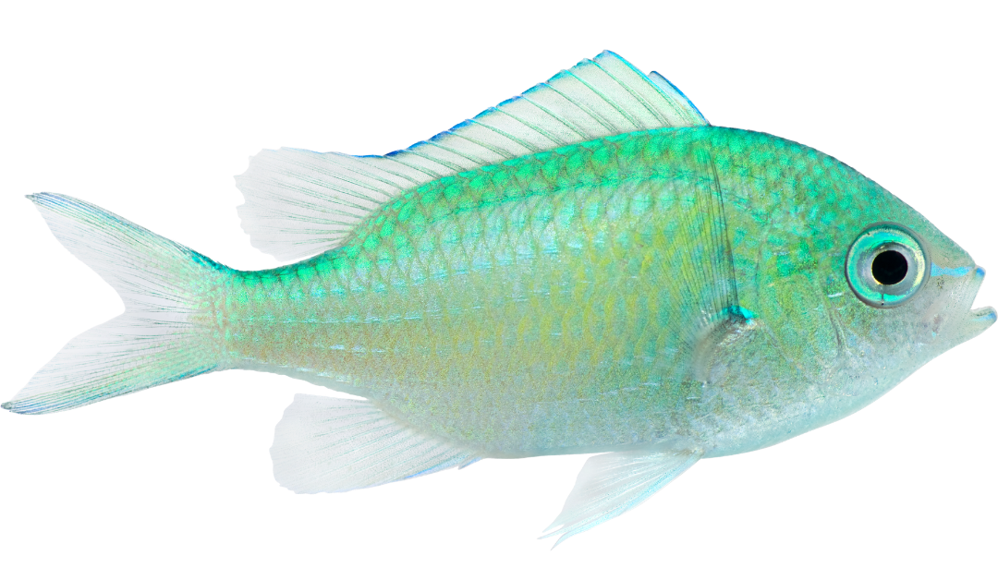
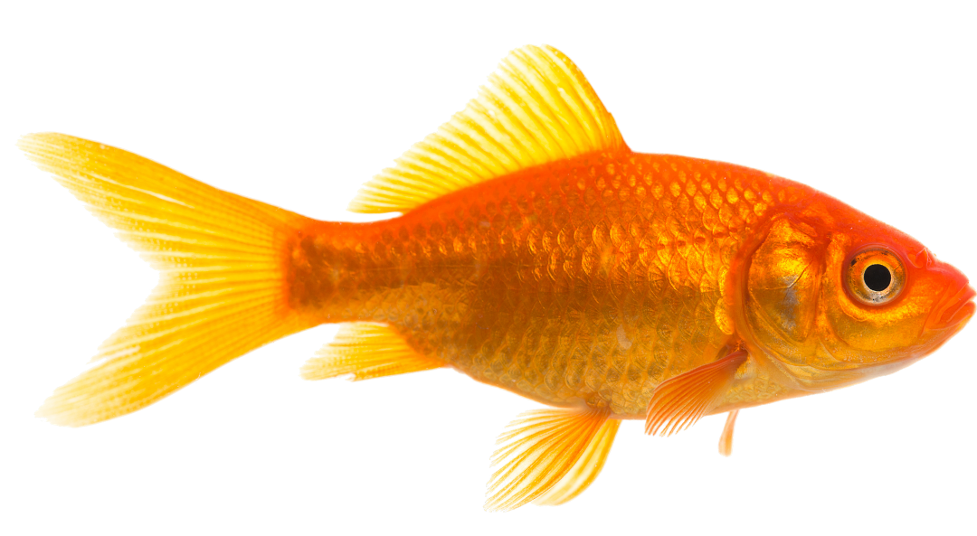
Longer and Shorter
The orange fish is shorter than the green fish.
starting line
No
Yes

Slide 19

shorter
starting line
longer

Slide 20

shorter
starting line
longer

Slide 21
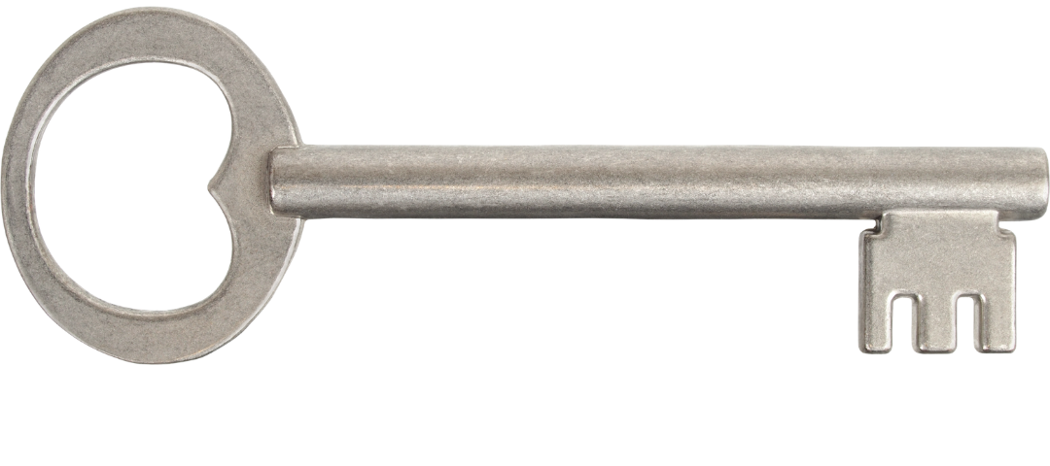
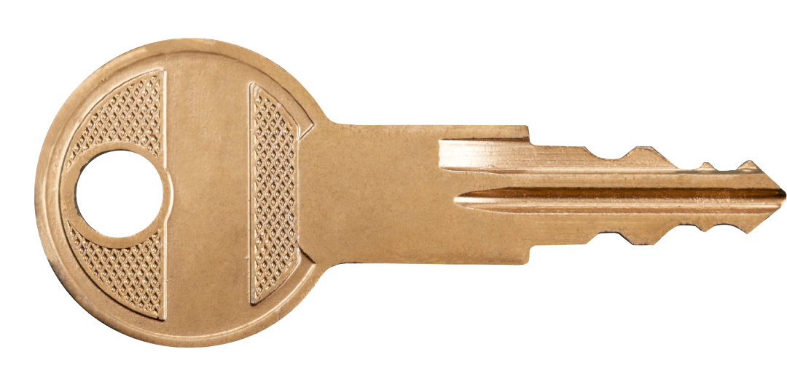
Comparing Lengths
Are the keys placed on the starting line correctly?
starting line
No
Yes

Slide 22


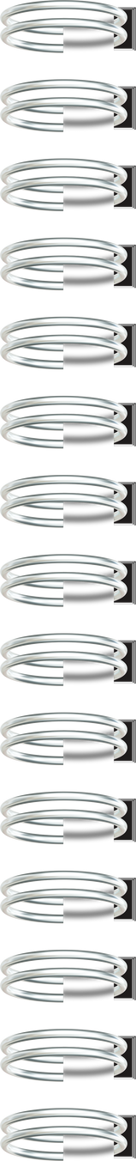

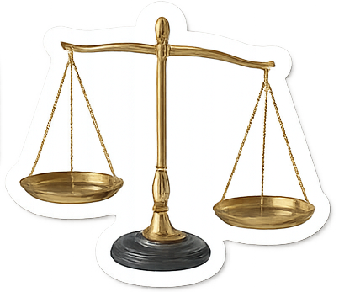

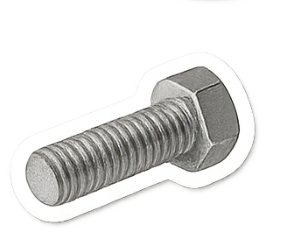
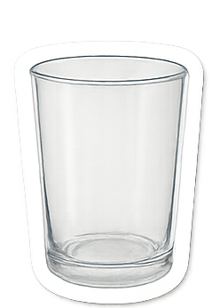
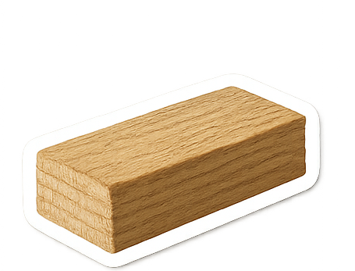
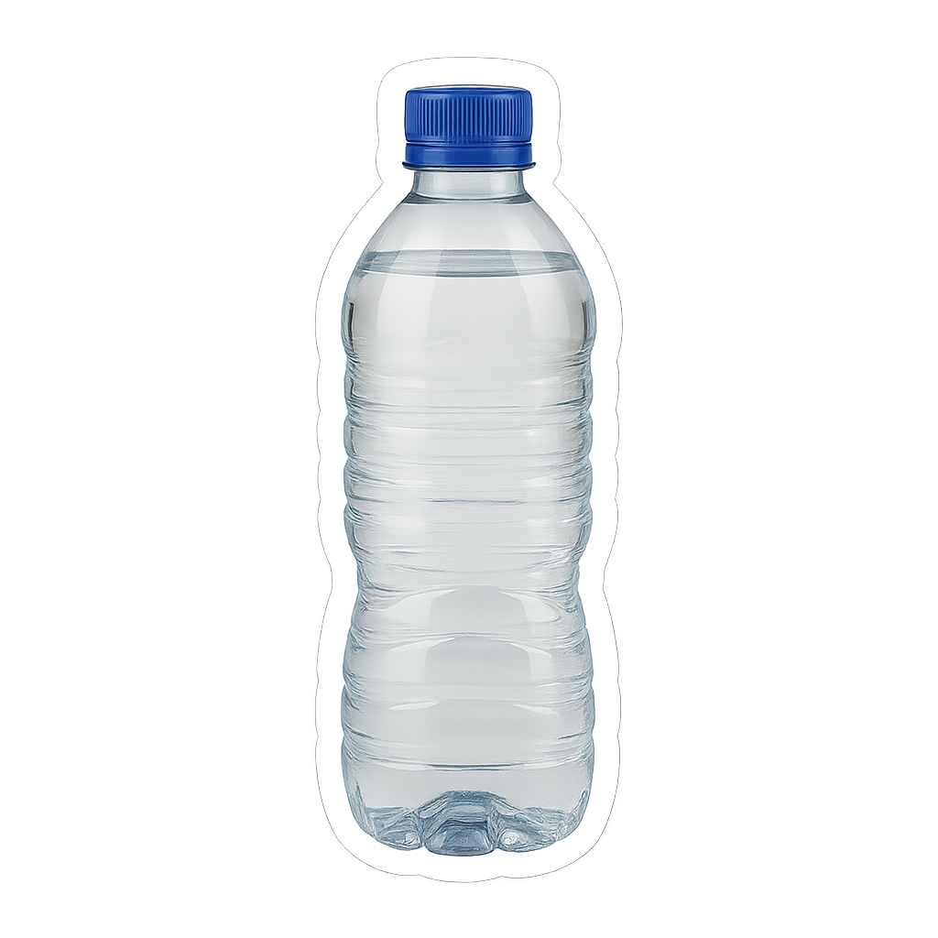
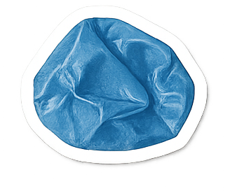
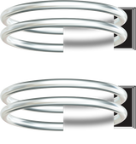

Slide 23

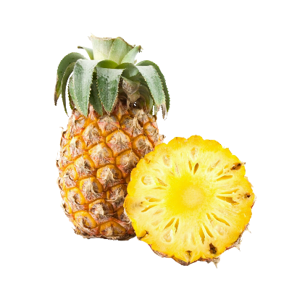



Making a Claim
A claim is what you think is true.
What is the healthiest fruit?

Slide 24
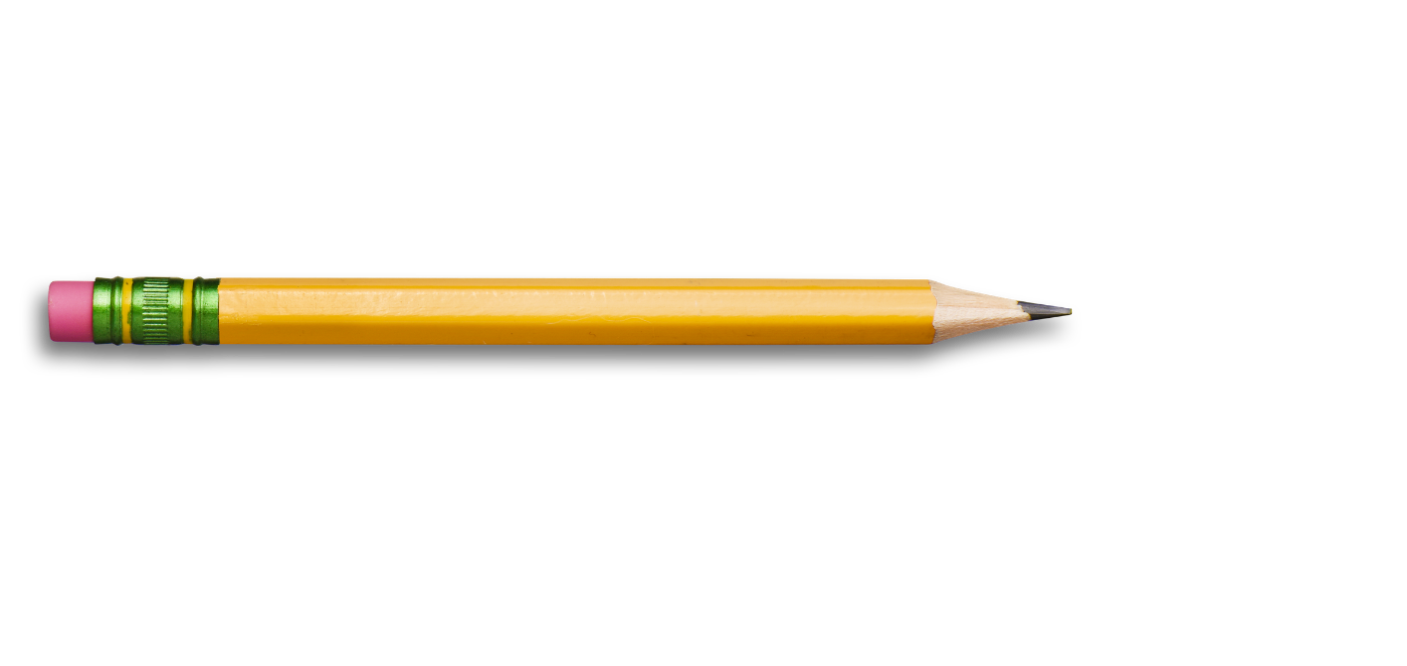
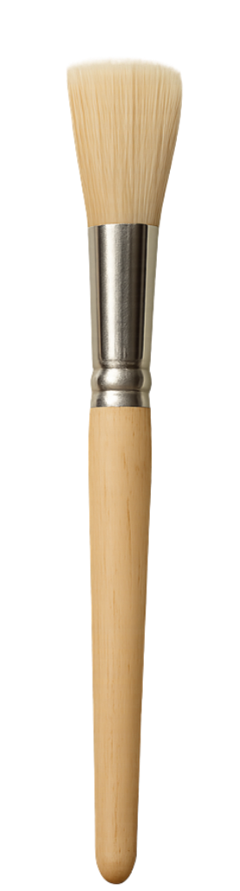

Length
I Do: Making a Claim
Question: Which object is longer?
My claim: _____
than the pencil.
The paintbrush is
longer
starting line

Slide 25
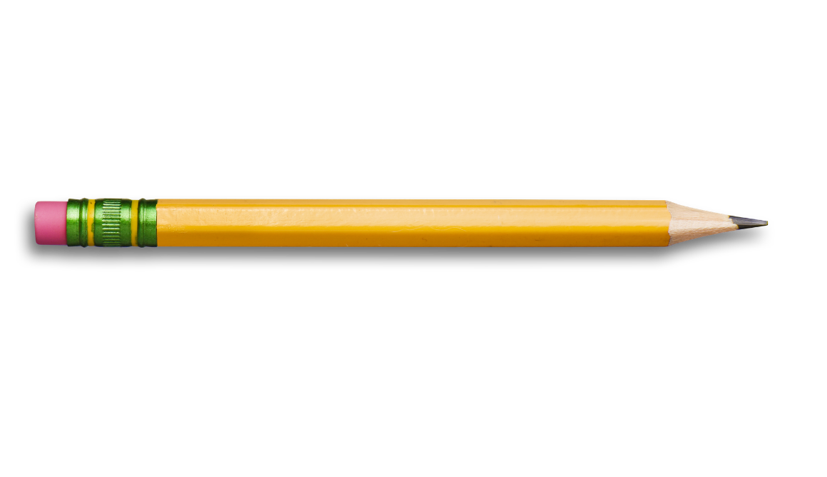
Length
I Do: Making a Claim
Question: Which object is shorter?
My claim: ______ than the paintbrush.
The pencil is
shorter
starting line

Slide 26
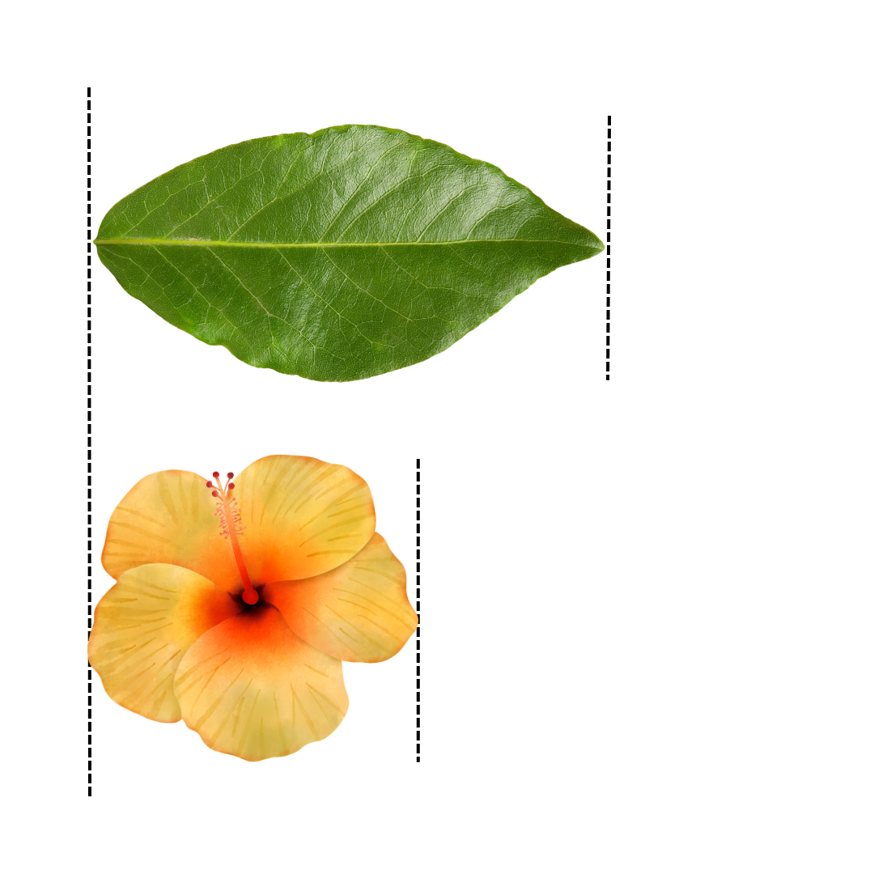
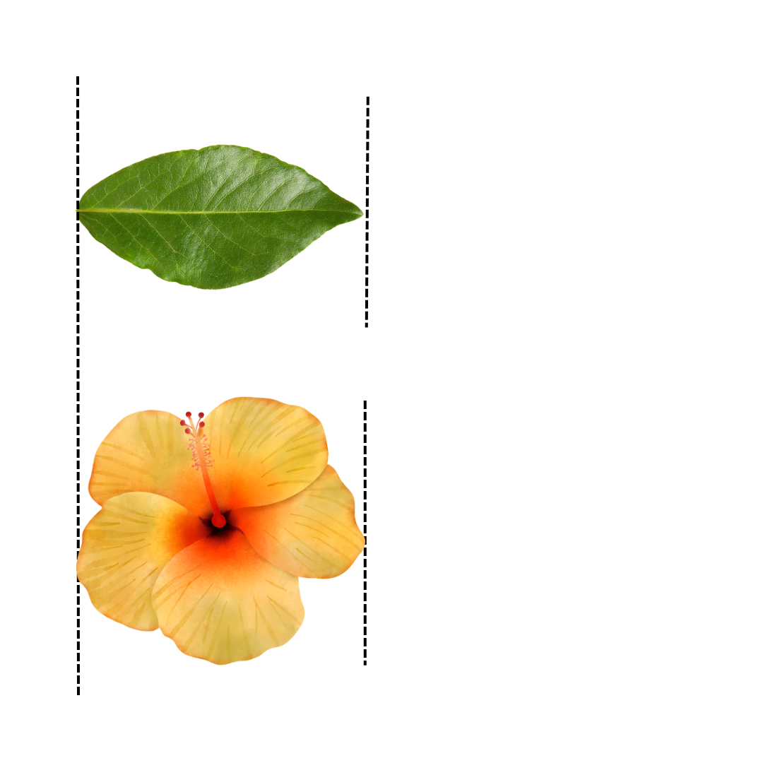
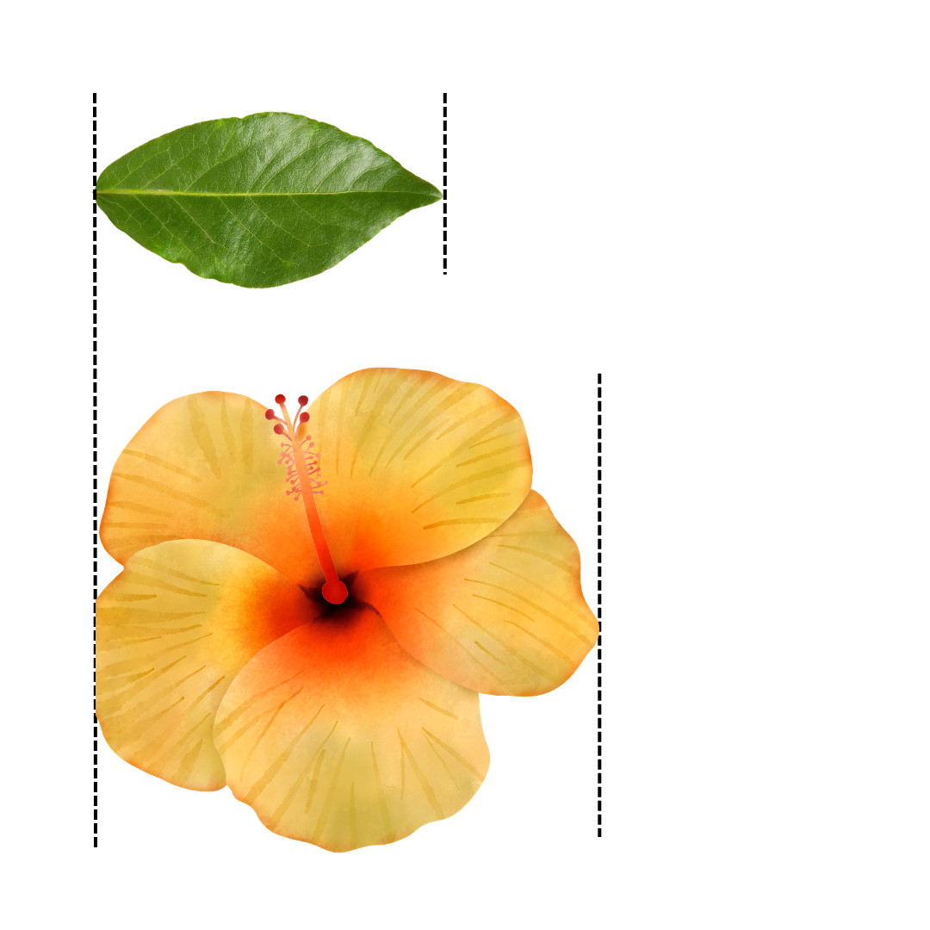
Compare Length
Which image matches the claim?
The leaf is longer than the flower.

Slide 27

Length
We Do: Making a Claim
Question: Which object is longer?
Our claim: ______ than the rubber.
The crayon is
longer
starting line

Slide 28
Length
We Do: Making a Claim
Question: Which object is shorter?
Our claim: ______ than the crayon.
The rubber is
shorter
starting line

Slide 29
same length
starting line

Slide 30
same length
starting line

Slide 31
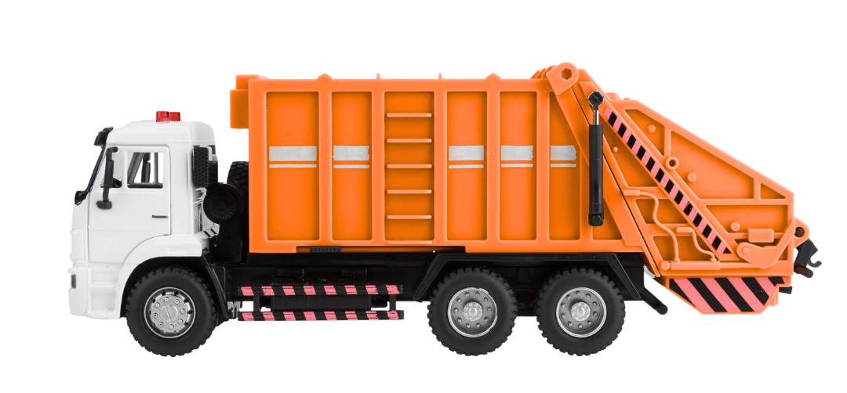
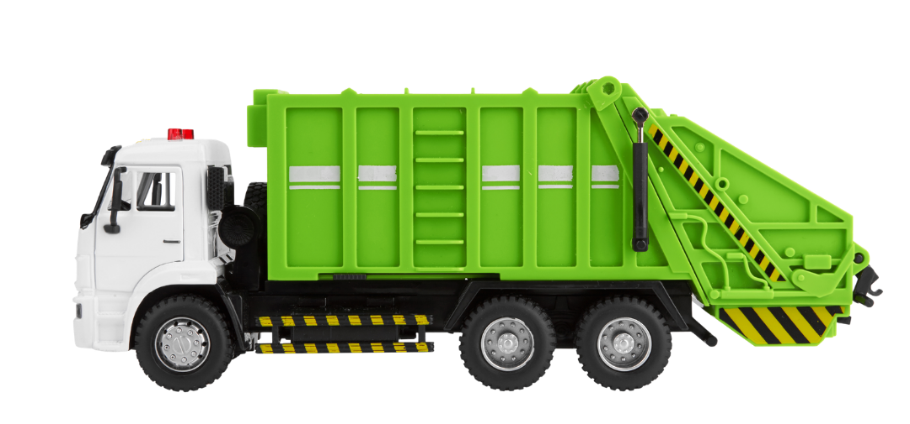
Compare Length
This image shows two toy trucks of the same length.
No
Yes

Slide 32
Length
We Do: Making a Claim
Question: Which object is longer?
Our claim: ____
length.
The glue sticks are the
same
starting line

Slide 33
Length
We Do: Making a Claim
Question: Which object is shorter?
Our claim: ____
length.
The glue sticks are the
same
starting line

Slide 34
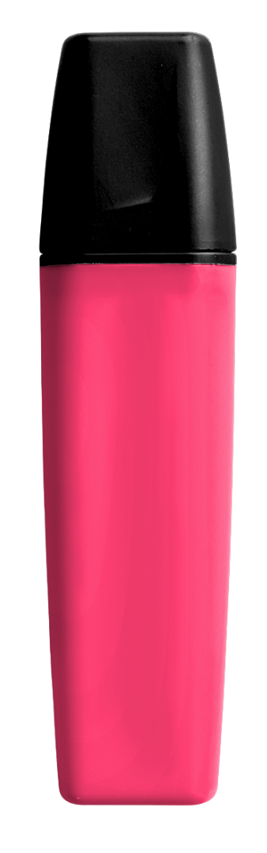
longer
starting line
shorter

Slide 35

Length
We Do: Making a Claim
Question: Which object is longer?
The highlighter is
Our claim: _____ than the rubber.
longer
starting line

Slide 36
Length
We Do: Making a Claim
Question: Which object is shorter?
Our claim: ______ than the highlighter.
The rubber is
shorter
starting line

Slide 37
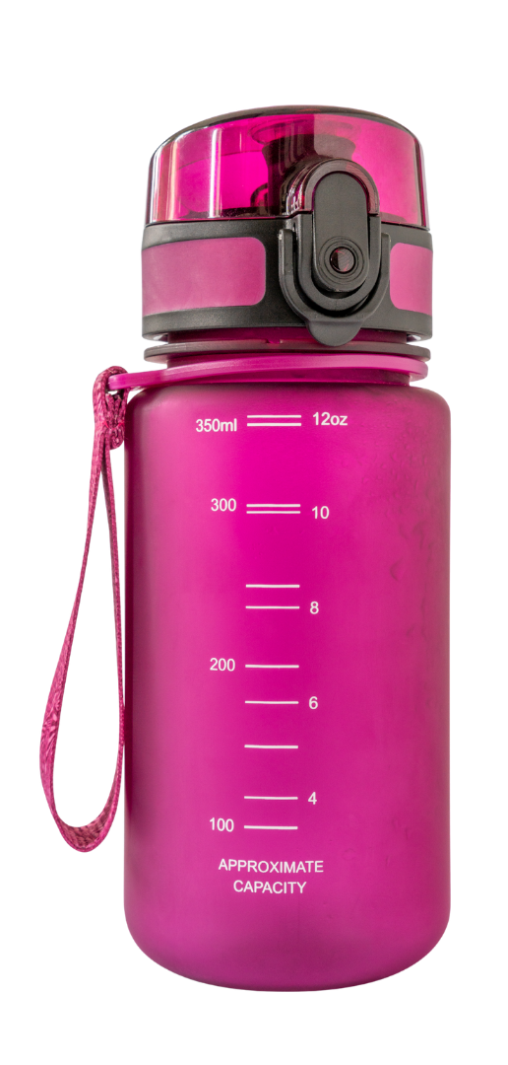

Comparing Length
Which object is longer?
1
2

Slide 38




Slide 39





Length is how far an object is from one end to the other.
length
end
end

Slide 40



Do you agree with Peter’s Claim? Why or why not?
The red lollipop is
_____ than the green lollipop.
longer
starting line

Slide 41





Learn more
Teach someone
I understand
Challenging

Slide 42


Exit Ticket
Date: _________
Lesson 1A
Lesson 2A
far
Length is how ____ an object is from one end to the other end.
2.
Which object is longer than the crayon?
  Crayon
  Rubber
  Marker
All objects have a l______.
loud
far
big
ength
3
I know _____ out of 3 answers.

Slide 43



In the next lesson, you will continue to learn about length.
starting line

